Slide 1
R Programming

Slide 2
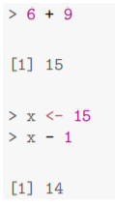
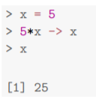
Basic Arithmetic and Objects
R has a command line interface, and will accept simple commands to it. This is marked by a > symbol, called the prompt. If you type a command and press return, R will evaluate it and print the result for you
The expression x <- 15 creates a variable called x and gives it the value 15. This is called assignment; the variable on the left is assigned to the value on the right. The left hand side must contain only contain a single variable.
Assignment can also be done with = (or ->).

Slide 3
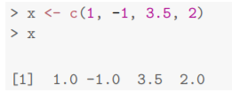
Vectors
The key feature which makes R very useful for statistics is that it is vectorized. This means that many operations can be performed pointwise on a vector.
The function c() is used to create vectors:

Slide 4
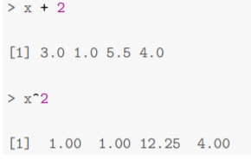
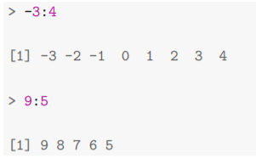

Then if we want to add 2 to everything in this vector, or to square each entry:
Some useful vectors can be created quickly with R. The colon operator is used to generate integer sequences

Slide 5
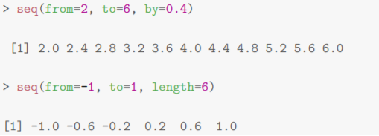
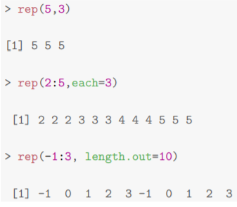
More generally, the function seq() can generate any arithmetic progression.
Sometimes it’s necessary to have repeated values, for which we use rep()

Slide 6
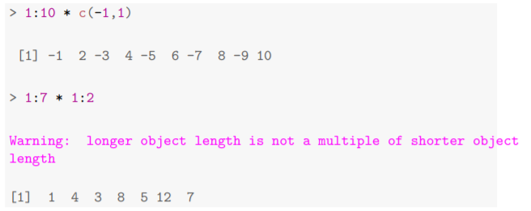
Recycling, is an important part of vectorization. If we perform a binary operation (such as +) on two vectors of different lengths, the shorter one is used over and over again until the operation has been applied to every entry in the longer one. If the longer length is not a multiple of the shorter length, a warning is given.

Slide 7
Exercise -
Create the following vectors in R using seq() and rep().
(i) 1, 1.5, 2, 2.5, . . . , 12
(ii) 1, 8, 27, 64, . . . , 1000.
The weights of five people before and after a diet programme are given in the table. Before 78 72 78 79 105 After 67 65 79 70 93 Read the ‘before’ and ‘after’ values into two different vectors called before and after. Use R to evaluate the amount of weight lost for each participant. What is the average amount of weight lost?

Slide 8
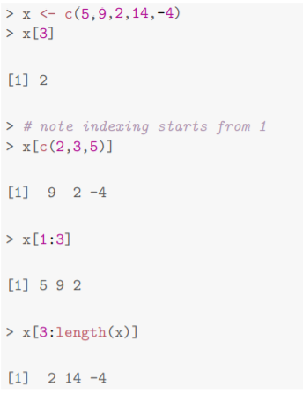
Subsetting
It’s frequently necessary to extract some of the elements of a larger vector. In R you can use square brackets to select an individual element or group of elements:

Slide 9
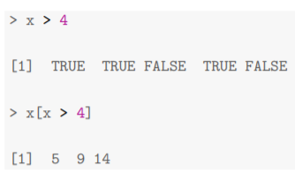
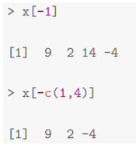
There are two other methods for getting subvectors. The first is using a logical vector (i.e. containing TRUE and FALSE) of the same length:
or using negative indices to specify which elements should not be selected:

Slide 10
Exercise -
The built-in vector LETTERS contains the uppercase letters of the alphabet. Produce a vector of (i) the first 12 letters; (ii) the odd ‘numbered’ letters; (iii) the (English) consonants.

Slide 11
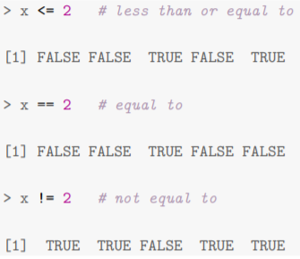
Logical Operators
As we see above, the comparison operator > returns a logical vector indicating whether or not the left hand side is greater than the right hand side. Here we demonstrate the other comparison operators:

Slide 12

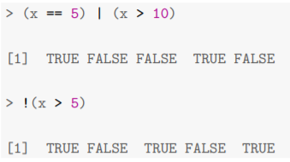
We may also wish to combine logical vectors. If we want the elements of x within a range, we can use the following:
The & operator does a pointwise ‘and’ comparison between the two sides. Similarly, the vertical bar | does pointwise ‘or’, and the unary ! operator performs negation.

Slide 13
Exercise -
The function rnorm() generates normal random variables. For instance, rnorm(10) gives a vector of 10 standard normals. Generate 20 standard normals, and store them as x.
Then obtain subvectors of
(i) the entries in x which are less than 1.
(ii) the entries between − 1 2 and 1.

Slide 14
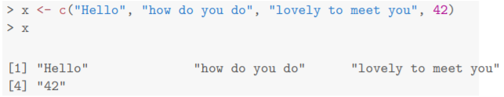
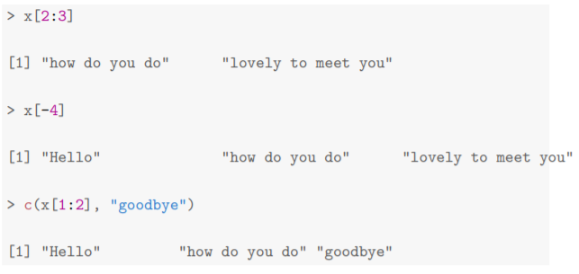
Character Vectors
We can create a character vector, in which each entry is a string of text. Strings in R are contained within double quotes ":
Notice that you cannot mix numbers with strings: if you try to do so the number will be converted into a string. Otherwise character vectors are much like their numerical counterparts.

Slide 15
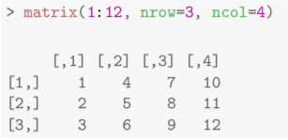

Matrices
To create a matrix use the function matrix(), specifying elements by column first:
This is called column-major order. Of course, we need only give one of the dimensions:

Slide 16


Getting help of vector recycling to create matrices
Sometimes it’s useful to specify the elements by row first

Slide 17
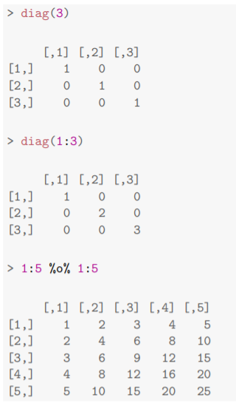
There are special functions for constructing certain matrices:
The last operator performs an outer product, so it creates a matrix with (i, j)-th entry xiyj .

Slide 18


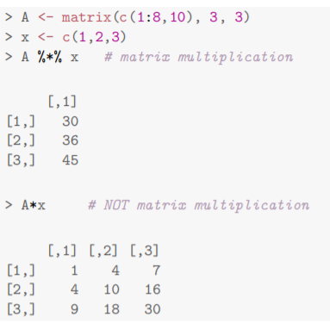
The function outer() generalizes this to any function f on two arguments, to create a matrix with entries f(xi , yj ).
Matrix multiplication is performed using the operator %*%, which is quite distinct from scalar multiplication *.

Slide 19
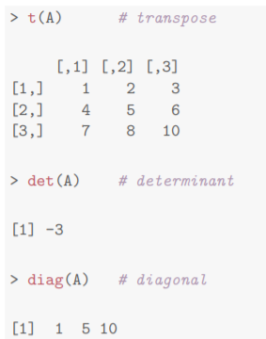
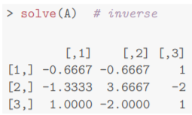
Standard functions exist for common mathematical operations on matrices.

Slide 20
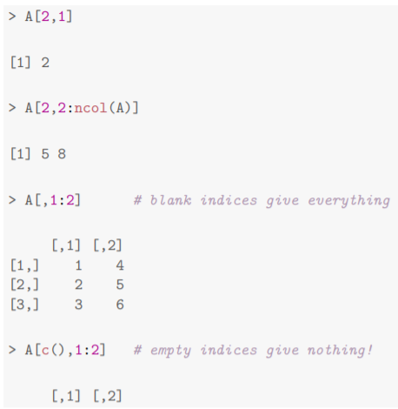
Matrices can be subsetted much the same way as vectors, although of course they have two indices. Row number comes first:

Slide 21
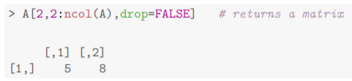
Notice that, where appropriate, R automatically reduces a matrix to a vector or scalar when you subset it. You can override this using the optional drop argument.

Slide 22
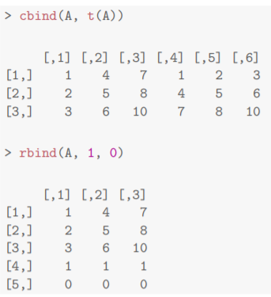
You can stitch matrices together using the rbind() and cbind() functions. These employ vector recycling:

Slide 23

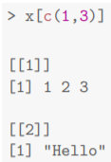
Lists
Other than vectors and matrices, the main object for holding data in R is a list1 . These are a bit like vectors, except that each entry can be any other R object, even another list.
Here x has 4 elements: a numeric vector, a logical, a string and another list. We can select an entry of x with double square brackets:
To get a sub-list, use single brackets:

Slide 24
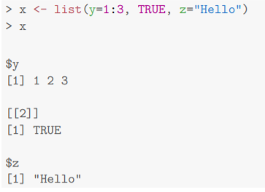
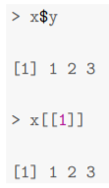
We can also name some or all of the entries in our list, by supplying argument names to list():
Notice that the [[1]] has been replaced by $y, which gives us a clue as to how we can recover the entries by their name. We can still use the numeric position if we prefer:

Slide 25

The function names() can be used to obtain a character vector of all the names of objects in a list.

Slide 26
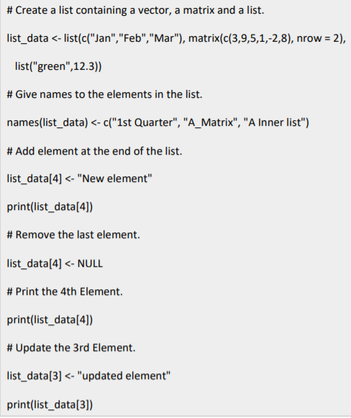
Manipulating List Elements
We can add, delete and update list elements by the index of the element in the list.
We can add and delete elements only at the end of a list.

Slide 27
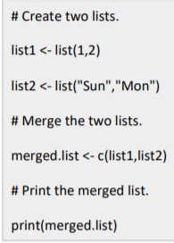
Merging Lists
You can merge many lists into one list by placing all the lists inside one list() Function.

Slide 28
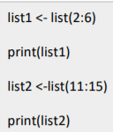
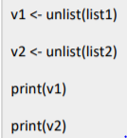
Convert R List to Vector?
A list can be converted to a vector so that the elements of the vector can be used for further manipulation.
we can use the unlist() function

Slide 29
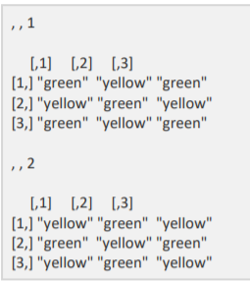
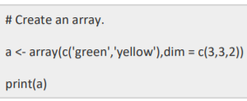
Arrays
While matrices are confined to two dimensions, arrays can be of any number of dimensions.
The array function takes a dim attribute which creates the required number of dimension.
In the below example we create an array with two elements which are 3x3 matrices each.

Slide 30
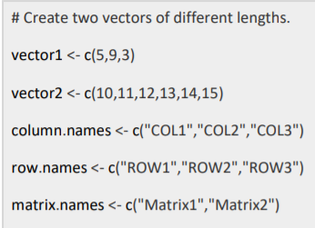
Naming Columns and Rows
We can give names to the rows, columns and matrices in the array by using the dimnames parameter

Slide 31
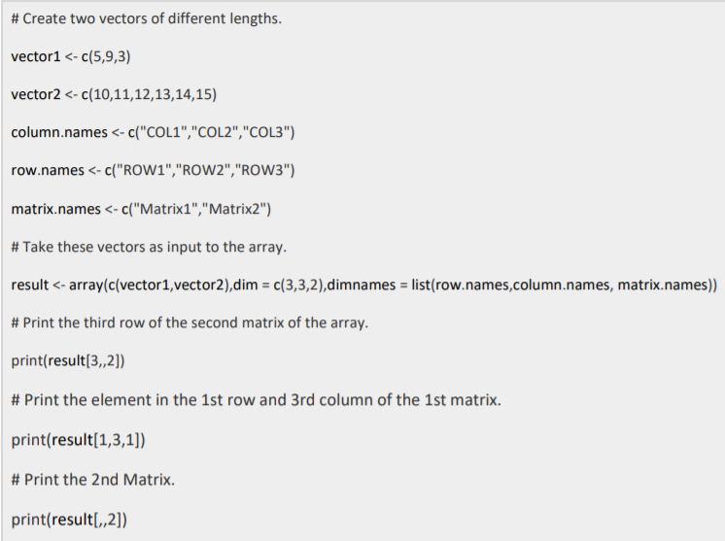
Accessing Array Elements

Slide 32


Data
R comes with many datasets built-in, particularly in the MASS package. A package is a collection (or library) of functions, datasets, and other objects; most packages are not loaded automatically, so you have to do it yourself:
You can now access various datasets from this package. Try looking at the dataset called hills.
To find out what the data represent, use the help function ?hills.

Slide 33

Data Frames
The object hills is something called a data frame. A data frame is a series of records represented by rows (in this case one for each race), each containing values in several fields (in this case dist, climb, time).
You can check that hills is a data frame by inspecting its class(es)

Slide 34
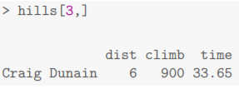
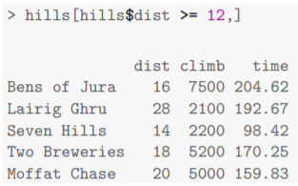
Data frames share many of the characteristics of matrices. We can select rows or columns in the same way:

Slide 35
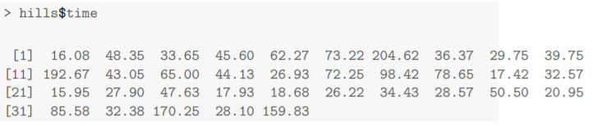
However, they also behave like lists indexed by the columns:

Slide 36
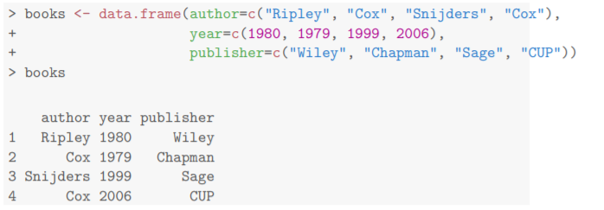
DataFrame
The command data.frame() is used to create a data frame, each argument representing a column.

Slide 37
To extract a specific column from a data frame, use the following syntax:
empid <- c(1:4)
empname <- c("Sam","Rob","Max","John")
empdept <- c("Sales","Marketing","HR","R & D")
emp.data <- data.frame(empid,empname,empdept)
print(emp.data)
result <- data.frame(emp.data$empname,emp.data$empdept)
print(result)
To extract specific rows from a data frame, use the following syntax:
result <- emp.data[1:2,]
print(result)

Slide 38
The following code extracts the first and third rows with second and third columns respectively.
result <- emp.data[c(1,2),c(2,3)]
print(result)
To add a salary column to the above Data Frame, use the following syntax:
emp.data$salary <- c(20000,30000,40000,27000)
n <- emp.data
print(n)

Slide 39
To add new rows to an existing Data Frame, we need to create a new data frame, which contains the new rows, and then merge it with the existing data frame using the rbind() function
emp.newdata <- data.frame(
empid = c(5:7),
empname = c("Frank","Tony","Eric"),
empdept = c("IT","Operations","Finance"),
salary = c(32000,51000,45000))
Merging the Created Data Frame with the Existing One:
emp.finaldata <- rbind(emp.data,emp.newdata)
print(emp.finaldata)

Slide 40
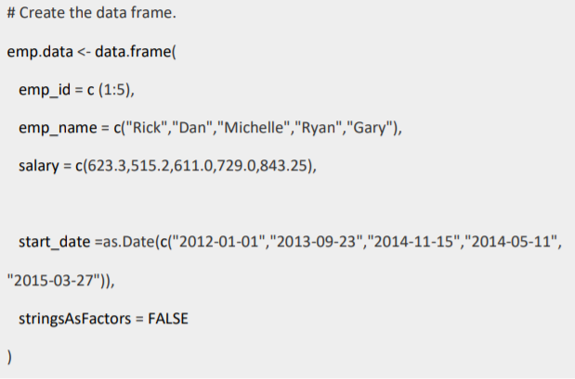

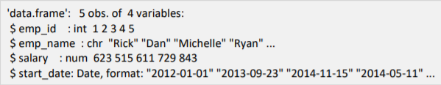
Get the Structure of the Data Frame
The structure of the data frame can be seen by using str() function.
When we execute the above code, it produces the following result −

Slide 41
Factors
Factors in R programming are used in data analysis for statistical modeling. They are used to categorize unique values in columns, like “Male, “Female”, “TRUE”, “FALSE”etc., and store them as levels.
Factors can be created using the factor() function and they take vectors as inputs.
data <- c("Male","Female","Male","Child","Child","Male","Female","Female")
print(data)
factor.data <- factor(data)
print(factor.data)

Slide 42
Conditional Statements in R Programming
Conditionals are expressions that perform different computations or actions depending on whether a predefined boolean condition is TRUE or FALSE
R programming provides three different types if statements that allows programmers to control their statements within source code. These are:
if statement
if….else statement
switch statement

Slide 43
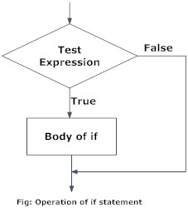
R if statement
The syntax of if statement is:
If the test_expression is TRUE, the statement gets executed. But if it’s FALSE, nothing happens
if (test_expression) {
statement
}

Slide 44
x <- 5
if(x > 0){
print("Positive number")
}

Slide 45
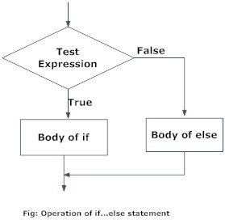
if…else statement
The syntax of if…else statement is:
The else part is optional and is only evaluated if test_expression is FALSE.
It is important to note that else must be in the same line as the closing braces of the if statement.
if (test_expression) {
statement1
} else {
statement2
}

Slide 46
x <- -5
if(x > 0){
print("Non-negative number")
} else {
print("Negative number")
}
The above conditional can also be written in a single line as follows.
if(x > 0) print("Non-negative number") else print("Negative number")
This feature of R allows us to write construct as shown below.

Slide 47
if…else Ladder
The if…else ladder (if…else…if) statement allows you execute a block of code among more than 2 alternatives
The syntax of if…else statement is:
if ( test_expression1) {
statement1
} else if ( test_expression2) {
statement2
} else if ( test_expression3) {
statement3
} else {
statement4
}

Slide 48
Example of nested if…else
x <- 0
if (x < 0) {
print("Negative number")
} else if (x > 0) {
print("Positive number")
} else
print("Zero")

