Slide 1

B.TECH CSE | FOUNDATION COURSE (TINKERING & ELEMENTS OF DESIGN)
Cloud Removal from
LISS-IV Satellite Imagery
using Generative AI
Detecting clouds and shadows, then reconstructing the ground beneath them, while never touching a valid observed pixel.
Student name1, Student name2, Student name3, Student name4
Department of Computer Science & Engineering | Session 2025-26
Notes:
Introduce the project: LISS-IV is ISRO's 5.8 m multispectral camera. Clouds ruin a large share of scenes, especially in the monsoon. We detect cloud and shadow, reconstruct the hidden ground with a GAN, and keep every clear pixel untouched.

Slide 2
Why clouds are a big problem
Optical imagery drives land-cover mapping, crop monitoring and disaster assessment, but cloud blocks or attenuates the signal and shadow darkens the ground beside it.
Over India the southwest monsoon makes this worst, exactly when crops and forests need watching.
LISS-IV is sharp but spectrally thin: no blue, SWIR, cirrus or thermal band, so standard cloud tests do not apply.
5.8 m
3
spatial resolution
bands: green, red, NIR
10-bit
23-24 km
radiometric depth
multispectral swath
Notes:
LISS-IV characteristics from the data-product description. Because only three bands exist, we rely on spatial context and texture, not spectral rules like Fmask.

Slide 3
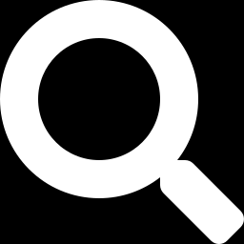
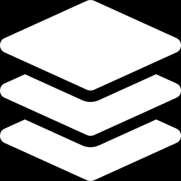
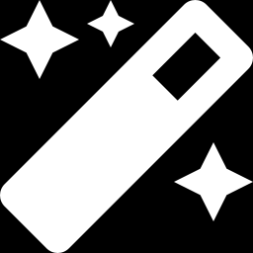
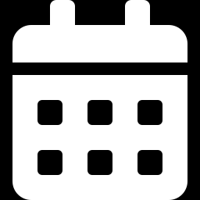
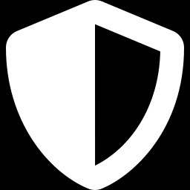
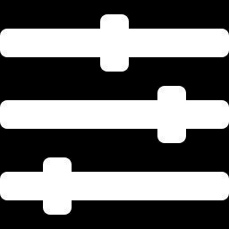
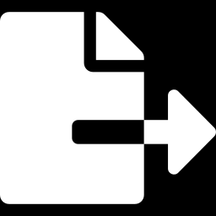
Why old methods fall short
WHAT FAILS TODAY
OUR OBJECTIVES
Detect cloud and shadow with a U-Net
Interpolation
Blurs large gaps, cannot invent missing structure
Reconstruct the ground by mask-conditioned inpainting
Temporal filling
Needs a near-date clear scene and no ground change
Keep valid pixels and band relationships intact
Thresholding
Export auditable GeoTIFF with a processing manifest
Mistakes bright built-up land for cloud, water for shadow
Notes:
Classical methods each fail in a known way. Generative models fix that but risk hallucination, which is why our design preserves clear pixels and labels generated ones.

Slide 4
Our approach: a five-step pipeline
1
Preprocess and tile
Radiometric and geometric correction; 256×256 tiles, 32-px overlap
2
Detect cloud and shadow
U-Net predicts the mask M, trained with BCE + Dice loss
3
Reconstruct
Gated-convolution generator fills the masked region from context
4
Composite
Valid pixels kept exactly; generated pixels only inside the mask
5
Evaluate and export
PSNR, SSIM, RMSE, SAM; GeoTIFF plus manifest
Notes:
Walk the five steps. Step 4 is the key safety idea: the output equals the observed image everywhere outside the mask.

Slide 5
The model and how it learns
Generator
Loss term | Role | Acts on
L1 (pix) | Reconstruction | Masked
L1 (valid) | Preserve observed | Unmasked
SSIM | Local structure | Whole tile
VGG | Texture, semantics | Features
SAM | Band consistency | Masked
LSGAN | Realistic texture | Patches
U-Net with gated convolutions and a dilated residual bottleneck
Discriminator
Mask-conditioned PatchGAN with a least-squares (LSGAN) loss
Y = (1 − M)·X + M·Ŷ
Observed pixels stay; estimates fill the mask
Notes:
Six loss terms are combined with weights tuned on validation. The adversarial weight is deliberately small so sharpness never overrides fidelity. SAM keeps the green-red-NIR relationship plausible, which matters for NDVI.

Slide 6
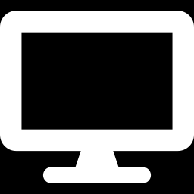
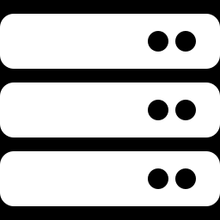
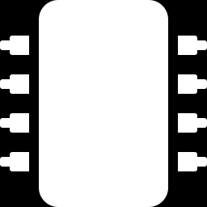
System architecture
Client browser
Application server
GPU server
Web UI
HTTPS
REST API
gRPC
Cloud detector
Map viewer
Job queue
GAN inpainter
Storage
Async jobs keep the app responsive
Scene store
Model store
Metadata DB
Notes:
Separating the GPU server isolates the Python deep-learning runtime from the web backend and allows independent scaling. Uploads are validated, originals are never overwritten, and every job records a manifest.

Slide 7
How we measure success
PSNR
Pixel-level fidelity (dB)
Method | PSNR | SSIM | SAM
Nearest / bilinear | – | – | –
U-Net, L1 only | – | – | –
U-Net + SSIM | – | – | –
U-Net + adversarial | – | – | –
Proposed GAN | – | – | –
SSIM
Structure and edges
RMSE
Per-band error
SAM
Spectral-angle error
Masks: precision, recall, F1, IoU. Scene-level split, scored on masked regions and full image.
Values to be filled from our measured test run
Notes:
Fill the table with our own test-run numbers only. Do not quote figures from other papers or sensors. Report mean and standard deviation across scenes, not only the best case, and show failure cases.

Slide 8


Conclusion and future scope
What we built
Where next
Cloud and shadow detection plus mask-conditioned reconstruction for LISS-IV
Valid pixels preserved; generated pixels labelled as estimates
Auditable web service with provenance
Uncertainty maps for low-confidence regions
Multi-temporal and SAR guidance
Other sensors, after validation
Downstream tests: classification, crop and flood monitoring
Reconstructed pixels are model estimates, not verified observations.
Thank you | Questions?
Notes:
Close with the honest limitation: thick-cloud regions admit many plausible solutions. Invite questions.

