Slide 1

CareerPath
A Structured Career Guidance Platform for Students
Supervisor: Dr. Dinesh Mohan Joshi
Name: Manvendra Pratap Singh
Roll No: M25AI2122
IIT Jodhpur | School of AI & Data Science | M.Tech | April 2026

Slide 2
The Problem: A Discovery Gap in Career Guidance
Urban Student
Rural / Semi-Urban Student
School counselors & coaching centres
Career fairs & workshops nearby
Peer network with informed parents
Easy access to verified information
No counselors, no career fairs
Unaware of many career options
Misses scholarships & affordable paths
Relies on word-of-mouth
VS
"If a student doesn't know a career option exists, they can never search for it." This is the Discovery Gap — and no amount of searching can fix what you don't know to look for.

Slide 3
Project Objectives
What Career Path aims to achieve — bridging the career-guidance gap for every student.
1
Structured Discovery
2
Mobile-First Access
Build a hierarchical, browsable career knowledge
base — Stream → Category → Branch → Career —
so students discover options without prior knowledge.
Deliver a lightweight Flutter app that works
on low-end devices with offline caching, targeting
rural and semi-urban students.
3
Verified Content
4
Scalable Backend
Provide an Admin Panel where educators or
counsellors add, update, and verify career data
in real time — no developer needed.
Design a modular Flask REST API with JWT auth
and SQLite storage that can grow to support
100+ career paths and future AI features.
A student should never miss
a career opportunity simply because they didn't know it existed.

Slide 4
Why Not Just Use Chat GPT / LLMs?
LLMs are powerful — but they solve a different problem.
ChatGPT / LLMs
CareerPath
Requires the student to ask the right question
Browse & discover options without prior knowledge
Answers may be generic, outdated, or hallucinated
Curated, verified, and structured data
No persistent, navigable knowledge structure
Hierarchical: Stream => Category => Branch => Career Path
Cannot be administered or updated by domain experts
Admin panel for real-time content management
Needs reliable internet & can be expensive
Offline-friendly mobile app with cached data

Slide 5
The Solution: Structured Discovery
CareerPath organises career knowledge into a browsable hierarchy — like a map, not a search engine.
1
2
3
4
5
Stream
Category
Branch
Career Path
Resources
▸ Science
▸ Engineering
▸ Computer Sci.
▸ Software Dev
▸ Books
▸ Commerce
▸ Medical
▸ Mechanical
▸ Data Scientist
▸ Institutes
▸ Arts
▸ Design
▸ Biotech
▸ Researcher
▸ Job Sectors
Students start from what they know (a stream) and progressively discover
specific career paths, resources, institutes, and job opportunities.

Slide 6
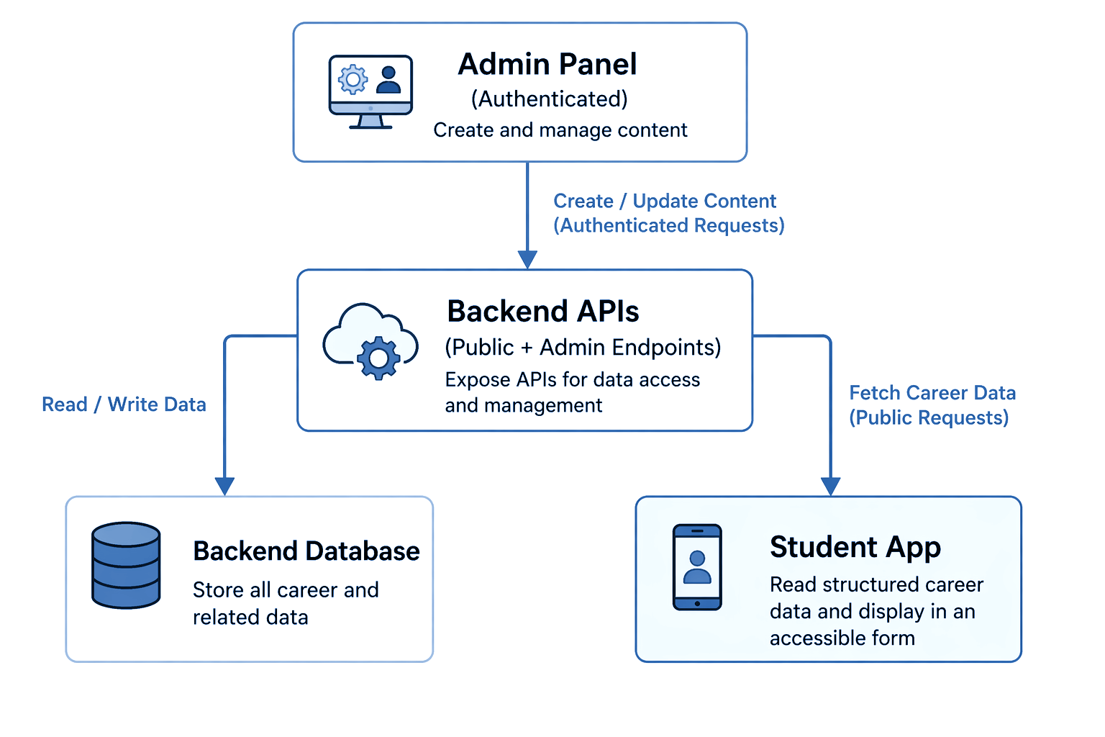
System Architecture

Slide 7
Key Features & Deliverables
Student App
Admin Panel
Backend API
Profile & onboarding
Stream-based suggestions
Hierarchical drill-down
Search & bookmarks
Offline data caching
Quiz & feedback support
CRUD for all entities
Stream & node management
Book & institute Management
No-code content updates
Real-time API integration
Public read endpoints
Admin write endpoints
Blueprint-based routes
JWT access control
CORS support
Modular & extensible

Slide 8
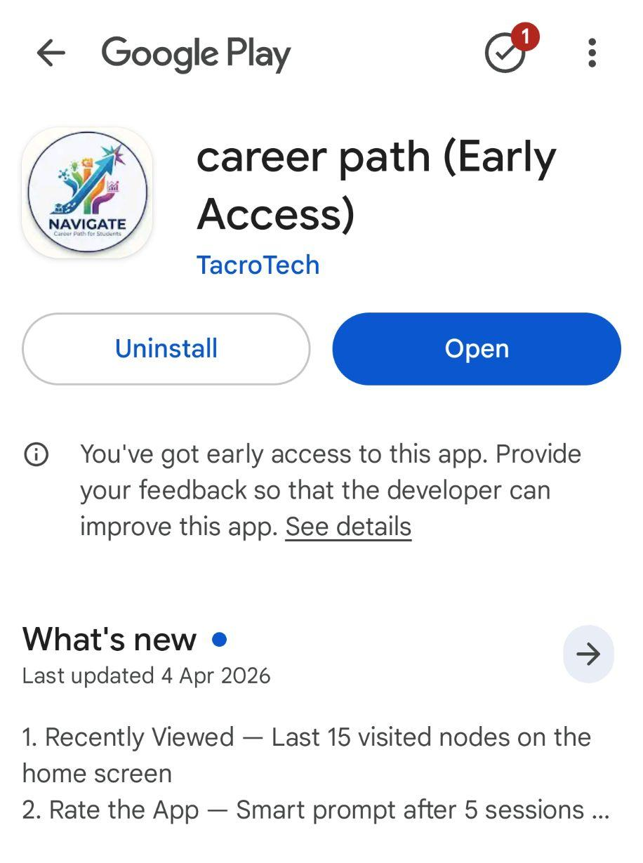
App is Live — Early Access on Google Play Store
CareerPath is already published and available for initial feedback.
What's Already Live
Basic career data populated across multiple streams
Stream → Category → Sub-Category hierarchy browsable
Student onboarding & profile setup
Search and explore career paths
Bookmark and save interesting options
Download now !!

Slide 9
Conclusion & Road Ahead
What We Built
Road Ahead (Semester 4)
Structured, hierarchical career data model
Flutter app for students (on Play Store)
Admin panel for content management
Flask backend with REST APIs & JWT auth
Bridges the discovery gap for rural students
Populate 100+ career paths with verified data
Advanced search & strength-based filtering
Analytics dashboard for usage insights
AI-powered recommendation engine
Multi-language / localization support
CareerPath is not a replacement for LLMs — it's the structured map
that helps students know what to explore, even before they know what to ask.

Slide 10
Future Vision — Beyond M.Tech
CareerPath doesn't end with the degree, it evolves into a long-term ecosystem.
Scholarship
Discovery
2
College & Counselor
Onboarding
3
More on the
Horizon
1
List colleges & institutes that offer scholarships
Show eligibility & steps to apply for each scholarship
Help students find affordable paths
Partner with colleges to onboard their career counselors
Counselors recommend paths directly to students
Build a verified counselor network
Mentorship matching — connect students with alumni
Regional language support for wider accessibility
Community forums for peer help
We will keep evolving, onboarding more colleges, adding scholarship data,
and building community-driven features to make career guidance truly accessible.

Slide 11
CareerPath is not just an app —
it's a mission to ensure no student
is left behind because of lack of guidance.
Thank You
Manvendra Pratap Singh | M25AI2122 | IIT Jodhpur
Supervisor: Dr. Dinesh Mohan Joshi

