Slide 1
Team Maverheads
Dronacharya College of Engineering, Khentwas, Gurugram
PROJECT NAME: ADHYANAM

Slide 2
Problem statement
Create a portal for those who are not financial capable for affording the cost of university fees. To help these students get donors(for assistance with funds, donation of used electronic devices, of stationery materials). This portal should also allow students to also avail scholarships for their desired universities based on some eligibility criteria.

Slide 3
Solution
Our team has decided to create a web based platform, “Adhyanam”. There will be a students area as well as an admin area. The students can fill out an application form available on the website only which will be further analysed to present them with available scholarships based on their application. The platform will also help students with finding appropriate internships, furthermore, these students can manage their profiles as well. The admin side will include features such as managing scholarships, reviewing applications, communication with students, analytics and reporting. Students will also be made available with a personalized chatbot to help them certain tasks such as setting reminders, displaying suggestions for scholarships and internships etc.

Slide 4
Tech stack
Chatbot: Python(pyttsx3, pyautogui, webbrowser, wikipedia, psutil, smtplib, speech_recognition)
Website: ReactJs with vite framework, tailwind css, MySQL, backend apis NodeJs/express

Slide 5
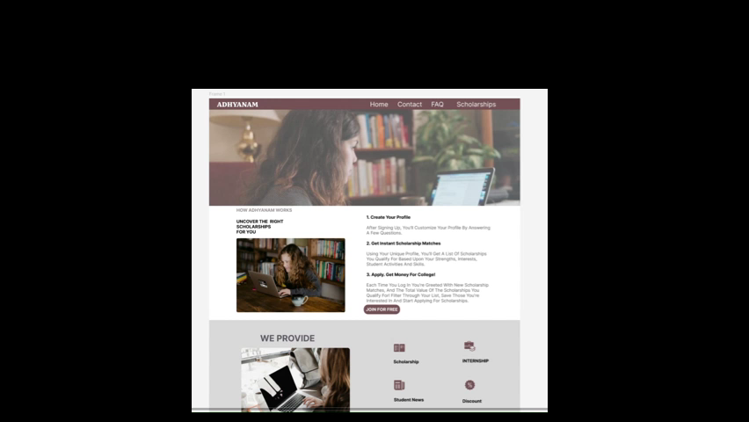
Business model AND sample preview
Target Audience: Our main targets will be students who come from economically weaker backgrounds and will reach them via crowd-sourcing options.
Sample web-design of the platform:

