Slide 1



S manish sagar Manvendra Singh Rathore
Drug Review Sentiment Analysis

Slide 2
ABOUT
This project is developed under internship project part of ineuron AI division .
In this project we got the dataset based on drug reviews ,which contains drugname ,condition and reviews .
The core of is to do EDA ,sentiment analysis with NLP ,and build a model with Machine learning algorithms.
This model predicts the sentiment of review/comment given to drug .

Slide 3
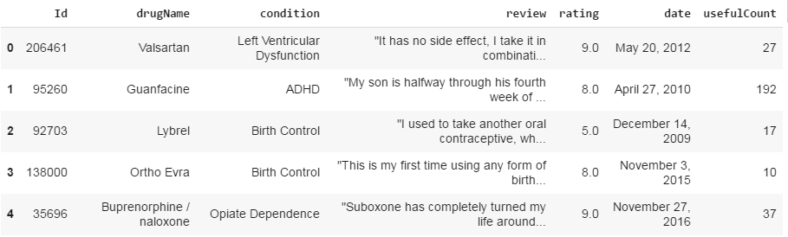
DRUG REVIEW DATASET

Slide 4
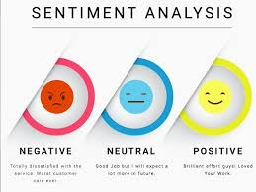
PROBLEM STATEMENT
Drug Review Sentiment –
Our goal is to predict the Sentiment of reviews/comments which is given to a specific drug .

Slide 5
Objectives
Analyze Data –
Data is extracted and filtered before analysis .
Each sentence and opinion is examined for subjectivity.
Indexing (Sentiment Classification) - Each subjective sentence is classified into positive, negative or neutral .
Delivery (Presentation of Output) – Displays the sentiment of reviews .

Slide 6

INTRODUCTION
The practice of applying Natural Language Processing and Text Analysis techniques to identify and extract subjective information from a piece of text .
It determines if an expression is positive, negative, or
neutral .
It is an emerging field that attempts to analyze and measure human reviews and convert it into hard facts .

Slide 7

Dealing with Null Values
Replacing null values with Other category if present in condition column ( because of less % of null values )
Removing rows having Null values in them completely .

Slide 8
DATA ANALYSIS
If we take a look at data set combined train and test it contains 215063 rows with various drugs ,conditions and reviews . We did various methods to analyze the data and plotted the graphs using ‘Matplotlib’ and ‘seaborn’ .

Slide 9
Exploratory Data Analysis
We will be doing EDA to various rows and columns like drugs , condition and reviews .
EDA is the core process of any data analysis , in which we should summarize the individual characteristics of data such as patterns , trends , outliers , statistics and visualization .
After loading the data we came to know that its has (1 float ,2int ,4object) and no column has none or missing values .

Slide 10
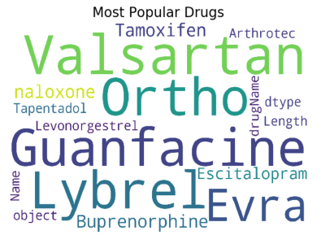
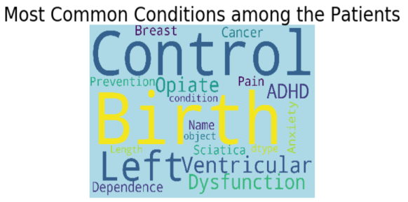
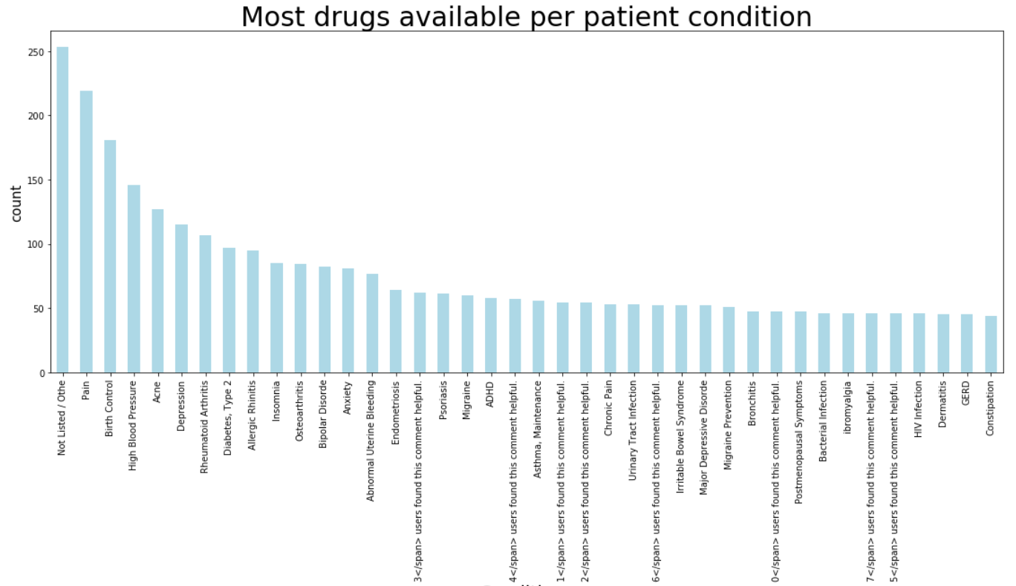
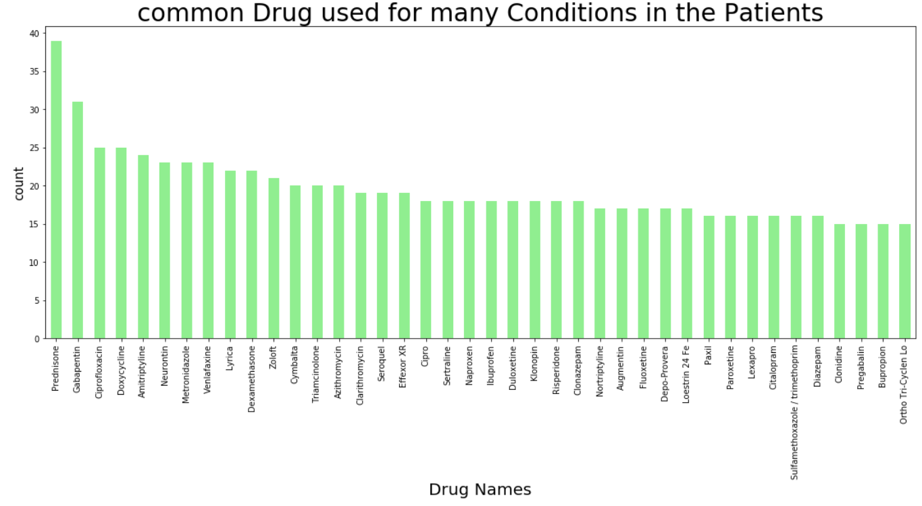
Graphs

Slide 11
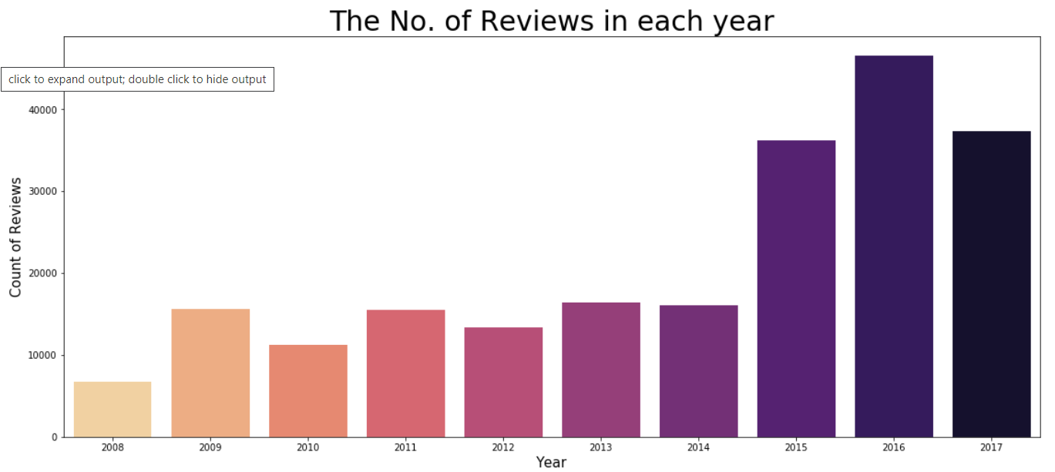
Graphs
As reviews are increasing year by year , we can observe from above the need and impact sentimental analysis can have on the society .

Slide 12
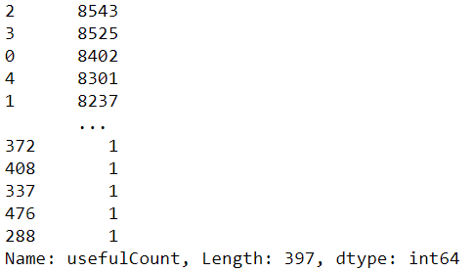
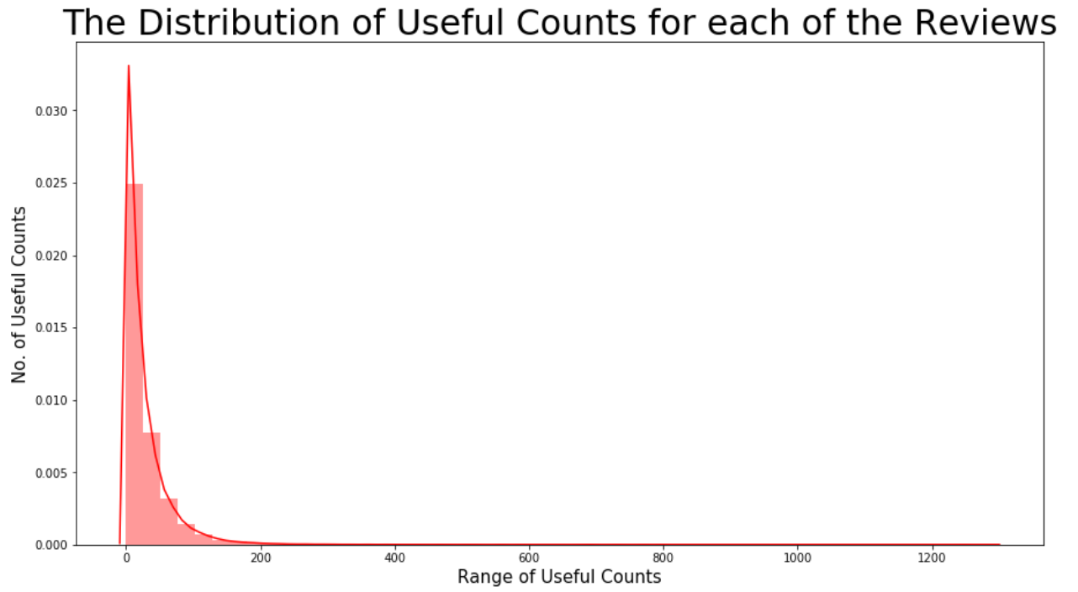
Graphs and visualizations ..
-> Analysis on usefulCounts attribute .

Slide 13

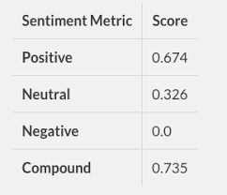
NLP Part
Nlkt package -
We used nlkt package which provides various ulities for NLP .
We tried to remove stopwords('me', 'my', 'myself', 'we') in our reviews using nltk .
VaderSentiment Analyser -
we used SentimentIntensityAnalyzer to get the polarity scores of sentiments .
We hence divided sentiments as positive , negative and neutral .

Slide 14
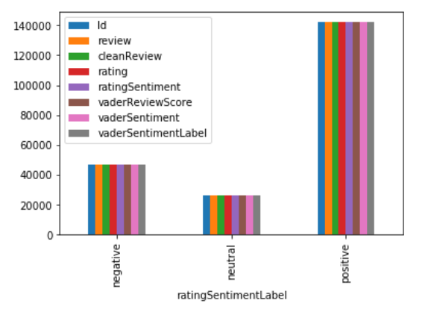
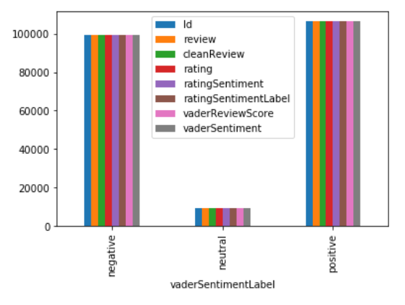
Useful Attributes
Rating_Sentiment –
positive - if (>= 7)
neutral - if (>=4) & (<7)
negative - if (<=3)
Vader_Sentiment –
positive - if (>=0.05)
neutral - if (>-0.05) & (<0.05)
negative – if(<=-0.05)

Slide 15
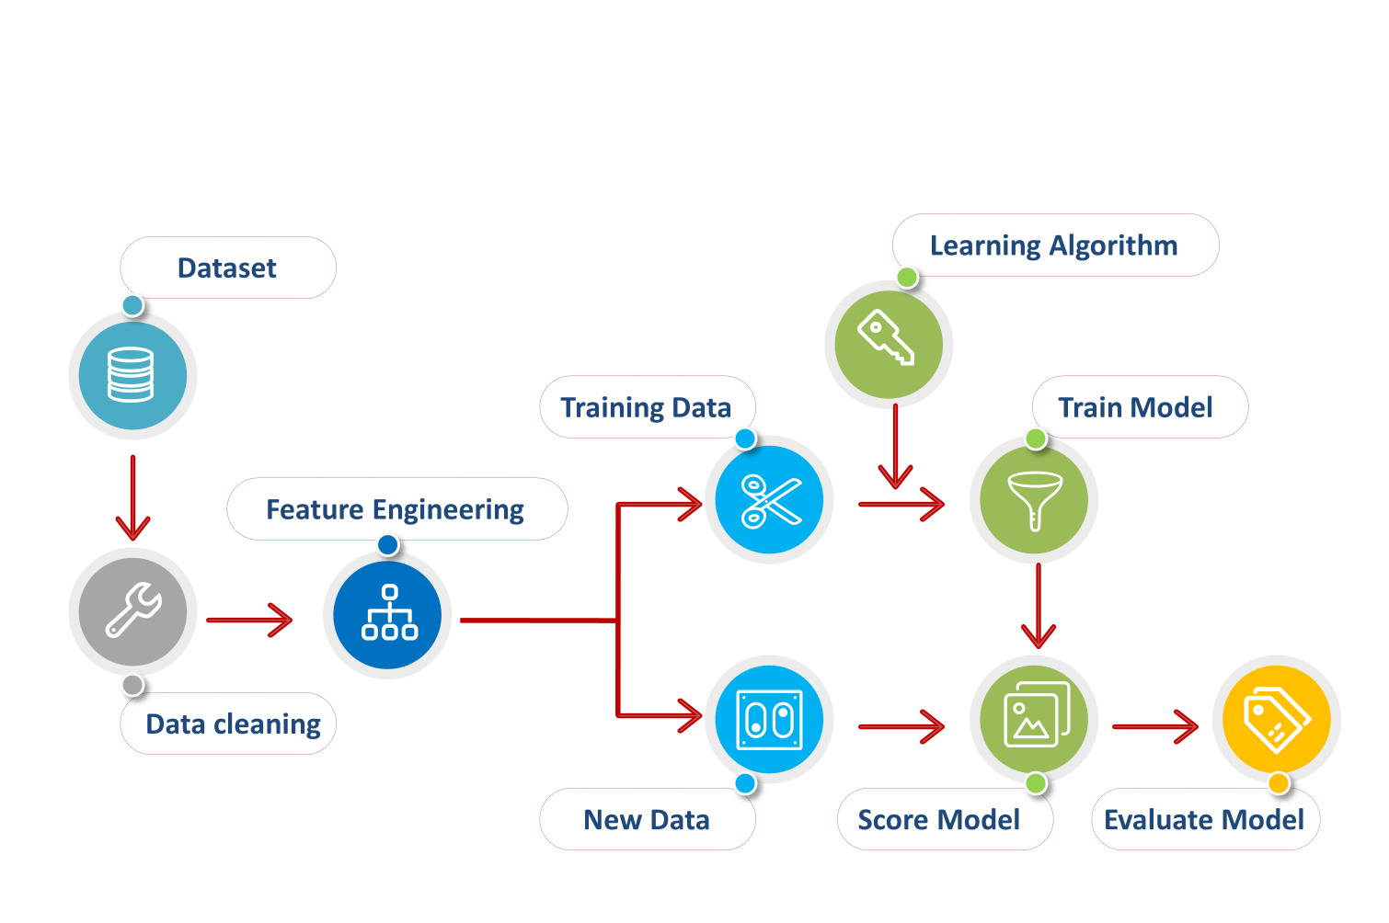
Modeling ..
To predict something useful from the datasets, we need to implement machine learning algorithms .
There are many types of algorithms like Linear SVC , Logistic Regression , etc. that can be used for modeling purpose .

Slide 16
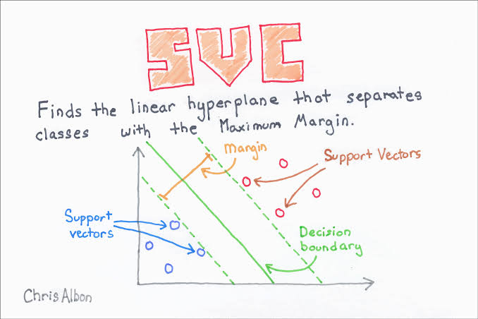
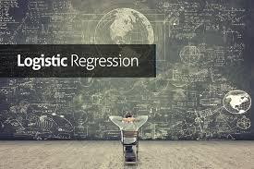
Algorithms used ..
1). LinearSVC –
The objective of a Linear SVC is to fit to data you provide , returning a “best fit” hyperplane that divides, or categorizes, your data. You can then feed some features to your classifier to see what the "predicted" class is. This makes this specific algorithm rather suitable for our uses, though you can use this for many situations. Let's get started.
2). Logistic Regression –
This is a Supervised Machine Learning algorithm which is used for the classification problems, it is a predictive analysis algorithm and based on the concept of
probability . It is thereby used to predict the probability of a target variable .

Slide 17
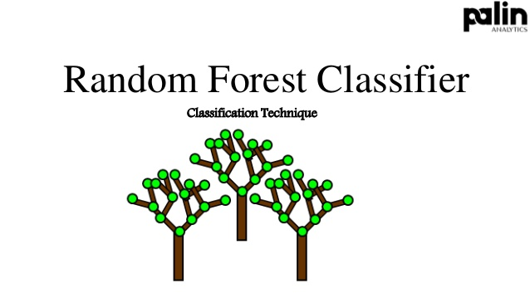
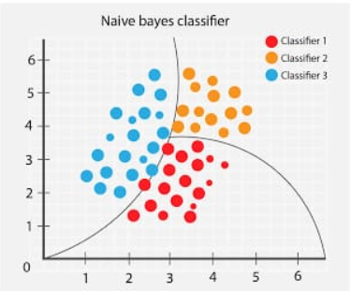
Algorithms used ..
3).RandomForestClassifier –
This Algorithm consist of many decisions trees. It uses bagging and feature randomness when building each individual tree to try to create an uncorrelated forest of trees whose prediction by committee is more accurate than that of any individual tree.
4). MultinomialNB Classifier –
The multinomial Naive Bayes classifier is suitable for classification with discrete features (e.g., word counts for text classification) . The multinomial distribution normally requires integer feature counts . However, in practice, fractional counts such as tf-idf may also work.

Slide 18
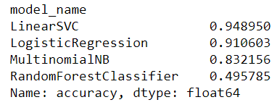
Best Algorithm
Linear SVC() –
It showed us the best results amoung the four algorithms used .

Slide 19
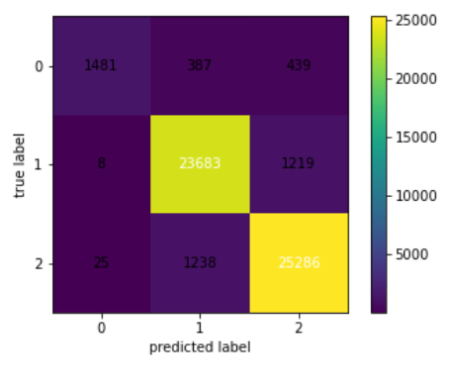
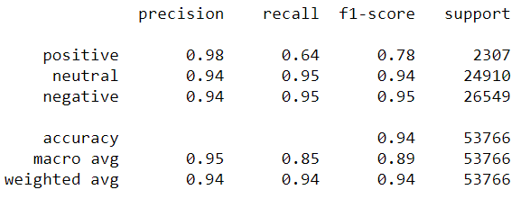
Model Report
Confusion Matrix -
A confusion matrix is a table that is often used to describe the performance of a classification model (or “classifier”) on a set of test data for which the true values are known. It allows the visualization of the performance of an algorithm.
Classification Report –
It shows the score of precision , recall and support which can be used to classify how good our model is .
More the precision more good and accurate our model is .

Slide 20
API and UI DEVELOPMENT
Flask api has been used for back end development of ui . A user friendly application is built where user can enter reviews/comments and get the Sentiment of his comments .
Html and CSS is used for front end development in UI .

Slide 21
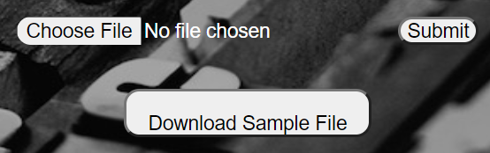
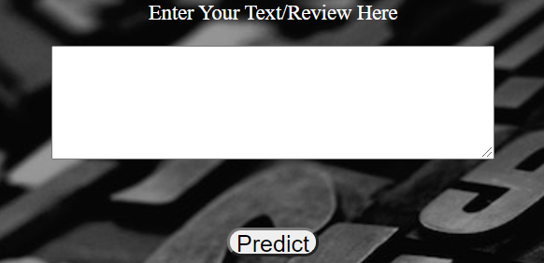
UI Description
We added About section where you can find description of the application .
Functionalities ->
You can write your comment or review in the text box and predict it to get the Sentiment of the comment .
You can upload csv / excel file for bulk predictions .
You can also download sample file for your reference.
You can retrain the model with your dataset aswell .

Slide 22
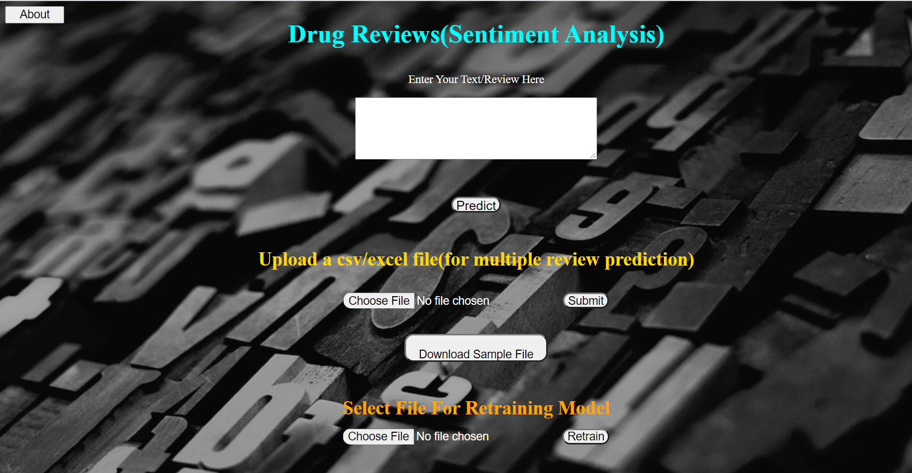
Final User Interface

Slide 23
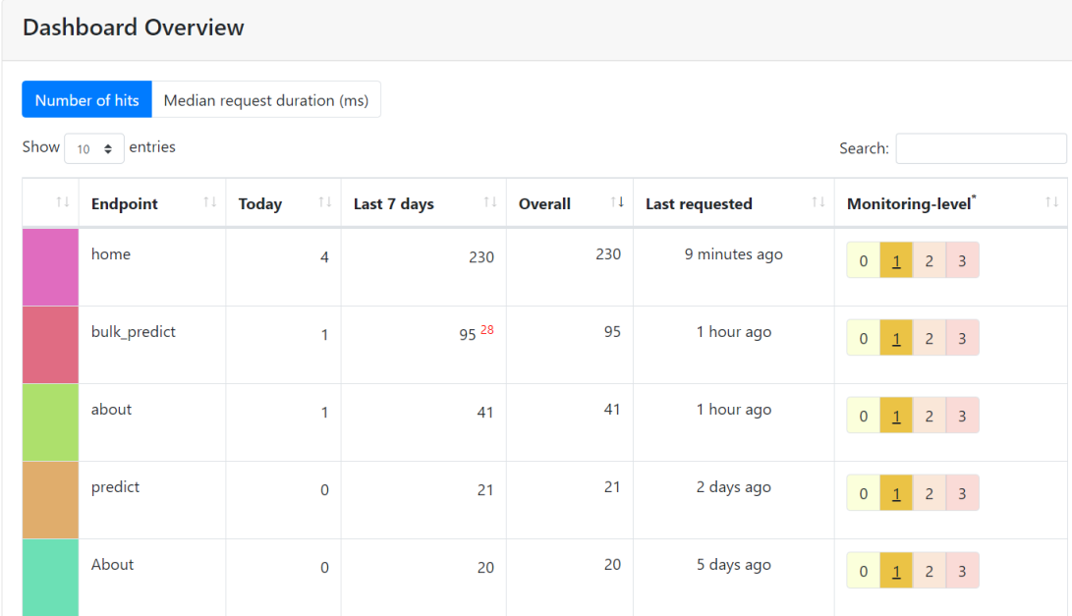
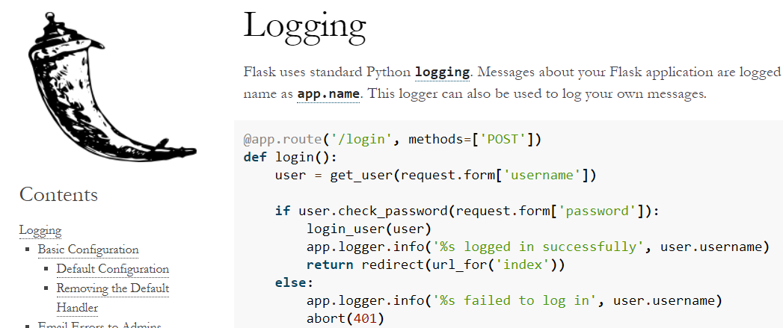
Monitoring And Logging
Monitoring –
The monitoring of machine learning models refers to the ways we track and understand our model performance in production from both a data science and operational perspective.
Flask has its own monitoring package which can be used for this purpose .
Logging –
Messages about your Flask application are logged with app.logger , which takes the same name as app.name .
Application logging involves recording information about your application’s runtime behavior .

Slide 24

Dockerisation
Docker is a tool designed to make it easier to create, deploy, and run applications by using containers. Containers allow a developer to package up an application with all of the parts it needs, such as libraries and other dependencies, and deploy it as one package.

Slide 25

Cloud Deployment -
Cloud deployment refers to the enablement of SaaS (software as a service), PaaS (platform as a service) or IaaS (infrastructure as a service) solutions that may be accessed on demand by end users or consumers.
Model deployed in aws cloud using EC2 instance .

Slide 26
Access To Our App
Web Link :-
http://ec2-18-223-118-160.us-east-2.compute.amazonaws.com:8080/
( Stopped for now due to deployment cost .. )
Git Hub Link :-
https://github.com/manvendrasrathore20015/Drug-Review-Sentiment-Flask-Deployment
Google Drive Link :- https://drive.google.com/drive/folders/1OsZ_SH7boZspmw6YY1rkLXKJHRAo7x-O?usp=sharing

Slide 27


