Slide 1

Paraphrase Detection with BERT: A Deep Dive
Discover paraphrase detection and its key role in understanding language.
Explore BERT’s impact on NLP and Microsoft’s MRPC dataset from Hugging Face.

Slide 2

Understanding Paraphrase Detection
Definition
Applications
Determining if two sentences express the same meaning.
Question answering
Plagiarism detection
Content summarization
Challenges
Metrics
Semantic similarity versus word overlap and context understanding.
Accuracy
Precision
Recall
F1-score

Slide 3

Introducing BERT: Bidirectional Encoder Representations from Transformers
Transformer Architecture
Bidirectional Training
Uses attention and parallel processing for language modeling.
Processes context from both left and right of a word.
Pre-training & Fine-tuning
Strengths
Builds on large corpora, then specializes on specific tasks.
Captures subtle meanings and manages context effectively.

Slide 4
The Microsoft Research Paraphrase Corpus (MRPC)
Dataset Overview
Statistics
Features
Accessibility
Labeled sentence pairs for paraphrase detection tasks.
5,801 pairs, 76% show paraphrase relation.
Real-world examples with varied sentence types.
Available easily on Hugging Face’s datasets library.

Slide 5
Implementing Paraphrase Detection with BERT and MRPC
Environment Setup
1
Install Python, Transformers, and PyTorch or TensorFlow.
Data Preprocessing
2
Tokenize and format inputs for BERT compatibility.
Model Fine-tuning
3
Train BERT on the MRPC dataset for paraphrase detection.
Evaluation
4
Test on a held-out dataset to measure accuracy and recall.

Slide 6
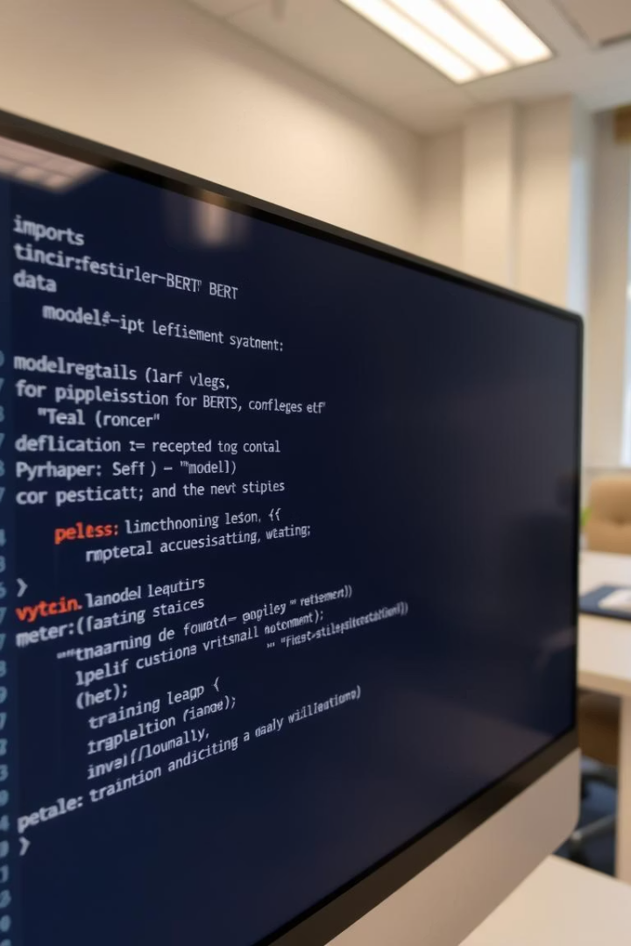




Code Example: Fine-tuning BERT for Paraphrase Detection
Load Model & Tokenizer
Prepare Dataset
Set Training Parameters
Train & Evaluate
This snippet highlights the essential fine-tuning workflow using Transformers.

Slide 7
Results and Analysis
Performance
Comparison
Error Analysis
Ablation Studies
High accuracy and F1-score on MRPC test set
BERT surpasses traditional baseline models.
Common failures found in ambiguous sentence pairs.
Hyperparameter tuning impacts results significantly.

Slide 8
Conclusion and Future Directions
BERT’s Effectiveness
Improvement Areas
Excels at recognizing paraphrases via deep contextual modeling.
Integrate external knowledge, optimize training approaches.
Future Research
Next Steps
Explore cross-lingual tasks and new paraphrase datasets.
Encourage community exploration of BERT and paraphrase detection.

