Slide 1
User Adds Click Predictor App
CAPSTONE PROJECT
Presented By:
1. Manvi Chaturvedi-Invertis University (B.Tech 7th sem)

Slide 2
OUTLINE
Problem Statement
Proposed System/Solution
System Development Approach
Result
Conclusion
Future Scope
References

Slide 3
Problem Statement
Develop a machine learning model and convert it into a Web App for predicting user add clicks accurately based on historical user interaction data. The model should leverage features such as user demographics, browsing behavior, and ad content to forecast the likelihood of a user clicking on an advertisement, ultimately improving ad targeting and effectiveness. The app Ensures a Precised prediction for a user add click.
.

Slide 4
Proposed Solution
Objectives: The objective of this project is to create a user add click prediction model and web application to predict that the user will click on the displayed add or not by using a predefined dataset.
Data Collection: The data was Gathered like age ,spent hours ,country ,gender, city, clicked on add or not from dataset source.
Data Preprocessing: Clean and process the collected data .
Data Cleaning: Handle missing values, outliers, and inconsistencies in the dataset.
Machine Learning Algorithms : Implement Logistic Regression Model to classify the add clicks to either yes or no.
Exploratory Data Analysis (EDA):
Visualize Data: Explore relationships and patterns in the data through charts, histograms, and statistical summaries.
Correlation Analysis: Identify correlations between features and the target variable (ad clicks) to understand which features are most influential.

Slide 5
Proposed Solution
Model Selection and Training:
Split Data: Divide the dataset into training and validation sets (e.g., 70% training, 30% validation).
Model Selection: Choose appropriate machine learning models for classification tasks such as Logistic Regression, Decision Trees, Random Forests, Gradient Boosting, or Neural Networks based on the dataset size and complexity.
Model Training: Train multiple models on the training dataset and evaluate their performance using appropriate evaluation metrics (e.g., accuracy, precision, recall, F1-score, ROC AUC).
8. Model Deployment:
Final Model Selection: Select the best-performing model based on validation results.
Deployment Strategy: Implement the model into a production environment, integrating it with existing systems or platforms for real-time prediction of ad clicks.

Slide 6
System Approach
SYSTEM REQUIREMENTS : Windows 11 OS, 8GB RAM, I3 or I5 processors, smooth net connection.
Librairy Required : Numpy ,Pandas, os, Matplotlib, Seaborn, Sklearn.
Software : Jupyter Notebook, Google Colab, IBM Watson Studio.

Slide 7
Algorithm
Algorithm Chosen : Supervised Machine Learning -> Classification -> Logistic Regression
Import Libraries: First, import necessary libraries such as NumPy for numerical operations, Scikit-learn for machine learning algorithms, and metrics for evaluation.
Data Splitting: Split your data (X for features and y for target variable) into training and testing sets using train_test_split.
Model Initialization: Create an instance of LogisticRegression().
Model Training: Fit the logistic regression model to the training data using model.fit(X_train, y_train).
Prediction: Use the trained model to make predictions on the testing data (X_test) with model.predict(X_test).
Evaluation: Calculate the accuracy of the model using accuracy_score, generate a confusion matrix with confusion_matrix, and produce a classification report with classification_report.
Results: Print out the accuracy score, confusion matrix, and classification report to evaluate how well the logistic regression model predicts user ad clicks based on the features provided.

Slide 8
Result
Our ad click prediction ML model app represents a significant advancement in optimizing ad campaign strategies by predicting user click behaviors accurately. With robust performance metrics and a user-friendly interface, it is poised to deliver value to advertisers seeking to maximize their ROI through targeted advertising strategies. We look forward to further refining and expanding the capabilities of our app to meet evolving industry needs.

Slide 9
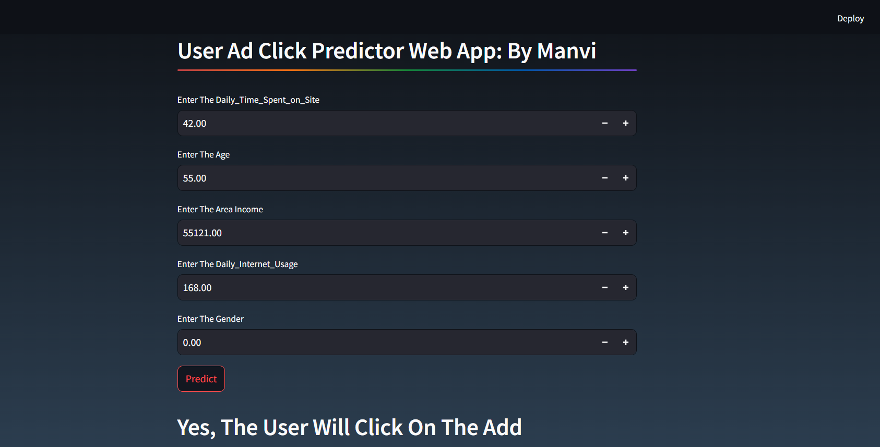

Slide 10
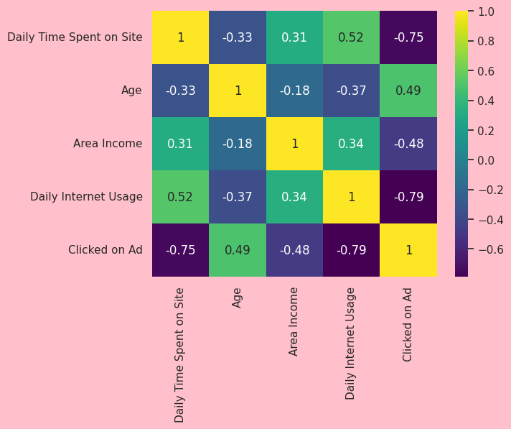

Slide 11
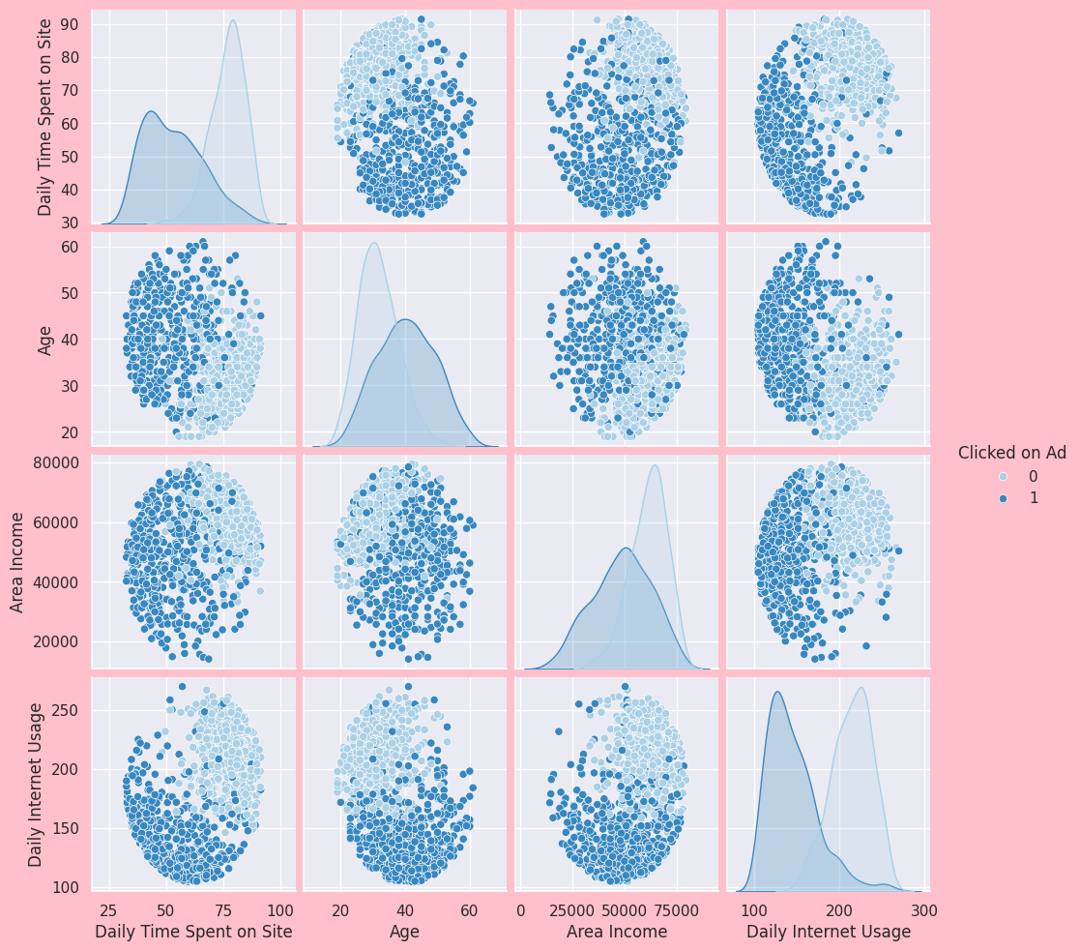

Slide 12
Conclusion
In conclusion, the User Ad Click Prediction app represents a significant advancement in digital advertising strategies by harnessing machine learning to forecast user interactions with advertisements. Through meticulous data analysis, model development, and rigorous evaluation, the app aims to optimize add targeting and maximize ad campaign effectiveness.

Slide 13
Future scope
Enhanced Feature Engineering: Incorporate more sophisticated feature engineering techniques to capture nuanced user behaviors and preferences. This could involve leveraging advanced natural language processing (NLP) for text-based features, sentiment analysis of user comments, or incorporating temporal dynamics and contextual information.
Real-Time Prediction and Personalization: Develop capabilities for real-time prediction of ad clicks, enabling dynamic adjustments to ad placements and content based on immediate user interactions and feedback. Implement personalized recommendations tailored to individual user preferences and behaviors in real-time.
Incremental Learning and Adaptability: Implement techniques for incremental learning and adaptive modeling to continuously update the prediction model with new data streams. This ensures the model remains relevant and effective in capturing evolving user behaviors and market trends over time.

Slide 14
References
Scikit-learn documentation for logistic regression and model evaluation metrics.
Coursera, edX, and Udacity courses on machine learning and data science.

Slide 15
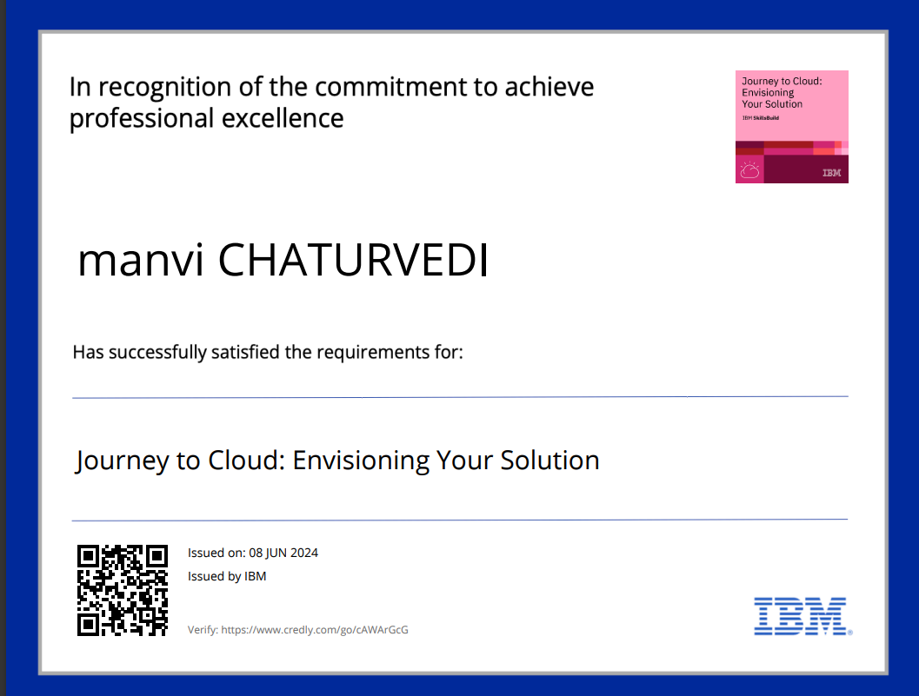
course certificate 1

Slide 16
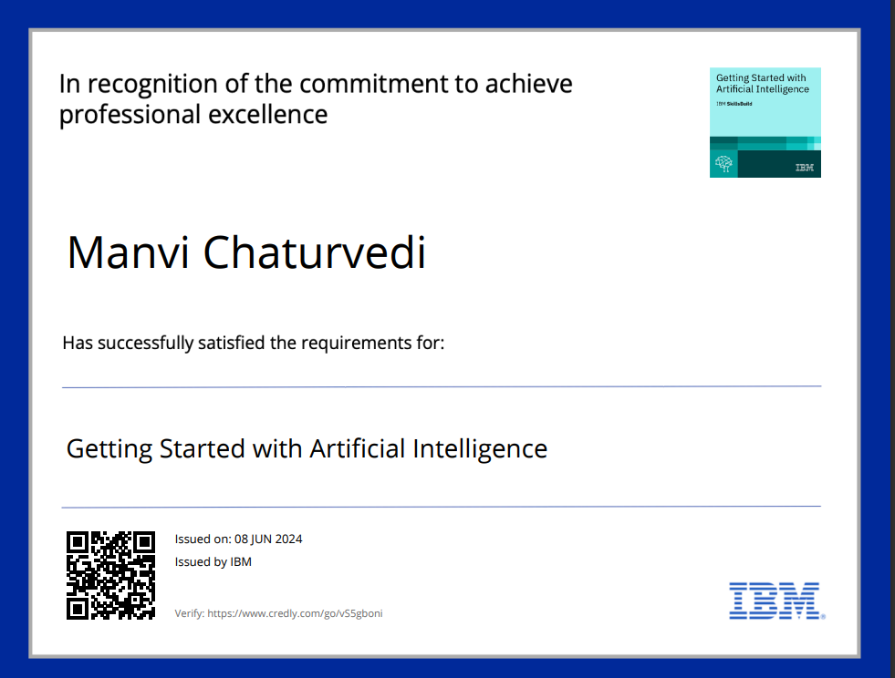
course certificate 2

Slide 17
THANK YOU

