Slide 1

PAGE 1
CYBER SECURITY
Clickjacking attack
Arin Vaidya Jain
Manvi Garg

Slide 2

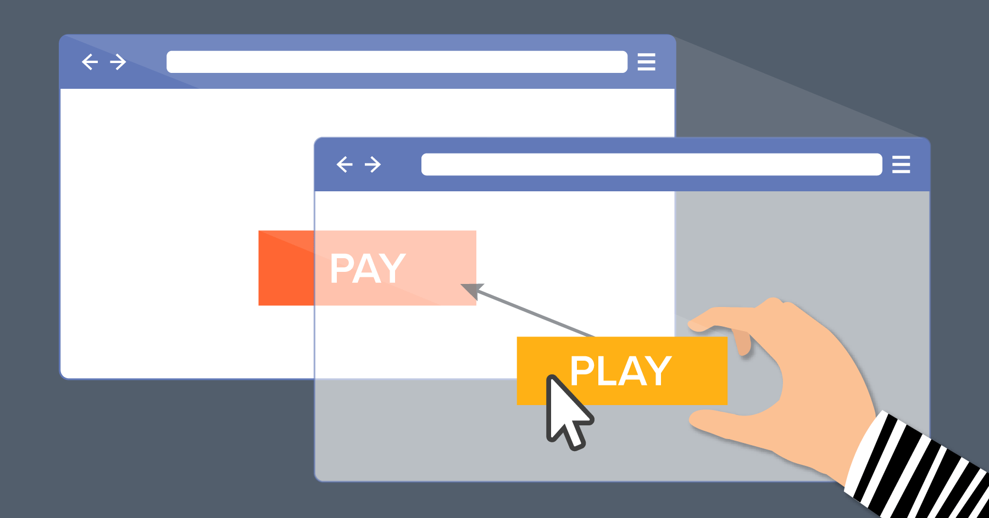
PAGE 2
ABOUT
A clickjacking attack, or user interface (UI) redressing, is a malicious technique where attackers trick users into clicking on hidden, invisible, or transparent web elements (like buttons or links) layered on top of a legitimate site. By doing so, users unknowingly perform actions, such as transferring funds, liking pages, or revealing credentials, believing they are interacting with the innocuous top layer.
CYBER SECURITY

Slide 3
PAGE 3
PROBLEM STATEMENT
  Users often trust websites and click buttons without verifying actions
  Attackers can design fake interfaces to trick users
  Sensitive actions like money transfer can be triggered unknowingly
  Lack of user awareness and security measures increases risk
CYBER SECURITY

Slide 4
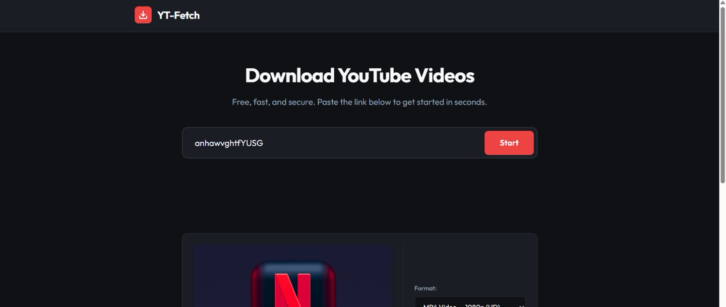
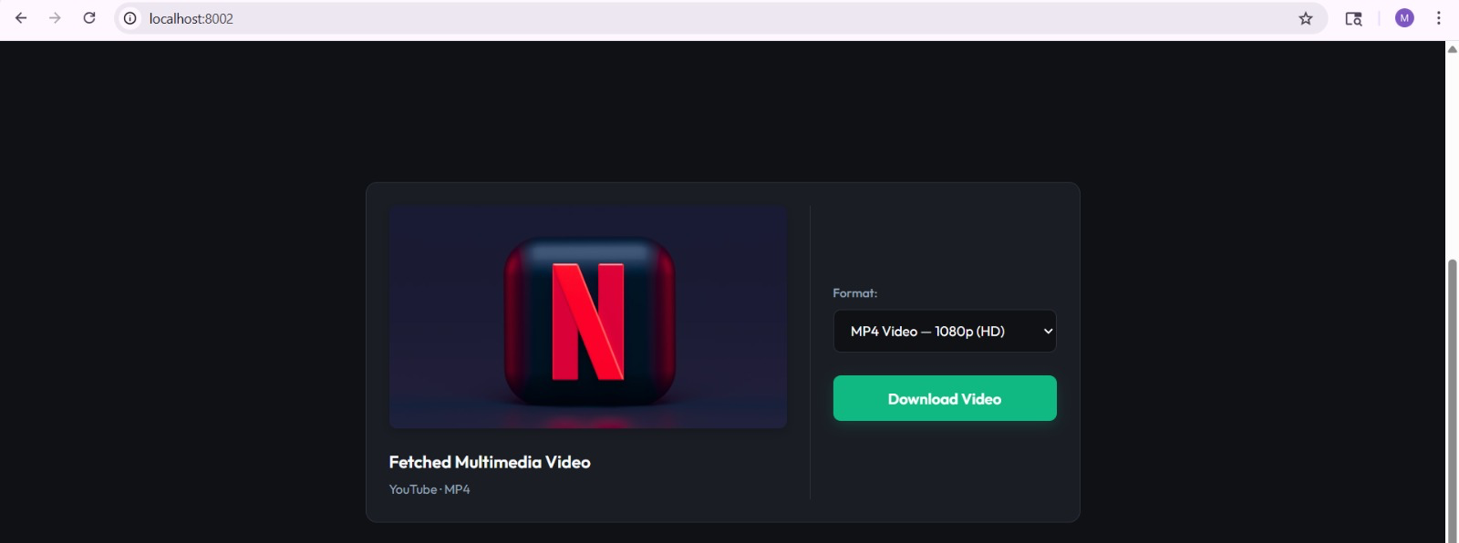
WORKING
PAGE 4
A fake video downloading website is created
A “Download Video” button is shown to the user
CYBER SECURITY

Slide 5
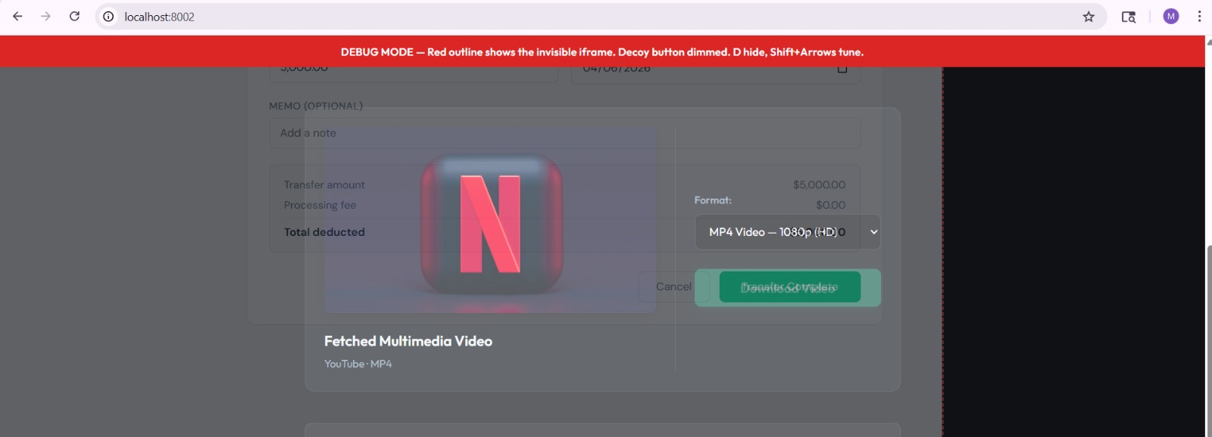
WORKING
PAGE 5
A hidden iframe loads another webpage (bank page)
The “Transfer Money” button is placed under the fake button
CYBER SECURITY

Slide 6
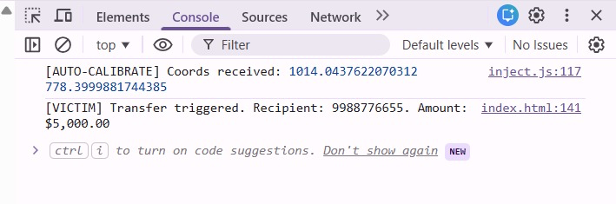
WORKING
PAGE 6
When the user clicks download, the hidden action is triggered
CYBER SECURITY

Slide 7
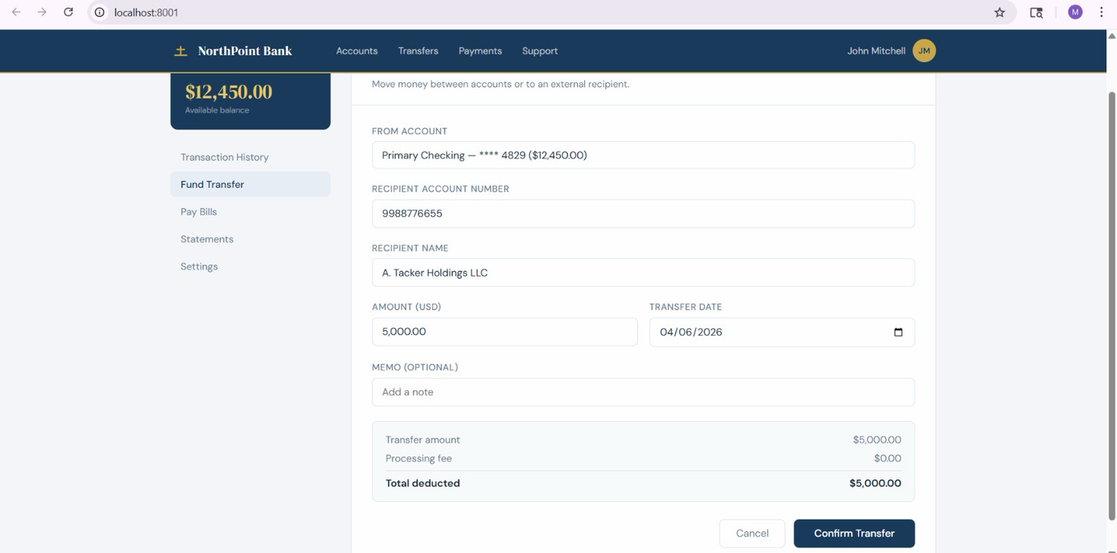
WORKING
PAGE 7
The Bank page tab is open in another tab with an ongoing transaction
CYBER SECURITY

Slide 8

PAGE 8
impact of the attack
  Unauthorized actions can be performed without user consent
  Financial loss (e.g., unintended money transfer)
  Loss of user trust in websites
  Can be used for stealing data or permissions
CYBER SECURITY

Slide 9
PAGE 9
  Use X-Frame-Options to prevent the page from being embedded in iframes
  Apply Content Security Policy (CSP) to control which sites can load content
  Implement frame-busting techniques to block hidden frames
  Add user verification (OTP/password) before sensitive actions
  Avoid clicking on unknown or suspicious websites
PREVENTION

Slide 10
PAGE 10
THANK YOU!
CYBER SECURITY

