Slide 1

AMAZON FINE FOOD REVIEWS
MANVI JAIN

Slide 2
OBJECTIVE
Conducting a sentiment analysis on the reviews given by users for amazon fine foods on the www.amazon.com website in order to check the accuracy of the sentiments against the ratings already provided by users and in turn the helpfulness of the review.

Slide 3
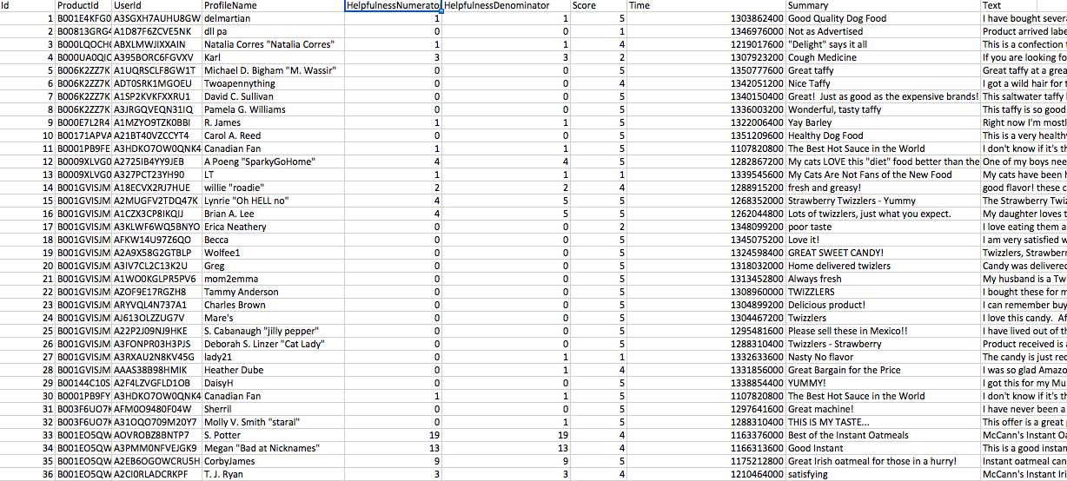
About the dataset
The dataset was taken from www.kaggle.com website.
Size: The original dataset had a total 568,454.

Slide 4
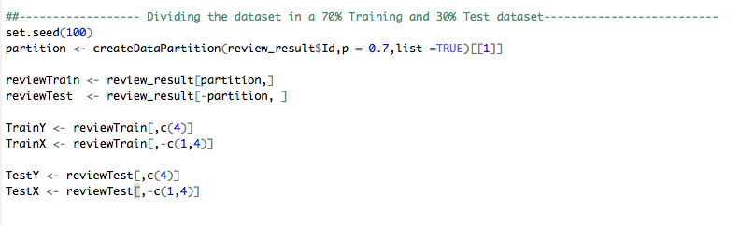
Dataset used for training and testing
Used createDataPartition to divide the data into Training and test sets.

Slide 5
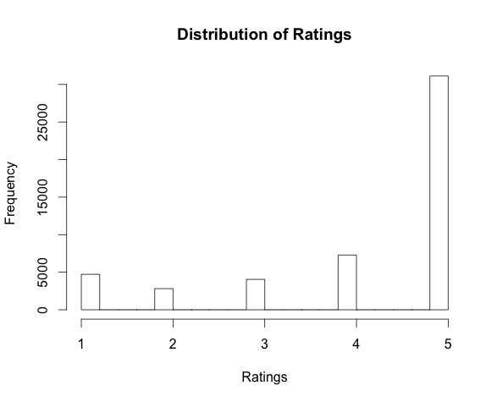
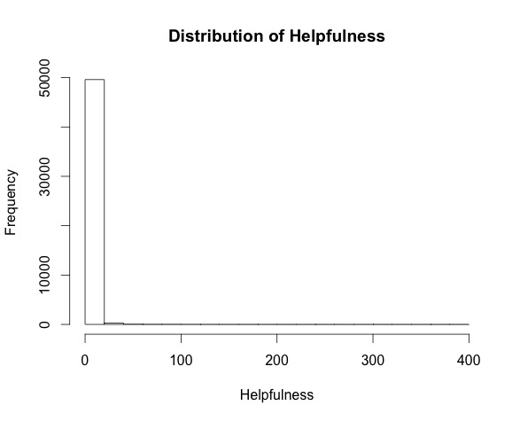
Exploratory analysis of variables
The reviews with a 5 rating were more common
Most of the reviews given were not so helpful

Slide 6
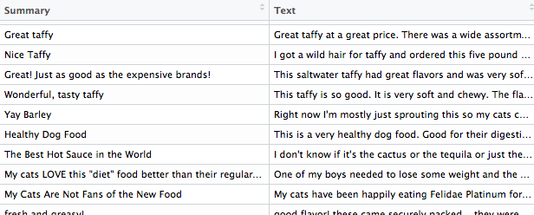
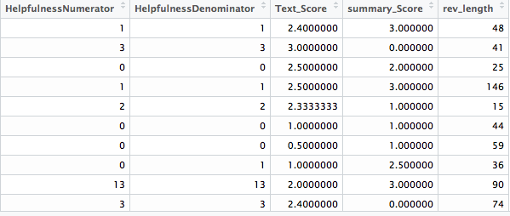
Predictors
Categorical predictors
Final 5 predictors

Slide 7
Predictor selection
Categorical Predictors
Product id
Profile name
Summary
Text
Final predictors
HelpfulnessNumerator
HelpfulnessDenominator
Text_Score : score of review calculated based on sentiment analysis
Summary_score : score of summary review
Rev_length : length of review text. Preprocessed, centered and scaled.

Slide 8
SENTIMENT ANALYSIS
BASIC CLEANING OF DATA
Stemming
Removing stop words(faced challenge with the usage of ‘not’ word in context of bad reviews)
To lower case
Removing punctuations
spellcheck

Slide 9
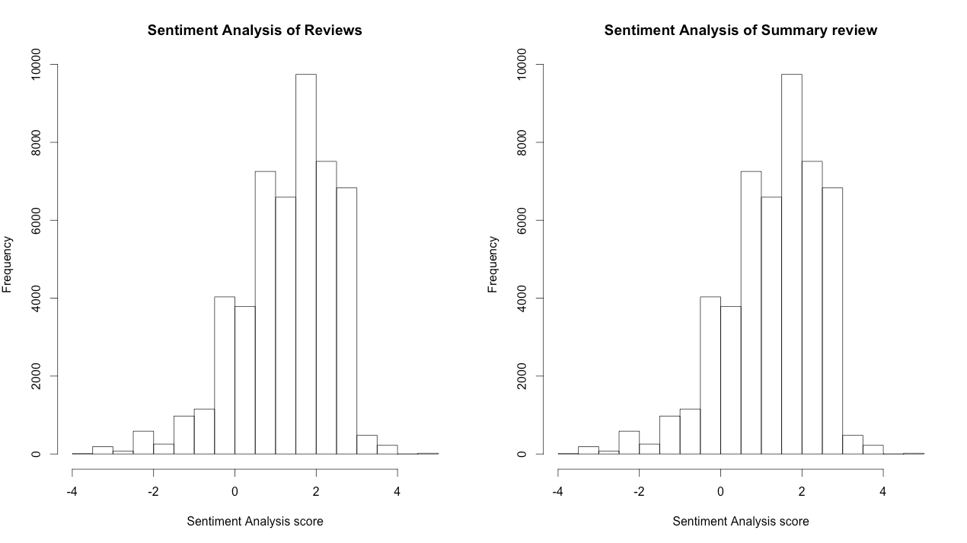
SENTIMENT ANALYSIS
In comparison with actual ratings ,sentiment analysis gives us a pretty good analysis. Ratings above 0 being positive and below 0 being negative. Used the AFINN wordlist to assign scores.

Slide 10
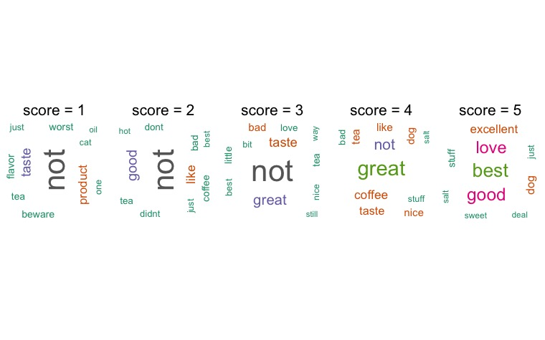
WORD CLOUD
Score > 3 : Positive Score < = 3 : Negative

Slide 11


RESPONSE

Slide 12
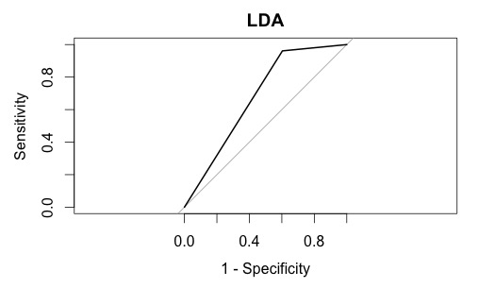
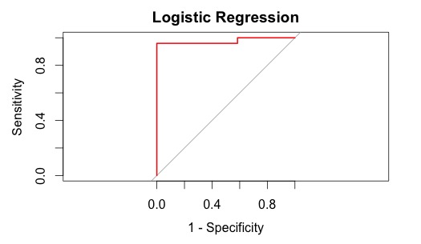
LINEAR MODELS
MODEL | ACCURACY | KAPPA | AREA UNDER THE CURVE
LINEAR DISCRIMINANT ANALYSIS | 0.8277685 | 0.4224906 | 0.6801
LOGISTIC REGRESSION | 0.8304932 | 0.4366161 | 0.6788

Slide 13
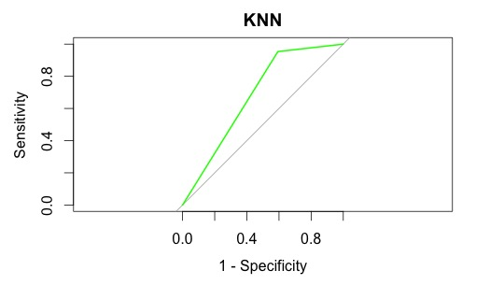
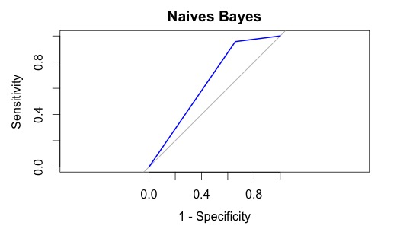
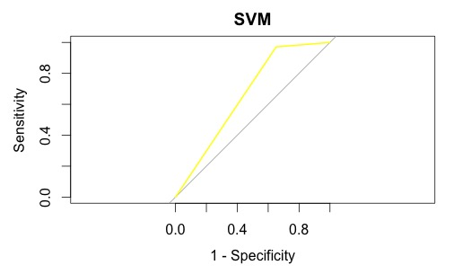
NON LINEAR MODELS
MODEL | ACCURACY | KAPPA | AREA UNDER THE CURVE
KNN | 0.8194905 | 0.4143690 | 0.6801
NAIVES BAYES | 0.8076072 | 0.4366161 | 0.6493
SVM | 0.8014602 | 0.3537227 | 0.6596

Slide 14
Insights and findings
KNN gave the best accuracy for Non linear models and Logistic regression for Linear models
Positive reviews were more common
Positive reviews were shorter
Positive reviews were more helpful
Logistic regression gave the best accuracy, linear models performed better

Slide 15
citations
J.McAuley and J. Leskovec. From amateurs to connoisseurs: modeling of user expertise through online reviews. WWW,2013
https://snap.stanford.edu/data/web-FineFoods.html
AFINN. Developed at the technical university of Denmark. (https://github.com/wooorm/afinn-111))
AFINN. Developed at the Technical University of Denmark.)

