Slide 1
SQL Masterclass
-Manvi Madan

Slide 2





About Me

Slide 3
Agenda
Introduction to SQL
Tools and Database used
Demo:
SQL Statements
Joins
Union
Operators
Stored Procedures
SQL Server Functions
SQL Database Statements
Important Concepts for Interview
Q/A

Slide 4
Introduction
SQL stands for Structured Query Language.
It is the standard language used for relational database management systems.
SQL Statements are used to perform tasks such as update data on a database, or retrieve data from a database.

Slide 5

Tools and Database Used
Tool: Azure Data Studio
Database: AdventureWorks

Slide 6
Demo

Slide 7
SQL Statements
SELECT
SELECT DISTINCT
SELECT TOP
COMMENTS
WHERE
AND, OR, NOT
ORDER BY
ALIASES
UPDATE
DELETE
NULL VALUES
NULL FUNCTIONS
LIKE
WILDCARDS
IN
BETWEEN

Slide 8
Demo
SQL Statements

Slide 9
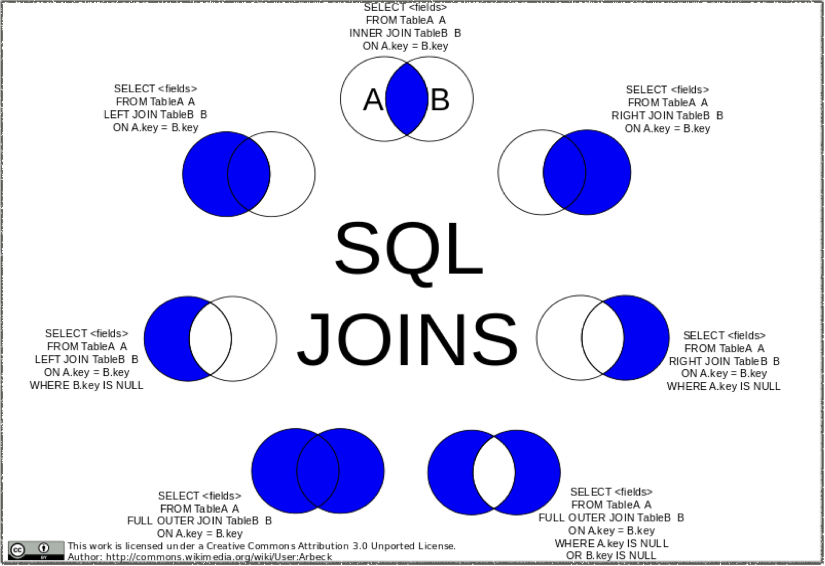
Source: Wikipedia Commons
SQL JOINS

Slide 10
Demo
SQL Joins

Slide 11
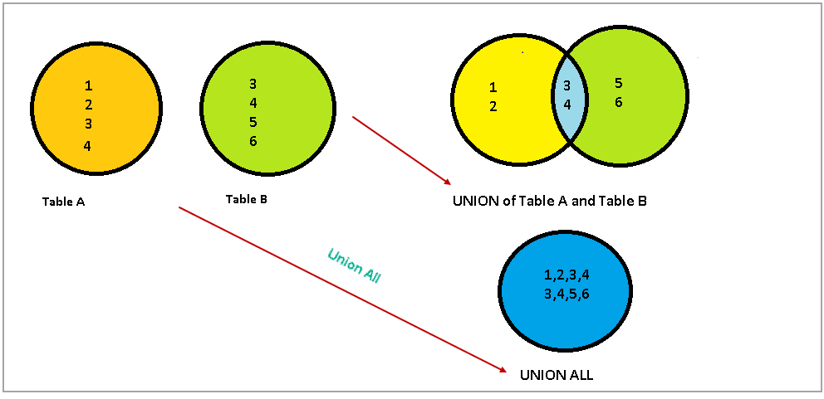
Union
Source: Sqlshack

Slide 12
Demo
SQL Union

Slide 13

SQL Arithmetic Operators
Operator | Description
+ | Add
- | Subtract
* | Multiply
/ | Divide
% | Modulo

Slide 14
SQL Comparison Operators
Operator | Description
(=) | Equal to
> | Greater than
< | Less than
>= | Greater than or equal to
<= | Less than or equal to
<> | Not equal to

Slide 15
SQL Bitwise Operators
Operator | Description
& | Bitwise AND
| | Bitwise OR
^ | Bitwise exclusive OR

Slide 16
SQL Logical Operators
Operator | Description
ALL | TRUE if all of the subquery values meet the condition
AND | TRUE if all of the subquery values meet the conditions separated by AND is TRUE
ANY | TRUE if any of the subquery values meet the condition
BETWEEN | TRUE if the operand is within the range of comparisons
EXISTS | TRUE if subquery returns one or more records
IN | TRUE if the operand is equal to one of a list of expressions
LIKE | TRUE id the operand matches a pattern
NOT | Displays a record if the condition(s) is NOT TRUE
OR | TRUE if ant of the conditions separated by OR is TRUE
SOME | TRUE if any of the subquery values meet the condition

Slide 17
Demo
SQL Operators

Slide 18
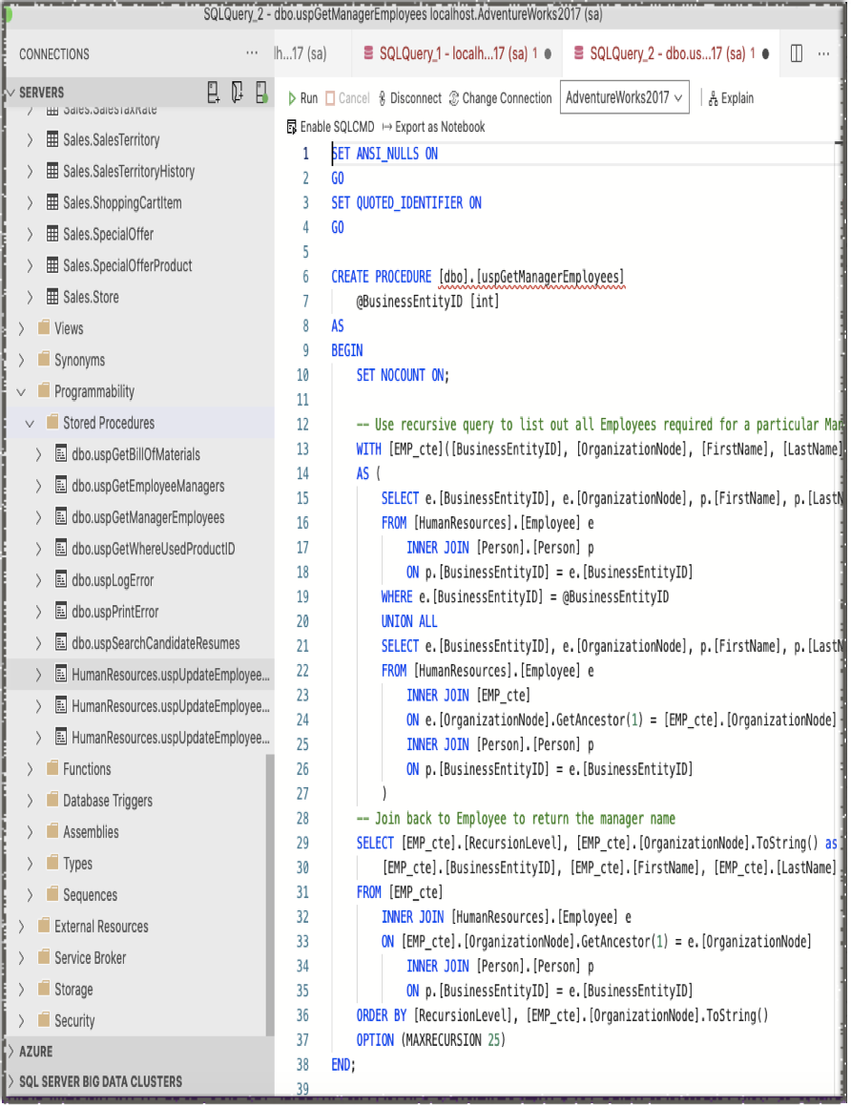
Stored Procedures
A Stored procedure is a group of SQL statements that has been created and stored in the database.
It will accept input parameters so that a single procedure can be used over the network by several clients using different input data.
It will reduce network traffic and increase the performance.
If we modify a stored procedure all the clients will get the updated stored procedure

Slide 19
Advantages of using Stored Procedures
Enables modular programming
Allows faster execution
Reduce network traffic
Provides better security to your data
https://stackoverflow.com/questions/459457/what-is-a-stored-procedure#:~:text=A%20stored%20procedure%20is%20a%20group%20of%20SQL%20statements%20that,clients%20using%20different%20input%20data.

Slide 20
Demo
Stored Procedure

Slide 21
SQL Server String Functions
CONCAT
CONCAT_WS
FORMAT
LEFT
LEN
LOWER
LTRIM
RIGHT
RTRIM
SUBSTRING
TRIM
UPPER

Slide 22
Demo
String Functions

Slide 23
SQL Server Numeric Functions
MAX
MIN
ROUND
SUM
ABS
CEILING
AVG
COUNT
FLOOR
LOG
PI
ROUND
SQAURE
SQRT
SIN
TAN

Slide 24
Demo
Numeric Functions

Slide 25
SQL Server Date Functions
CURRENT_TIMESTAMP
DATEADD
DATEDIFF
DATEFROMPARTS
DATEPART
DAY
GETDATE
GETUTCDATE
ISDATE
MONTH
SYSDATETIME
YEAR

Slide 26
Demo
Date Functions

Slide 27
Other Important Functions
CAST
COALESCE
CONVERT
CURRENT_USER
ISNULL
ISNUMERIC
NULLIF
SESSION_USER
SYSTEM_USER
USER_NAME

Slide 28
Demo
Other SQL Server Functions

Slide 29
SQL Database Statements
Create DB
Drop DB
Backup DB
Create Table
Drop Table
Alter Table
SQL Constraints
SQL Not NULL
SQL Unique
SQL Primary Key
SQL Foreign Key
SQL Check
SQL Default
SQL Index
SQL Auto Increment
SQL Dates
SQL Views
SQL Injection
SQL Data Types

Slide 30
Demo
Database Statements

Slide 31
Important Concepts for Interview
Conditional Selects
SQL Windows Functions
Removing Duplicates
Case statement
SQL Joins
Select Distinct Statement
Union and Union All
SQL Aggregate Functions
https://medium.com/swlh/5-important-sql-concepts-for-your-next-data-science-interview-27e8bcf3d045

Slide 32

Conditional Selects

Slide 33
SQL Windows Functions

Slide 34
Removing Duplicates

Slide 35
Case Statement

Slide 36
SQL Joins

Slide 37
SELECT DISTINCT Statement

Slide 38
Union and Union all

Slide 39
SQL Aggregate Functions

Slide 40
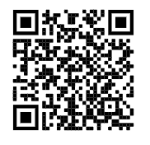
Github Repository

Slide 41

Got Questions?
Ask here or Reach out
Website: manvimadan.com
LinkedIn:
Twitter:
IG:

