Slide 1
SQL Masterclass
UOA IBSS Workshop Series
-Manvi Madan

Slide 2





About Me

Slide 3
Agenda
Introduction to SQL
Tools and Database used
Demo:
SQL Statements
Joins
Union
Operators
Stored Procedures
SQL Server Functions
SQL Database Statements
Important Concepts for Interview
Q/A

Slide 4
Introduction
SQL stands for Structured Query Language.
It is the standard language used for relational database management systems.
SQL Statements are used to perform tasks such as update data on a database, or retrieve data from a database.

Slide 5

Tools and Database Used
Tool: Azure Data Studio
Database: AdventureWorks

Slide 6
Data Model:
AdventureWorks
Source: SQLzoo.net/wiki/Adventureworks

Slide 7
Demo

Slide 8
SQL Statements
SELECT
SELECT DISTINCT
SELECT TOP
COMMENTS
WHERE
AND, OR, NOT
ORDER BY
ALIASES
UPDATE
DELETE
NULL VALUES
LIKE
WILDCARDS
IN
BETWEEN

Slide 9

SQL Server Wildcards
Operator | Description | Example
% | Represents zero or more characters | st% will find street, st. etc
- | Represents a single character | b_t will find bat, bit etc.
[] | Represents any single character within the brackets | b[oa]t will find bot, bat but not bit
^ | Represents any character not in the brackets | b[^a-b]t will find bot, but, bit. It will not find bat
- | Represents a range of characters | b[a-b]t will find bat only

Slide 10
Demo
SQL Statements

Slide 11
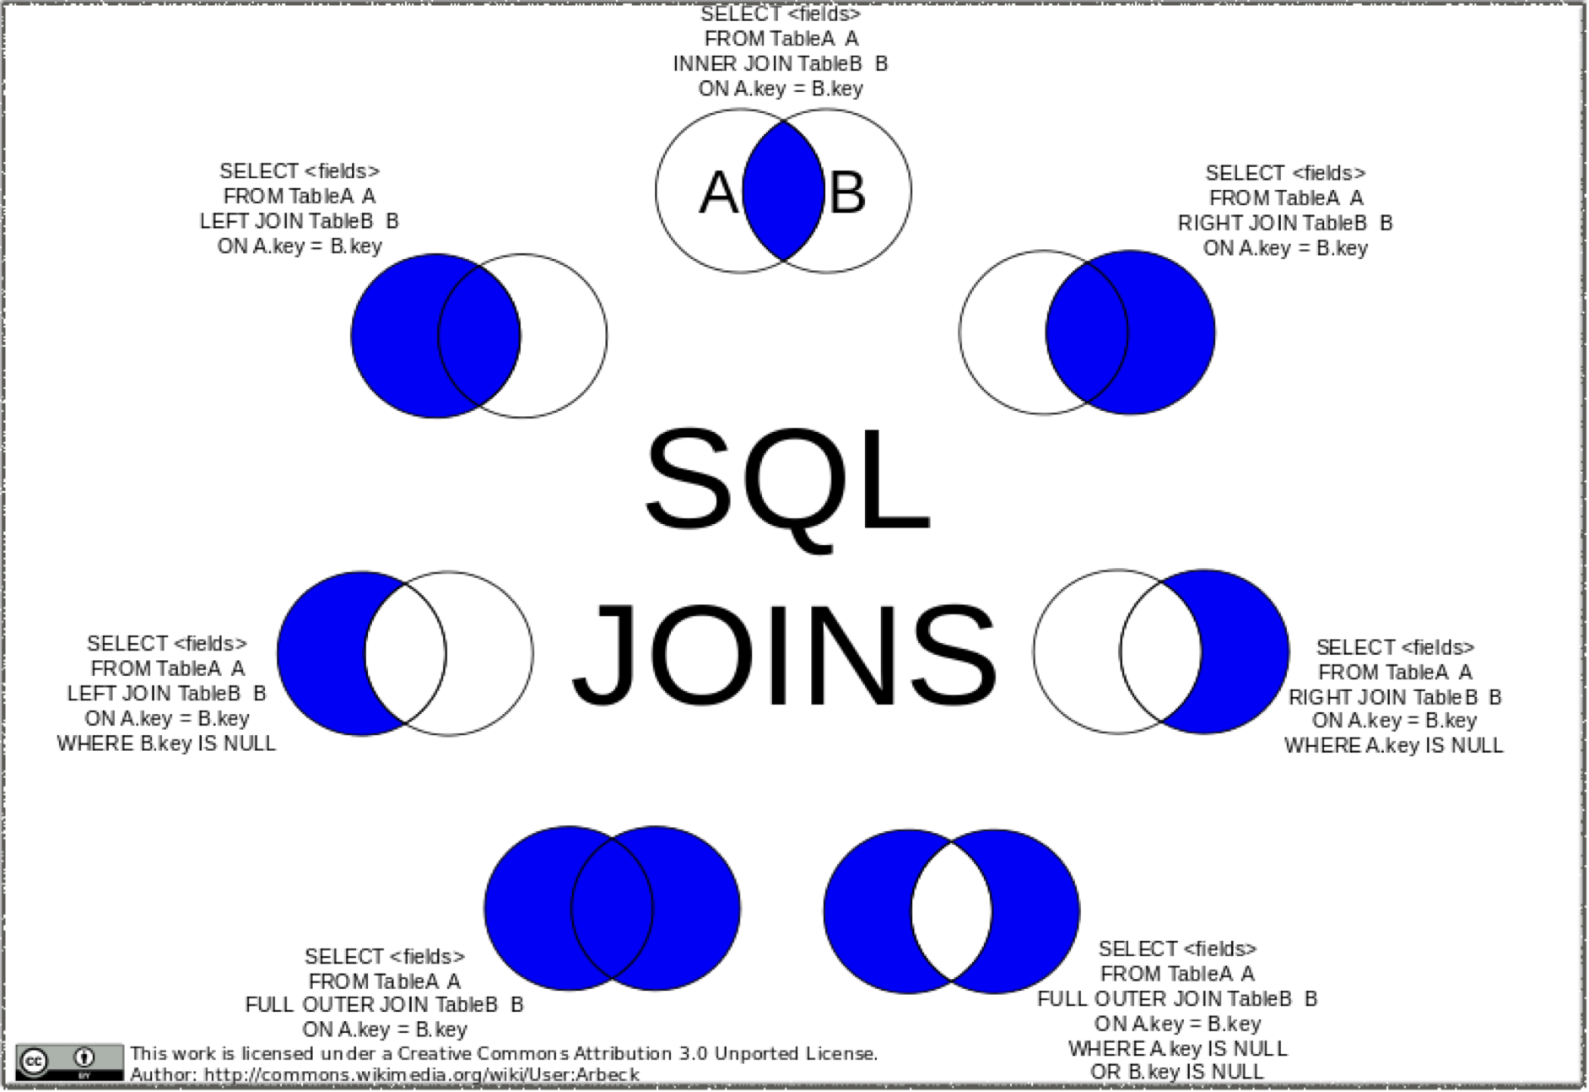
Source: Wikipedia Commons
SQL JOINS

Slide 12
Demo
SQL Joins

Slide 13
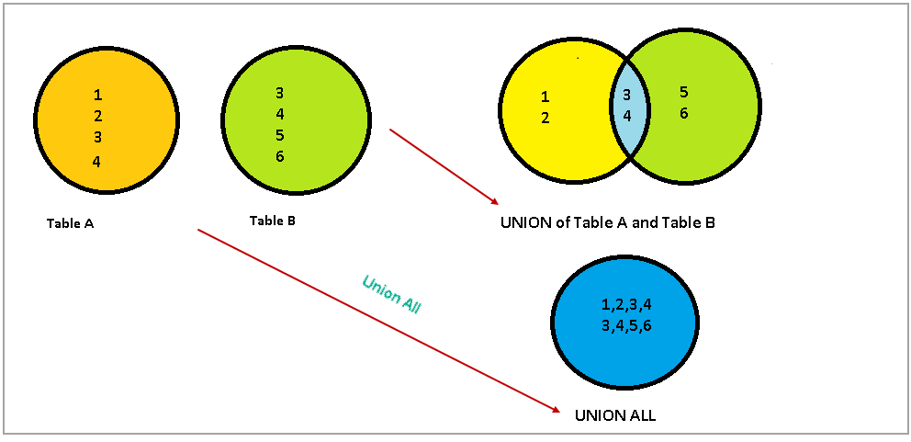
Union
Source: Sqlshack

Slide 14
Demo
SQL Union

Slide 15
SQL Arithmetic Operators
Operator | Description
+ | Add
- | Subtract
* | Multiply
/ | Divide
% | Modulo

Slide 16
SQL Comparison Operators
Operator | Description
(=) | Equal to
> | Greater than
< | Less than
>= | Greater than or equal to
<= | Less than or equal to
<> | Not equal to

Slide 17
SQL Bitwise Operators
Operator | Description
& | Bitwise AND
| | Bitwise OR
^ | Bitwise exclusive OR

Slide 18
SQL Logical Operators
Operator | Description
ALL | TRUE if all of the subquery values meet the condition
AND | TRUE if all of the subquery values meet the conditions separated by AND is TRUE
ANY | TRUE if any of the subquery values meet the condition
BETWEEN | TRUE if the operand is within the range of comparisons
EXISTS | TRUE if subquery returns one or more records
IN | TRUE if the operand is equal to one of a list of expressions
LIKE | TRUE id the operand matches a pattern
NOT | Displays a record if the condition(s) is NOT TRUE
OR | TRUE if ant of the conditions separated by OR is TRUE
SOME | TRUE if any of the subquery values meet the condition

Slide 19
Demo
SQL Operators

Slide 20
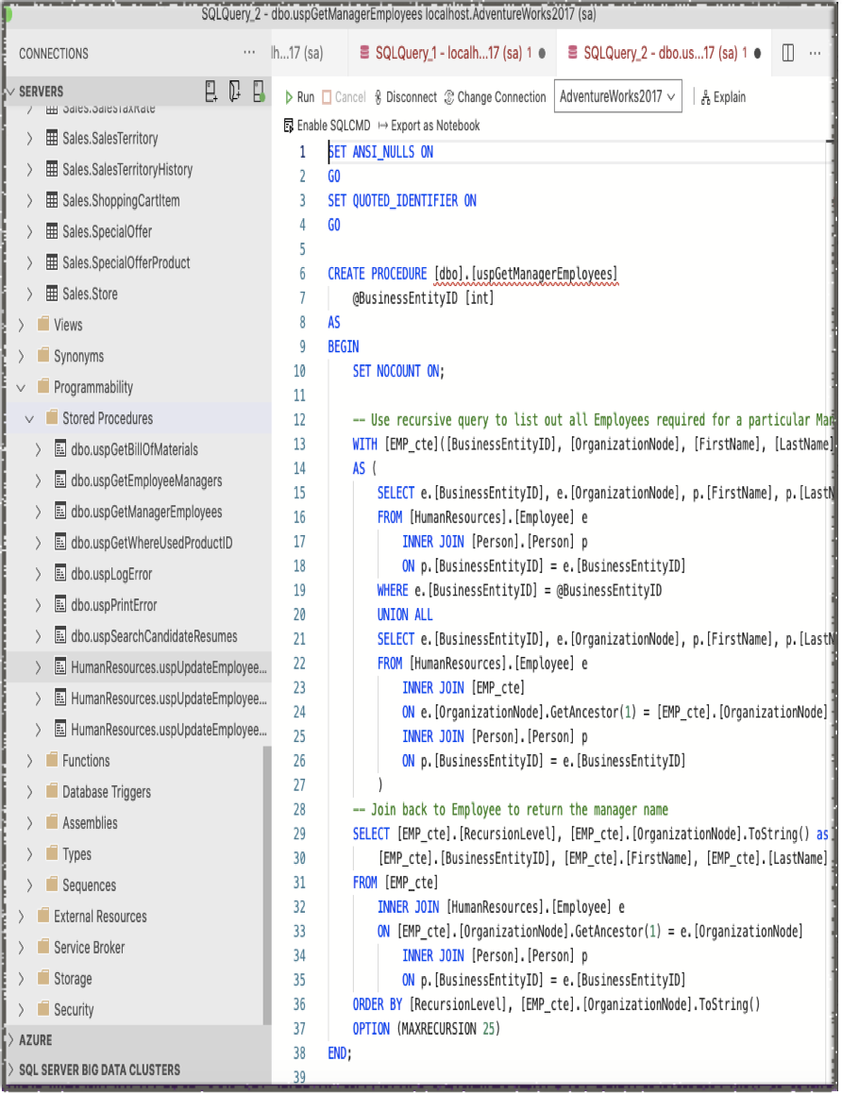
Stored Procedures
A Stored procedure is a group of SQL statements that has been created and stored in the database.
It will accept input parameters so that a single procedure can be used over the network by several clients using different input data.
It will reduce network traffic and increase the performance.
If we modify a stored procedure all the clients will get the updated stored procedure

Slide 21
Advantages of using Stored Procedures
Enables modular programming
Allows faster execution
Reduce network traffic
Provides better security to your data

Slide 22
Demo
Stored Procedure

Slide 23
SQL Server String Functions
CONCAT
CONCAT_WS
FORMAT
LEFT
LEN
LOWER
LTRIM
RIGHT
RTRIM
SUBSTRING
TRIM
UPPER

Slide 24
Demo
String Functions

Slide 25
SQL Server Numeric Functions
MAX
MIN
ROUND
SUM
ABS
CEILING
AVG
COUNT
FLOOR
LOG
PI
ROUND
SQAURE
SQRT
SIN
TAN

Slide 26
Demo
Numeric Functions

Slide 27
SQL Server Date Functions
CURRENT_TIMESTAMP
DATEADD
DATEDIFF
DATEFROMPARTS
DATEPART
DAY
GETDATE
GETUTCDATE
ISDATE
MONTH
SYSDATETIME
YEAR

Slide 28
Demo
Date Functions

Slide 29
Other Important Functions
CAST
COALESCE
CONVERT
CURRENT_USER
ISNULL
ISNUMERIC
NULLIF
SESSION_USER
SYSTEM_USER
USER_NAME

Slide 30
Demo
Other SQL Server Functions

Slide 31
SQL Database Concepts
Create DB - used to create new SQL Database
Drop DB - used to drop SQL Database
Backup DB - used to create a full back up of an existing SQL Database
Create Table - used to create new table
Drop Table - used to drop table
Alter Table - used to alter table
SQL Constraints - used to specify rules for data in a table
SQL Not NULL - NOT NULL constrain enforces a column to NOT accept NULL values
SQL Unique - ensures all values in this column are unique
SQL Primary Key - this constraint uniquely identified each record in a table
SQL Foreign Key - this is a field or a collection of field in one table, that refers to the primary key in another table. The table with Foreign key is referenced as a child table while the one with primary key is called parent table.
SQL Check - this constraint is used to limit the value range that can be used to be placed in a column
SQL Default - this constraint is used to set a default value for a column
SQL Index - is used to create indexes in tables
SQL Auto Increment - this allows a unique number to be generated automatically when a new record is inserted into a table
SQL View - view is a virtual table based on the result set of a SQL statement
SQL Injection - SQL injection usually occurs when you ask a user to input their username, pwd but instead they give you a SQL statement that will run on your database and can potentially be malicious

Slide 32
Important Concepts for Interview
Conditional Selects
SQL Windows Functions
Removing Duplicates
Case statement
SQL Joins
Select Distinct Statement
Union and Union All
SQL Aggregate Functions

Slide 33
Conditional Selects
Fetching data that satisfies given condition.
Can use WHERE or HAVING to achieve this.
Example1: SELECT BusinessEntityID, JobTitle, LoginID FROM HumanResources.Employee WHERE JobTitle = 'Research and Development Engineer';
Example2: SELECT SUM(LineTotal) AS SumOfLineTotal, SalesOrderID FROM Sales.SalesOrderDetail GROUP BY SalesOrderID HAVING SUM(LineTotal) > 1000;
Having cannot be used as a where clause, it can only supplement.

Slide 34
SQL Window Functions
SQL Window function performs a calculation across a set of tables rows that are somehow related to the current row.
Example: SELECT FirstName, LastName, e.JobTitle, HireDate, COUNT(*) OVER(PARTITION BY JobTitle) AS CountOfTitle FROM HumanResources.Employee AS e INNER JOIN Person.Person AS p ON e.BusinessEntityID = p.BusinessEntityID

Slide 35
Removing Duplicates
How to eliminate duplicate records can come in handy.
One way is to identify using a unique identifier like ROWID and delete the duplicate ones.

Slide 36
Case Statement
This is excel equivalent of IF-THEN.
Example: SELECT BusinessEntityID, CASE BusinessEntityID WHEN 0 THEN 'Even' ELSE 'Odd' END FROM HumanResources.Employee;

Slide 37
SQL Joins
Joins help us get data from multiple tables and combine them.
This can be achieved based on a certain condition or some common column.
Self Joins are significant for example to find out a list of employees and their managers if given an employee table.

Slide 38
SELECT DISTINCT Statement
The SELECT DISTINCT statement can be useful when we want to return a unique value and ignore duplicates.

Slide 39
Union and Union all
Union would combine result set of two queries given they have the same number of columns, similar datatype and are in the same order.
Union All is same but it will include the duplicates unlike Union.

Slide 40
SQL Aggregate Functions
These functions aggregate over a column and return a single value.
Example: AVG(), COUNT(), MAX(), MIN() and SUM().
These can quite useful to gather basic statistics.

Slide 41
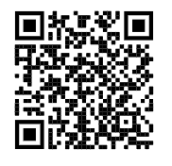
Github Repository

Slide 42

Got Questions?
Ask here or Reach out
Website: manvimadan.com
LinkedIn: nz.linkedin.com/in/manvimadan
Twitter: twitter.com/manvimadandotai
IG: instagram.com/manvimadan.ai/

