Slide 1




Slide 2
RSM CASE STUDY
Team 9
Manvi Mehta
Huyen Tran
Sarika Francis
Yamini Veepuri

Slide 3
Case Goal
Identify 3 locations to hold the conference with the goals of optimizing the quantitative resource while considering the qualitative aspects.

Slide 4
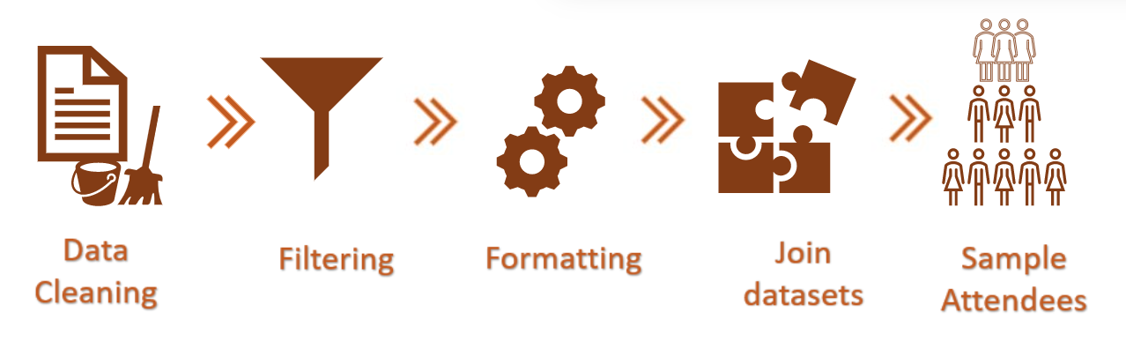
Process Flow

Slide 5
DECIDING
FACTORS
Travel time
Revenue Lost
Attendance
Expenses
Location

Slide 6
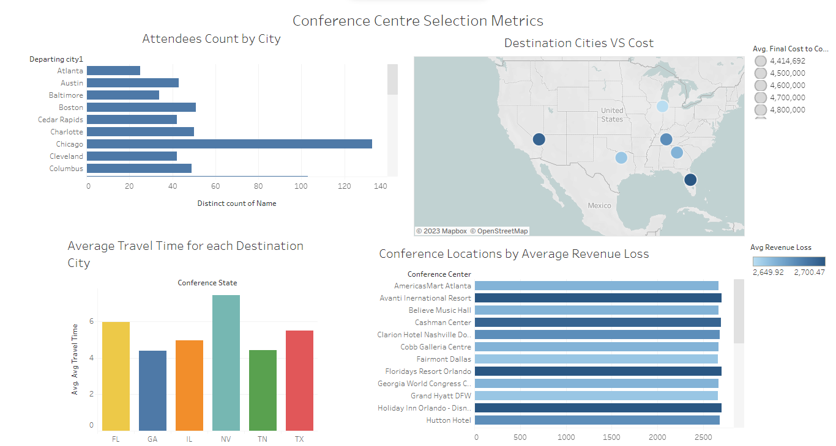
Visualizations
Tableau Dashboard
Notes:
https://public.tableau.com/app/profile/manvi.mehta/viz/Dashboard_16761376585900/Dashboard1?publish=yes

Slide 7
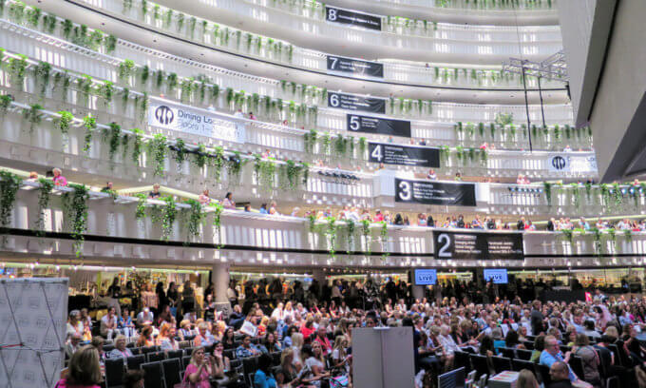



Recommendation #1
AmericasMart Atlanta
4.73M 1496 4.4hrs
State of the art architecture
Unlimited dining/entertainment activities
Local Attractions

Slide 8
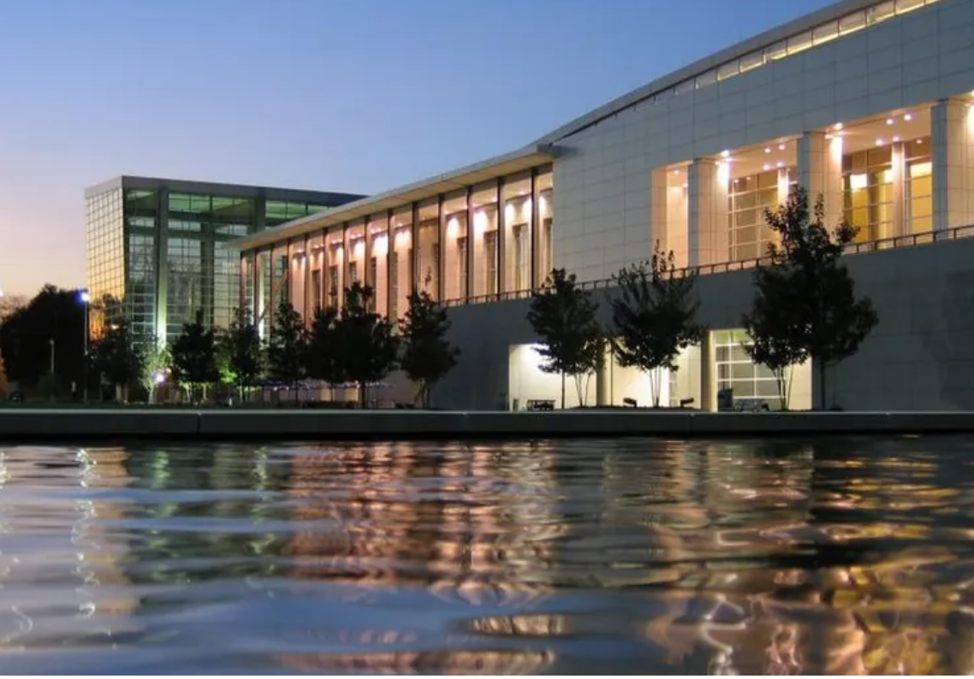
Recommendation #2
Georgia World Congress Center
4.79M 1496 4.4hrs
Heart of downtown
Recreational Activities
Accessibility

Slide 9
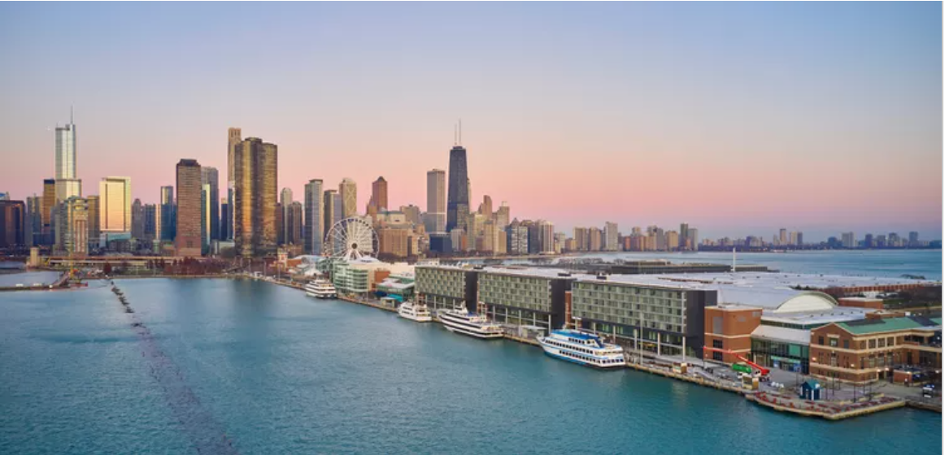
Recommendation #3
Navy Pier Hall Complex
4.43M 1382 4.9hrs
Location
Attractions
Accessibility
Notes:
Location: navy pier
cost (generally in the low average cost)
Plenty of parking
30’ from airport
Close to the loop (more activities after the conference)
Choose this over morgan mfg is because of the view

Slide 10
Thank You!
Notes:
https://public.tableau.com/app/profile/manvi.mehta/viz/Dashboard_16761376585900/Dashboard1?publish=yes

