Slide 1
Instructions keypress list
Instruction image | Keypress to wait for
instr_01.png | Space
instr_02.png | G
instr_03.png | Space
instr_04.png | Space
instr_05.png | Space
instr_06.png | Wait 3s and move to next image
instr_07.png | Right arrow
instr_08.png | Wait 3s and move to next image
instr_09.png | Space
instr_10.png | Wait 3s and move to next image
instr_11.png | Down arrow
instr_12.png | Wait 3s and move to next image
instr_13.png | Space
instr_14.png | Space
instr_15.png | Space
instr_16.png | R
instr_17.png | Space
instr_18.png | 2
instr_19.png | Space
instr_20.png | Space
instr_21.png | Space
instr_22.png | Space
instr_23.png | Space

Slide 2
Trial list
There are 10 versions of the trial lists, to counterbalance some task parameters across subjects.
Idea is to run a different version for either each batch of participants on Mturk, or for each participants (based on the last digit of their ID or on a random number generator from 1 to 10).
Start EACH trial by a 3-second fixation cross (white +, font ~50), displayed in the center of the screen.
Then each trial is one of two types: observe or play, according to trType column of the trial list csv file.
The dimensions (in pixels) provided in this powerpoint assume a screen that’s at least 1000 (w) * 800 (h) pixels. If the actual dimensions are bigger, that’s fine, but if the actual dimensions of the screen as smaller, the provided dimensions may need to be scaled down.

Slide 3
Details of an OBSERVE trial
In the trial_list csv file, if trType = 1, then we have an observe trial
Start the trial with the word ‘Observe’ (font~40) shown on screen for 1 second, as below.
The word to display is in the trTypeText column of the csv file
Observe

Slide 4
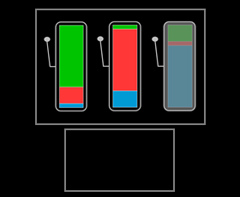
Details of an OBSERVE trial
Then draw 2 light gray boxes as well as the slot machines for 2 seconds
Top box: 700 (w) * 400 (h) pixels , x=0 (centered), y=130
Bottom box: 303 (w) * 230 (h) pixels, x=0 (centered), y=-230
Path for each slot machine image is in csv file:
leftImPath: 161 (w) * 334 (h) pixels, x=-250, y=120
midImPath: 161 (w) * 334 (h) pixels, x=0, y=120
rightImPath: 161 (w) * 334 (h) pixels, x=250, y=120

Slide 5
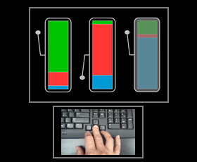
Details of an OBSERVE trial
Then keep showing the slot machines and play the video in the bottom box. The path to the video file is specified in the videoPath column of the csv file.
Dimension of the video: 293 (w) * 220 (h) pixels
Position: x=0 (centered), y=-230

Slide 6
Details of an OBSERVE trial
1.1 seconds after the start of the video, replace the chosen slot machine by the same file with the lever towards the bottom.
For example, if middle action (corrAct=2 in csv file) is chosen, like below, replace image from midImPath by changing ‘a’ to ‘p’ in file name
E.g. replace ‘stimuli/R1_lbu_a.png’ by ‘stimuli/R1_lbu_p.png’
Keep this on screen until the end of the video.

Slide 7
Details of an OBSERVE trial
That’s the end of an observe trial
Display fixation cross for 3 seconds before start of next trial

Slide 8
Details of a PLAY trial
In the trial_list csv file, if trType = 2, then we have a play trial
Start the trial with the word ‘Play’ (font~40) shown on screen for 1 second, as below.
The word to display is in the trTypeText column of the csv file
Play

Slide 9
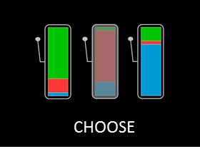
Details of a PLAY trial
Then show the 3 slot machine as well as the word ‘CHOOSE’ (font ~40)
Path for each slot machine image is in csv file:
leftImPath: 161 (w) * 334 (h) pixels, x=-250, y=0
midImPath: 161 (w) * 334 (h) pixels, x=0, y=0
rightImPath: 161 (w) * 334 (h) pixels, x=250, y=0
Position of the word ‘CHOOSE’: x=0, y=-300
Wait for key press (list of 2 available keys determined by column avKeys of csv file) for a maximum of 4 seconds.

Slide 10
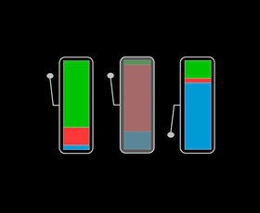
Details of a PLAY trial
If one of the two key pressed from avKeys was recorded, show feedback screen (lever of the chosen slot machine down) for 0.5 seconds.
For example, if right action (keypress = right arrow) is chosen by the participant, like below, replace image from rightImPath by changing ‘a’ to ‘p’ in file name
E.g. replace ‘stimuli/B1_lbu_a.png’ by ‘stimuli/B1_lbu_p.png’

Slide 11

Details of a PLAY trial
Then show token corresponding to chosen action: path for token image determined by ‘tokenIfLeft’, ‘tokenIfMid’ and ‘tokenIfRight’ columns of the csv file, for left, middle and right choices, respectively.
Token image is shown centered (x=0, y=0), dimensions 120*120 pixels, for 2 seconds.

Slide 12
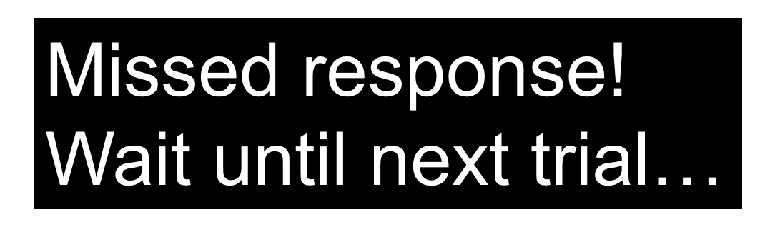
Details of a PLAY trial
If no key press is recorded within the 4-second time limit (when the slot machines and the word ‘CHOOSE’ are on the screen), show the ‘missed_pic.png’ image (in the stimuli folder) in the center of the screen for 2.5 seconds.

Slide 13
Details of an PLAY trial
That’s the end of a play trial
Display fixation cross for 3 seconds before start of next trial

Slide 14
Data that need to be recorded
See remaining columns (with NaNs) of the csv file:
Choice (only on play trials): either ‘left’, ‘middle’, or ‘right’ (or leave a NaN if missed)
ChoiceRT (in seconds or ms, only on play trials): time difference between onset of CHOOSE screen and button press
isCorr (only on play trials): equals one if choice == corrResp column, 0 if different choice, NaN if no choice
tokenShown (only on play trials): which token was shown: 1 for green, 2 for red, 3 for blue
outcome (only on play trials): if tokenShown == goalToken column, then outcome = 10 points (!! Number of points per correct outcome may need to be changed…. !!), 0 otherwise
miss (only on play trials): equals 1 if trial was missed
tFixOn, tTrTypeOn, tSMOn, tVidOn, tResp, tChFbOn, tTokOn, tMissOn are the onsets (in seconds or ms) relative to the beginning of the task (i.e. the onset of the first fixation cross) of the fixation cross, the trial type (‘Observe’ vs ‘Play’ onset), the slot machine, the video (only on observe trials), the choice (only on play trials), the choice feedback (only on play trials), the token (only on play trials), and the missed text (only on missed trials).

Slide 15
Break
At the end of block 1 (runNb=1 and trialNb=42), display a break screen saying:
“End of block 1/2. Please take a short break and press space when you are ready to start block 2”
Wait for a space press and continue looping through the trials.

Slide 16
End of the task
Display thank you message
Depending on what Jeff does on his tasks, show the subject how many points they won (by summing over the ‘outcome’ column).

