Slide 1
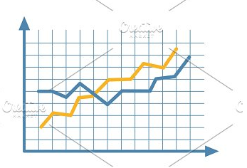
Forecasting Suicides using Historical Data
ALY6015- Second Quarter, Term A, Dr. Matthew Goodwin
Analysis Report of Final Capstone Project
Assignment Completion Date: 02/16/19
Manvinder Kaur [NUID: 001402192]
Ai Uyen Thi Huynh [NUID: 001406618]
Silicon Valley, Northeastern University, CA.

Slide 2

Introducing Dataset:
Suicide Rates Over 1985 to 2016
The Dataset contains number of suicides in different countries over 1985 to 2016. It covers data for 101 countries in the form of categorical fields and continuous numerical fields
Categorical Data :
Age
Gender
Generation
Numerical Data :
Number of suicide
Suicide Rate
Population
GDP for year
GDP per capita

Slide 3

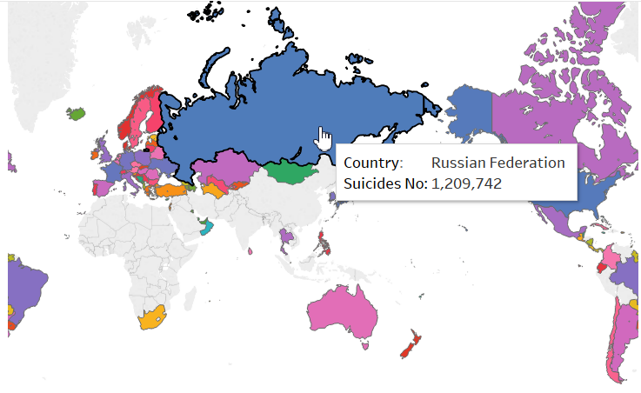
Research Questions
Forecasting the number of suicides in year 2019.
Country with maximum number of suicides in 2019.
– Currently its Russia
Visualization done in Tableau

Slide 4

Model Implemented
Methods/Models tried and implemented
✓: We developed the R-code to find top 10 countries with highest suicide over the period of time.
✓: We answered questions like “ The female commit more suicide or the males and visualize it for all the age groups“ using the graphical representations.
✓: We conducted an experiment to finding the suicide rate and number of suicides among different age groups.
✓: We worked on finding the correlation of suicide with all the “dimensions“
✓: “We answered question by preforming “Time series using ARIMA prediction model“ and preforming “Linear regression model” for better results.

Slide 5
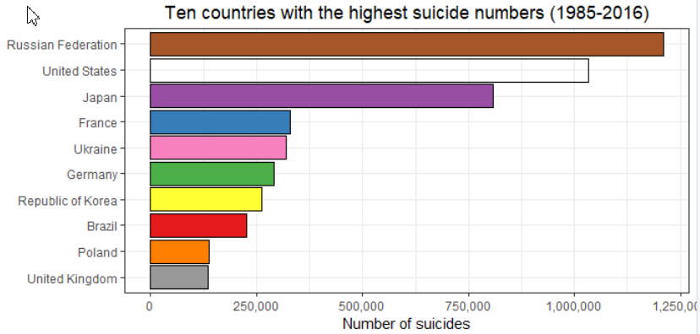
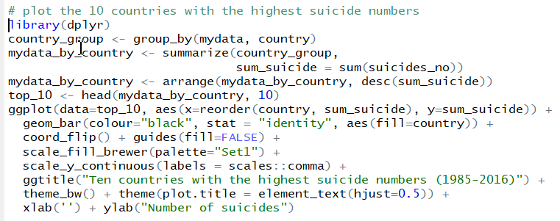
Top Ten countries with highest suicide number
Inference:
We can see from this graph that Russia has the highest number of deaths by suicide, following by United States and Japan – the top three countries dominate the list, accounting for 64% of the total number of the top 10.

Slide 6
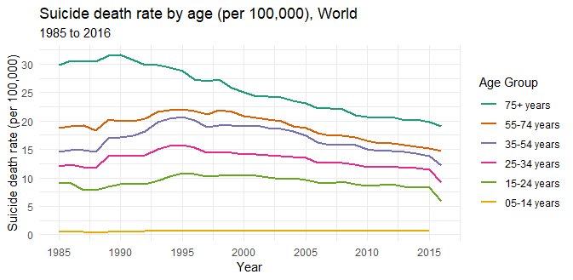
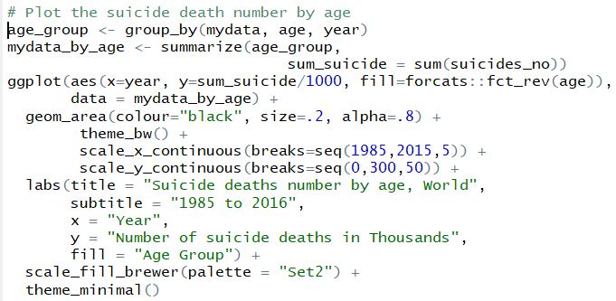
Top Ten countries with highest suicide number
Inference:
There is an overall decline in suicide rates (measured per 100,000 people) across various age categories. The oldest age group had decreasing rates since 1990, while the younger ones saw the decreasing trend 10 years later, since 2000.

Slide 7
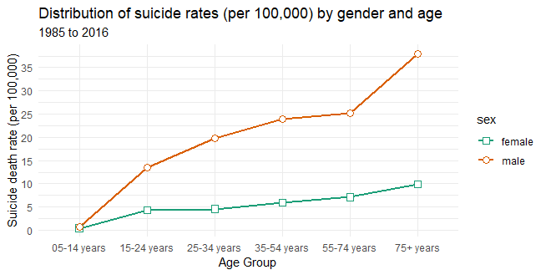
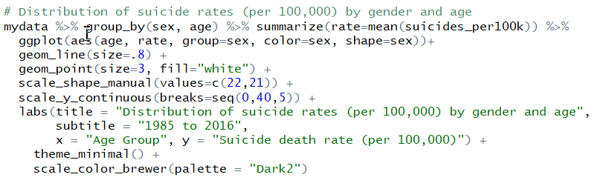
Top Ten countries with highest suicide number
Inference:
The gap between male and female rate for suicide is also different and not constant by age. There is almost no difference in the youngest group (05-14 years old), then the difference is getting bigger when the age increases, and it is biggest in the eldest group (> 75 years old) and middle-age group (55-74 years old

Slide 8
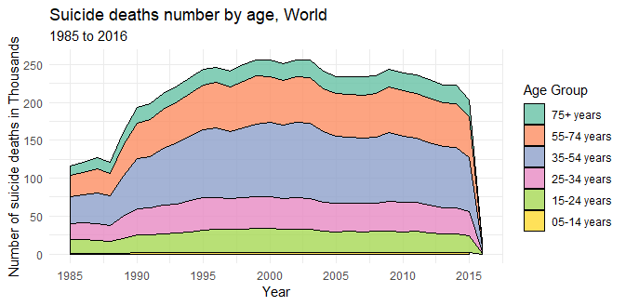
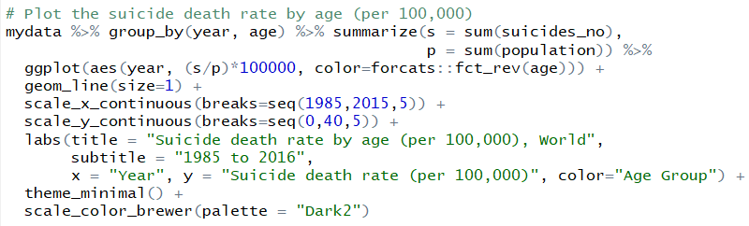
Top Ten countries with highest suicide number
Inference:
The 35-54 year old group takes up the largest share of number of suicide deaths, roughly 36.3% of deaths. The younger groups, aged 15-34, are at lower risks of taking their own lives, with 28.6%. As age increases (55 and above), the number of suicides decrease.

Slide 9
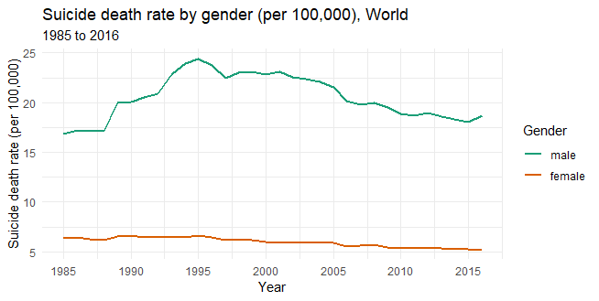
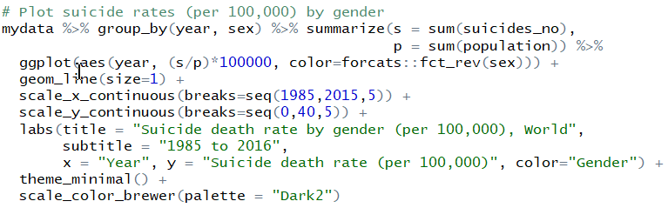
Top Ten countries with highest suicide number
Inference:
There is a big gap in suicide rate between male and female. We can see that male suicide rate is more than 3 times higher than rate for female. Both rates for male and female are seeing the declining trends over years.

Slide 10
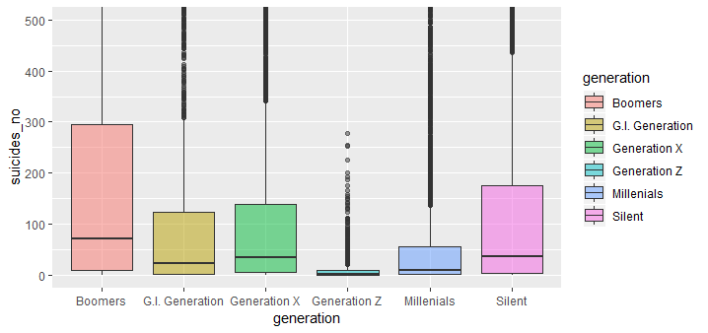
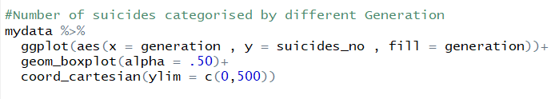
Top Ten countries with highest suicide number
Inference:
Looking at the box plot, we see that baby boomer generation has the highest rate of suicide (34%) compare to 26% of silent generation and 23% of generation X. Generation Z holds the lowest share, with only 0.24%.

Slide 11
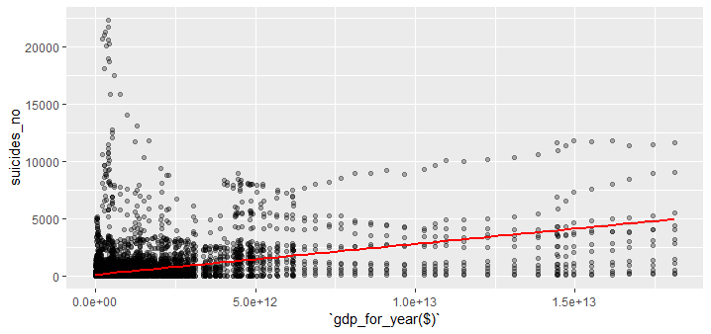
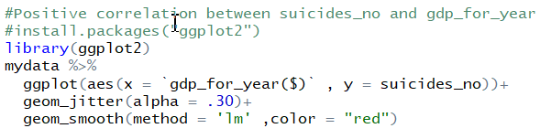
Top Ten countries with highest suicide number
Inference:
Looking at the graph we see a positive correlation between number of suicides and GDP for year, effect size on the correlation is -0.4335046. It's considering to be small effect size. Therefore, we can firmly say that there is slightly positive correlation and yet significant between suicides_no and gdp_for_year.

Slide 12
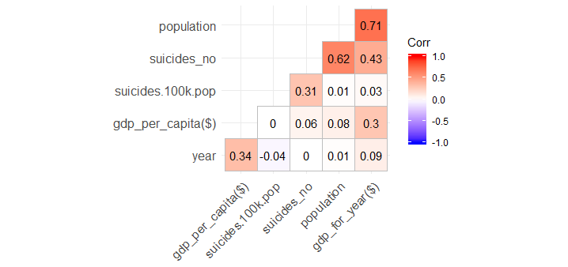
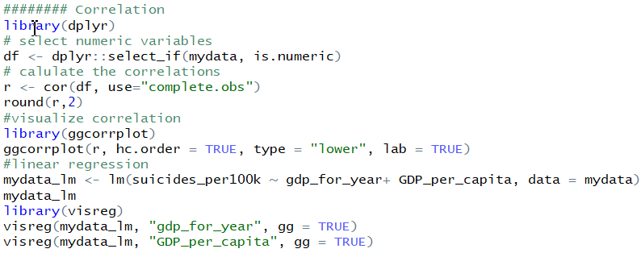
Top Ten countries with highest suicide number
Inference:
We want to understand if there is a correlation between suicide and GDP of a country. However, we found a weak positive association between suicide number and GDP for year, 0.43, which is very close to 0, so we cannot say anything about this relation. Other variables, such as population or year, do not reasonably associated with the decrease or increase in rate of suicide.

Slide 13
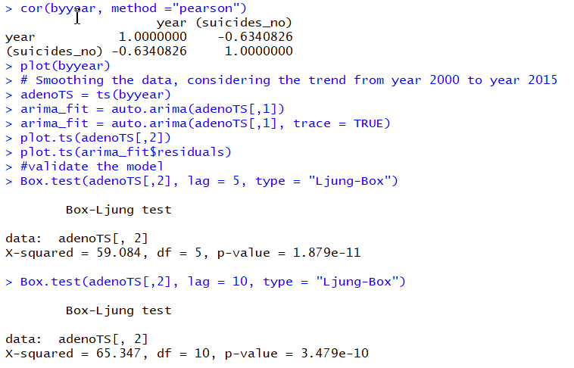
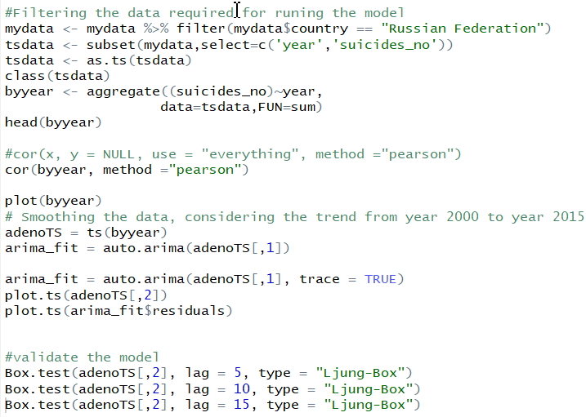
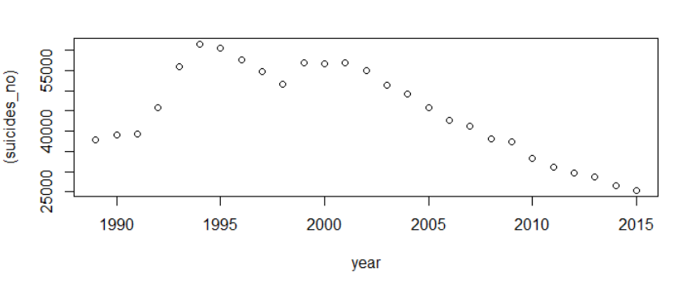
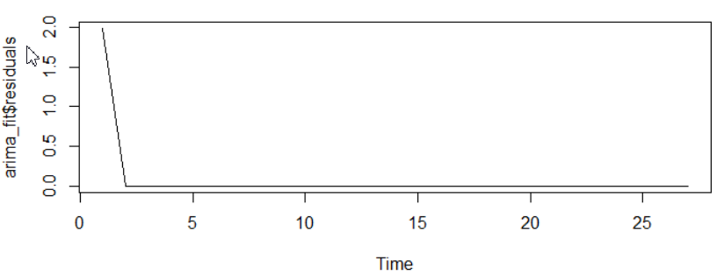
R-code and console out-put: The model is run on the Country with highest suicides i.e. Russian Federation
Results- Time series ARIMA

Slide 14
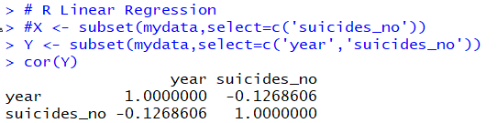
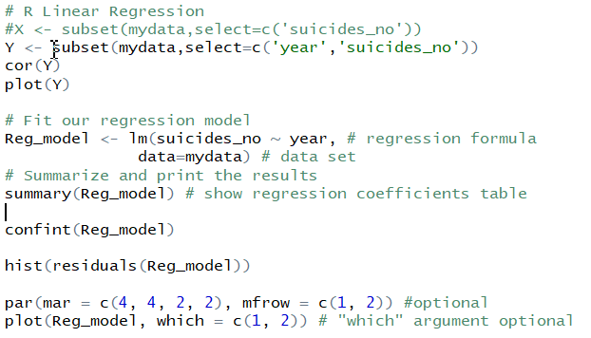
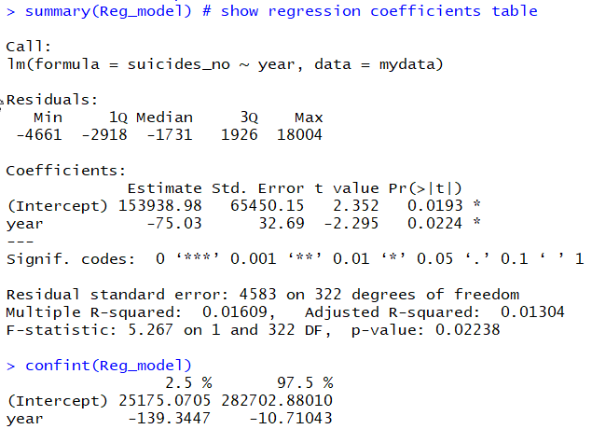
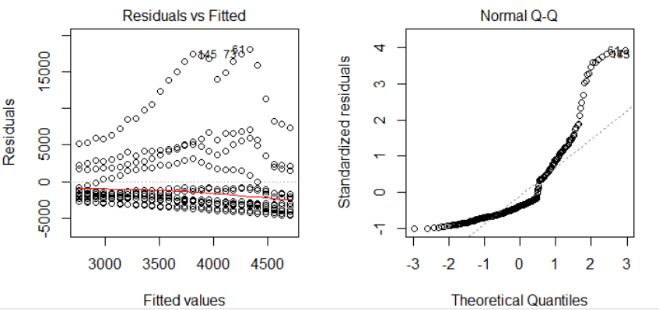
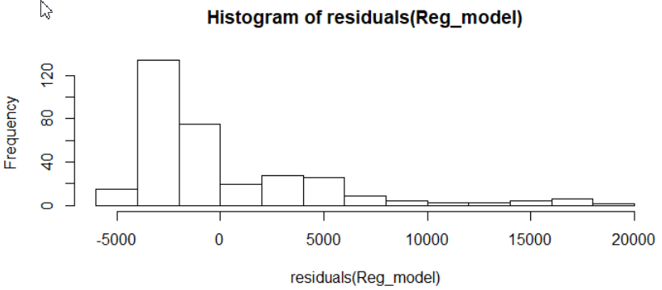
Results- Linear Regression
R-code and console out-put

Slide 15

Results
Time series model: ARIMA Model include “Running the model, validating and predicting the model”
Not ideal: The data set don’t have enough frequency data
The suicide number has started to decrease from year 2000 and it is projected that the number will further fall. As the correlation coefficient in negative for number of suicides.
Regression model: Linear regression Model include “Running the model, validating and predicting the model”
Ideal: The data set has the linear decreasing trend

Slide 16
Reference Page
Kan Nishida (2016). Filtering Data with dplyr. Medium blog. Retrieved from https://blog.exploratory.io/filter-data-with-dplyr-76cf5f1a258e
Lindsay Lee, Max Roser and Esteban Ortiz-Ospina (2016). Suicide. Our World in Data. Retrieved from https://ourworldindata.org/suicide
RDocumentation. Correlation, Variance and Covariance (Matrices). Retrieved from https://www.rdocumentation.org/packages/stats/versions/3.5.2/topics/cor
World Bank Dataset. Suicide Rates Overview 1985 to 2016. Kaggle. Retrieved from https://www.kaggle.com/russellyates88/suicide-rates-overview-1985-to-2016
Notes:
This slide explains the format and purpose of a references page.
The facilitator may stress that each source referenced within the paper should also appear on the reference page, which appears at the end of the paper.
To create a references page,
center the heading—References—at the top of the page;
double-space reference entries;
flush left the first line of the entry and indent subsequent lines. To use “hanging” feature of “Indent and Space” tab, go to “Paragraph” →”Indentation” →choose “Hanging” in the ”Special” box.
Order entries alphabetically by the author’s surnames. If a source is anonymous, use its title as an author’s surname.
Note: Unlike MLA, APA is only interested in what they call “recoverable data”—that is, data which other people can find. For example, personal communications such as letters, memos, emails, interviews, and telephone conversations should not be included in the reference list since they are not recoverable by other researchers.
For specific information about entries in the reference list, go to http://owl.english.purdue.edu/owl/resource/560/05

Slide 17
The End

