Slide 1
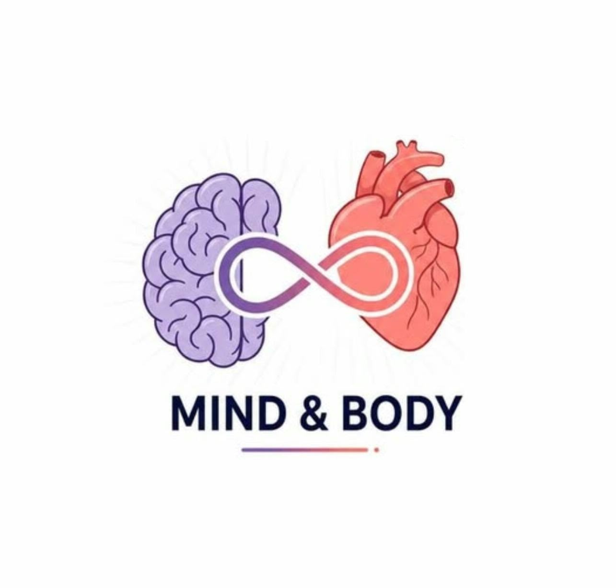
Banasthali Udgam 2026
Your Mind • Your Body • Your Pattern
Team Name: ManKush
Team Members: Khushi Sharma
                Manvi Rajput
Institution: Banasthali Vidyapith
Problem Track: Accessible Health &
                Wellness
Track → Discover → Act → Learn

Slide 2
Problem Statement
HOW DOES MENTAL HEALTH AFFECT PHYSICAL HEALTH — AND CAN WE IDENTIFY THESE CONNECTIONS EARLY?
Wellness signals are often tracked separately, making important relationships between mental and physical health difficult to notice.
Population averages don’t reflect individual patterns, because what is “normal” for one person may be different for another.
Mental and physical health influence each other — changes in stress, mood, sleep, activity, and other wellness signals may be connected to physical changes.
Early warning patterns can easily go unnoticed, especially when changes are gradual rather than sudden.
People need simple, personalized, and explainable insights, not complex dashboards or medical diagnoses.
Manual tracking becomes overwhelming when users have to continuously log every health and lifestyle variable.
The real challenge is turning scattered wellness data into meaningful patterns that help individuals better understand their own well-being.

Slide 3
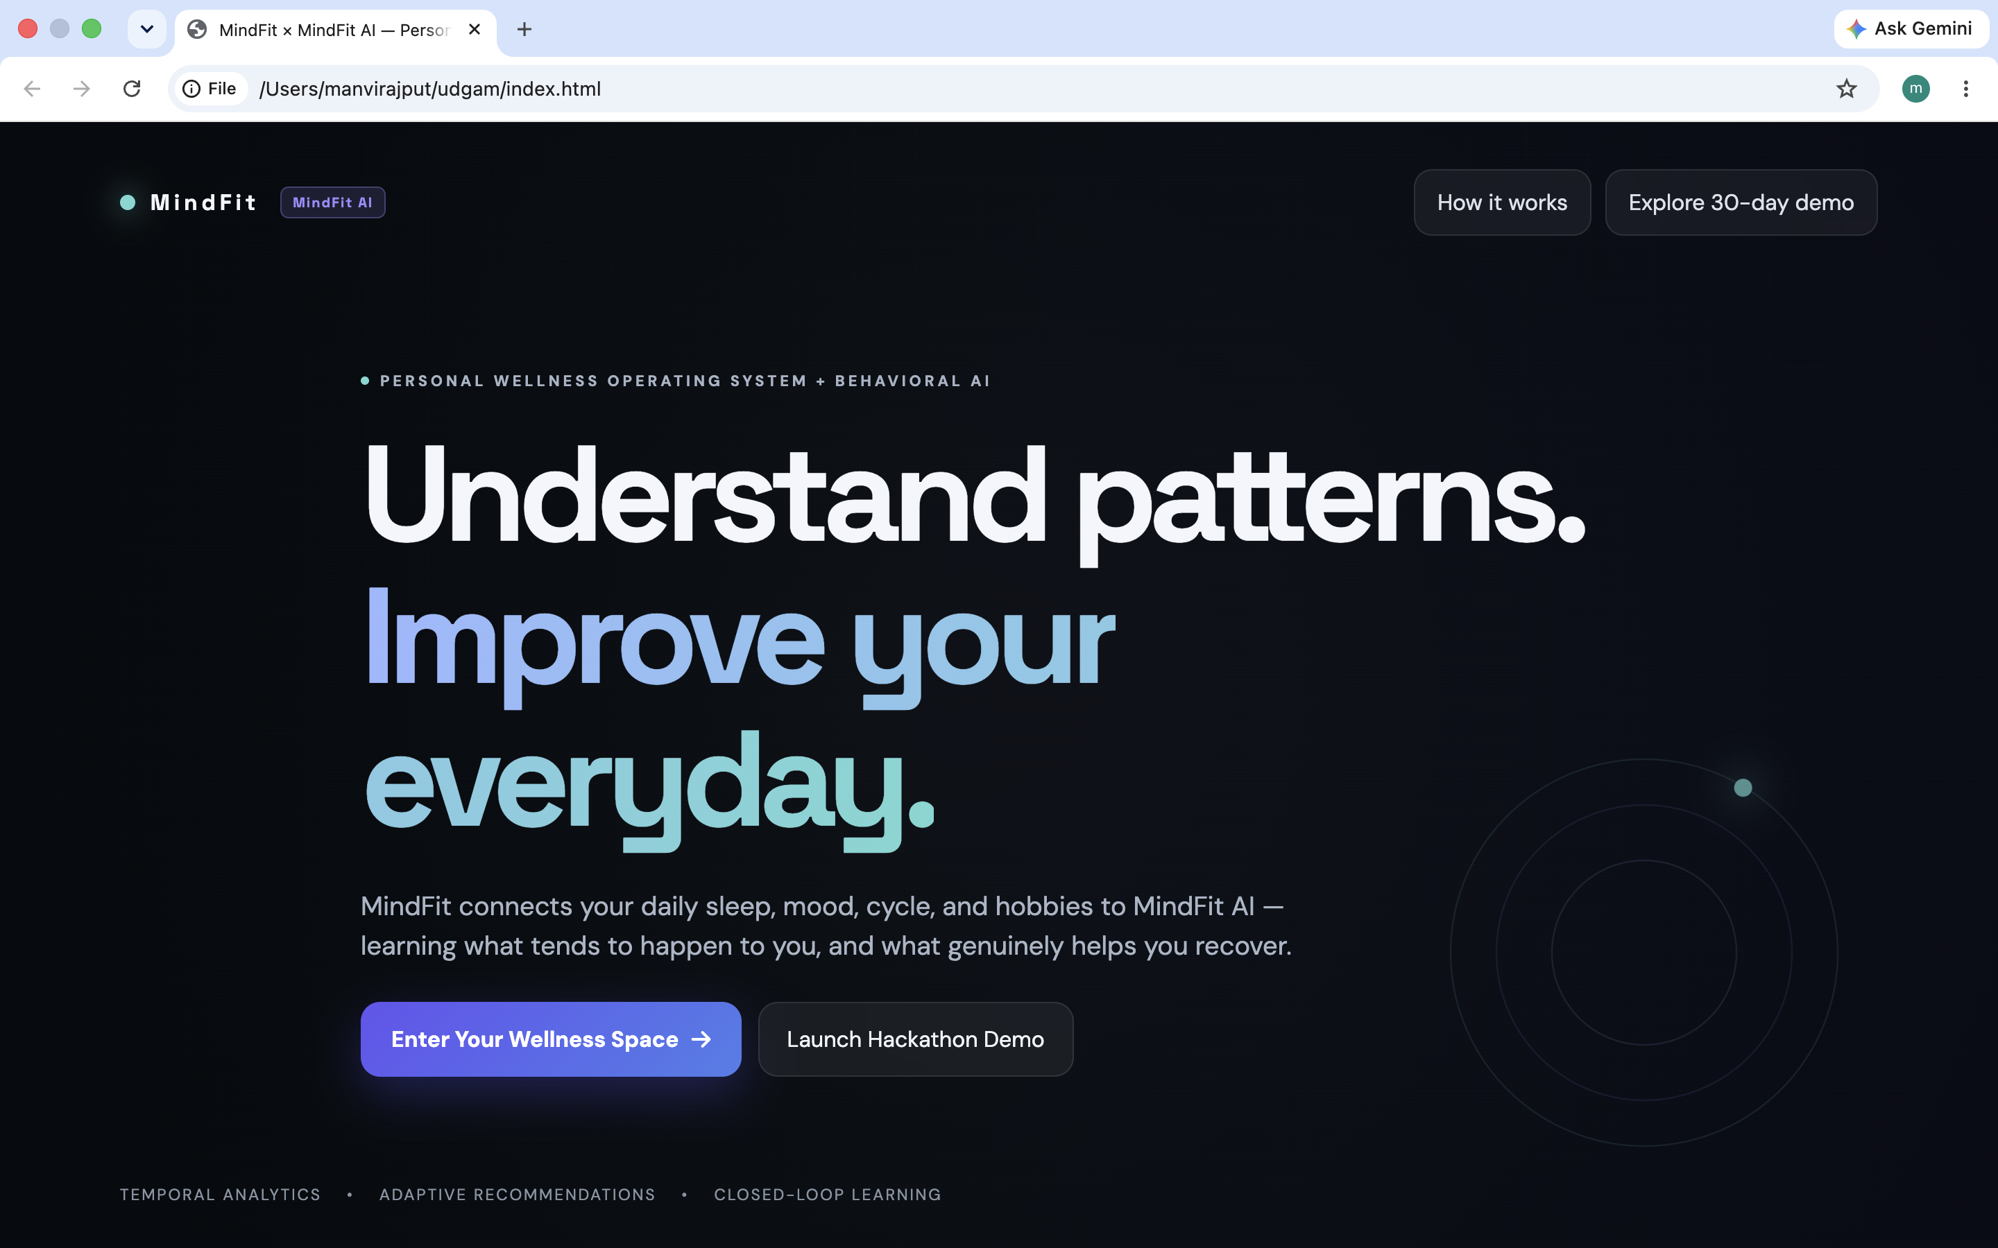
Our Solution
User Impact
It understands the connection between their daily habits, mental wellbeing, and menstrual health.
It continuously analyzes the user’s:
Sleep • Stress • Mood • Energy • Symptoms • Menstrual Cycle
and uses their own historical data to build a personal baseline, identify meaningful patterns, and provide clear, personalized recommendations.
Instead of simply showing raw health data, MindFit answers:
“What is changing in my body and routine, and what patterns can I learn from it?”
Track → Learn → Detect Patterns → Understand → Take Action

Slide 4
Innovation & USP
Your baseline. Your patterns. Your recommendations.
PERSONAL BASELINE
PATTERNS DISCOVERY
Sleep ↔ Stress
Stress ↔ Physical symptoms
Activity ↔ Energy
Cycle ↔ Symptoms.
Learns what is "normal" for each user
Compares current health against their own history
PERSONALIZED ACTIONS
MENSTRUAL CONTEXT
Sleep improvement
Regular meals/hydration
Physical activity
Recreation & hobbies
Stress-management activities.
Cycle logging adds context without requiring wearables or expensive devices.
Personalized • Explainable • Lightweight • No wearable dependency

Slide 5
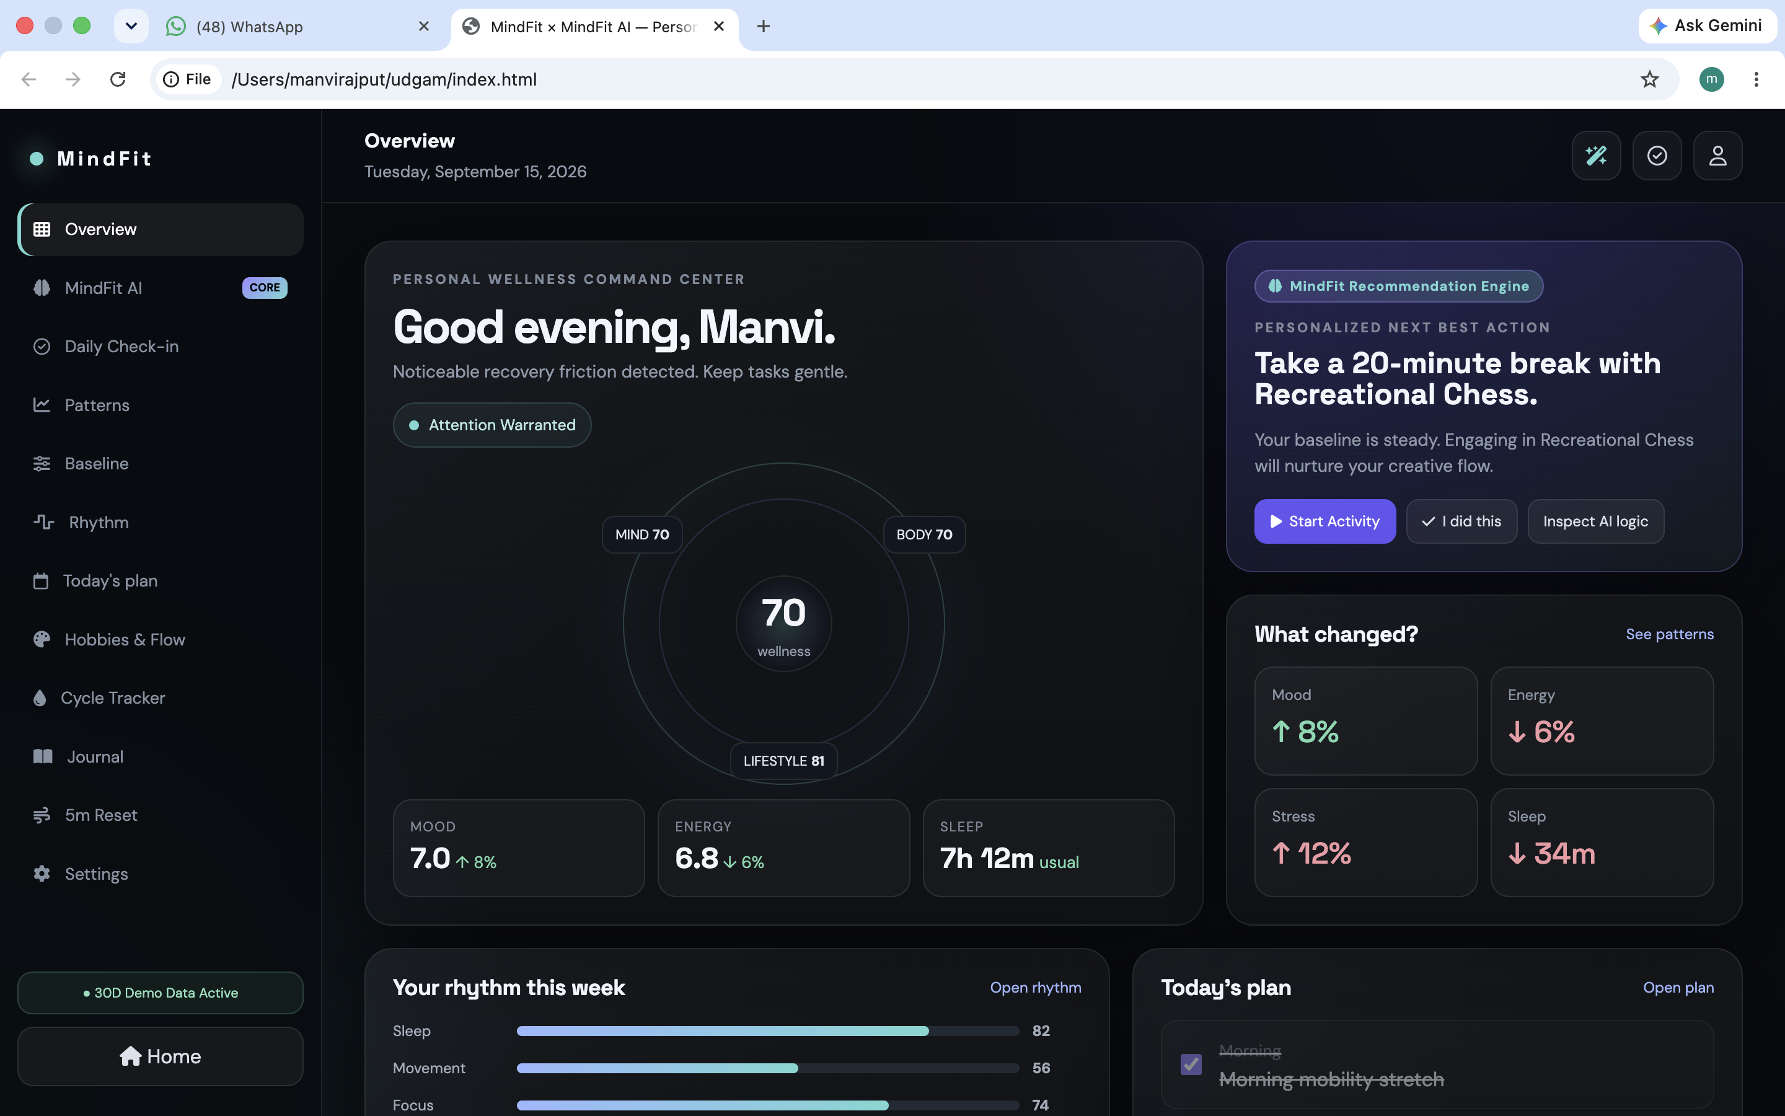
How It Works
Process Flow
1
Authenticate / open dashboard
↓
2
Log daily signals + cycle
↓
3
Update personal baseline
↓
4
Detect patterns & lagged relationships
↓
5
Generate insight + recommendation
ML finds the pattern → AI explains it → User chooses the action
4

Slide 6
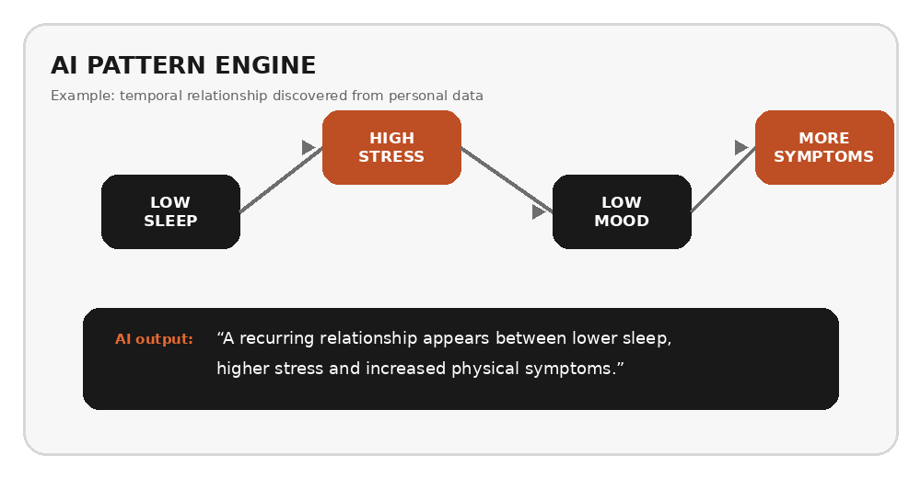
Technology & AI
Technology Stack
Frontend
HTML • CSS • JavaScript
Visualization
Chart.js
UI
Font Awesome • Goggle Fonts
Future Scope :
5
Important: correlation is presented as a pattern, never as causation or diagnosis.
Flask • SQLite • Pandas • NumPy
5
4

Slide 7
Impact & Feasibility
USER IMPACT
INNOVATION
FEASIBILITY
• Turns scattered symptoms into a readable personal story.
• Encourages self-awareness and healthier next choices.
• Reduces tracking burden with a lightweight daily check-in.
• Provides menstrual-health context when enabled.
• Personal baseline instead of generic averages.
• Temporal / lagged relationship detection.
• Recommendation loop learns what helps the individual.
• LLM explains structured findings instead of inventing them.
• Python + Flask + SQLite keeps MVP lightweight.
• Works without wearables or a paid data source.
• LLM can be connected later through a clean API layer.
• Modular architecture supports cloud DB, auth and integrations.
7

Slide 8
Future Roadmap & Closing
From personal tracking to a continuously learning companion.
NOW
NEXT
LATER
Optional wearable integrations
Privacy-preserving cloud sync
Clinician-shareable summaries
Personal baseline
Rule + statistical pattern engine
Cycle-aware logging
LLM-powered explanations
Better temporal models
Personal response learning
Prototype
https://manvirajput21.github.io/ManKush-MindFit/
8 / 8

