Slide 1

Recording Voice and Converting to Transcript
By
Manvi Shah 1711049
Prithvi Shah 1711051
Sidhi Shah 1711053

Slide 2
Problem Definition
Automatic Speech Recognition is a technology that helps us to transform a spoken utterance of words into a sequence of tokens(words, syllables, phenomes, characters).
Students spend a lot of time making notes for their lectures. Professionals in various areas need high-quality transcripts to perform their work-related activities and there is always a need to keep everything organised.
There is always a lookout for a good app - in one instance where we actually resort to getting someone’s to help transcribe a book's worth of lecture notes.

Slide 3
Objectives
Speech to text recognition technology is one of the fastest growing technologies.
Nowadays, students spend a lot of time making notes. Our objective is to build an android app which is capable to record the professor’s lectures in the college and store them as an audio file.
We then convert these audio files as well as any input audio lecture file into notes (or text). So students can use it to refer and revise the notes anytime later.

Slide 4
Scope
Earlier, speech-to-text used to be specifically only for desktops. The development of mobile devices and the explosion of easily accessible apps has made it easy to carry out transcription on a smartphone or tablet.
The android app can be used by the students to listen to the audio lectures as well as to refer the transcribed notes.
It can also be used by people with disability to share information with people through voice input.

Slide 5
Design & Methodology
The core of an automatic transcription service is the automatic speech recognition system which is composed of - acoustic and linguistic components.
The acoustic component is responsible of converting the audio in your file into a sequence of acoustic units
the linguistic component is responsible of converting these sequence of acoustic units into words, phrases, and paragraphs.

Slide 6
Design & Methodology
Acoustic model
Linguistic model
Converts audio into small acoustic units.
Units are matched to sounds that we use in our daily language
Converts acoustic units into words and phrases.
Analyses the relationship between words to determine which one to use.

Slide 7
Working
Speech_to_text
A library that exposes device specific speech recognition capability.This plugin contains a set of classes that make it easy to use the speech recognition capabilities of the mobile device in Flutter. It supports both Android and iOS. The target use cases for this library are commands and short phrases, not continuous spoken conversion or always on listening.
Usage
To use this plugin, add audio_recorder as a dependency in your pubspec.yaml file.
Android
Make sure you add the following permissions to your Android Manifest
<uses-permission android:name="android.permission.RECORD_AUDIO" />
<uses-permission android:name="android.permission.WRITE_EXTERNAL_STORAGE" />

Slide 8
Working
iOS Make sure you add the following key to Info.plist for iOS
<key>NSMicrophoneUsageDescription</key>
<string>Record audio for playback</string>

Slide 9
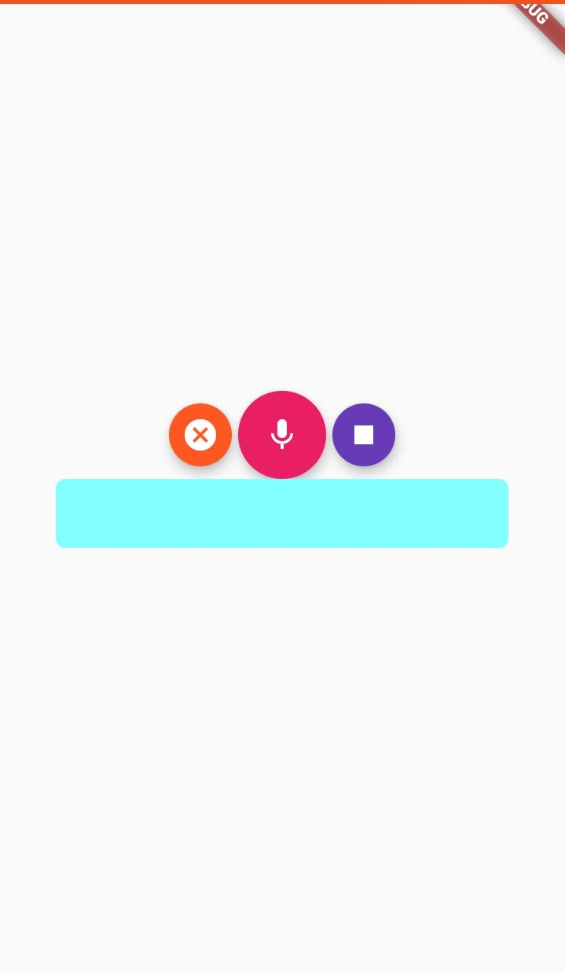
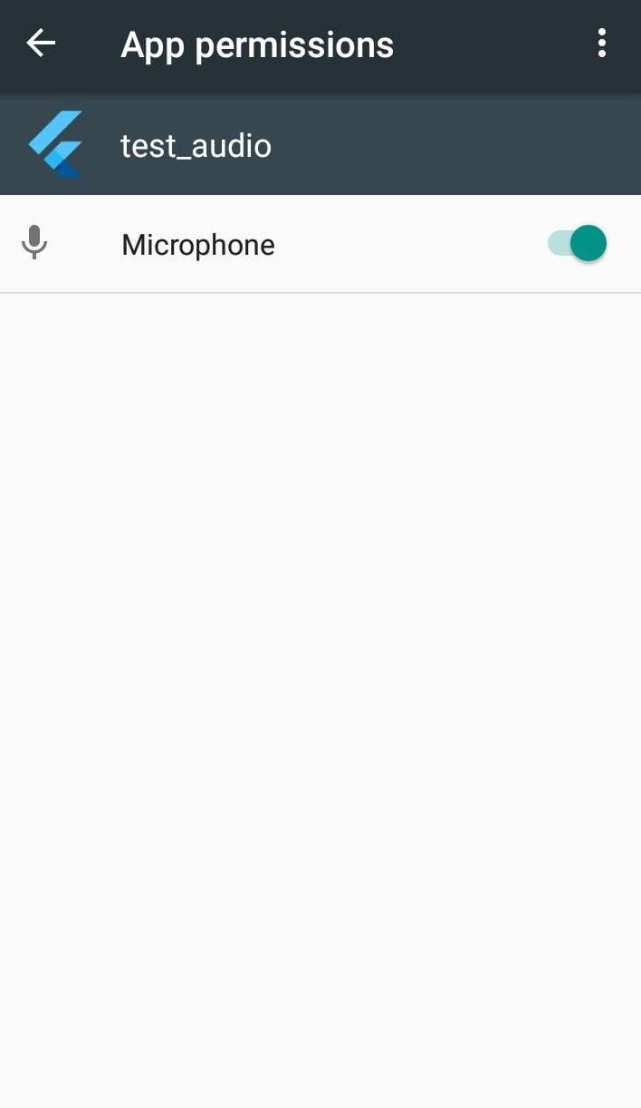

Slide 10
Limitations
Difficult to interpret speech in a noisy environment.
Difficulty in recognizing certain dialects and accents. A multitude of dialects and accents create additional complexity for the model.
Understanding homonyms. Homonyms are words that sound the same, but differ in meaning and spelling.

Slide 11
Conclusion
Students and disabled need high-quality transcripts. The technology behind the conversion of speech to text has advanced at a fast pace, making it quicker, cheaper and more convenient than manual notes.
Although the technology is not there yet to reach human performance, the accuracy can get upto 95%.

