Slide 1

WORLD’S HAPPINESS REPORT
RNS INSTITUTE OF TECHNOLOGY
BENGALURU - 98
DEPARTMENT OF INFORMATION SCIENCE & ENGINEERING
Presentation on Internship
Candidate Name : R G Manvitha
USN: 1RN19IS111
Candidate Name : Rutvick Sreedhar
USN: 1RN19IS124
Inflow Technologies
Guide
Dr.Suresh L
HOD , Dept of ISE, RNSIT
Panel member
Mr. Nirmalkumar S. Benni
Assistant Prof., Dept of ISE, RNSIT

Slide 2
AGENDA
Abstract
About the Company
Introduction
Literature Survey
Requirements
System Design
Detailed Design
Implementation
Testing
Conclusion and Future Enhancements
References
Q & A

Slide 3
ABSTRACT
The World Happiness Report is a historic survey of worldwide happiness that ranks 156 countries based on how happy their residents believe they are.
The World Happiness Report 2019 focuses on happiness and community: how happiness has developed over the last twelve years, with an emphasis on the technology, social norms, conflicts, and government policies that have fueled those changes.
Happiness score depends on 6 factors : GDP per capita, Social support, Healthy life expectancy, Freedom to make life choices, Generosity, Perceptions of corruption. The prediction of scores is carried out by a regression model and it gives an accuracy of 77.9%.

Slide 4
About the Company
Inflow Technologies, founded in 2005, is a niche player in the Distribution Services industry in South Asia, providing Value Added Distribution in Cyber Security, Networking, Unified Communications and Collaboration, AIDC & POS, Infrastructure & Application Software, Storage Management, and Electronic Security products. It is headquartered in Bangalore and has a presence in 15 cities.
Inflow Technologies empowers system integrators and resellers to design, deploy, and adopt IT technologies to meet the demands of their customers. Inflow operates with a team of 390+ people and 2300+ channel partners in India and South Asia, and has agreements with 50+ global technology vendors across Networking, Cyber Security, UCC, Surveillance, AIDC, Server, Storage, and Software.

Slide 5
INTRODUCTION
The World Happiness Report is a publication that contains articles and rankings of national happiness, based on respondent ratings of their own lives, which the report also correlates with various (quality of) life factors , these factors include : GDP per capita, Social support, Healthy life expectancy, Freedom to make life choices, Generosity, Perceptions of corruption .
The graph plotted is mainly discussing about the materialistic and non materialistic features that contribute to the happiness score .
The regression model is used to predict the happiness score in future , using these 6 attributes and pickle file is created to deploy the model in iostream.

Slide 6
LITERATURE SURVEY
Model | Analysts | Accuracy (%)
Linear regression with multiple inputs | Rutvick and Manvitha | 77.9
Linear regression with single inputs at a time | Jacob Good | 74.6
Random Regression | Kushal | 72
Linear Regression using imputer | Kinshuk das | 68

Slide 7
Requirements
Hardware :
Processor Intel(R) Core(TM) i5-8265U CPU @ 1.60GHz 1.80 GHz
Installed RAM 8.00 GB (7.89 GB usable)
System type 64-bit operating system, x64-based processor
Software :
Python Jupyter notebook
Power BI
Visual Studio

Slide 8
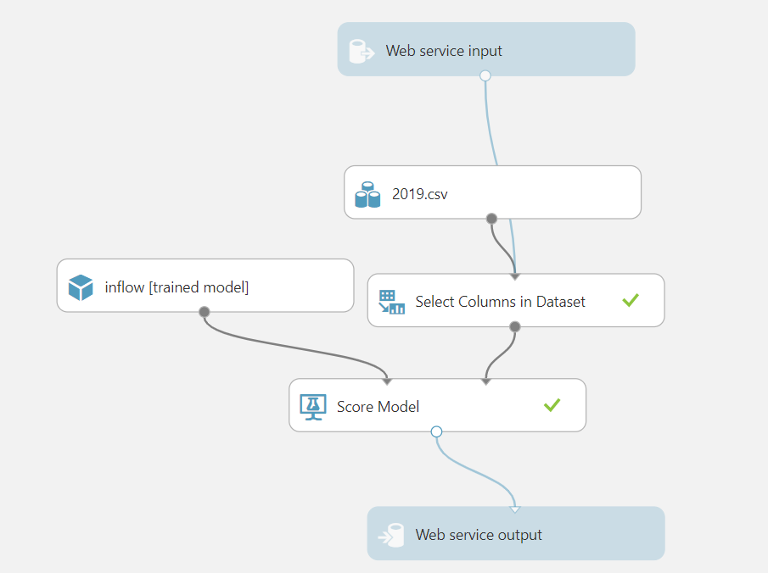
System Design
Design details –

Slide 9
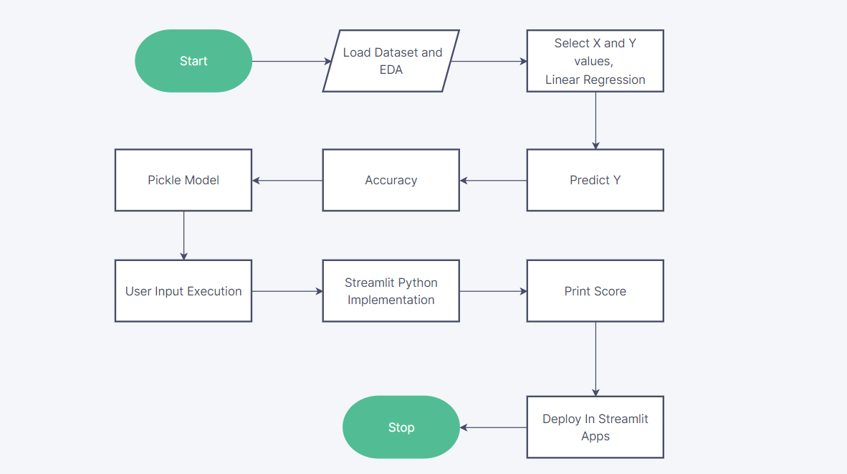
Detailed Design
Design details –

Slide 10
Implementation / Coding
Pseudocode :
from sklearn.linear_model import LinearRegression
lr=LinearRegression()
lr.fit(x,y)
y_pred=lr.predict(x)
y_pred
from sklearn.metrics import r2_score,mean_squared_error
data1['predicted_happiness_score']=y_pred
r2_score(y,y_pred)

Slide 11
Design
Design details
The csv file is loaded into the notebook using pandas , EDA process is done on the dataset .
The x is the independent values such as attributes contributing to find the score and y is the dependent variable .
Linear regression model is imported from sklearn , this model uses the formula y=mx+c in-order to train the model . Then y is predicted using the model.
R2 score is calculated for accuracy and then pickle files are created.
The pickle files are used as an input for streamlit for building the frontend.
Deployment of the model using streamlit.io app.

Slide 12
CONCLUSIONS
There are several factors for the happiness for any person , but 6 factors are considered such as GDP per capita, Social support, Healthy life expectancy, Freedom to make life choices, Generosity, Perceptions of corruption and linear regression model is used for predicting the score with 77.9% accuracy.
These scores helps to analyse and create objectives that promote strong communities with high levels of trust, high employment and quality of employment, enhanced mental and physical health, family life support, and accessible, high-quality education.
An examination of these data in their broader economic and social contexts will allow for a more comprehensive evaluation of the relative value of various elements supporting happiness.
The findings can be used to propose new approaches to creating and providing public services ranging from elder care to community services.

Slide 13
Future Enhancements
The app deployment could be extended for offline mobile users .
Logistic regression or SVM models could be used for predictions
Flask model could be implemented for deployment .

Slide 14
REFERENCES
[1] https://worldhappiness.report/
[2] https://resources.unsdsn.org/happiness-and-well-being
[3] https://www.drishtiias.com/daily-updates/daily-news-analysis/un-world-happiness-report-2019
[4] https://www.kaggle.com/datasets/PromptCloudHQ/world-happiness-report-2019
[5] https://s3.amazonaws.com/happiness-report/2019/WHR19_Ch1.pdf

Slide 15
Question and Answer

Slide 16
THANK YOU

