Slide 1
Analog and Digital Electronic Lab Subject Code:18csl37
Design and Implement code converter
Binary to Gray
Gray to Binary code using basic gates

Slide 2
To realize binary to gray code
Binary code: code used in digital computers, based on a binary number system in which there are only two possible states, off and on, usually symbolized by 0 and 1.
Step need to follow while converting
1) Recode the MSB as it is.
2) Add the MSB to the next bit, record the sum & neglect the carry.
second way is EX-OR operation.
3) Repeat the process.

Slide 3
binary to gray code
Example:
sum 1 0 1 0 (Binary code)
1 0 1
1 1 1 1 (Gray code)
EX-OR

Slide 4
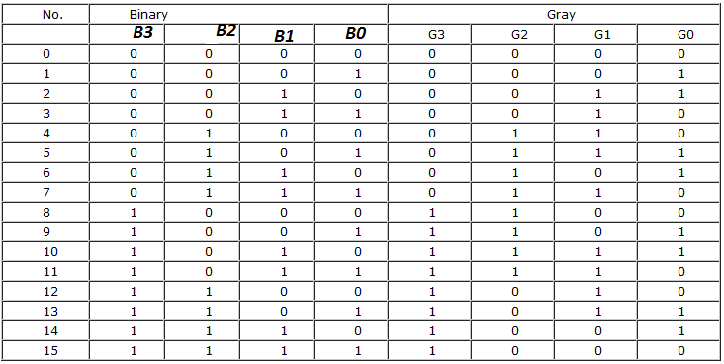
binary to gray code

Slide 5
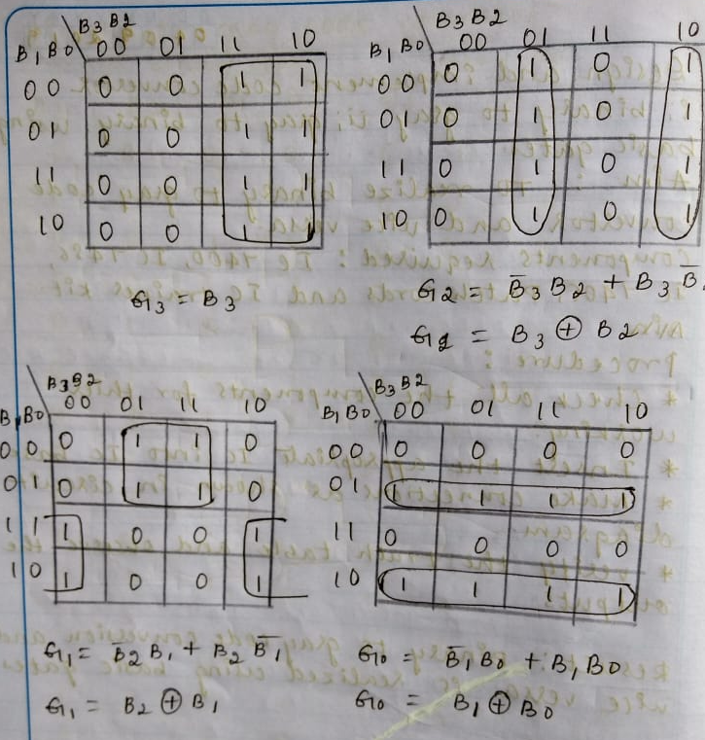
binary to gray code k map

Slide 6
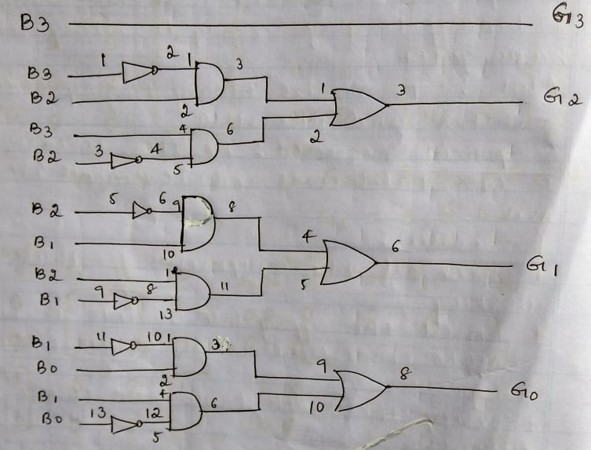
binary to gray code circuit diagram

Slide 7
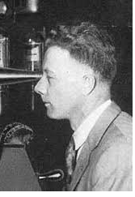
Gray to Binary code
Gray code: The reflected binary code, also known just as reflected binary or Gray code after Frank Gray, is an ordering of the binary numeral system such that two successive values differ in only one bit.
Binary number is converted to gray code to reduce switching operations.
Applications: error correction in digital
Communication such as digital television
& Some cable TV systems & reliability
of the switching systems is improved.

Slide 8
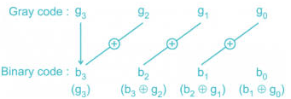
Gray to Binary code

Slide 9
Gray to Binary code
Example:
sum 1 0 1 0 (Gray code)
1 1 0 0 (Binary code)
EX-OR

Slide 10
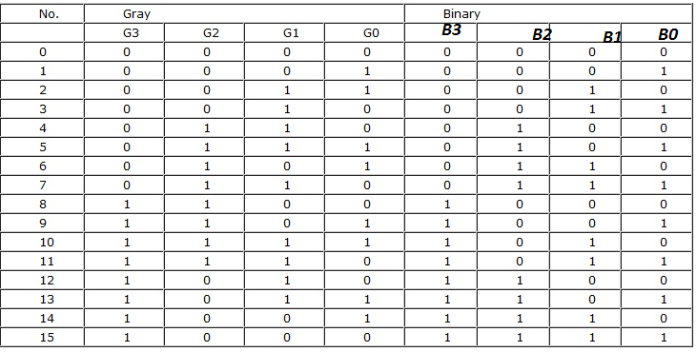
Gray to Binary code

Slide 11
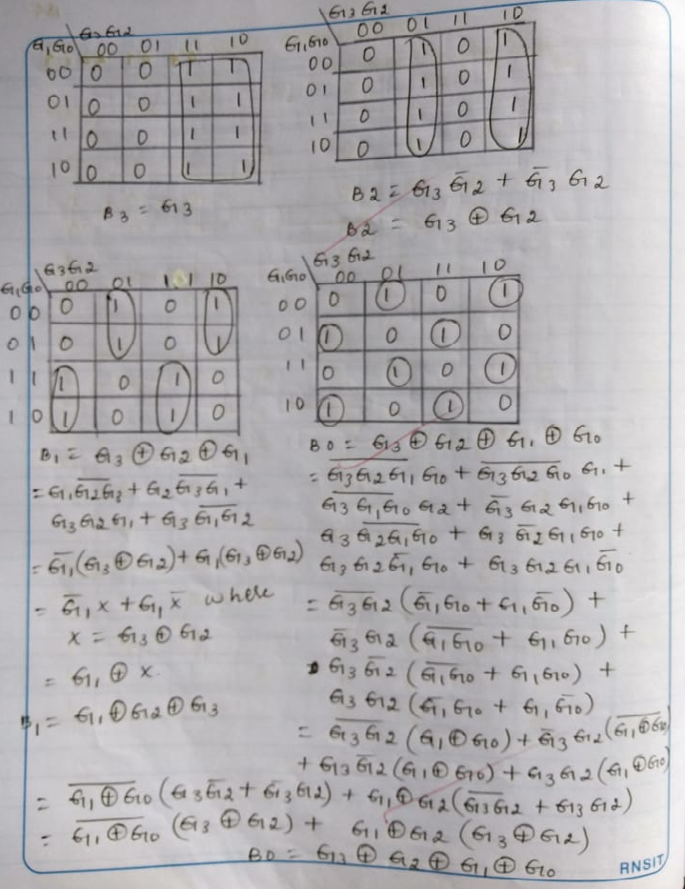
Gray to Binary code k-map

Slide 12
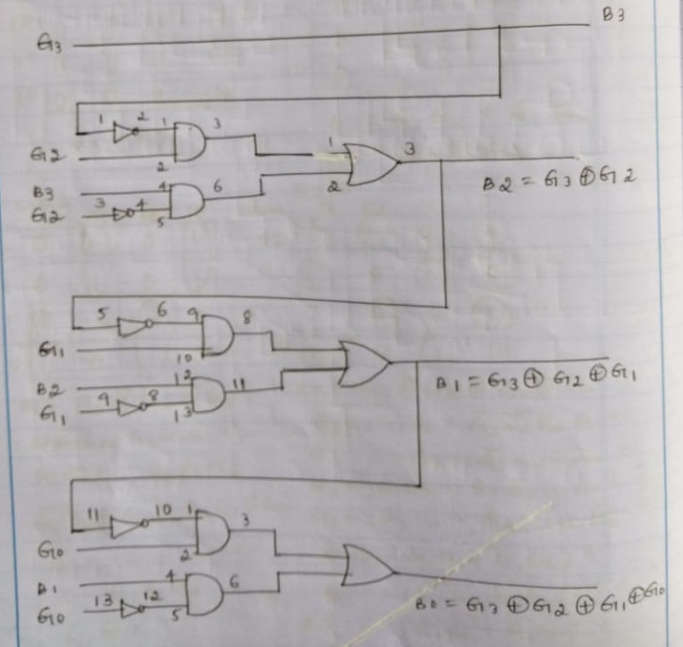
Gray to Binary code circuit diagram

Slide 13
Thank you

