Slide 1
Analog and Digital Electronic Lab Subject Code:18csl37
Given any 4-variable logic expression, simplify using Entered Variable
Map and realize the simplified logic expression using 8:1 multiplexer IC. And implement the same in HDL

Slide 2
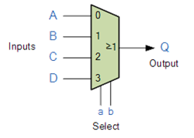
Multiplexer
A multiplexer, also known as a data selector, is a device that selects between several analog or digital input signals and forwards it to a single output line.
A multiplexer of inputs has select lines, which are used to select which input line to send to the output.

Slide 3
Map Entered Variable (MEV)
A Map Entered Variable (MEV) is a Karnaugh map in which the size of the map is reduced by removing one or more of the variables from the specification of the map cell locations.
One of the input variable is placed inside Karnaugh map
This reduces the Karnaugh map size by one degree.
i.e. a three variable problem that requires 23 = 8 locations in Karnaugh map will require 2(3-l) = 4 locations in entered variable map.
This technique is particularly useful for mapping problems with more than four input variables.

Slide 4
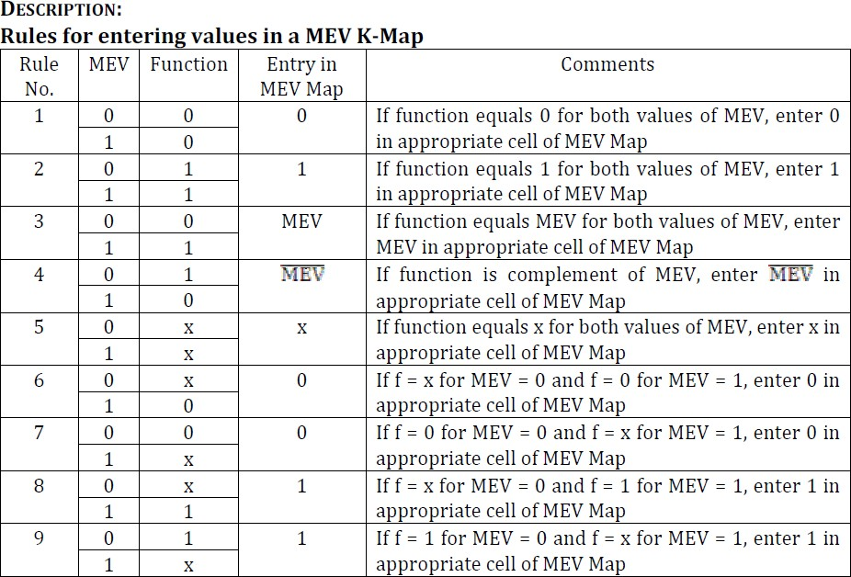

Slide 5
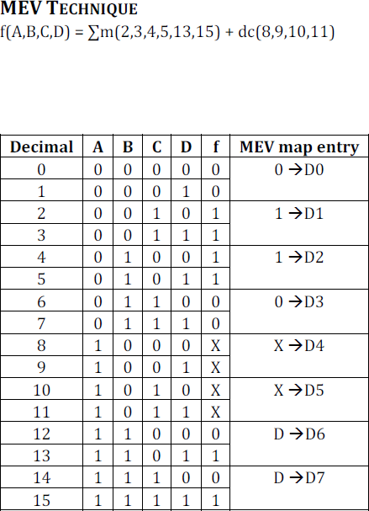
Example

Slide 6
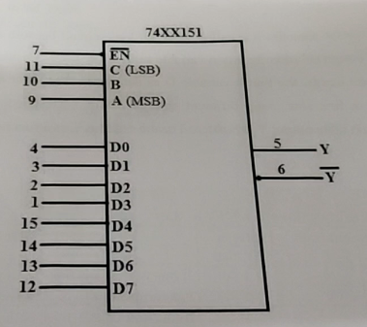
8:1 multiplexer IC Pin details-IC 74151

Slide 7
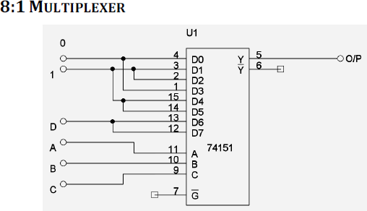
Circuit diagram

Slide 8
Thank you

