Slide 1
Sales Dashboard Design
Data Analyst Internship - Task 3
Tableau Dashboard Project

Slide 2
Project Overview
Objective: Design an interactive dashboard for business stakeholders.
Tool: Tableau Public
Dataset: Sample Superstore Sales Dataset
Features: KPI Cards, Trend Analysis, Regional Analysis, Category Analysis, Filters

Slide 3
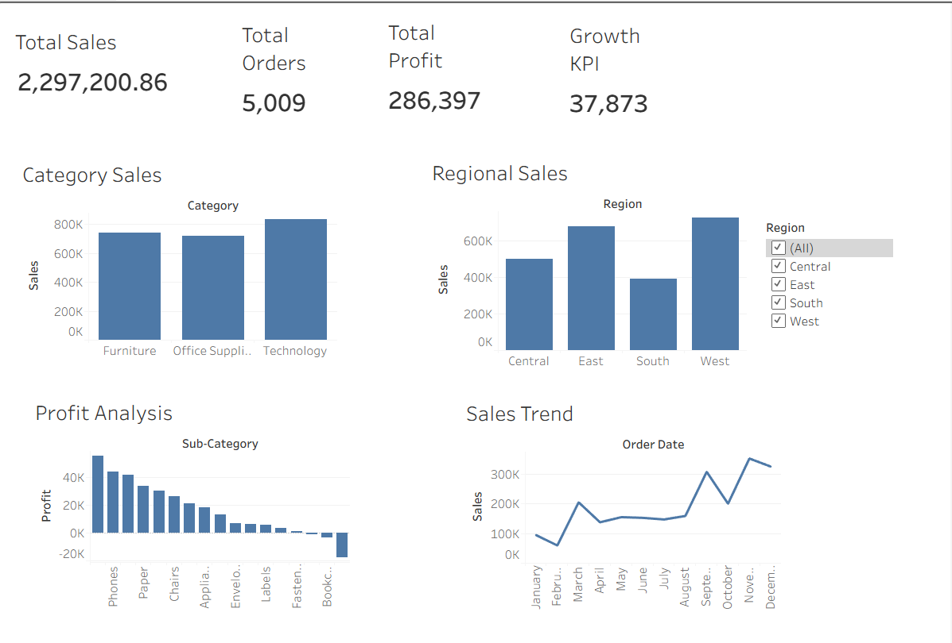
Dashboard Screenshot

Slide 4
KPIs Included
Total Sales: 2,297,200.86
Total Orders: 5,009
Total Profit: 286,397
Growth KPI: 37,873

Slide 5
Visualizations Used
Category Sales (Bar Chart)
Regional Sales (Bar Chart)
Profit Analysis by Sub-Category
Sales Trend (Line Chart)
Region Filter for Dashboard Interactivity

Slide 6
Key Business Insights
Technology category generated the highest sales.
West region achieved the highest revenue.
Sales increased significantly during the final months.
Some sub-categories contributed lower or negative profit.

Slide 7
Conclusion
An interactive Tableau dashboard was created to monitor sales performance, profitability, order volume, regional trends, and category performance. The dashboard supports data-driven business decisions.

