Slide 1
Pixel-Wise Deep Reinforcement LearningApproach for Ultrasound Image Denoising
TEAM MEMBERS :
K. BALA SAI MANVITHA (CS22B1030)
M. KRISHNA TEJA (CS22B1044)
K. PRANAY SAI (CS22B1054)
V. SRI MANASWINI (CS22B2030)

Slide 2
Objective
Develop a novel denoising model for ultrasound images that goes beyond traditional and CNN-based methods.
Leverage Reinforcement Learning (RL) to allow adaptive, per-pixel decision-making.
Achieve interpretable denoising through transparent filtering actions.
Improve image quality metrics like PSNR while preserving fine details in anatomical structures.

Slide 3
Survey / Related Work
1. Traditional Denoising Methods:
Gaussian Filter: Simple smoothing, but causes blurring.
Median Filter: Preserves edges, but ineffective under high noise.
Bilateral Filter: Better edge preservation, but static application.
2. CNN-Based Denoising:
DnCNN, U-Net: Strong performance on synthetic datasets.
Limitations: Black-box nature, requires lots of data, poor generalization.

Slide 4
3. Pixel-Wise Reinforcement Learning:
Key Innovation: Treat each pixel as an RL agent.
Allows local context awareness and adaptive decision-making.
Interpretable: Can track which actions were applied where.

Slide 5
Proposed Work
1. Dataset and Noise Modeling:
Used BSD68 dataset (68 grayscale images).
Added Gaussian noise (σ = 15) to simulate realistic ultrasound noise.
2. Action Space:
9 Actions: increase/decrease intensity, apply various filters, or do nothing.
These actions mimic interpretable image operations.

Slide 6
3. Model Architecture – MyFcn:
Fully convolutional network.
Includes dilated convolutions and a ConvGRU module for memory.
Two heads: Policy (predict actions), Value (estimate reward).
4. Training Approach:
A3C algorithm used.
5-step episodes with rewards based on PSNR improvement.
Total loss = policy loss + value loss + entropy regularization.

Slide 7
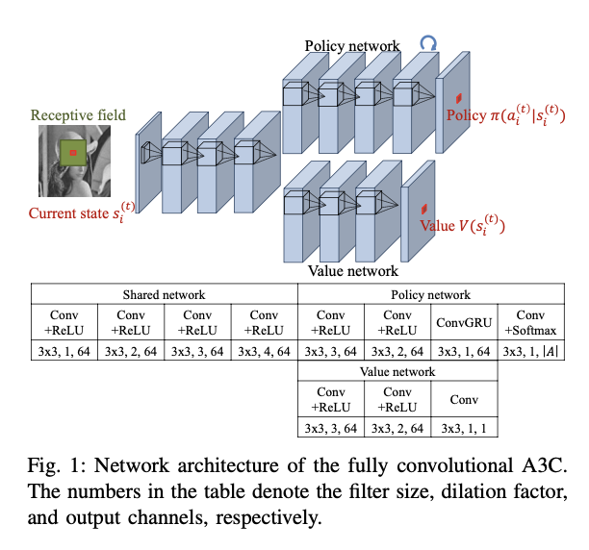
Model Architecture

Slide 8
Implementation
Framework & Tools:
Implemented in TensorFlow 2.x.
Used OpenCV and NumPy for image processing.
System Modules:
mini_batch_loader.py: Prepares image patches with augmentation.
MyFcn.py: Model definition.
State.py: Environment simulating pixel-wise action effects.
pixelwise_a3.py: A3C algorithm implementation with updates.

Slide 9
Training Details:
Batch size: 64
Episodes: 50,000
Optimizer: Adam with learning rate decay
Evaluation every 3000 episodes
PSNR tracked to evaluate learning progress

Slide 10
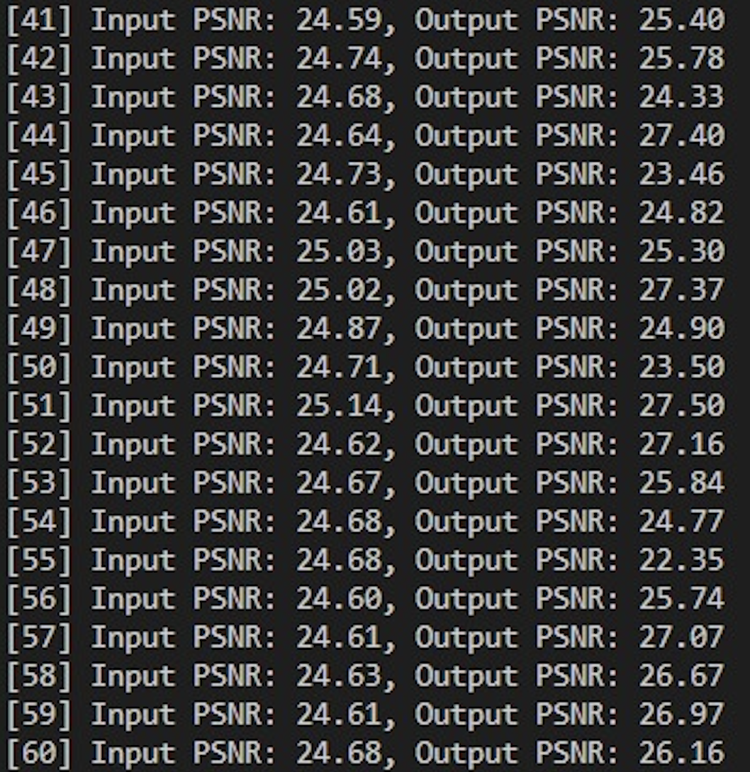
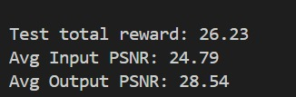
Results
Quantitative Metrics:
Input PSNR: 24.79 dB
Output PSNR: 28.54 dB
Gain: +3.74 dB
Qualitative Observations:
Reduced speckle noise and sharper edges.
Preserved small anatomical features better than traditional or CNN methods.
Action Maps showed which filters were applied where, validating interpretability.

Slide 11
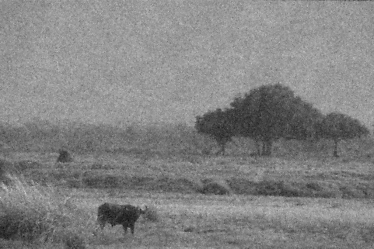

Significance:
Even a small PSNR gain can be significant in medical imaging.
Highlights the adaptability of PixelRL over fixed pipelines.
Input
output

Slide 12
Remarks & Future Work
Observations:
RL enables per-pixel control and interpretability.
Model is more robust to variable noise levels.
Future Work:
Add complex filters like wavelet transforms.
Try advanced RL methods like PPO (Proximal Policy Optimization) or SAC (Soft Actor-Critic) for stability and efficiency.

Slide 13
Individual Contributions
K. Bala Sai Manvitha (CS22B1030)
Conducted the literature review on denoising techniques and compiled insights to guide model development.
Contributed to the policy and value network tuning, and coordinated the writing of the final report and presentation.
M. Krishna Teja (CS22B1044)
Handled dataset preparation, noise modeling, and preprocessing pipeline.
Assisted in implementing and validating the evaluation metrics (PSNR, qualitative comparisons).

Slide 14
K. Pranay Sai (CS22B1054)
Implemented the neural network architecture (MyFcn) including ConvGRU and dual policy-value heads.
Led the integration and training using the A3C reinforcement learning framework.
V. Sri Manaswini (CS22B2030)
Developed the custom image environment and pixel-agent action simulation logic.
Coordinated testing, visualization of outputs, and final presentation formatting.

Slide 15
Conclusion
Developed a Pixel-Wise Deep Reinforcement Learning (PixelRL) model for ultrasound image denoising
Leveraged A3C-based actor-critic learning where each pixel acts as an agent with a discrete action set.
Integrated temporal memory (ConvGRU) to enhance learning across steps.
Achieved interpretable and adaptive denoising while maintaining image details.

Slide 16
THANK
YOU

