Slide 1
CROP YIELD PREDICTION
Group ID:25SM05
P.Deepthi 2301CS14
A.Manvitha Reddy 2301CS29
G.Sai Bhaskari 2301AI19
G.Vasavi 2301AI43

Slide 2
Roles and Responsibilities
Name & Roll no | Role | Responsibilities
Deepthi | Data collection & preprocessing | Data loading & EDA
Sai Bhaskari Guru | Feature engineering | Feature engineering
Manvitha Reddy | Modeling lead | Design and train ML models using feature engineering
G Vasavi | Model evaluation | Optimizes models using hyperparameter tuning and evaluate performances using RMSE,MAE,R^2.

Slide 3
Introduction:
Problem statement:
Agricultural crop production is influenced by multiple environmental, geographical, and soil-related factors. Predicting crop yield accurately is challenging due to variations in nutrients (N, P, K), rainfall, temperature, pH, area, state, and crop type. This project aims to develop machine learning models that can reliably forecast crop production (in tons) using these features
Objective
To build and evaluate machine learning models Random Forest and Gradient Boosting to predict agricultural crop production. This includes performing EDA, implementing feature engineering, tuning hyperparameters, and assessing performance using MAE, RMSE, and R²
Motivation
Reliable crop yield predictions support food security, resource optimization, and better economic planning. Machine learning can help farmers and policymakers make informed decisions, reduce risks, and adapt to changing climate conditions

Slide 4
Literature Review
Backpropagation in Neural Networks (Rumelhart, Hinton & Williams, 1986):
Introduced the backpropagation algorithm, enabling multi-layer neural networks to learn from data — forming the foundation of modern ANN-based crop-yield prediction models.
Crop Yield Prediction using RF, SVM, and LR (Uddin et al., 2021):
Applied machine-learning models using weather and soil attributes (rainfall, temperature, humidity, soil nutrients), showing that weather features play a major role in crop yield forecasting.
Hybrid Feature-based Yield Prediction (Mishra et al., 2018):
Reviewed ML techniques (LR, RF, ANN) and concluded that combining soil + weather attributes yields the highest accuracy compared to using either feature category alone.
Research Gaps
Limited focus on non-linear ensemble + deep learning hybrid approaches for agricultural prediction.
Lack of systematic hyperparameter optimization in most previous ML crop-yield models.
Minimal usage of advanced feature engineering and interaction features (soil × weather).
Real-world deployment challenges remain due to generalization issues across states, crops, and seasons.

Slide 5
Methodology
Dataset overview
State_Name,Crop_Type,Crop,N,P,K,pH,rainfall,temperature,
Area_in_hectares,Production_in_tons,Yield_ton_per_hec
New features
Created a new 10 Nutrient ratios & balances,9 Climate interactions,5 Polynomial features,3 Stress indicators and 3 Area interactions
Feature transformation and scaling
Transformed skewed features by using power transformation.Applied log1p transformation for target variable feature.

Slide 6
Flow Chart
Model development
Hyperparameter tuning
Feature engineering
Data preprocessing
Evaluation

Slide 7
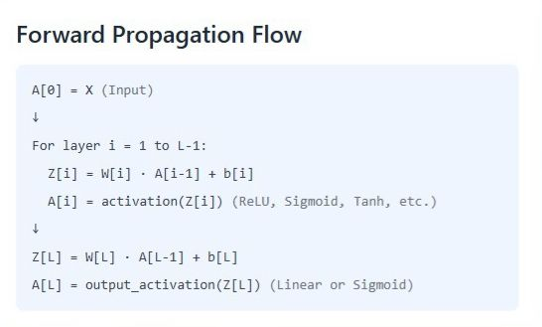
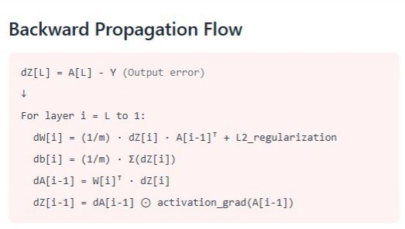
DEEP NEURAL NETWORK

Slide 8
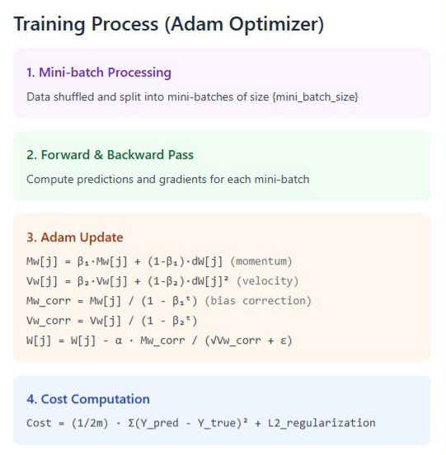
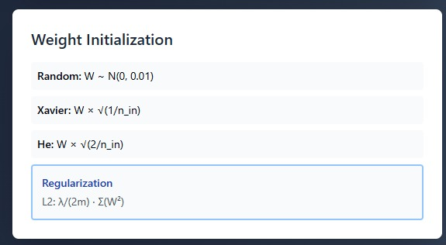

Slide 9
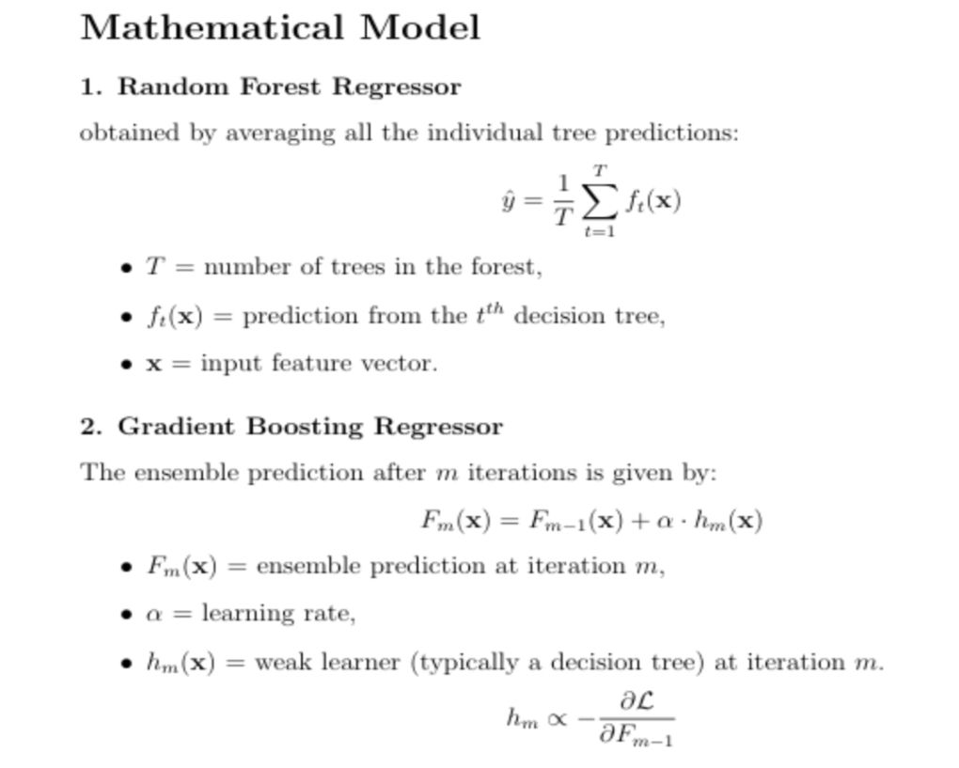
Random forest and Gradient Boosting

Slide 10
Results
Model | BASELINE RESULTS | AFTER HYPERPARAMETER TUNING
DNN | R²=0.83 | R²=0.89
Random Forest | R²=0.77 | R²=0.83
Gradient Boosting | R²=0.73 | R²=0.899

Slide 11
Hyperparameter Tuning
Optuna Technique: For hyper parameter tuning.
Optuna finds the optimal hyper parameters by using TPE algorithm.
1)DNN H.P :
2)Random Forest:
1)Gradient Boosting :
learning_rate, number_of_layers
number_of_neurons
activation_function
batch_size
epochs
N_estimators
Max_features
Max_depth
Min_samples_split
min_samples_leaf
N_estimators
Max_features
Max_depth
Min_samples_split
Min_samples_leaf
Reg_lambda
Early_stopping_rounds
Learning rate

Slide 12
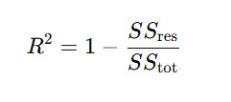


Evaluation metrics:
R² (Coefficient of determination) MAE – Mean Absolute Error
RMSE- Root mean square error

Slide 13
Conclusion :
Log-transform of the target and power transformation of skewed features helped stabilize variance and reduce model error.
Successfully built a complete ML pipeline for crop-yield prediction including preprocessing, feature engineering, model development, optimization, and evaluation.
Hyperparameter tuning with Optuna enhanced performance across RF, Gradient Boosting, and DNN models compared to baselines.
The optimized Gradient Boosting model a achieved the best overall RMSE, MAE, and R² on the test dataset.

Slide 14
References
1)Rumelhart, Hinton & Williams (1986) — “Learning Internal Representations by Error Propagation”
2)“Using Machine Learning Algorithms for Crop Yield Prediction”
Authors: S. Shafi Uddin et al., Agriculture 2021
3)“Predicting Crop Yield Using Machine Learning: A Review”
Authors: Mishra et al., 2018

