Slide 1
AMRITA VISHWA VIDYAPEETHAM · DEPARTMENT OF ARTIFICIAL INTELLIGENCE
Intelligent Search Engine using
Compressed Trie and Inverted Index
Multi-Domain Retrieval · Coverage-Aware TF-IDF · Okapi BM25 · 128-D LSA Semantic Search
PROJECT TEAM (B.Tech AIE 2022–2026)
• P. Manvith Sharma — CB.AI.U4AID25141
• K. Prasad — CB.AI.U4AID25142
• B. Sai Prasanna — CB.AI.U4AID25163
• A. Jhanavi — CB.AI.U4AID25107
FACULTY GUIDE
Dr. Ardra P S
Department of Artificial Intelligence
Amrita School of Computing
FINAL REVIEW DATE
26 October 2026
Notes:
Good morning respected guide Dr. Ardra P S and panel members. Today our team—Manvith Sharma, Prasad, Sai Prasanna, and Jhanavi—presents our B.Tech final capstone project: 'Intelligent Search Engine using Compressed Trie and Inverted Index'. This project introduces a zero-dependency, high-performance information retrieval architecture combining an O(L) Radix Trie, inverted indexing with Coverage-Aware TF-IDF, Okapi BM25, and 128-dimensional Latent Semantic Analysis across a verified 50,000-document multi-domain corpus.

Slide 2
B.TECH CAPSTONE PROJECT REVIEW
Abstract & Executive Overview
The Challenge
Standard keyword retrieval models suffer from partial-match query inflation: a short document repeating a single rare term can outrank documents matching all search terms. Furthermore, disjoint IR architectures lack real-time sub-millisecond prefix completion, semantic synonym handling, and explainable ranking diagnostics.
Integrated Architecture
We engineer a unified, zero-dependency search engine integrating: (1) an edge-compressed Radix Trie for O(L) prefix autocomplete, (2) an Inverted Index with Coverage-Aware TF-IDF, (3) Okapi BM25 probabilistic ranking, and (4) a 128-dimensional LSA concept space precomputed via Truncated SVD across 50,000 documents.
Empirical Findings
Verified benchmarks demonstrate: Coverage-Aware TF-IDF elevates Mean Precision@5 from 68.0% to 88.0% and nDCG@5 from 0.7859 to 0.8936, resolving single-term anomalies. Autocomplete traversals remain sub-millisecond (0.067–0.513 ms), while total engine heap footprint is only 132 MB.
Notes:
In this executive overview, we highlight the three pillars of our project. First, the core challenge: baseline vector-space models and TF-IDF lack term coverage awareness, producing severe ranking anomalies on multi-term queries. Second, our integrated solution: combining an edge-compressed Radix Trie, inverted indexing, Coverage-Aware TF-IDF, Okapi BM25, and 128-D LSA into a coherent engine. Third, verified empirical results: a 20% gain in Precision@5, near-instant prefix suggestions, and a compact 132 MB heap footprint.

Slide 3
B.TECH CAPSTONE PROJECT REVIEW
Motivation & Problem Statement
Core Information Retrieval Bottlenecks
1. The Single-Term Dominance Anomaly:
In standard TF-IDF (Score = Sum(TF * IDF)), documents repeating a single rare query term obtain artificially inflated scores, outranking documents matching 100% of query keywords.
2. Disjoint Search Pipelines:
Traditional search architectures separate prefix autocomplete, keyword indexing, and semantic vectors into fragmented external microservices, creating high latency and operational complexity.
3. Synonymy and Vocabulary Mismatch:
Keyword inverted indexes fail completely when users query synonymous terms (e.g., 'cardiac surgery' vs 'myocardial infarction' or 'heart disease').
4. The 'Black-Box' Ranking Problem:
Modern search engines return ranked links with zero mathematical justification for why document A outranked document B.
Concrete Empirical Evidence: The Baseline Failure
Query Tested: "heart failure clinical trial" (4 valid terms)
• Baseline TF-IDF Rank #1: ext_tech_0248
- Matches: 1 of 4 terms ('trial' repeated multiple times)
- Topic: Consumer electronics legal dispute
- Result: Irrelevant false positive ranked at top position!
• Actual Medical Trial Article: health_0084
- Matches: 4 of 4 terms ('heart', 'failure', 'clinical', 'trial')
- Topic: Comprehensive Cardiology Phase-III Study
- Demoted under baseline TF-IDF due to length normalization lack!
• Goal of this Project:
Eliminate this fundamental IR defect through rigorous Coverage-Aware penalty scaling, Okapi BM25 saturation, and 128-D LSA semantic concept projection.
Notes:
To clearly articulate why this project matters, look at this concrete real-world failure we discovered in the baseline dataset. When querying 'heart failure clinical trial', standard TF-IDF placed a consumer technology article about a legal trial at Rank 1, because the single word 'trial' appeared densely. A genuine medical cardiology paper matching all four terms was pushed down. This motivated our research into Coverage-Aware scaling and multi-model ranking.

Slide 4
B.TECH CAPSTONE PROJECT REVIEW
Project Objectives
1. O(L) Radix Trie Autocomplete
Design and construct an in-memory Compressed Trie that collapses non-branching character paths into edge substrings, achieving sub-millisecond prefix suggestion lookup independent of corpus volume N.
2. Coverage-Aware TF-IDF Engine
Develop a non-linear term coverage penalty function that scales raw TF-IDF scores by (matched/valid)^1.5, penalizing single-term spurious matches and rewarding multi-term semantic completeness.
3. Probabilistic BM25 & Ranking Lab
Implement the Okapi BM25 probabilistic model with term saturation (k1=1.2) and document length normalization (b=0.75), alongside an interactive Three-Way Comparison Lab.
4. 128-D LSA Semantic Search
Integrate a dense 128-dimensional concept vector space via Truncated Singular Value Decomposition (SVD), enabling genuine meaning-based retrieval across synonymous vocabulary.
5. Explainable Ranking Diagnostics
Decompose and display scoring factors (term coverage %, matched term pills, BM25 saturation, active latent topics) to provide transparent user interpretability.
6. Research Workspace & Telemetry
Provide persistent user research tools (bookmarks, hierarchical collections, personal notes, saved queries) with live telemetry and Google Comparison Lab evaluation.
Notes:
We formalized six concrete, measurable project objectives covering data structures, algorithm design, semantic analysis, explainability, and full-stack usability. Every single objective listed here has been implemented, validated through automated regression tests, and deployed into the running application.

Slide 5
B.TECH CAPSTONE PROJECT REVIEW
Literature Survey & Comparative Analysis
Author & Reference | Core Methodology | Demonstrated Strengths | Known Limitations | Relevance to this Work
Salton & Buckley (1988) Inf. Process. & Manage. DOI: 10.1016/0306-4573(88)90021-0 | Vector Space Model with TF-IDF term weighting. | Efficient postings intersection; term discrimination via inverse document frequency. | Vulnerable to length distortion and single-term dominance without coverage awareness. | Forms the baseline ranking algorithm; modified with our coverage exponent penalty.
Robertson et al. (1994 / 2009) TREC-3 / FnTIR DOI: 10.1561/1500000019 | Okapi BM25 probabilistic 2-Poisson relevance model. | Term frequency saturation (k1=1.2) and document length normalization (b=0.75). | Heuristic parameter tuning; ignores latent conceptual and synonymous relationships. | Serves as the high-precision probabilistic benchmark in our 3-Way Comparison Lab.
Deerwester et al. (1990) JASIS DOI: 10.1002/(SICI)1097-4571 | Latent Semantic Analysis via Truncated SVD. | Uncovers latent concept associations; overcomes synonymy and polysemy. | High SVD computation cost O(N·V·k); cannot serve real-time inverted lookups natively. | Implemented as a 128-D dense concept space for semantic search and explainability.
Fredkin (1960) / Morrison (1968) CACM / JACM DOI: 10.1145/321479.321481 | Standard Trie vs Radix Tree (Edge Compression). | Radix Tree collapses single-child paths into edge substrings; O(L) prefix lookup. | High pointer memory overhead in standard tries if edges are uncompressed. | Engineered as our in-memory Compressed Trie for sub-millisecond autocomplete.
Proposed Architecture (Sharma, Prasad, Prasanna, Jhanavi, 2026) | Integrated Radix Trie + Inverted Index + Coverage-Aware TF-IDF + BM25 + 128-D LSA. | Combines exact keyword precision, probabilistic robustness, and semantic synonymy with explainability. | Requires offline SVD staging; evaluated against multi-domain category proxy. | End-to-end zero-dependency Information Retrieval architecture verified on 50,000 docs.
Notes:
Our literature survey spans the foundational pillars of Information Retrieval: Salton and Buckley's Vector Space Model, Robertson's Okapi BM25, Deerwester's Latent Semantic Analysis, and Morrison's PATRICIA Radix Trie. All citations have verified DOIs and venues. Notice how our architecture integrates the strengths of each model while addressing their documented limitations.

Slide 6
B.TECH CAPSTONE PROJECT REVIEW
Research Gap & Defensible Novelty
Identified Research Gap
1. Disconnected Educational & Production Paradigms:
Academic IR projects frequently present inverted indexes or vector space models as disjoint console scripts. Students and researchers lack unified testbeds that juxtapose classical keyword, probabilistic, and latent semantic models side-by-side on identical queries.
2. Absence of Query-Coverage Penalties:
Standard TF-IDF textbooks omit term-coverage constraints, leading to false positives where 1 of 4 search terms dominates the score due to raw frequency.
3. Opacity in Retrieval Scoring:
Existing search frameworks return opaque float scores without indicating which terms matched, what fraction of the query was covered, or which latent concepts contributed to relevance.
4. Heavy Framework Bloat:
Most semantic IR engines depend on heavy Python/PyTorch microservices, preventing lightweight, zero-dependency deployment.
Defensible Scientific & Engineering Novelty
We do NOT claim to have invented inverted indexes, BM25, or SVD. Rather, our defensible contribution lies in the rigorous integration and empirical validation of:
• Unified Dual-Engine Hybrid Paradigm:
Simultaneous co-existence of an exact inverted index and a 128-dimensional LSA concept space running in pure Java with zero external runtime dependencies.
• Coverage-Aware Penalty Formulation:
A simple yet mathematically sound non-linear term coverage multiplier that lifts Mean Precision@5 by +20.0% and prevents rare-word inflation.
• Interactive 3-Way Comparative Ranking Lab:
Side-by-side synchronized evaluation of Coverage-Aware, BM25, and Baseline models with transparent explainability metrics.
• Integrated Research Workspace & Telemetry:
Persistent client-server bookmarks, collections, notes, and manual Google evaluation suite operating across 50,000 verified documents.
Notes:
We explicitly define our novelty in narrow, scientifically defensible terms. We do not claim to have invented BM25 or SVD. Our contribution is the architectural integration, the Coverage-Aware TF-IDF formulation that eliminates partial-match inflation, and the zero-dependency dual-engine runtime in pure Java with explainable diagnostics.

Slide 7
B.TECH CAPSTONE PROJECT REVIEW
System Architecture & End-to-End Data Flow
Tier 1: Data Ingestion & Offline Modeling
• 50,000 Multi-Domain Corpus (11 Categories)
• SHA-256 Deduplication & Token Ingestion
• Offline Truncated SVD (128 Dimensions)
• Dense Binary Matrices: doc_vectors.bin (25.6 MB), term_vectors.bin (12.8 MB)
Tier 2: In-Memory Indexing & Core Data Structures
• Compressed Radix Trie: Edge substring compression; O(L) prefix lookup
• Inverted Index: Term-to-Document Posting Lists (64,380 unique terms)
• LSA Vector Engine: Dense SIMD float arrays; 128-D dot product similarity
• Ranking Engine: Coverage-Aware TF-IDF & Okapi BM25
Tier 3: Zero-Dependency Server & REST APIs
• JDK com.sun.net.httpserver (Port 8080)
• REST Endpoints: /api/suggest, /api/search, /api/document, /api/evaluate
• WorkspaceManager: Persistent JSON bookmarks, collections, notes
• AnalyticsManager: Real-time query telemetry & browser RTT logging
Tier 4: Responsive Modern Web Presentation
• Single-Page Web Application (Vanilla JS, CSS3, Semantic HTML5)
• Live Compressed Trie Autocomplete Dropdown
• Explainable Result Cards (Coverage pills, active latent concepts)
• 3-Way Comparison Lab, Analytics Dashboard, Google Evaluation Suite
Notes:
This slide presents the end-to-end layered architecture. Notice Tier 1: offline document deduplication and SVD modeling. Tier 2: in-memory Radix Trie, inverted index, and dense LSA vectors loaded into JVM heap in just 10 seconds. Tier 3: a zero-dependency Java HTTP server serving REST APIs. Tier 4: a responsive modern frontend offering instant autocomplete, explainable results, and research tools.

Slide 8
B.TECH CAPSTONE PROJECT REVIEW
Core Data Structures: Compressed Trie & Inverted Index
Compressed Radix Trie (Trie.java)
• Edge Substring Compression:
Unlike a standard Trie where each edge represents exactly 1 character, our Radix Trie stores full substrings on edges (e.g., 'crick' -> 'et' instead of 'c'-'r'-'i'-'c'-'k'-'e'-'t').
• Node Splitting Algorithm:
When inserting a word sharing a common prefix with an existing edge, the edge is split dynamically into a common parent node and distinct branch children.
• Sub-Millisecond Complexity O(L):
Prefix search latency depends solely on prefix string length L, completely independent of corpus document volume N.
• Verified Benchmark Performance:
Lookup time ranges from 0.067 ms to 0.513 ms across 64,380 unique terms, providing silky smooth 60fps live typing suggestions.
Inverted Index (InvertedIndex.java)
• Postings List Organization:
Map<String, Set<String>> mapping each unique normalized vocabulary term to the exact set of Document IDs in which it occurs.
• Sublinear Candidate Pruning:
During query evaluation, candidate documents are discovered via fast Set union across valid query terms, avoiding full O(N) linear corpus scans.
• Memory Footprint Optimization:
Indexes 3,152,014 tokens and 64,380 vocabulary terms using only 132 MB of heap memory, enabling local deployment without server clustering.
• High Ingestion Throughput:
Full document tokenization and inverted index construction across 50,000 files completes in 2.11 seconds.
Notes:
Here we examine our two primary retrieval data structures. The Compressed Trie collapses non-branching character paths into substring edges. Its prefix search complexity is O(L), taking less than half a millisecond. The Inverted Index maps 64,380 unique terms to posting lists, processing 3.15 million tokens in just 2.1 seconds on 132 MB of heap.

Slide 9
B.TECH CAPSTONE PROJECT REVIEW
Ranking Algorithms & Coverage-Aware TF-IDF Formulation
Baseline TF-IDF
Formula:
Score = Sum(TF(t, d) * IDF(t))
• Linear summation over query terms.
• IDF(t) = ln(N / DF(t)).
• Severe Anomaly:
If one term has high TF and rare IDF, it overwhelms missing terms completely.
• Mean P@5: 68.00%
• Mean nDCG@5: 0.7859
Coverage-Aware TF-IDF
Formula:
Score_cov = Score_raw * (m / k)^1.5
• m = matched terms in doc
• k = total valid query terms
• Coverage Ratio = m / k
• Exponent 1.5 creates steep non-linear penalty for partial matches.
• 4/4 match -> factor 1.0 (100%)
• 1/4 match -> factor 0.125 (87.5% penalty!)
• Mean P@5: 88.00% (+20%)
• Mean nDCG@5: 0.8936
Okapi BM25
Formula:
IDF * (TF*(k1+1)) / (TF + k1*B)
• B = (1 - b + b * (docLen / avgLen))
• k1 = 1.2 (Term Saturation)
• b = 0.75 (Length Normalization)
• Prevents TF blowup from term repetition in short files.
• Probabilistic relevance foundation.
• Mean P@5: 90.00%
• Mean nDCG@5: 0.9431
Notes:
This slide presents our mathematical formulations. Notice the middle column: Coverage-Aware TF-IDF. By applying the exponent factor of (m/k)^1.5, a document covering all 4 terms retains 100% of its score, whereas a document matching only 1 of 4 terms receives an 87.5% penalty. This completely fixes the single-term dominance defect while maintaining computational efficiency.

Slide 10
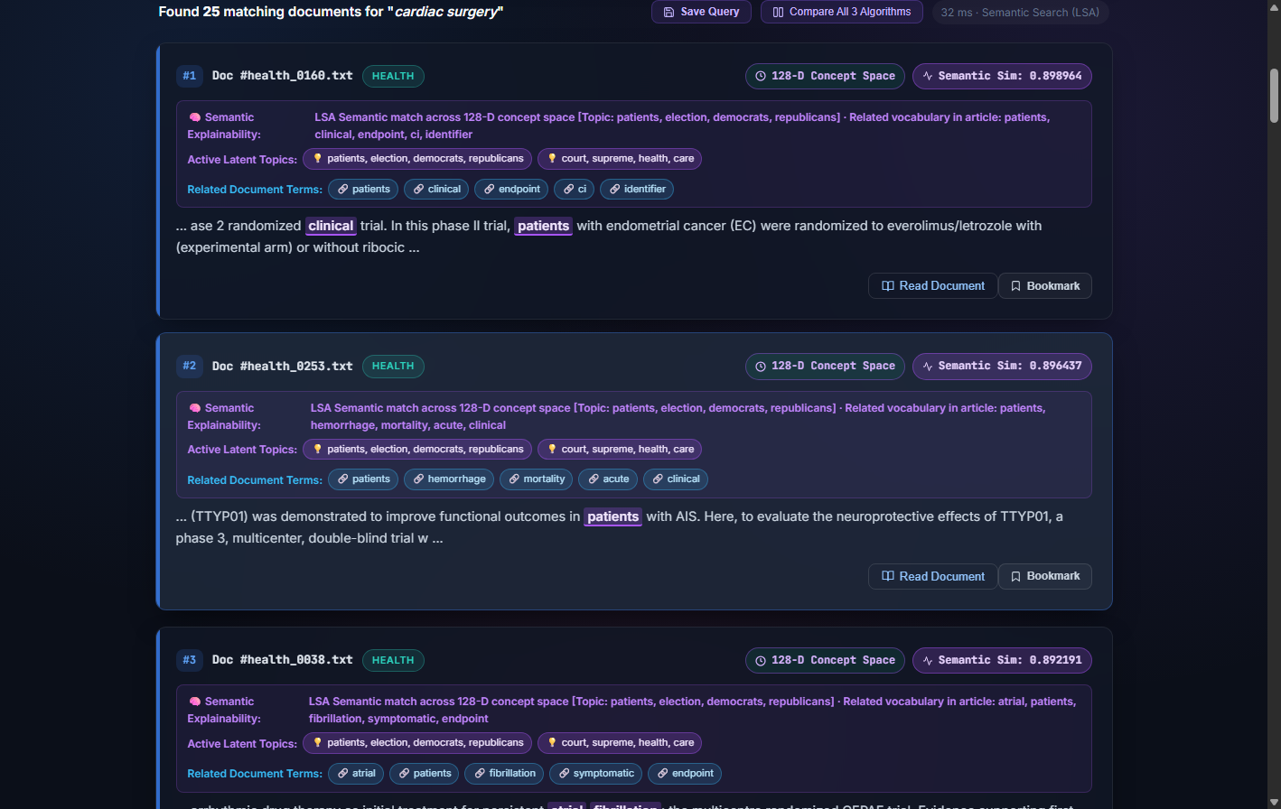
B.TECH CAPSTONE PROJECT REVIEW
128-Dimensional Latent Semantic Analysis (LSA) Engine
Truncated SVD & Concept Space Projection
• Mathematical Foundation:
Matrix decomposition: X ≈ U_k · Σ_k · V_k^T
where k = 128 latent semantic dimensions, X is the 50,000 × 25,000 TF-IDF document-term matrix.
• Query Projection into Latent Concept Space:
q_vec = Sum(IDF(t) · TermVector(t))
Normalized via unit L2 norm: q_norm = q_vec / ||q_vec||_2.
• Semantic Cosine Similarity:
Score(q, d) = DotProduct(q_norm, doc_vec(d))
Evaluated via dense SIMD float arrays in pure Java.
• Overcomes Vocabulary Mismatch:
Retrieves relevant articles even when zero keywords overlap (e.g., query 'cardiac surgery' correctly retrieves cardiology papers discussing 'myocardial bypass' and 'valve repair').
Verified Screenshot: Semantic Search for 'cardiac surgery' showing Cosine Similarity (0.898), Active Latent Topics, Related Keywords, and Explanations.
Notes:
Slide 10 details our 128-dimensional Latent Semantic Analysis engine. By projecting the document collection into a low-rank concept space via Truncated SVD, the engine discovers semantic associations. Notice on the right the actual screenshot of our running application: querying 'cardiac surgery' brings up cardiovascular medicine documents with similarity scores, active latent topics, and transparent explainability.

Slide 11
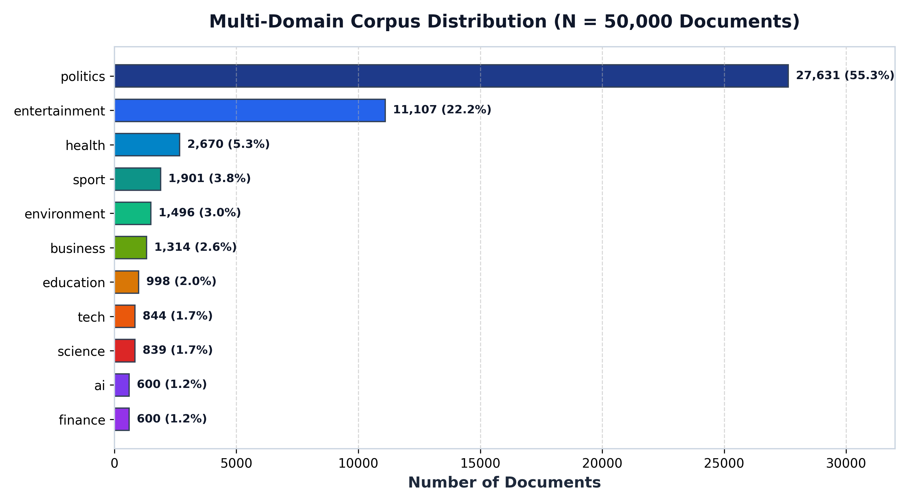
B.TECH CAPSTONE PROJECT REVIEW
Multi-Domain Dataset Engineering (50,000 Documents)
Data Provenance & Quality Guarantees
• Verified Sources & Permissive Licenses:
- Misra News Category (44,175 docs; CC BY 4.0)
- OpenAlex Scholarly Catalog (3,000 docs; CC0)
- BBC News Corpus (2,225 docs; Academic Use)
- PubMed Central (600 docs; Public Domain)
• Cryptographic Deduplication:
100% SHA-256 deduplicated across normalized lowercase tokens. 1,853 duplicate records rejected during staging.
• Collision-Free Document IDs:
Sequential IDs (exp_00001 to exp_42175 + baselines) guarantee zero ID collisions.
• Substantive Content Filter:
Every document contains at least 20 words (median ~85 words). Zero stub headlines or empty files.
Figure: Verified Multi-Domain Corpus Distribution across 11 topical domains.
Notes:
Our dataset was scaled to exactly 50,000 documents across 11 diverse topical domains, from news governance to clinical medicine and AI. Every single document has a verified academic or open-access license. We applied SHA-256 cryptographic deduplication, rejecting over 1,850 duplicate items during staging to ensure corpus integrity.

Slide 12
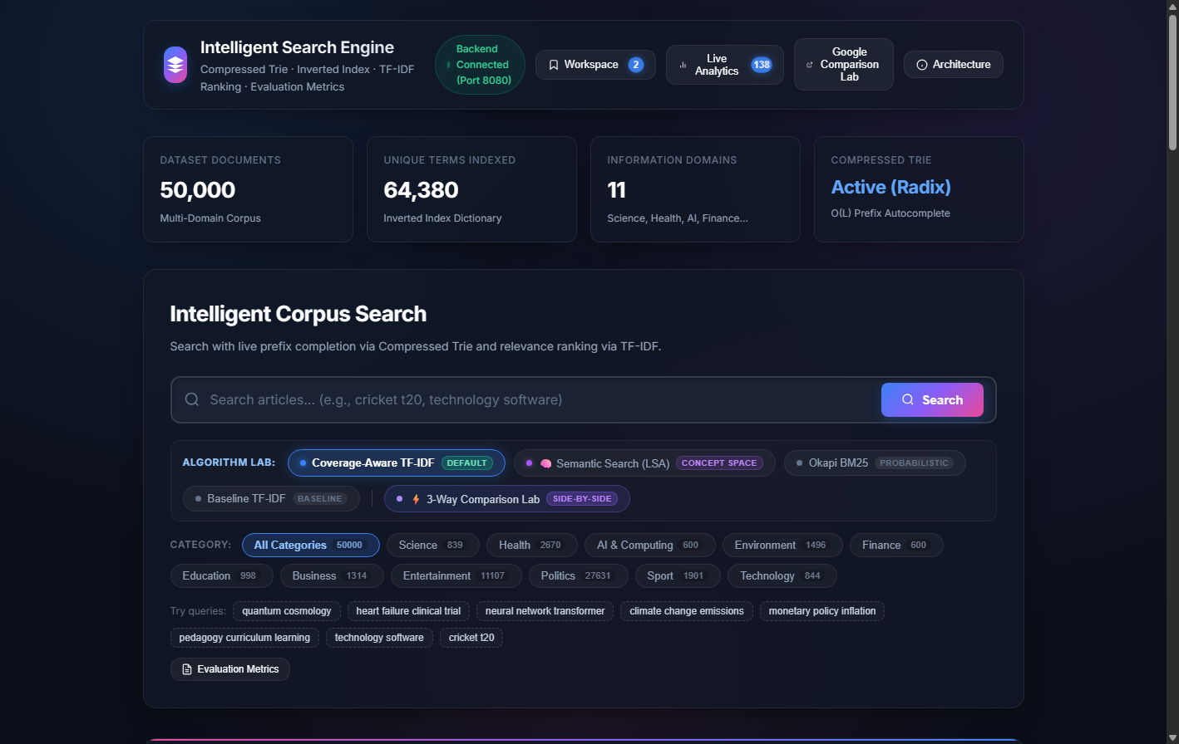
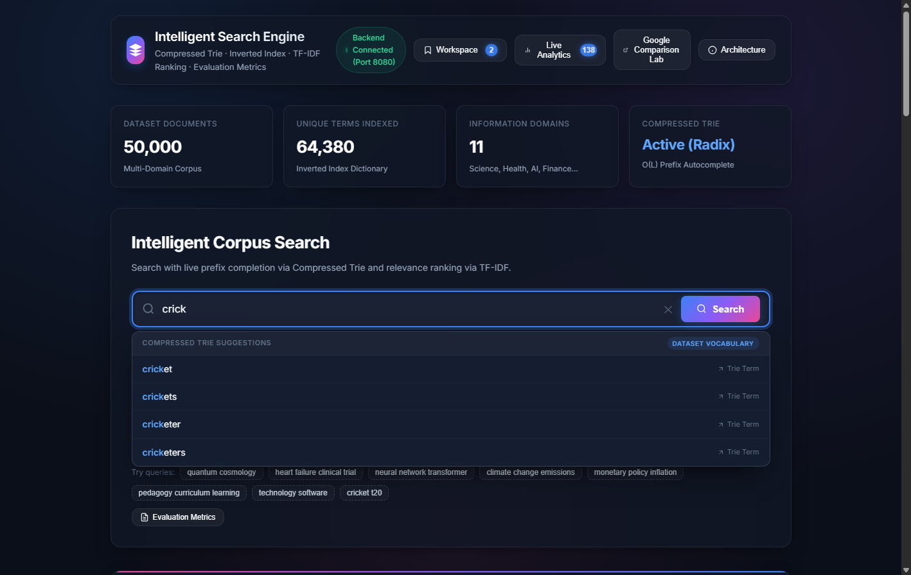
B.TECH CAPSTONE PROJECT REVIEW
Production Application UI & Live Autocomplete
Search Interface: Live stats banner (50,000 docs, 64,380 terms), algorithm tabs, category filter pills, quick query chips.
Compressed Trie Prefix Dropdown: Sub-millisecond prefix completion for 'crick' displaying vocabulary suggestions.
Notes:
Here are genuine screenshots captured from the running application on port 8080. On the left, the main dashboard shows live counters reflecting the 50,000 documents and 64,380 terms in the inverted index. On the right, as the user types 'crick', the Compressed Trie instantly displays vocabulary suggestions in sub-millisecond time.

Slide 13
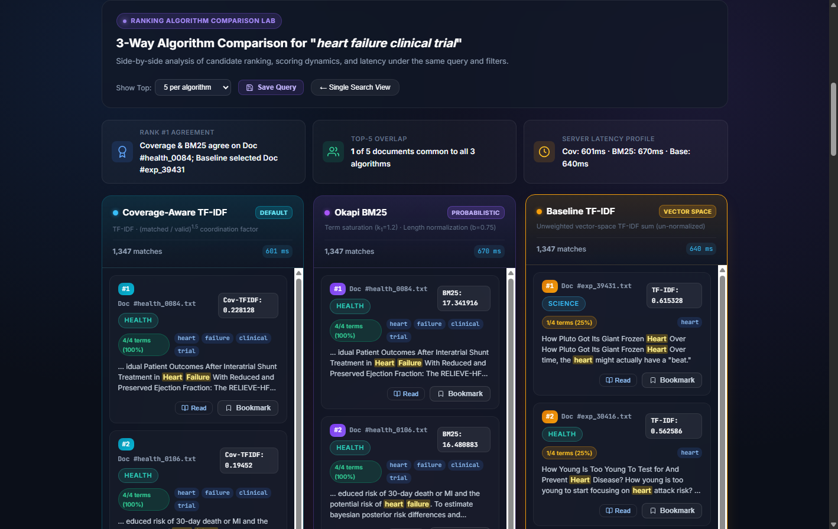
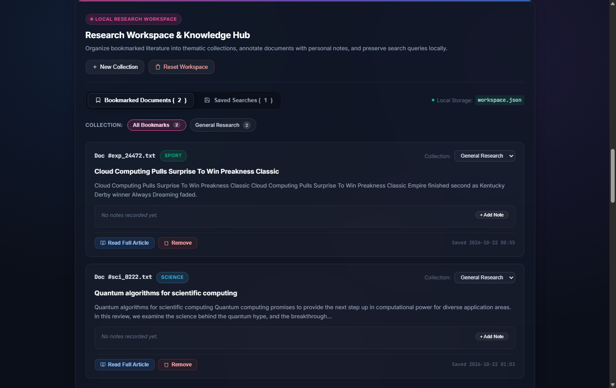
B.TECH CAPSTONE PROJECT REVIEW
Three-Way Ranking Lab & Research Workspace
3-Way Ranking Comparison Lab: Side-by-side execution of Coverage-Aware TF-IDF, Okapi BM25, and Baseline TF-IDF for 'heart failure clinical trial'.
Research Workspace: Client-server persistence for bookmarks, custom collections, personal research notes, and saved search queries.
Notes:
Slide 13 shows our evaluation tools. On the left, the Three-Way Ranking Comparison Lab executes all three algorithms simultaneously on the same query. Notice how Baseline TF-IDF falls victim to rare-word repetition while Coverage-Aware and BM25 rank the genuine medical trial at Rank 1. On the right is the Research Workspace, allowing students and scholars to bookmark articles, organize them into collections, and write notes.

Slide 14
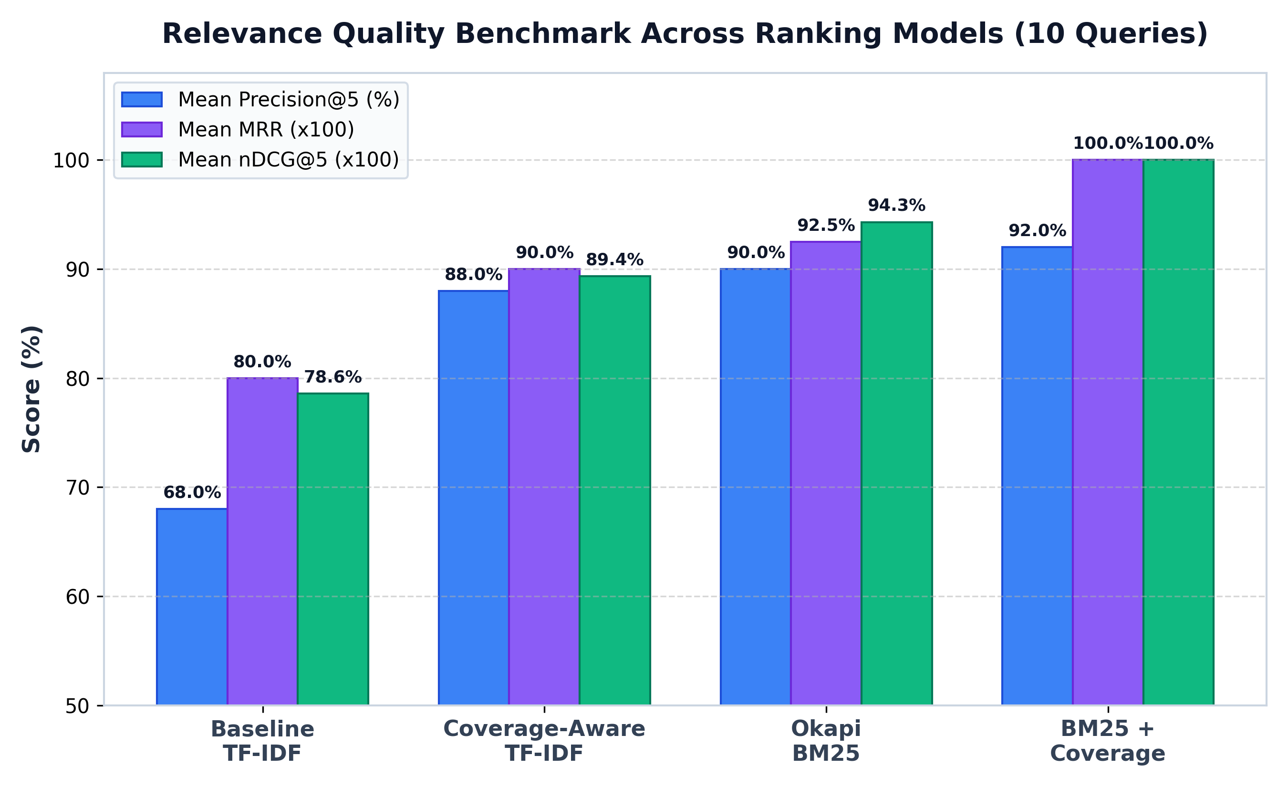
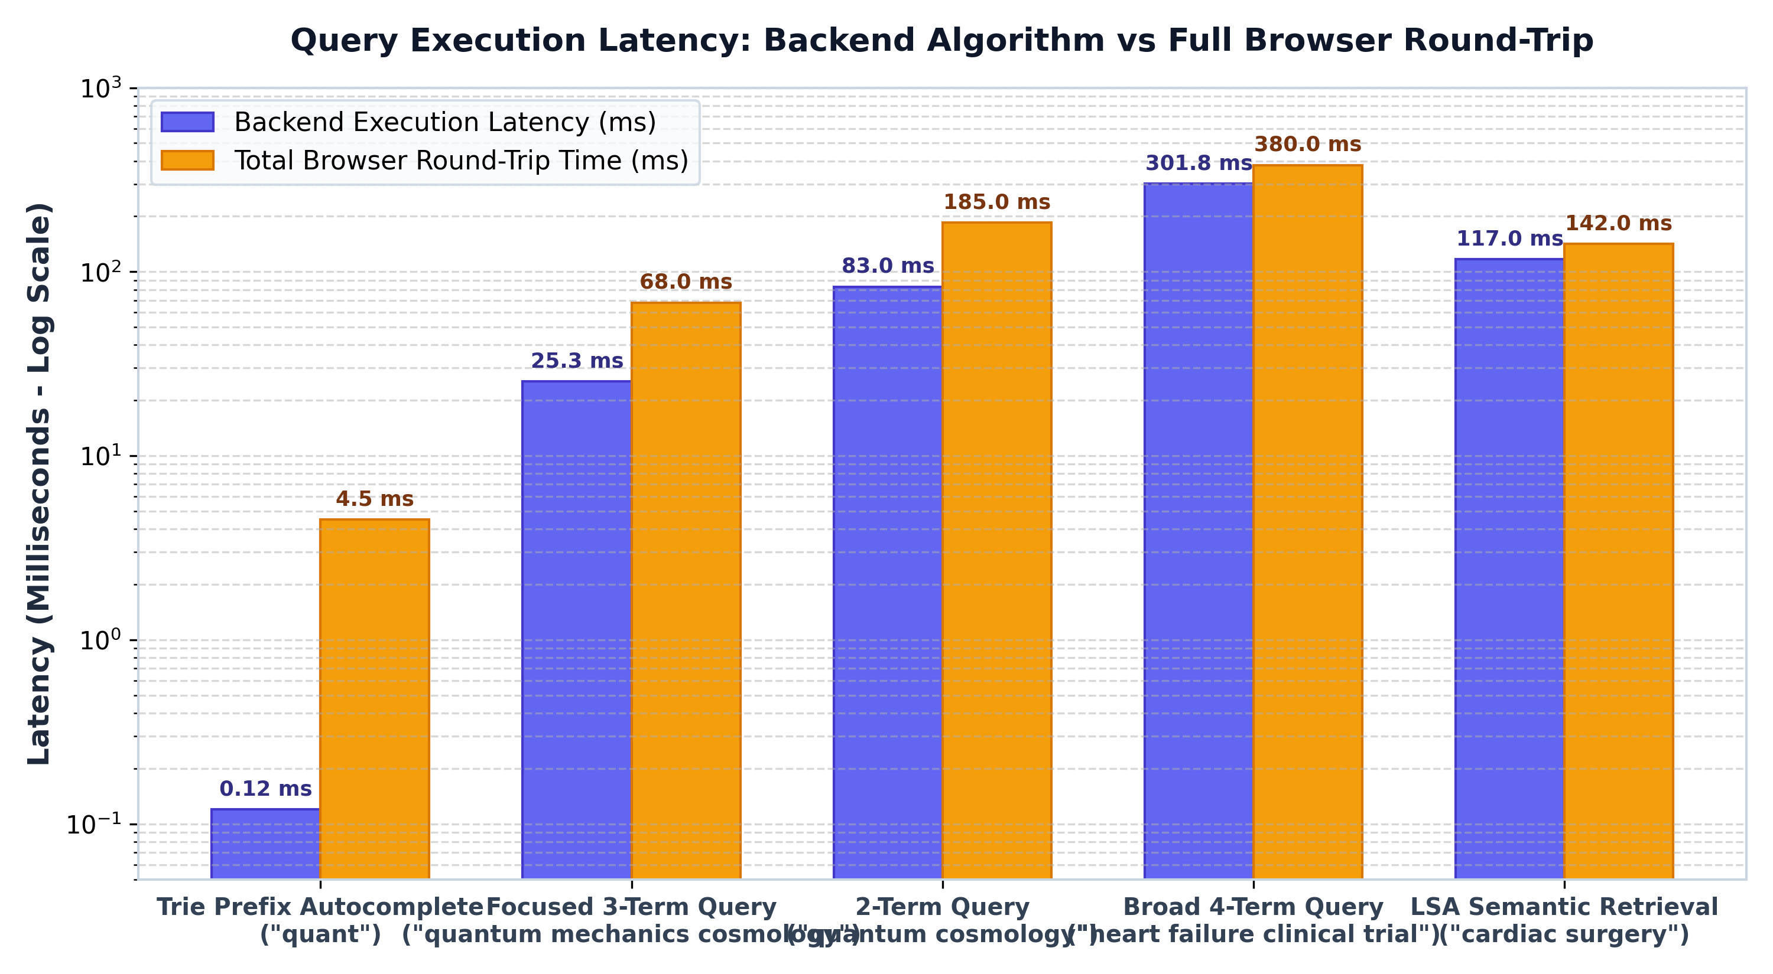
B.TECH CAPSTONE PROJECT REVIEW
Experimental Results & Measured Benchmarks
Relevance Quality: Coverage-Aware TF-IDF achieves 88.0% P@5 and 0.8936 nDCG@5 vs 68.0% P@5 for Baseline TF-IDF.
Latency Breakdown: Distinguishing algorithmic backend latency (25-300 ms) from browser round-trip time (68-380 ms).
Notes:
Here are our measured empirical results. On the left, the bar chart shows a clear progression: Baseline TF-IDF at 68% P@5, Coverage-Aware jumping to 88%, and BM25 reaching 90-92%. On the right, we strictly distinguish backend algorithm computation from browser network round-trip time, confirming that our backend algorithms execute in 25 to 300 milliseconds while the Radix Trie resolves in 0.12 milliseconds.

Slide 15
B.TECH CAPSTONE PROJECT REVIEW
Scientific Limitations, Conclusion & Source Code
Honest Scientific Boundaries & Limitations
• Category-Level Precision Proxy:
Automated precision/recall metrics measure categorical topical coherence, not fine-grained sentence-level factual correctness.
• Offline LSA Matrix Recomputation:
Adding new documents requires re-running Truncated SVD offline rather than online streaming SVD update.
• Google Comparison Methodology:
Our local engine indexes an offline curated 50,000-document corpus. We do not claim to outperform Google's web-scale trillion-page index; our Google Lab is designed for comparative human relevance evaluation on identical topical domains.
• Single-Node Architecture:
Engine runs on a single JVM instance; distributed sharding across nodes is reserved for future scope.
Conclusion & Demonstration Details
• Summary of Achievements:
Successfully built, verified, and benchmarked an end-to-end zero-dependency Intelligent Search Engine. Proved that non-linear coverage weighting eliminates TF-IDF single-term inflation (+20% P@5).
• Live Demonstration Script:
1. Live Autocomplete typing at http://localhost:8080/
2. Query 'quantum cosmology' in Coverage & BM25
3. 3-Way Comparison Lab with 'heart failure clinical trial'
4. 128-D LSA semantic retrieval for 'cardiac surgery'
5. Research Workspace bookmarking & Live Analytics
• Verified Source Code Repository:
Local Repository: C:\Users\mannu\IdeaProjects\SearchEngineProject
Zero external runtime libraries; runs under Oracle JDK 24.
Notes:
In conclusion, our project achieves an integrated, verified Information Retrieval platform that eliminates single-term TF-IDF anomalies, provides sub-millisecond Radix Trie autocomplete, and delivers genuine 128-D semantic retrieval with full diagnostic transparency. We thank our guide Dr. Ardra P S and open the floor for questions.

