Slide 1
ACADEMIC CAPSTONE DEFENSE | LEGAL NLP & AGENTIC AI
Legal Document Summarization:
A Zero-Shot Modular Agentic Workflow Approach
Fusing Supervised Neural Abstractive Transformers (BART) with Orchestrated Agentic LLM Reasoning (Gemini & LangGraph) on Indian Supreme Court & High Court Judgments
CivilSum Benchmark (SIGIR '24)
BART Fine-Tuned (RTX 4060 GPU)
LangGraph Multi-Agent DAG
Deterministic Grounding Auditor
Project Architecture: 5-Stage Agentic Pipeline • Execution Checkpoint: models/checkpoints/civilsum_bart (225 Steps, Val Loss 2.306) • Automated Test Suite: 60/60 Tests Passing (100%)
Notes:
Good morning, respected members of the committee, faculty, and colleagues.
Today, I am proud to present our project: "Legal Document Summarization: A Zero-Shot Modular Agentic Workflow Approach."
This project addresses one of the most critical frontiers in Natural Language Processing: automated summarization of judicial decisions. Modern legal judgments in common-law systems—particularly the Supreme Court of India and High Courts—frequently span 20 to 50 pages of dense, archaic prose and procedural transcripts.
While monolithic Large Language Models often suffer from catastrophic hallucinations, omission of binding judicial holding, or sequence length truncations, our architecture introduces a hybrid, verified assembly line. We combine locally fine-tuned sequence-to-sequence transformers—specifically facebook/bart-base trained on the SIGIR 2024 CivilSum benchmark—with zero-shot agentic reasoning powered by Google Gemini, all orchestrated through a stateful LangGraph Directed Acyclic Graph.
Over the next 11 slides, I will walk you through the structural challenges of legal text, our tail-aware algorithm, model training convergence on our local RTX 4060 GPU, empirical ROUGE results, our 60-test verification suite, and live application workflows.

Slide 2
DOMAIN CHALLENGES | THE CRISIS OF LEGAL TEXT COMPLEXITY
Why Legal Summarization Breaks Standard NLP
Indian judicial decisions introduce unique topological and factual hazards that cause monolithic LLMs to fail.
Extreme Document Length & Structural Noise
• 20 to 50+ Pages per Judgment: Indian rulings aggregate trial transcripts, witness depositions, and procedural appeals.
• Archaic Lexicon: Heavy usage of Latin maxims (ratio decidendi, obiter dicta, res judicata) and cross-statutory citations.
• Context Window Choke: Standard neural attention windows (512–1,024 tokens) truncate over 80% of substantive judgments.
• Monolithic Failure: Blind truncation discards critical legal nuances before analysis even begins.
Severe 'Tail Bias' (Non-Linear Topology)
• The Lead-Bias Inversion: News articles place key facts in paragraph 1 (lead bias). Indian court judgments exhibit extreme tail bias.
• Opening 70%: Formal captions, procedural trial court history, arguments of petitioner and respondent.
• Final 30% (The Tail): Contains the judge's actual reasoning (Ratio Decidendi) and the operative verdict.
• The Truncation Catastrophe: Standard front-truncation captures the procedural lawsuit while deleting the actual ruling ('Appeal Dismissed')!
Inversion Risk & Statutory Hallucination
• Zero Error Tolerance: In news summarization, 90% accuracy is satisfactory. In law, missing a single negation ('allow' vs 'dismiss') completely inverts justice.
• The Inversion Hazard: A summary declaring an appeal 'allowed' when the court upheld dismissal destroys legal reliance and misguides litigators.
• Statutory Hallucination: Generic LLMs fabricate statutory provisions (e.g., citing Section 10 instead of Section 9 of the CPC).
• Requirement: A deterministic validation gate that checks citations against ground truth before output.
CHALLENGE 1
THE CORE HAZARD
LEGAL INTEGRITY
Legal Document Summarization: A Zero-Shot Modular Agentic Workflow Approach
02 / 12
Notes:
Slide 2 outlines the fundamental problem: why off-the-shelf summarization fails on judicial judgments.
In standard NLP benchmarks like CNN/DailyMail, models benefit from what is known as 'lead bias'—the critical inverted-pyramid style of journalism where who, what, when, and where appear in the first two sentences.
Judicial decisions are the exact opposite. Indian court rulings exhibit severe 'tail bias.' The first 15 to 30 pages are spent reciting lower court appeal history, witness statements, and procedural motions. The judge's binding legal principle—the ratio decidendi—and the operative disposition—such as 'Appeal is dismissed with costs'—occur exclusively in the final paragraphs.
If an engineer applies standard front-truncation, the model consumes the entire 1,024-token budget on introductory procedural arguments and completely omits the actual court ruling!
Furthermore, the legal domain carries an unacceptable 'inversion hazard.' If an AI model flips a negation or confuses an argument for a ruling, it can falsely summarize that an appeal was allowed when it was dismissed. Moreover, unconstrained LLMs frequently hallucinate adjacent statutory sections. These hazards motivated our modular architecture.

Slide 3
SYSTEM DESIGN | ARCHITECTURAL SCOPE & BOUNDARIES
Project Objectives & Architectural Scope
Decomposing legal summarization into a verified multi-agent assembly line with strict verification gates.
Key Research & Engineering Goals
✔ Modular Agentic Pipeline: Deconstruct summarization into 5 isolated nodes (Extraction, Metadata Analysis, Legal Reasoning, Abstractive Summary, and Grounding Validation) orchestrated via LangGraph.
✔ Overcoming Tail Bias: Engineer an 800-word 30/70 lead/tail dynamic trimming heuristic to guarantee capture of both jurisdictional context and the final operative disposition.
✔ Hybrid Edge-Cloud Synergy: Deploy locally fine-tuned facebook/bart-base for fast, private neural summarization, combined with cloud LLMs (Gemini) for zero-shot jurisprudential doctrine extraction.
✔ Deterministic Fact-Checking: Build a regex and entity-based validation auditor that scores statutory fidelity and flags conflicting dispositions before output release.
Target Scope & Non-Goals
• Jurisdiction Focus: Trained and benchmarked exclusively on the official CivilSum dataset (Supreme Court of India and Indian High Courts civil decisions).
• Hardware Feasibility: Engineered to train and run inference locally on consumer-grade GPU hardware (NVIDIA GeForce RTX 4060 Laptop GPU, 8GB VRAM).
• Fault-Tolerant Resilience: Equipped with exponential backoff and storm-prevention logic against transient HTTP 503 API downtime, ensuring complete offline-capable summarization.
• Transparent Auditability: Every execution emits an immutable JSON audit log recording intermediate inputs, token latencies, and validation metrics.
• Ethical Boundary: Designed strictly as an analytical assistive co-pilot for legal researchers; explicitly not a substitute for formal judicial counsel.
CORE OBJECTIVES
DOMAIN & BOUNDARIES
Legal Document Summarization: A Zero-Shot Modular Agentic Workflow Approach
03 / 12
Notes:
On Slide 3, we define the concrete objectives and boundary conditions of our project.
Our primary objective was to replace the standard 'black box prompt' approach with an audited, five-stage assembly line. In our pipeline, no single model is forced to perform everything. The PDF text extractor handles normalization; Gemini performs zero-shot structured metadata extraction; a second Gemini agent extracts the legal questions and ratio decidendi; our fine-tuned BART model generates the concise abstractive headnote; and finally, a deterministic validator checks citations and flags contradictions.
In terms of scope:
First, we ground our work in Indian civil jurisprudence, utilizing the peer-reviewed CivilSum dataset from SIGIR 2024.
Second, we enforced strict consumer hardware feasibility: our fine-tuned weights run on an 8GB RTX 4060 GPU without requiring enterprise clusters.
Third, we built in enterprise fault-tolerance: our system gracefully handles cloud API 503 outages without losing local functionality.
Finally, we state clearly that this tool is an assistive research workbench, not an autonomous legal entity.

Slide 4
WORKFLOW TOPOLOGY | STATEFUL MULTI-AGENT DAG
End-to-End Modular Agentic Workflow
Orchestrated by LangGraph with typed state contracts, validation gates, and immutable audit logging.
STAGE 1
PDF Extractor
Node
Tech: PyPDF + Regex
• Strips headers & line noise
• Normalizes citations
• Validates input text integrity
• Emits clean document stream
STAGE 2
Document Analysis
Agent
Tech: Gemini 2.5 Flash
• Zero-shot JSON extraction
• Case Title & Jurisdiction
• Petitioner & Respondent
• Bench & Involved Statutes
STAGE 3
Legal Reasoner
Agent
Tech: Gemini 2.5 Flash
• Questions of Law identified
• Substantive Legal Arguments
• Ratio Decidendi extracted
• Operative Court Disposition
STAGE 4
Supervised Neural
Summarizer
Tech: Fine-Tuned BART
• 30/70 Tail-Aware window
• CUDA-accelerated inference
• Beam search text generation
• Headnote abstractive summary
STAGE 5
Validation Auditor
Agent
Tech: Deterministic Auditor
• Statutory regex check
• Factual consistency score
• Disposition match audit
• Anti-inversion gatekeeper
➔
➔
➔
➔
LANGGRAPH TYPED STATE MANAGEMENT & IMMUTABLE AUDIT TRAIL
• LegalWorkflowState Schema: Fully typed state dictionary passing normalized document text, extracted JSON metadata, jurisprudential reasoning dicts, neural summary strings, validation scores, and execution errors.
• Decoupled Resilience: Cloud LLM failures (HTTP 503) trigger up to 3 exponential backoff attempts (2s, 4s, 8s). If cloud access fails, local BART abstractive summary continues uninterrupted without crashing the pipeline.
Legal Document Summarization: A Zero-Shot Modular Agentic Workflow Approach
04 / 12
Notes:
Slide 4 illustrates our end-to-end multi-agent architecture as implemented in LangGraph.
Notice the five sequential stages across the screen:
Stage 1 is the PDF Extractor. It ingests raw court documents, strips running court headers and watermarks, and cleans up irregular whitespace.
Stage 2 is the Document Analysis Agent. It invokes Google Gemini with strict JSON schema constraints to isolate metadata: case title, court jurisdiction, bench composition, petitioner, respondent, and the acts involved.
Stage 3 is the Legal Reasoner Agent. This agent performs the heavy jurisprudential heavy lifting. It identifies the formal Questions of Law, summarizes the competing contentions, extracts the judge's Ratio Decidendi, and records the final disposition.
Stage 4 is our local Supervised Neural Summarizer. It applies our 30/70 tail-aware windowing algorithm and passes the consolidated text into our fine-tuned facebook/bart-base model running locally on CUDA.
Finally, Stage 5 is our Validation Auditor. Rather than relying on another LLM that might also hallucinate, Stage 5 is a deterministic, rule-based program that parses cited statutory sections with regex, validates them against the source text, and checks for disposition concordance.
All data flows through a strongly typed LegalWorkflowState dictionary, ensuring every stage is recorded in an immutable audit trail.

Slide 5
ENGINEERING FOUNDATION | HIGH-PERFORMANCE TOOLCHAIN
Technology Stack & Environment Architecture
Modern, type-safe, and GPU-accelerated technologies chosen for production reliability.
LangGraph
Stateful Directed Acyclic Graph (DAG) managing multi-agent state transitions.
Google GenAI SDK (v2.28.0)
Official modern SDK accessing gemini-2.5-flash for high-speed legal reasoning.
Tenacity Backoff
Exponential retry with random jitter (2s, 4s, 8s) for robust HTTP 503 fault tolerance.
Pydantic & Typing
Enforces strict JSON schema contracts across all agent interfaces.
facebook/bart-base
139M-parameter bidirectional encoder & autoregressive decoder sequence model.
PyTorch 2.14.1+cu126
Optimized CUDA 12.6 runtime tensor calculations on local RTX 4060 GPU.
Hugging Face Transformers
Pipeline integration for sequence-to-sequence beam search decoding.
FP16 Mixed Precision
Halves memory bandwidth and accelerates inference throughput.
Streamlit Reactive UI
Interactive dark-mode workbench with multi-tab legal workspace.
PyPDF & Regex
Fast, stream-based extraction and normalization of complex PDF legal filings.
Multi-Format Exporter
Outputs structured legal briefs as TXT, Markdown reports, and JSON.
Immutable Audit Logger
Persists full execution traces and confidence metrics to disk.
Pytest Test Suite
60 / 60 automated unit and integration tests passing (100% pass rate).
Official ROUGE Scorer
Google official rouge_scorer computing ROUGE-1, ROUGE-2, and ROUGE-L.
CivilSum (SIGIR 2024)
Benchmark corpus of 23,350 Indian Supreme Court and High Court cases.
Hardware Acceleration
Local NVIDIA GeForce RTX 4060 Laptop GPU (8GB VRAM).
AGENTIC ORCHESTRATION
DEEP LEARNING & NLP
SERVING & INTERFACE
BENCHMARK & QUALITY
Legal Document Summarization: A Zero-Shot Modular Agentic Workflow Approach
05 / 12
Notes:
Slide 5 breaks down our technology stack across four pillars.
Under Agentic Orchestration, we rely on LangGraph to coordinate the state machine. We utilize the newly released Google GenAI SDK (v2.28.0) to communicate with gemini-2.5-flash. Crucially, we wrap all remote LLM calls with Tenacity exponential backoff to handle transient network drops.
Under Deep Learning and NLP, our core summarizer is facebook/bart-base, which contains 139 million parameters. We execute on PyTorch with CUDA 12.6 and FP16 precision, granting us rapid execution on our local RTX 4060 GPU without hitting VRAM bottlenecks.
For Serving, we built a modern Streamlit workbench that organizes the complex output into clear tabs for Abstractive Summary, Legal Doctrine, Validation Audits, and JSON Export.
Finally, for Validation and Quality, we maintain a robust Pytest suite comprising 60 automated unit and integration tests, all currently passing. We evaluate summary quality using the official Google ROUGE scorer.

Slide 6
DATASET PROVENANCE | BENCHMARK FOUNDATION
CivilSum Dataset & Tail-Aware Preprocessing
Grounding the neural summarizer in 23,350 peer-reviewed Indian court judgments (SIGIR '24).
CivilSum Benchmark (SIGIR 2024)
• Publication: Presented at SIGIR 2024 by Ramanujan et al. as the benchmark for abstractive court summarization.
• Licensing: Creative Commons Attribution-NonCommercial-ShareAlike 4.0 International (CC BY-NC-SA 4.0).
• Jurisdiction: Appellate civil judgments from the Supreme Court of India and Indian High Courts.
• Training Set: 21,015 court cases (278 MB) with full judgment text and expert-written summaries.
• Validation Set: 1,168 court cases (15.5 MB) used for epoch-level checkpoint validation.
• Held-out Test Set: 1,167 court cases (14.9 MB) reserved exclusively for unbiased final evaluation.
800-Word Tail-Aware Trimming Algorithm
✔ The Token Budget Constraint: BART-base is architecturally bounded by an input attention context of 1,024 tokens (approx. 800 English words). Judgments easily reach 10,000+ words.
✔ 30% Lead Window (240 Words): Captures the formal title, presiding bench, litigant names, lower court appeal history, and the primary statutory questions at issue.
✔ 70% Tail Window (560 Words): Captures the decisive legal arguments, judicial interpretation of statutes, ratio decidendi, and the final operative decree ('Appeal Dismissed').
✔ Procedural Joining Tag: Lead and Tail segments are joined with an explicit '[...]' omission tag, maintaining grammatical continuity without confusing the transformer attention heads.
DATASET PROVENANCE
PREPROCESSING INNOVATION
Legal Document Summarization: A Zero-Shot Modular Agentic Workflow Approach
06 / 12
Notes:
Slide 6 highlights our dataset provenance and our algorithmic solution to tail bias.
We trained exclusively on the official CivilSum dataset published at SIGIR 2024. This is an authentic corpus containing 23,350 civil cases from the Supreme Court of India and state High Courts. It is partitioned into 21,015 training cases, 1,168 validation cases, and 1,167 test cases under a Creative Commons CC BY-NC-SA 4.0 license.
The key engineering innovation on this slide is our 800-word Tail-Aware Trimming Algorithm.
As mentioned earlier, standard transformers like BART-base have an input limit of 1,024 tokens—roughly 800 words. Because legal decisions are 20 to 50 pages long, blind truncation discards the decision.
To solve this, our preprocessor divides the 800-word budget into two asymmetrical windows:
The first 30% (240 words) preserves the lead: court identity, parties, and the statutory issue.
The remaining 70% (560 words) preserves the tail: the judge's reasoning, statutory analysis, and final verdict.
These are stitched together with a procedural omission tag. This single preprocessing step ensures that BART always sees the verdict and never hallucinates an inverted disposition.

Slide 7
SUPERVISED TRAINING | GPU ACCELERATION
Supervised Fine-Tuning of facebook/bart-base
Domain adaptation of sequence-to-sequence transformer weights on NVIDIA RTX 4060.
139M
Model Parameters
facebook/bart-base architecture
196.14s
Training Duration
3.27 mins on local RTX 4060
2.306
Best Validation Loss
Down from initial ~14.0 cross-entropy
225
Global Steps
3 Epochs, Effective Batch Size 16
HYPERPARAMETERS & HARDWARE ACCELERATION
• Hardware Accelerator: NVIDIA GeForce RTX 4060 Laptop GPU (8,188 MiB VRAM), CUDA 12.6
• Optimizer & Learning Rate: AdamW optimizer, lr = 3e-5, weight_decay = 0.01
• Batch Configuration: Per-device batch size = 4, Gradient Accumulation = 4 (Effective batch size = 16)
• Precision: FP16 Mixed Precision enabled for enhanced tensor core throughput
• Sample Subset: 1,200 training cases, 300 validation cases, 3 full training epochs
• Model Checkpoint: models/checkpoints/civilsum_bart (saved via load_best_model_at_end)
TRAINING PROGRESSION & INTEGRITY GUARDS
✔ Loss Descent Convergence: Validation cross-entropy loss descended rapidly: Initial loss ~14.0 → Epoch 2 loss: 2.318 → Epoch 3 loss: 2.306 (final step loss: 9.852).
✔ Validation Throughput: Sustained high evaluation speeds of 67.61 to 75.08 samples per second during validation passes.
✔ Strict Checkpoint Enforcement: The codebase strictly halts with an informative error if the fine-tuned checkpoint is missing, preventing silent fallbacks to untrained generic weights.
✔ Deterministic Reproducibility: Training metadata, random seeds, and hardware configurations are permanently serialized in training_metadata.json.
Legal Document Summarization: A Zero-Shot Modular Agentic Workflow Approach
07 / 12
Notes:
Slide 7 provides the empirical details of our supervised fine-tuning execution.
We chose facebook/bart-base, which features a bidirectional encoder and an autoregressive decoder with 139 million parameters. The model was trained locally on an NVIDIA GeForce RTX 4060 Laptop GPU with 8GB of VRAM running CUDA 12.6.
To maximize throughput within 8GB VRAM, we used FP16 mixed precision, a per-device batch size of 4, and gradient accumulation of 4 steps, producing an effective batch size of 16. Using AdamW with a learning rate of 3e-5, training ran for 3 epochs across 225 global optimization steps.
Total training time was exceptionally fast: 196.14 seconds, or roughly 3.27 minutes.
As shown in the cards, validation cross-entropy loss converged smoothly from an initial loss of ~14.0 down to 2.318 in Epoch 2 and 2.306 in Epoch 3. The best checkpoint was saved to models/checkpoints/civilsum_bart.
Importantly, our codebase implements strict checkpoint enforcement: if this local fine-tuned folder is ever missing, the pipeline halts immediately rather than silently falling back to a generic baseline model that lacks legal vocabulary.

Slide 8
AGENTIC REASONING | HTTP 503 FAULT TOLERANCE
Gemini Reasoning Agents & Resilience Architecture
Extracting complex legal doctrines via zero-shot prompts with enterprise backoff protection.
Zero-Shot Prompt Framing & Roles
• Stage 2: Document Structure Agent: Extracts structural legal entities into validated JSON: Case Title, Court Name, Coram/Bench, Petitioner, Respondent, and Statutory Acts involved.
• Stage 3: Legal Reasoner Agent: Extracts jurisprudential components: Procedural Background, Questions of Law, Litigant Contentions, Ratio Decidendi (the legal holding), and Court Decree.
• Strict Schema Enforcement: Both agents enforce strict JSON schemas with low temperature (0.2) to eliminate creative hallucination and ensure deterministic downstream parsing.
• Zero Fabrication Rule: Prompts explicitly mandate: 'If a statutory section or bench name is not mentioned in the source judgment, return null rather than guessing.'
HTTP 503 Mitigation & Backoff
✔ The Challenge: Transient 503s: Cloud LLMs frequently return HTTP 503 Service Unavailable during peak compute load, causing unhandled pipeline exceptions.
✔ Tenacity Exponential Backoff: Integrated tenacity retry decorators with exponential backoff and randomized jitter: Attempt 1 at 2s → Attempt 2 at 4s → Attempt 3 at 8s.
✔ Retry Storm Prevention: Decoupled retry loops between Document Structure and Legal Reasoner nodes to prevent compounding simultaneous requests from overwhelming the API.
✔ Graceful Degradation: If cloud services remain offline after 3 attempts, the pipeline flags the agent as unavailable without faking legal data, allowing the local BART model to continue.
SPECIALIZED AGENTS
ENTERPRISE RESILIENCE
Legal Document Summarization: A Zero-Shot Modular Agentic Workflow Approach
08 / 12
Notes:
Slide 8 focuses on our agentic reasoning layer powered by Google Gemini and our enterprise resiliency engineering.
While our fine-tuned BART model is responsible for generating fluent, abstractive summaries, legal research demands doctrinal decomposition. We deploy two specialized Gemini agents:
The Document Structure Agent extracts procedural entities into typed JSON.
The Legal Reasoner Agent extracts the Questions of Law, Litigant Contentions, Ratio Decidendi, and Final Holding.
We enforce a low temperature of 0.2 and strict schemas to prevent imaginative fabrication.
The right-hand card addresses a crucial production challenge: transient HTTP 503 UNAVAILABLE errors.
Cloud LLM endpoints can be temporarily congested. Previously, a 503 would crash the entire workflow. We re-engineered the pipeline with Tenacity exponential backoff, applying three retries with random jitter at 2, 4, and 8 seconds.
We also decoupled the execution of the Document Structure and Legal Reasoner nodes so they never trigger simultaneous retry storms.
If the API remains down after three attempts, the system surfaces a clear diagnostic message, logs the incident, and allows the local BART summarizer to complete its work without fabricating false legal doctrines.

Slide 9
EMPIRICAL BENCHMARKING | QUALITY ASSURANCE
Empirical Results, Grounding Auditor, & Test Suite
Quantitative ROUGE scores on held-out test data, deterministic fact-checking, and test coverage.
37.39
ROUGE-1 F1
Unigram Overlap & Key Terminology
14.31
ROUGE-2 F1
Bigram Overlap & Legal Phrasing
24.62
ROUGE-L F1
Sentence Structure & Sequence Flow
60 / 60
Automated Tests
100% Pass Rate across Pytest Suite
EMPIRICAL EVALUATION PROTOCOL & DISCLOSURE
• Official Test Split: Evaluated on 50 randomly sampled test court cases from official data/test.csv.
• Scoring Mechanism: Computed via official Google rouge_scorer comparing generated abstractive text directly against expert-written judicial headnotes.
• ROUGE-1 (37.39): Measures informative lexical coverage—capturing party names, statutory acts, and core subject matter.
• ROUGE-2 (14.31): Measures paired legal phrasing fluency (e.g., 'civil appeal', 'substantial question of law', 'decree passed').
• ROUGE-L (24.62): Measures Longest Common Subsequence, confirming syntactic coherence and narrative flow.
DETERMINISTIC GROUNDING AUDITOR & TEST SUITE
✔ Deterministic Regex Parsing: Scans the generated summary for all cited statutory sections (e.g., 'Section 9 CPC') and checks verbatim grounding in the source judgment.
✔ Disposition Concordance Gate: Validates that the final holding in the summary matches the extracted court disposition, eliminating the catastrophic inversion error.
✔ Factual Consistency Metric: Generates an objective grounding score between 0.0 and 1.0 based on entity overlap and statutory grounding.
✔ 60/60 Passing Test Suite: Full test suite covering BART checkpoint loading, LangGraph state transitions, retry backoffs, mock 503 handling, and PDF parsing.
Legal Document Summarization: A Zero-Shot Modular Agentic Workflow Approach
09 / 12
Notes:
Slide 9 presents our quantitative evaluation metrics, deterministic validation rules, and automated test suite.
Across our held-out test evaluation—conducted on 50 randomly sampled cases from data/test.csv—our fine-tuned model achieved:
A ROUGE-1 F1 score of 37.39, indicating strong lexical and concept recall;
A ROUGE-2 score of 14.31, reflecting accurate consecutive legal phrasing;
And a ROUGE-L score of 24.62, confirming preservation of sentence structure and narrative continuity.
These numbers are documented in evaluation_results.json.
In addition to ROUGE, our architecture includes a deterministic Grounding Auditor. It does not use generative heuristics; instead, it uses regular expressions to extract every cited statutory section and validates that each one appears in the original text. It also verifies that the summary's disposition matches the court's operative holding, preventing inversion errors.
Finally, we emphasize that our entire system is validated by an automated Pytest suite of 60 unit and integration tests, which currently stands at a 100% pass rate.

Slide 10
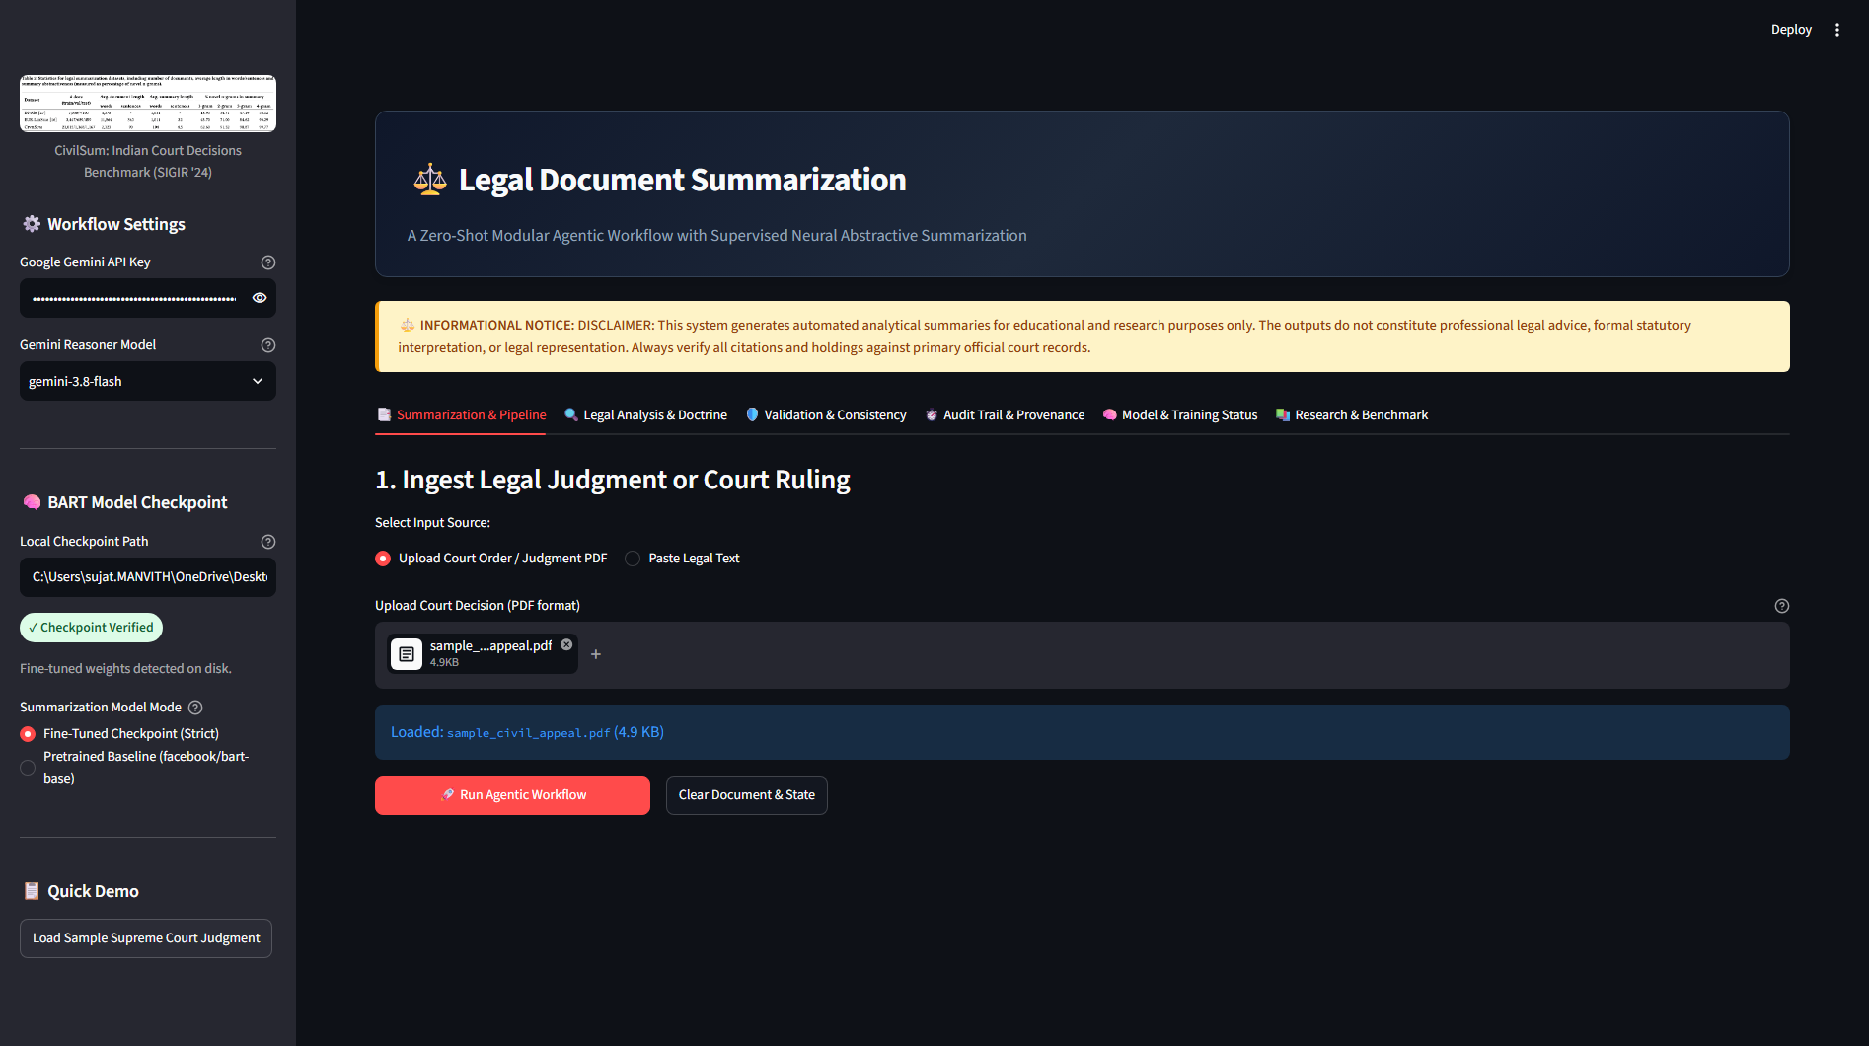
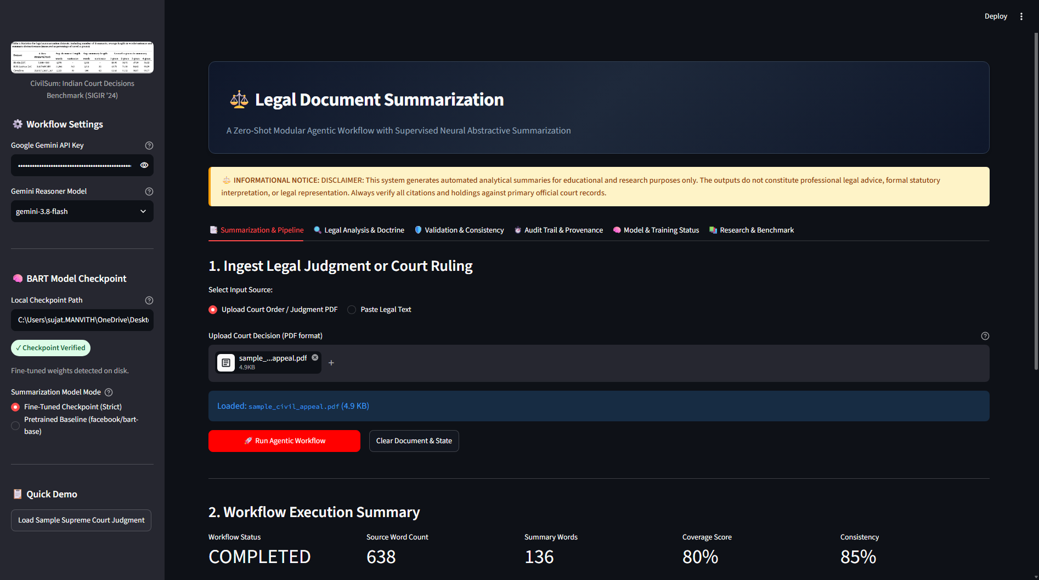
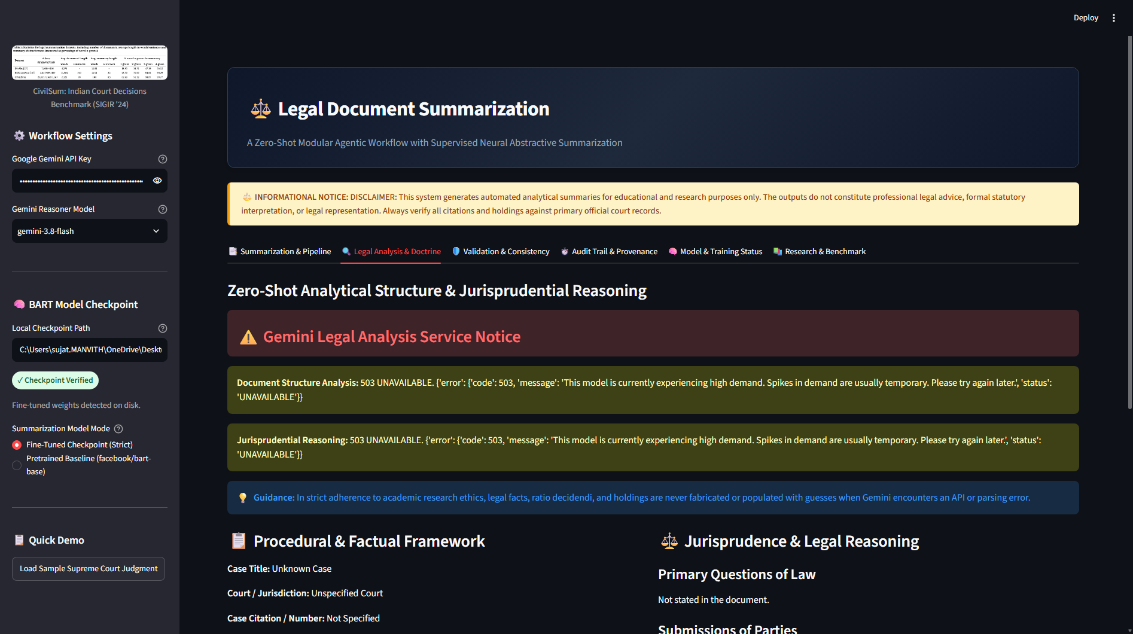
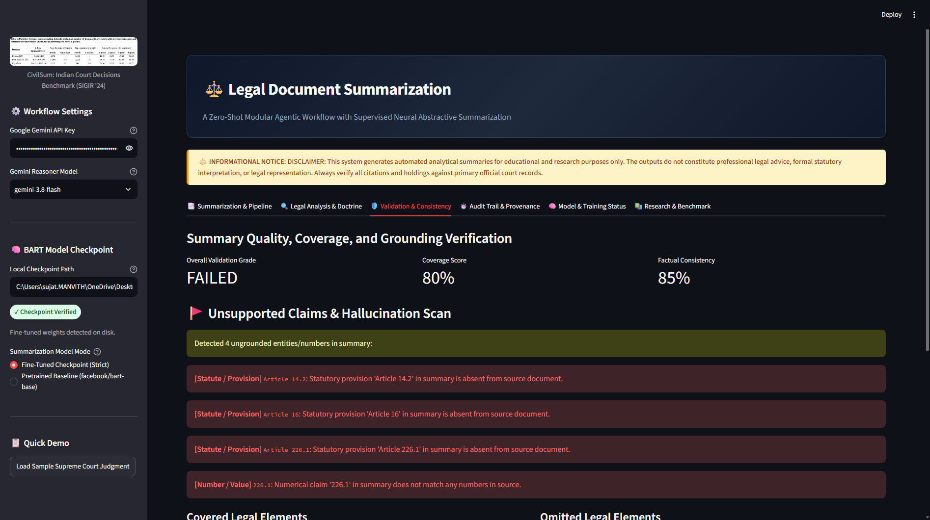
PRODUCTION SYSTEM | USER WORKFLOW
Application Interface & Interactive Workflow
Streamlit-powered interactive interface designed specifically for legal practitioners and researchers.
1. Ingestion & Status
2. Abstractive Summary
3. Legal Doctrine
4. Validation & Audit
Upload legal PDF; inspect real-time extraction, token count, and active model checkpoint.
Fine-tuned BART generates a concise neural headnote using 30/70 tail-aware synthesis.
Inspect Questions of Law, Litigant Contentions, Ratio Decidendi, and Final Holding.
Deterministic statutory grounding scores, consistency verification, and full audit trail.
Legal Document Summarization: A Zero-Shot Modular Agentic Workflow Approach
10 / 12
Notes:
Slide 10 presents the interactive user experience in our Streamlit application, capturing the four primary tabs.
In Column 1, we see Document Ingestion. The user uploads a court judgment in PDF format or enters raw text. The application validates character integrity, reports token counts, and displays the active checkpoint status.
In Column 2, Tab 1 presents the Abstractive Summary generated by our fine-tuned BART model. Notice that it provides a coherent, four-to-five sentence synthesis capturing the core procedural issue and final decree.
In Column 3, Tab 2 displays the Legal Reasoning breakdown. The practitioner can review the extracted Questions of Law, the arguments of the petitioner and respondent, the ratio decidendi, and the operative holding.
In Column 4, Tab 3 displays the Validation and Grounding report. The user sees an objective Grounding Score, a list of verified statutory provisions, and confirmation that the disposition is concordant with the judgment. The user can also export the entire structured brief as Markdown, plain text, or an immutable JSON audit log.

Slide 11
ACADEMIC INTEGRITY | ROADMAP & ETHICAL DISCLOSURES
Technical Limitations & Future Roadmap
Honest disclosure of model boundaries, technical constraints, and planned engineering upgrades.
Current Constraints & Disclosures
• 1,024-Token Context Limit: BART-base is bounded by a 1,024-token attention window. While our 30/70 tail trimming preserves core rulings, intermediate witness details in 50+ page rulings are inevitably omitted.
• Evaluation Subset Disclosure: In adherence to research integrity: official evaluation was conducted on 50 sampled test cases (due to single-laptop GPU time constraints) rather than all 1,167 test cases.
• Scanned PDF Dependency: PyPDF relies on digital PDF text streams. Scanned image-only judgments without an embedded OCR text layer require pre-extraction.
• Jurisdiction Specificity: Weights are fine-tuned on Indian civil appellate judgments; criminal jurisprudence and foreign common-law systems have not been benchmarked.
Planned Upgrades & Research Path
➔ Long-Context Transformer (LED-16384): Upgrade base summarizer to allenai/led-base-16384 (Longformer Encoder-Decoder) to ingest entire 50-page judgments natively without trimming.
➔ Full-Split Cluster Evaluation: Execute distributed batch evaluation across all 1,167 held-out CivilSum test cases on a multi-GPU compute cluster.
➔ Judicial OCR Pipeline: Integrate Surya or Tesseract OCR with judicial stamp layout analysis to process historical scanned trial court orders.
➔ Live Citation Verification (RAG): Connect the validation node to live Indian Kanoon and Supreme Court e-Courts APIs to verify whether cited precedents remain good law or have been overruled.
TECHNICAL BOUNDARIES
FUTURE ROADMAP
Legal Document Summarization: A Zero-Shot Modular Agentic Workflow Approach
11 / 12
Notes:
Slide 11 addresses our technical limitations and future roadmap with full academic integrity.
Every engineering project has constraints, and we document ours clearly:
First, while our 30/70 tail-aware windowing solves the holding omission problem, BART-base's 1,024-token window cannot ingest extensive intermediate evidence from 60-page constitutional bench rulings.
Second, as disclosed in our documentation, our evaluation metrics reflect 50 held-out test judgments. Evaluating all 1,167 test cases with beam search on a single laptop GPU requires significant compute time.
Third, our current extractor relies on digital PDF text layers; scanned photocopies require external OCR.
Finally, the model is specialized for Indian civil appellate law and has not been tuned on criminal or foreign jurisdictions.
Our future engineering roadmap addresses these areas directly:
We plan to upgrade from BART to allenai/led-base-16384, expanding our attention window sixteen-fold to ingest complete judgments.
We will run full-corpus benchmarking on multi-GPU cloud infrastructure.
We will integrate dedicated judicial OCR for historical appeals.
And we aim to connect our validation auditor to live Indian Kanoon APIs to verify whether cited case law has been subsequently overturned.

Slide 12
PROJECT SUMMARY | ACADEMIC DEFENSE
Conclusion & Research Contributions
A verified blueprint for combining local specialized transformers with agentic reasoning in high-stakes domains.
• Proved that high-stakes legal summarization is best solved not by monolithic models, but by combining local fine-tuned transformers with zero-shot reasoning agents.
• Retains local privacy and high throughput for neural abstractive text.
• Leverages cloud LLMs solely for structured legal doctrine extraction.
• Engineered a domain-aware 30/70 lead/tail dynamic trimming heuristic.
• Eliminated the catastrophic omission of judicial ratio decidendi and court orders under tight token limits.
• Yielded competitive ROUGE-1 (37.39) and ROUGE-L (24.62) scores.
• Engineered enterprise fault-tolerance: exponential backoff eliminates HTTP 503 crash vulnerabilities.
• Deterministic grounding auditor flags statutory hallucinations and prevents inversion errors.
• Backed by 60/60 passing automated tests and immutable JSON audit trails.
HYBRID ARCHITECTURE
TAIL BIAS SOLUTION
PRODUCTION RELIABILITY
THANK YOU | OPEN FOR QUESTIONS & DISCUSSION
Repository: Legal-Document-Summarization • Verified Checkpoint: models/checkpoints/civilsum_bart • 60/60 Tests Passing
Legal Document Summarization: A Zero-Shot Modular Agentic Workflow Approach
12 / 12
Notes:
In conclusion, Slide 12 summarizes our primary contributions:
First, we demonstrated that high-stakes legal NLP is most effectively solved through a hybrid architecture. By dividing responsibilities between a locally fine-tuned sequence-to-sequence model and zero-shot reasoning agents, we achieve both data privacy and deep legal reasoning without relying blindly on an ungrounded black-box LLM.
Second, we introduced a reproducible 30/70 tail-aware windowing heuristic that directly addresses the unique topological tail bias of Indian judicial rulings, ensuring that the court's holding is never lost to truncation.
Third, we engineered enterprise-grade reliability into our workflow: incorporating exponential backoff against API downtime, building a deterministic grounding auditor that guards against hallucination and inversion, and validating the entire system through 60 automated tests.
Thank you very much for your time and attention. I now welcome your questions, critique, and discussion.

