Slide 1
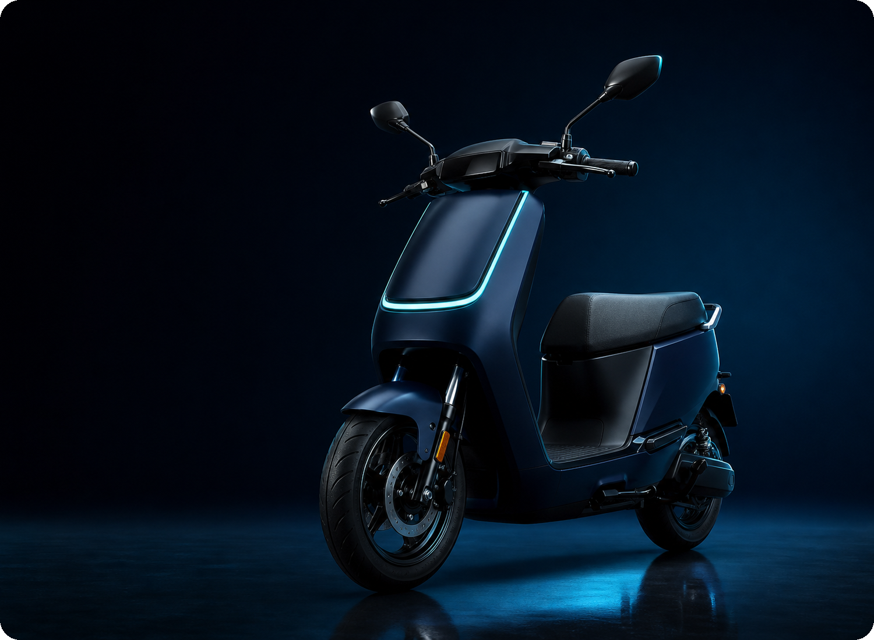
INDIAN INSTITUTE OF INFORMATION TECHNOLOGY, DHARWAD | MANAGERIAL ECONOMICS
CASE STUDY PRESENTATION · OCTOBER 2026
PROJECT REPORT
The Zenith-V
Launch Decision
Market structure, pricing strategy, game theory and capital budgeting for an electric scooter start-up
SUBMITTED BY
SUBMITTED TO
J Ganesh Kumar Reddy
Dr. K. T. Deepak
Associate Dean (Innovation, Entrepreneurship and IDRP)
Roll No. 23BDS024
The Zenith-V — flagship electric scooter of E-Mobility India, Bengaluru
LECTURE COVERAGE
Session 5
Pricing Strategies
·
Session 6
Profit
·
Session 7
Game Theory
·
Session 8
Risk
·
Session 9
Capital Budgeting & Fiscal Policy
This deck answers the three tasks in the assignment brief: market and demand analysis, pricing and game theory, and capital budgeting.
J GANESH KUMAR REDDY
· 23BDS024
Managerial Economics · Zenith-V Case Study · IIIT Dharwad
Page 1 of 9
Notes:
Good morning. This is my case-study presentation on the Zenith-V, the electric scooter that E-Mobility India plans to launch. The brief asks three questions: what kind of market we are entering, what we should charge, and whether the Chennai plant is worth ₹200 crore. I have drawn the concepts from Sessions 5 to 9 of the Managerial Economics course.

Slide 2
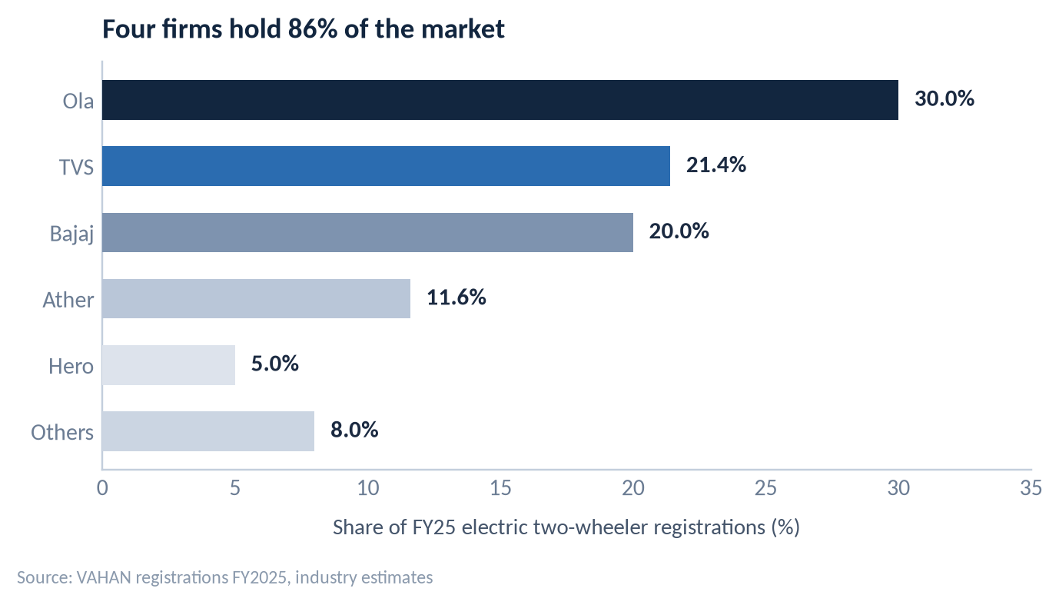
1 · MARKET & DEMAND ANALYSIS
LECTURE LINK · SESSION 7: GAME THEORY
Why this market is an oligopoly
Four firms sell 86% of India's electric scooters, each sets price by watching the others, and entry costs ₹200 crore.
1
Few sellers, high concentration
Ola, TVS, Bajaj and Ather take 86% of FY25 registrations. The HHI works out to about 1,900 — well above the 1,800 mark that signals a highly concentrated market.
2
Strategic interdependence
No firm can set a price without guessing rivals' reactions. When Ola cut prices on the S1 X, TVS and Bajaj responded within weeks through the iQube and Chetak ranges.
3
Barriers to entry — and to exit
A ₹200-crore plant, battery-cell contracts, a service network of 4,000+ points and brand trust. Incumbents can retaliate, and a new entrant cannot walk away easily.
Price rigidity, non-price competition
Concentration is the first test of an oligopoly: four firms, not the market, decide the price. Rivals track each other's prices and volumes week by week.
4
List prices sit in a narrow ₹30,000–40,000 band. Rivals compete on range, charging network, warranty and software instead of open price cuts.
So what? Plan for reactions. A price list is a move in a game, not a free choice.
Definition check: not perfect competition — only four price-makers, and entry is not free. Not a monopoly — no single firm can dictate price.
BOTTOM LINE an oligopoly, and a concentrated one — the decision rule is to predict rivals before setting a price.
J GANESH KUMAR REDDY
· 23BDS024
Managerial Economics · Zenith-V Case Study · IIIT Dharwad
Page 2 of 9
Notes:
An oligopoly has four recognisable features and this market shows all four. First, few sellers: Ola, TVS, Bajaj and Ather take 86% of FY25 registrations, giving an HHI of about 1,900. Second, strategic interdependence — every price decision is taken after predicting rivals' reactions. Third, barriers to entry: ₹200 crore of plant and thousands of service points. Fourth, price rigidity, with competition shifting to range, warranty and software.

Slide 3
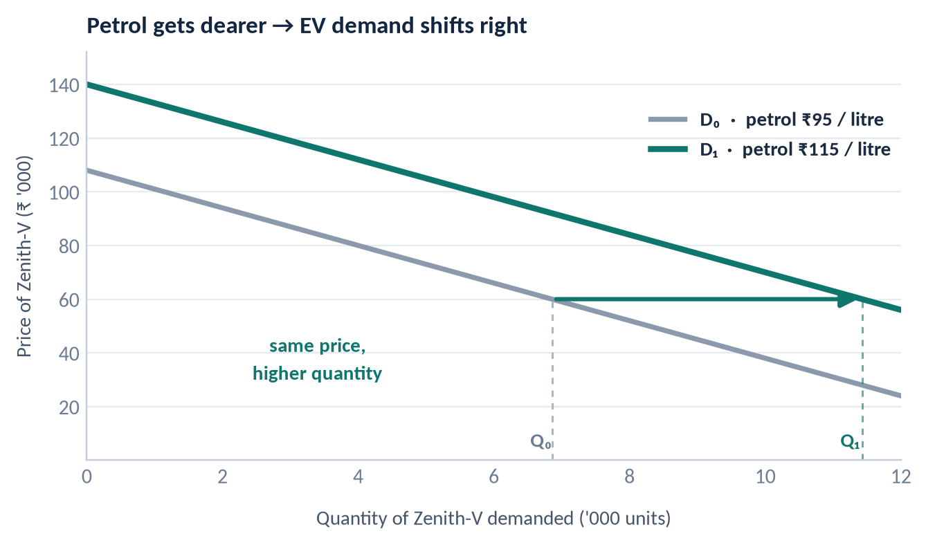
1 · MARKET & DEMAND ANALYSIS
LECTURE LINK · SESSION 5: PRICING STRATEGIES
How petrol prices move our demand
Petrol is the complement that makes a scooter run. When petrol gets dearer, the petrol option loses its cost advantage and demand for Zenith-V rises.
Petrol is a complement
A petrol scooter cannot run without petrol, so Zenith-V substitutes for the whole petrol bundle. The link is a cross-price elasticity, Exy > 0: a dearer litre of petrol raises the quantity of EVs demanded.
The monthly arithmetic
60 km a day at 45 km/l = 40 litres a month, about ₹4,200 at ₹105 a litre. The same distance on electricity costs about ₹360. That ₹3,840 a month, ₹46,000 a year, is the product we are actually selling.
A shift, not a movement along the curve
Our own price has not changed, so the whole curve shifts right. Petrol price is a demand shifter; a change in our own price would only move quantity demanded along a given curve.
OWN-PRICE
ELASTICITY
With dozens of close substitutes and only ~6% EV penetration, |ε| > 1: a 1% price cut raises quantity by more than 1%, so revenue rises. That is why price is our strongest lever.
J GANESH KUMAR REDDY
· 23BDS024
Managerial Economics · Zenith-V Case Study · IIIT Dharwad
Page 3 of 9
Notes:
Petrol is a complement to a petrol scooter, so when it becomes expensive the total cost of the petrol option rises and demand for the electric substitute rises. That is cross-price elasticity, and it is positive. Our own price has not changed, so this is a rightward shift of the demand curve, not movement along it. In money terms the customer saves about ₹3,840 a month, roughly ₹46,000 a year.

Slide 4
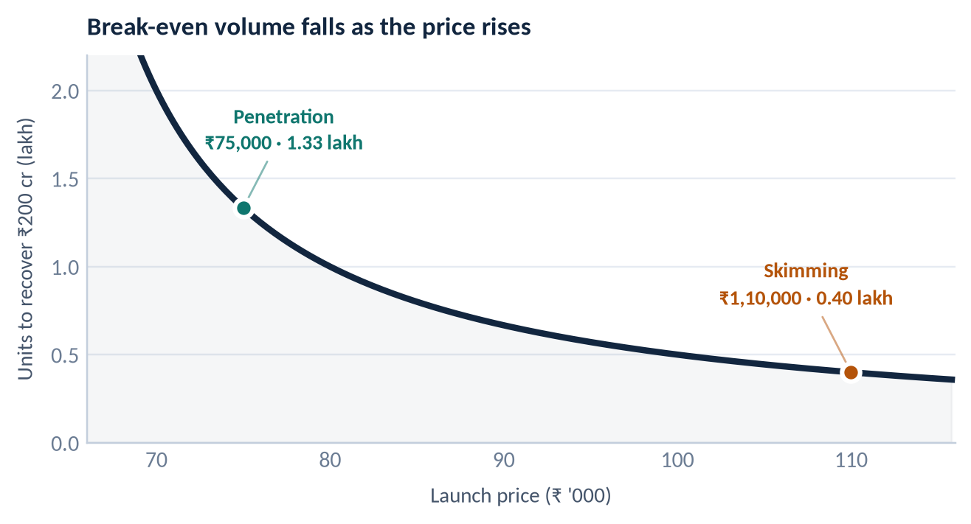
2 · PRICING & GAME THEORY
LECTURE LINK · SESSION 5: PRICING STRATEGIES
Recommendation: penetration at ₹74,999
The choice is not margin versus growth. At ₹74,999 we still earn ₹14,999 on every scooter, so penetration is a decision for scale — not a loss leader.
Set the launch price at ₹74,999 (ex-showroom) — a 25% mark-up over the ₹60,000 unit cost, with a ₹1,05,000 premium trim to serve the top of the market.
PENETRATION ← RECOMMENDED
SKIMMING
Launch price
₹74,999
₹1,10,000
Contribution / unit
₹14,999 (25%)
₹49,999 (83%)
Units to recover ₹200 cr
1.33 lakh
0.40 lakh
Works best when
Demand is elastic and rivals are already in place
Demand is inelastic and imitation is slow
Main risk
Thin margin if rivals match the cut
Invites undercutting within a quarter
Skimming recovers the plant in 0.40 lakh units; penetration needs 1.33 lakh. The real question is which volume the market will let us sell.
WHY PENETRATION FITS AN OLIGOPOLY
▪
Elastic demand: a lower price raises revenue, and volume compounds through the year.
▪
Experience curve: each doubling of output cuts cell costs 15–20%, widening the margin by year three.
▪
Deterrence: at ₹74,999 there is little room left for a rival to start a price war.
₹74,999
₹14,999
1.33 lakh
₹46,000
launch price, ex-showroom
contribution per unit · 25% mark-up
units to recover ₹200 crore
running cost saved per customer, per year
J GANESH KUMAR REDDY
· 23BDS024
Managerial Economics · Zenith-V Case Study · IIIT Dharwad
Page 4 of 9
Notes:
The brief frames this as market share versus recovering R&D, but at ₹74,999 we still make ₹14,999 a scooter, a 25% mark-up — so penetration is not loss-leading. Demand is elastic, so price moves revenue; and the experience curve means today's volume lowers tomorrow's cost. Skimming only works when demand is inelastic and imitation is slow, and neither holds with four rivals sitting on idle capacity.

Slide 5
2 · PRICING & GAME THEORY
LECTURE LINK · SESSION 7: GAME THEORY
How Ola and Ather are likely to react
Strategic interdependence: a rival's best price depends on ours. Our launch changes their payoffs, so their reaction is part of our decision.
PAYOFF MATRIX · (E-Mobility, Ola / Ather), ₹ crore over three years
EXPECTED SEQUENCE OF RESPONSES
OLA / ATHER MATCH
OLA / ATHER HOLD
WEEKS 1–4
OLA Matches on price — cashback and cheaper EMI on the S1 X, repositioned around 'lowest running cost'.
WE PENETRATE
₹74,999
(25, 30)
(45, 18)
MONTH 2
ATHER Does not chase ₹75,000. It defends the premium niche with a longer battery warranty and software features.
price war, margins thin
we take the volume
NASH EQUILIBRIUM
MONTHS 3–6
TVS · BAJAJ Respond through dealer finance and exchange offers rather than the list price, protecting margin and dealer trust.
WE SKIM
₹1,10,000
(14, 32)
(28, 35)
MONTH 6+
we lose on both counts
tacit truce, but unstable
THE FLOOR Industry margin drifts to ₹8,000–10,000 a scooter; volume leadership becomes the only durable prize.
OUR COUNTER-MOVES
Penetration is our dominant strategy and matching is the rivals' best reply, so (25, 30) is the Nash equilibrium — even though both firms would prefer the (28, 35) truce. That truce is not credible, which is why cartel-like outcomes do not survive in this market.
▪ Sell total cost of ownership (₹46,000 a year saved), never just the sticker price.
▪ Lock in an 8-year battery warranty and service reach before rivals copy the price.
▪ Play tit-for-tat: match a rival's cut, but never lead a second one.
BOTTOM LINE expect a matching response within weeks — so plan for a lower industry margin, and win on cost and service instead.
J GANESH KUMAR REDDY
· 23BDS024
Managerial Economics · Zenith-V Case Study · IIIT Dharwad
Page 5 of 9
Notes:
This slide is the core of strategic interdependence. Penetration is our dominant strategy, and matching is the rivals' best reply, so the outcome is the Nash equilibrium (25, 30), even though both firms would prefer the (28, 35) truce. That truce is not credible. Ola will match first; Ather will defend its premium niche rather than chase us down; TVS and Bajaj will respond through finance and exchange offers.

Slide 6
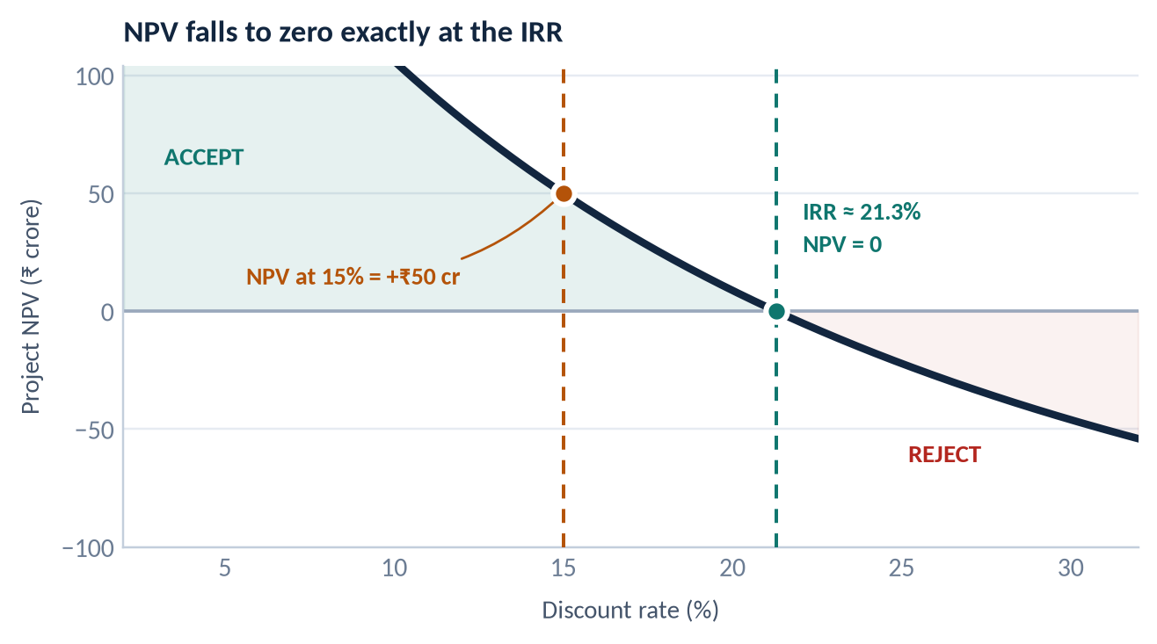
3 · CAPITAL BUDGETING
LECTURE LINK · SESSIONS 8 & 9: RISK · CAPITAL BUDGETING
A ₹50 crore NPV means the IRR is above 15%
If the project is worth ₹50 crore more than it costs at a 15% discount rate, its own rate of return must be higher than 15%.
1
Start from the NPV identity
NPV = PV of inflows − ₹200 crore = +₹50 crore, so the PV of inflows is ₹250 crore. The profitability index is 250 ÷ 200 = 1.25 — every rupee invested comes back as ₹1.25 in present value.
2
NPV always falls as the discount rate rises
Discounting the same cash flows at a higher rate can only shrink their value. At 15% NPV is still +₹50 crore, so it reaches zero only at a rate above 15%.
3
That crossing point is the IRR
The IRR is the rate at which NPV = 0, so IRR > 15% by construction. On level cash flows of about ₹49.8 crore a year for ten years, the IRR is ≈ 21.3% — a cushion of about 6 percentage points.
NPV @ 15%
PROFITABILITY INDEX
IRR
DECISION
+₹50 cr
1.25
≈ 21.3%
Accept
The curve crosses zero exactly at the IRR. Any discount rate below 21.3% — including our 15% hurdle — leaves a positive NPV.
IS THE PLANT DECISION MADE UNDER RISK OR UNDER UNCERTAINTY?
RISK outcomes known · probabilities can be estimated
UNCERTAINTY outcomes unknown · no probability can be assigned
Cell and commodity prices · rupee–dollar rate · interest on the ₹200 crore debt · warranty claims · dealer ramp-up. Modelled with sensitivity and scenario analysis.
A solid-state battery breakthrough · a redesign of the PM E-DRIVE subsidy · consolidation among rivals · a lithium supply shock · a lasting change in buyer taste. Met with staged capex and written exit rules.
VERDICT mainly uncertainty — the ₹50 crore NPV is a point estimate inside a distribution, not a promise.
J GANESH KUMAR REDDY
· 23BDS024
Managerial Economics · Zenith-V Case Study · IIIT Dharwad
Page 6 of 9
Notes:
The NPV result does most of the work. At 15% the project is worth ₹50 crore more than it costs, so the present value of inflows is ₹250 crore and the profitability index is 1.25. Because NPV falls as the discount rate rises, a positive NPV at 15% proves that the IRR is above 15%; on level cash flows of ₹49.8 crore for ten years it is about 21.3%. On risk: many inputs are measurable risks, but the big ones — a battery breakthrough or a subsidy redesign — are genuine uncertainty, which is the argument for staging the investment.

Slide 7
4 · CONCLUSION
SESSIONS 5–9 · RECAP
Proceed — with a staged commitment
All three analyses point the same way. The one refinement is to release capital in stages, because the plant is a bet under uncertainty.
MARKET
PRICE
CAPITAL
Oligopoly
₹74,999
Accept
86% held by four firms. Enter as a differentiated, scale-led challenger — never as a price-taker.
Penetration pricing. Elastic demand, a positive contribution on every unit, and a response we can anticipate.
IRR ≈ 21.3% against a 15% hurdle. Approve the plant — but stage the ₹200 crore against demand gates.
CONDITIONS AND GUARDRAILS
“Pricing low is not a discount strategy. It is a way of buying scale, learning and a cost advantage before rivals can react.”
1
Release capital in three gates — land and line (₹60 cr) → cell contracts (₹70 cr) → expansion (₹70 cr), each unlocked by measured demand.
Build the plant. Price to own the market. Stage the risk.
2
Write the exit rules now — walk away if the run-rate stays below 6,000 scooters a month for two consecutive quarters.
3
Target about 8% share by FY28 — roughly 1.6 lakh units a year, enough to recover the ₹200 crore inside the payback window.
WHAT WE ASK THE BOARD TO APPROVE
▪ ₹60 crore now for land and the first assembly line in Chennai.
4
Hold ₹74,999 for four quarters — a second cut invites a price war that no firm in an oligopoly can win.
▪ A launch price of ₹74,999, reviewed after four quarters — not before.
▪ ₹70 crore each for cell contracts and expansion, released only on demand evidence.
5
Recover R&D through the premium trim — the ₹1,05,000 variant, not the base price, carries the fixed-cost recovery.
▪ A formal review at the close of FY27, with the three gates as the test.
FINAL ANSWER build in Chennai, launch at ₹74,999, and let measured demand release the rest of the capital.
J GANESH KUMAR REDDY
· 23BDS024
Managerial Economics · Zenith-V Case Study · IIIT Dharwad
Page 7 of 9
Notes:
So the recommendation has three parts. Enter as a differentiated, scale-led challenger in an oligopoly. Launch at ₹74,999 with a premium trim above it. Accept the project, since IRR of roughly 21.3% clears the 15% hurdle, but release the ₹200 crore in three gates with written exit rules.

Slide 8
APPENDIX A
Assumptions and calculations
Every number in the deck can be re-checked from these inputs, so the argument can be re-run with different assumptions.
INPUT
VALUE
SOURCE
Unit manufacturing cost
₹60,000 per scooter
Brief
Recommended launch price
₹74,999 — contribution ₹14,999 (25% mark-up)
Analysis
Skimming alternative
₹1,10,000 — contribution ₹49,999 (83% mark-up)
Analysis
Plant investment
₹200 crore, Chennai
Brief
Discount rate / hurdle rate
15%
Brief
NPV at 15%
+₹50 crore → PV of inflows ₹250 crore, profitability index 1.25
Derived
Implied IRR
≈ 21.3% on level cash flows of ₹49.8 crore for 10 years
Derived, illustrative
Units needed to recover ₹200 crore
1.33 lakh at ₹74,999 · 0.40 lakh at ₹1,10,000
Derived
Petrol scooter running cost
60 km/day ÷ 45 km/l × 30 days = 40 litres × ₹105 = ₹4,200
Analysis
Electric scooter running cost
60 km/day × 0.025 kWh/km × 30 days × ₹8/kWh ≈ ₹360
Analysis
Market shares, FY25
Ola 30.0 · TVS 21.4 · Bajaj 20.0 · Ather 11.6 · Hero 5.0
VAHAN, industry
Concentration measure
HHI ≈ 1,900 · top-5 share 86%
Derived
J GANESH KUMAR REDDY
· 23BDS024
Managerial Economics · Zenith-V Case Study · IIIT Dharwad
Page 8 of 9
Notes:
Appendix A lists every input and every derived figure so the analysis can be re-run. The IRR is illustrative: the brief gives only the NPV at 15%, so I assumed level cash flows to show what an IRR of about 21% implies.

Slide 9
APPENDIX B
Lecture sessions used and rubric map
The concepts in this deck come from the recorded sessions listed below. Each slide is tagged with the session it draws on.
RECORDED SESSIONS REFERENCED
HOW THIS DECK MAPS TO THE RUBRIC
Session 5
Pricing Strategies
COMPONENT
MARKS
SLIDE
Penetration vs skimming, mark-up pricing, elasticity and price setting
Market & demand analysis
25
Slides 2–3
https://youtu.be/T25QYasiVrM
Session 6
Profit
Pricing & game theory
30
Slides 4–5
Contribution margin, break-even volume and economic profit
https://youtu.be/d7Qw3Bu-23E
Capital budgeting
35
Slide 6 (+ A)
Session 7
Game Theory
Payoff matrix, dominant strategy, Nash equilibrium, tit-for-tat
Presentation quality
10
All slides
https://youtu.be/f91JEkm7XZg
Session 8
Risk
Total
100
Knight's risk vs uncertainty, sensitivity and scenario analysis
https://youtu.be/LsGQdSKB80o
THE WHOLE ARGUMENT IN FOUR LINES
Session 9
Capital Budgeting & Fiscal Policy
Market
four firms, 86% share, mutual dependence → oligopoly
NPV, IRR, profitability index, discount rate, subsidy policy
Demand
petrol is a complement, so higher petrol shifts our demand right
https://youtu.be/Y_NwyfpzUIo
Pricing
penetration at ₹74,999; rivals match, margin settles lower
Capital
+₹50 cr NPV at 15% → IRR ≈ 21.3% → accept, in stages
DECLARATION
This assignment is my own work, prepared from the recorded sessions and the case brief, and is submitted on or before the deadline set in Google Classroom.
NOTE ON THE DATA
Market shares are FY25 VAHAN-based industry estimates, used to establish the market structure — not to forecast our own volumes. The IRR is illustrative, since the brief supplies only the NPV at 15%.
J GANESH KUMAR REDDY
· 23BDS024
Managerial Economics · Zenith-V Case Study · IIIT Dharwad
Page 9 of 9
Notes:
Appendix B records the recorded sessions I used and maps the deck to the marking rubric, so each component — market analysis, pricing and game theory, and capital budgeting — can be traced to specific slides.

