Slide 1
INDIAN INSTITUTE OF INFORMATION TECHNOLOGY (IIIT) DHARWAD
STUDENT NAME & REGISTER NUMBER
Course Assignment: Managerial Economics (Recorded Sessions 1–9) • Ittigatti Road, Dharwad - 580009
J GANESH KUMAR REDDY 23BDS024
The "Zenith-V" EV Scooter Launch
1. Case Study Key Financial & Market Parameters
Market Structure: Oligopoly (Ola, TVS, Bajaj, Ather = 83% share)
Unit Manufacturing Cost: ₹60,000 per Zenith-V scooter (explicit VC)
Recommended Launch Price: ₹79,999 Penetration Price (+₹20,000 margin)
Chennai Plant Investment: ₹200 Crore Fixed Outlay (Break-Even = 100k units)
Expected NPV @ r = 15%: +₹50 Crore (PV Inflows = ₹250 Cr ⇒ IRR ≈ 23.0%)
Market & Demand Analysis, Game-Theoretic Pricing & ₹200 Cr Capital Budgeting
• Role & Company: Senior Analyst at E-Mobility India, an EV startup in Bengaluru launching flagship scooter 'Zenith-V'.
• Task 1 — Market & Demand (Sessions 2 & 4): Indian EV scooter Oligopoly (Ola, Ather, TVS) & Cross-Price Elasticity of petrol and charging complements.
• Task 2 — Pricing & Game Theory (Sessions 5–7): Unit cost = ₹60,000; Penetration Pricing (₹79,999) vs. Price Skimming, Break-Even (1,00,000 units), and Strategic Interdependence.
• Task 3 — Capital Budgeting & Risk (Sessions 8–9): ₹200 Crore Chennai plant with NPV = +₹50 Cr @ 15% discount rate; IRR deduction and Measurable Risk vs. Uncertainty.
2. IIIT Dharwad Recorded Sessions Applied
Sessions 2–4: Demand Shift, Cross-Elasticity, Scale, Market DNA
Session 5 (Pricing): Penetration vs. Skimming & Buffett's Value Rule
Session 6 (Profit): Accounting/Economic Profit & Break-Even (TR=TC)
Session 7 (Game Theory): Strategic Interdependence (Jio) & Nash Eq.
Sessions 8–9 (Risk & CapEx): Risk vs. Uncertainty, NPV, IRR & Fiscal Policy
Submitted By: J GANESH KUMAR REDDY 23BDS024
Submitted To: Dr. K. T. Deepak, Associate Dean (Innovation, Entrepreneurship and IDRP)
Institution: IIIT (Triple-IT) Dharwad, Ittigatti Road, Near Sattur Colony, Dharwad - 580009 (www.iiitdwd.ac.in)
PRESENTATION STRUCTURE (7 SLIDES AS REQUIRED BY PROJECT RUBRIC — 100 MARKS):
Slide 1 | Slide 2 (25M) | Slide 3 (25M) | Slide 4 (30M) | Slide 5 (30M) | Slide 6 (35M) | Slide 7 (10M)
Title & Case Overview | Market Structure (Oligopoly DNA) | Demand & Petrol Elasticity (Exy) | Penetration Pricing & Break-Even | Competitor Reaction & Game Theory | Capital Budgeting (NPV, IRR, Risk) | Final Verdict & Conclusion
The "Zenith-V" EV Scooter Launch • E-Mobility India (Bengaluru)
J GANESH KUMAR REDDY 23BDS024
IIIT Dharwad (www.iiitdwd.ac.in) | Slide 1 of 7
Notes:
[J GANESH KUMAR REDDY 23BDS024 — IIIT Dharwad | Submitted to Dr. K. T. Deepak] Slide 1 introduces the Zenith-V EV Scooter Launch presentation by J GANESH KUMAR REDDY 23BDS024, submitted to Dr. K. T. Deepak, Associate Dean, IIIT Dharwad.

Slide 2
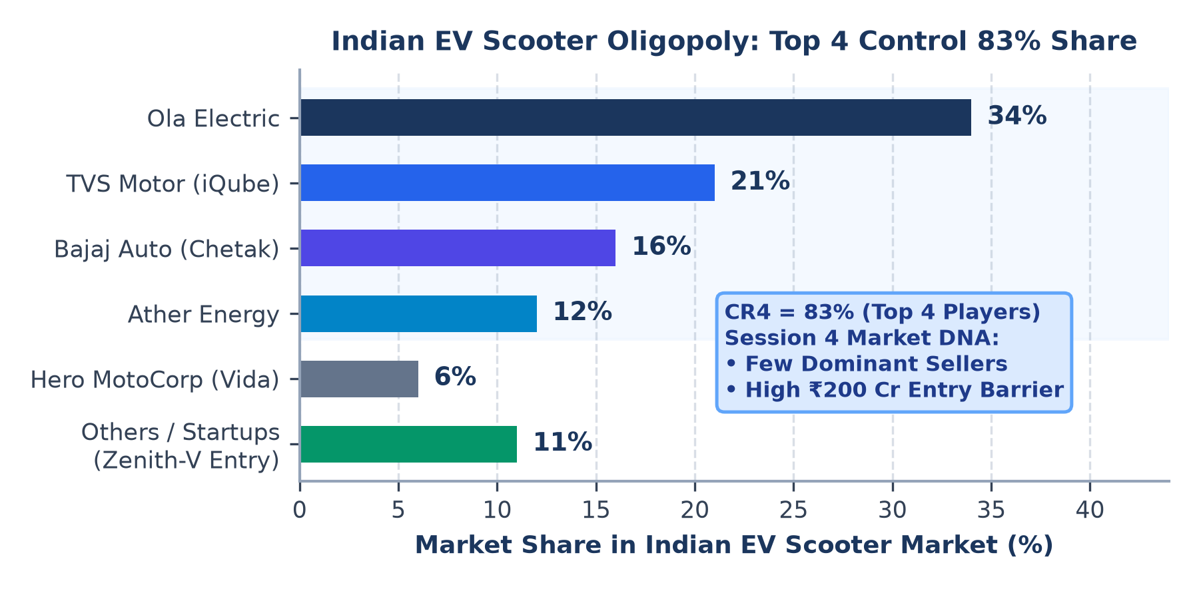
Slide 2: Market Structure Analysis
IIIT DHARWAD • DR. K. T. DEEPAK (SESSIONS 1–9)
Task 1A & Session 4 (Market DNA): Why the Indian EV Scooter Market is an Oligopoly
J GANESH KUMAR REDDY 23BDS024
Core Answer (Session 4 Market DNA): A market structure is defined by competitor count, product nature, and entry barriers. The Indian EV scooter market is an OLIGOPOLY because 4 dominant firms (Ola Electric, TVS, Bajaj, Ather = 83% share) control supply behind high capital barriers.
Key Characteristics of Oligopoly Present in the Zenith-V Scenario
1. Few Dominant Sellers (High Concentration — CR4 = 83%): Instead of hundreds of tiny sellers, top 4 players — Ola Electric (~34%), TVS (~21%), Bajaj (~16%), and Ather (~12%) — control ~83% of India's EV scooter sales, giving each major firm significant market power.
2. High Barriers to Entry & Economies of Scale (Session 3): Directly illustrated in our case by the massive ₹200 Crore capital investment required to build the Chennai manufacturing plant. Just like the Tesla Gigafactory (Session 3), large plants achieve lower Long-Run Average Cost (LRAC), while battery BMS R&D and AIS-156 safety norms deter small entrants.
3. Strategic Interdependence (Session 7): Firms cannot set prices independently. E-Mobility India's choice between Penetration Pricing and Price Skimming directly impacts Ola and Ather's market shares and triggers immediate competitive counter-moves.
4. Differentiated Products (Differentiated Oligopoly): While all firms sell electric 2-wheelers, they differentiate via battery range, smart dashboard UI, 8-year warranties, and proprietary charging networks (Ather Grid, Ola Hypercharger).
SESSION 4 MARKET DNA COMPARISON: WHY OLIGOPOLY FITS BEST
Market DNA | Perfect Comp. | EV Oligopoly (Zenith-V) | Monopoly
Number of Sellers | Many Small Firms | Few Dominant (Ola, Ather, TVS) | Single Seller
Entry Barriers | None (Free Entry) | Very High (₹200 Cr Plant Capex) | Absolute Block
Pricing Behavior | Price Taker | Interdependent (Game Theory) | Price Maker
The "Zenith-V" EV Scooter Launch • E-Mobility India (Bengaluru)
J GANESH KUMAR REDDY 23BDS024
IIIT Dharwad (www.iiitdwd.ac.in) | Slide 2 of 7
Notes:
[J GANESH KUMAR REDDY 23BDS024 — IIIT Dharwad | Submitted to Dr. K. T. Deepak] Slide 2 explains why the Indian EV scooter market is an Oligopoly using Session 4 Market DNA and Session 3 Economies of Scale (Tesla Gigafactory parallel).

Slide 3
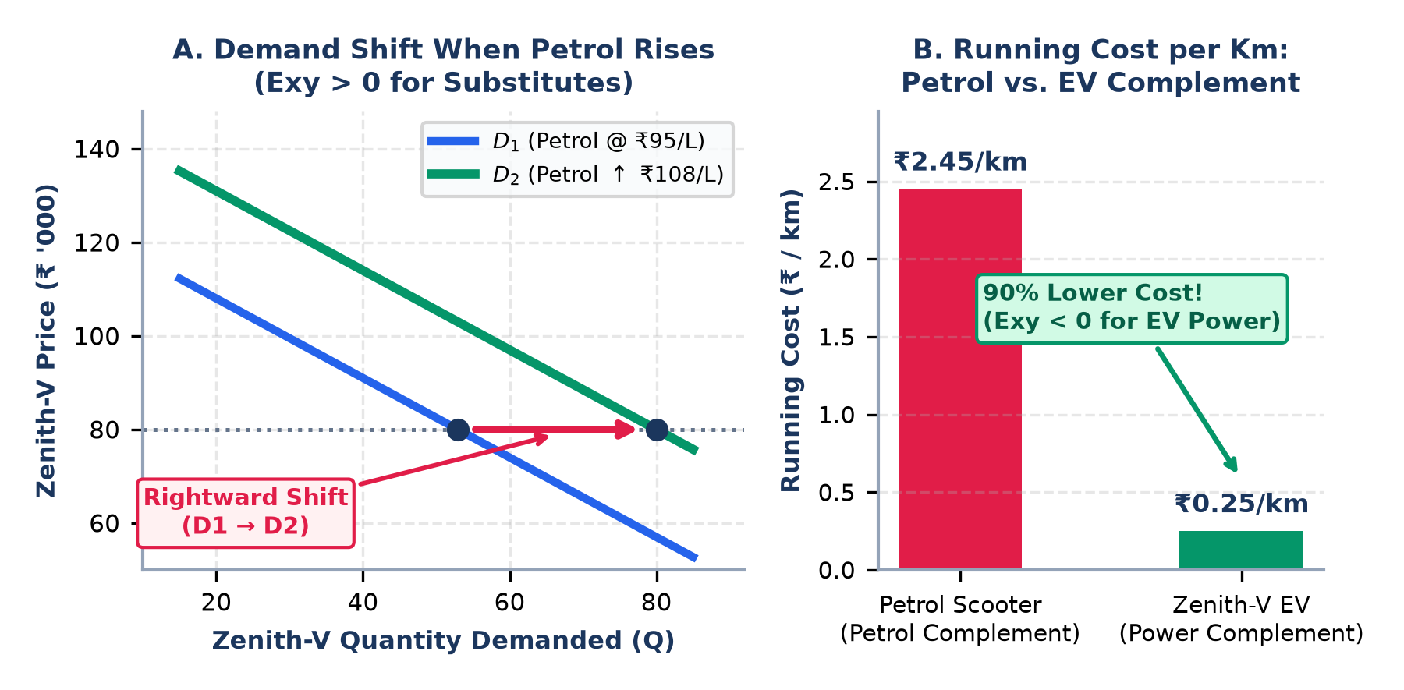
Slide 3: Demand & Elasticity Analysis
IIIT DHARWAD • DR. K. T. DEEPAK (SESSIONS 1–9)
Task 1B & Session 2: How Petrol & Complement Prices Shift Zenith-V Demand
J GANESH KUMAR REDDY 23BDS024
Causal Mechanism (Session 2): Petrol Price Rises (>₹100/L) ⇒ ICE Scooter Running Cost Rises (~₹2.45/km vs. ₹0.25/km for EV) ⇒ Demand for ICE Scooters Falls ⇒ Commuters Switch to Substitute Zenith-V (Rightward Demand Curve Shift D1 → D2).
1. How Petrol Prices Affect Zenith-V Demand (Exy > 0)
Concept Illustrated (Session 2): Cross-Price Elasticity of Demand (Exy = %ΔQd of Good X ÷ %ΔP of Good Y) and a Rightward Shift of the Demand Curve (vs. movement along the curve).
Positive Cross-Price Elasticity (Exy > 0 — Substitutes): Petrol (ICE) scooters and Zenith-V EV scooters are substitutes. When petrol prices rise, total cost of owning an ICE scooter rises, shifting the entire Zenith-V demand curve rightward (D1 → D2) at every price level.
90% Operating Cost Advantage: Zenith-V costs ~₹0.25/km to run on electricity vs. ~₹2.45/km on petrol, saving daily commuters ₹25,000–₹30,000 per year.
2. Impact of a Complement's Price on Demand (Rubric Focus)
Complement Price Rule (Exy < 0): Complementary goods are used jointly — a rise in a complement's price reduces demand for the primary good (Negative Cross-Price Elasticity).
A. Petrol as a Complement to ICE Scooters: Petrol is a direct complement to ICE scooters (Exy < 0). Higher petrol prices reduce ICE scooter demand, pushing buyers to our substitute Zenith-V.
B. Electricity & Chargers as Complements to Zenith-V: Domestic EV power tariffs, home chargers, and fast-charging grids are direct complements to Zenith-V (Exy < 0): lower charging costs directly increase Zenith-V demand.
SUMMARY OF CROSS-PRICE ELASTICITY (Exy) EFFECTS ON ZENITH-V
Related Good | Economic Relation | Elasticity (Exy) | Impact on Zenith-V
Petrol (ICE Fuel) | Complement to ICE | Positive (Exy > 0) | ↑ Petrol Price ⇒ ↑ EV Demand
EV Charging Power | Complement to EV | Negative (Exy < 0) | ↓ Power Cost ⇒ ↑ EV Demand
Rival Petrol Scooters | Direct Substitutes | Positive (Exy > 0) | ↑ ICE Price ⇒ ↑ EV Demand
The "Zenith-V" EV Scooter Launch • E-Mobility India (Bengaluru)
J GANESH KUMAR REDDY 23BDS024
IIIT Dharwad (www.iiitdwd.ac.in) | Slide 3 of 7
Notes:
[J GANESH KUMAR REDDY 23BDS024 — IIIT Dharwad | Submitted to Dr. K. T. Deepak] Slide 3 explains Session 2 Demand Curve Shift and Cross-Price Elasticity of Demand (Exy) for both Petrol (Exy > 0) and EV Charging Complements (Exy < 0).

Slide 4
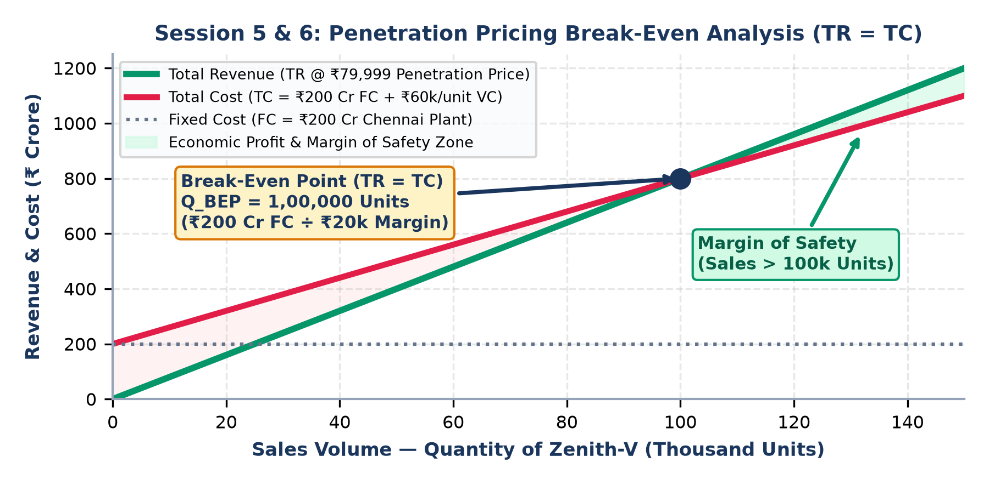
Slide 4: Recommended Pricing Strategy & Justification
IIIT DHARWAD • DR. K. T. DEEPAK (SESSIONS 1–9)
Task 2A & Sessions 5–6: Penetration Pricing (₹79,999), Value Perception & Break-Even Profit
J GANESH KUMAR REDDY 23BDS024
Strategic Advice (Sessions 5 & 6): Adopt PENETRATION PRICING at ₹79,999 (over ₹60,000 unit manufacturing cost = +₹20,000 unit margin) and reject Price Skimming. This maximizes customer value perception, achieves Break-Even at 1,00,000 units, and scales the ₹200 Cr Chennai plant.
Economic Justification for Penetration Pricing (Sessions 3, 5 & 6)
1. Value Perception & Elasticity (Session 5 — Pricing Strategies): Per Warren Buffett's principle ('Price is what you pay; Value is what you get'), launching at ₹79,999 against Ola, Ather & TVS (₹1.10L–₹1.45L) creates unmatched value perception among price-elastic Indian commuters (|Ep| > 1.5).
2. Break-Even Point & Margin of Safety (Session 6 — Profit): With Chennai plant Fixed Cost FC = ₹200 Crore, explicit unit cost AVC = ₹60,000, and price P = ₹80,000 (₹79,999), unit contribution is +₹20,000. Break-Even Quantity (TR = TC) is Q_BEP = ₹200 Cr ÷ ₹20,000 = 1,00,000 units (₹800 Cr revenue). High penetration volume rapidly pushes sales into the Margin of Safety zone to generate positive Economic Profit.
3. Economies of Scale in the ₹200 Cr Chennai Plant (Session 3): Like the Tesla Gigafactory (Session 3), our ₹200 Cr plant requires high capacity utilization to spread Fixed Costs (AFC = FC/Q) and unlock bulk LFP battery cell discounts.
4. Why Price Skimming Fails + Phase-2 Decoy Tiering (Session 5): Skimming works only with a monopoly innovation and inelastic demand. As a new Bengaluru startup in an oligopoly, skimming leaves the ₹200 Cr plant idle. After winning base share, we can introduce 'Zenith-V Pro' (2nd/3rd degree price discrimination).
SESSION 5 & 6 EVALUATION: PENETRATION PRICING vs. PRICE SKIMMING
Economic Criterion | Penetration Pricing (CHOSEN) | Price Skimming (REJECTED)
Launch Price & Margin | ₹79,999 (+₹20k unit margin) | ₹1,15,000+ (Tiny sales volume)
Break-Even (100k units) | Reaches BEP fast; wide safety margin | Fails to reach BEP; Economic Loss
₹200 Cr Plant Impact | High utilization & low LRAC | Idle capacity & high fixed cost/unit
The "Zenith-V" EV Scooter Launch • E-Mobility India (Bengaluru)
J GANESH KUMAR REDDY 23BDS024
IIIT Dharwad (www.iiitdwd.ac.in) | Slide 4 of 7
Notes:
[J GANESH KUMAR REDDY 23BDS024 — IIIT Dharwad | Submitted to Dr. K. T. Deepak] Slide 4 justifies Penetration Pricing at ₹79,999 using Session 5 (Warren Buffett value principle & elasticity), Session 6 (Break-Even at 1,00,000 units where TR = TC = ₹800 Cr, Margin of Safety, Economic Profit), and Session 3 (Tesla Gigafactory Economies of Scale).

Slide 5
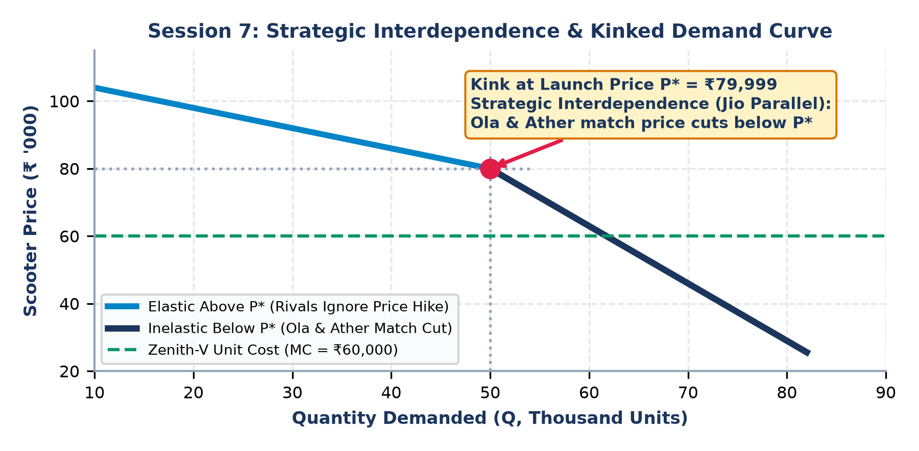
Slide 5: Competitor Response & Strategic Interdependence
IIIT DHARWAD • DR. K. T. DEEPAK (SESSIONS 1–9)
Task 2B & Session 7 (Game Theory): Reliance Jio Parallel, Kinked Demand & Nash Equilibrium
J GANESH KUMAR REDDY 23BDS024
Strategic Interdependence (Session 7): In an oligopoly, one firm's pricing directly alters rivals' payoffs. Just as Airtel & Vodafone had to slash prices when Reliance Jio entered with penetration pricing, Ola Electric and Ather will retaliate when Zenith-V launches at ₹79,999.
Game-Theoretic Analysis of Competitor Reaction (Session 7)
1. Strategic Interdependence & Reliance Jio Parallel (Session 7): When Reliance Jio disrupted Indian telecom with penetration pricing, incumbents (Airtel, Vodafone, Idea) could not ignore it — they had to cut tariffs and consolidate to survive. Similarly, Ola, Ather & TVS cannot ignore Zenith-V's ₹79,999 entry.
2. Sweezy's Kinked Demand Curve Explanation: Above launch price P* (₹79,999), demand is elastic because rivals ignore price hikes. Below P*, demand is relatively inelastic because Ola and Ather will match price cuts to defend their market share.
3. Expected Retaliation by Ola Electric, Ather & TVS: • Price Matching on Base Trims: Cutting prices on entry flanker models (Ola S1X, Ather Rizta) and offering ₹10k–₹15k festive/exchange discounts while protecting flagship S1 Pro / 450X margins.
• Non-Price Competition: Bundling 8-year battery warranties, 0% down-payment EMIs, and free fast-charging credits (Ather Grid / Ola Hypercharger).
4. Dominant Strategy, Prisoner's Dilemma & Counter-Move: Penetration pricing is our Dominant Strategy. To avoid a margin-destroying Prisoner's Dilemma price war, E-Mobility India should pair ₹79,999 with a 5-year warranty, Battery-as-a-Service (BaaS) plans, and a higher-margin 'Zenith-V Pro' trim.
SESSION 7 PAYOFF MATRIX: DOMINANT STRATEGY & NASH EQUILIBRIUM
Zenith-V \ Rivals | Ola & Ather: Match Cut on Base Trims | Ola & Ather: Keep High Prices (Ignore Entry)
Penetration (₹79,999) [Dominant Strategy] | NASH EQUILIBRIUM ★ (+₹50 Cr) Zenith-V: 10% | Rivals: Base Cut | Zenith-V: 18% share (+₹85 Cr NPV) Rivals: Lose heavy market share
Price Skimming (₹1,15,000) | Zenith-V fails (<2% share, -₹30 Cr) Ola & Ather dominate market | Zenith-V gets tiny niche (3% share) ₹200 Cr Chennai plant stays idle
The "Zenith-V" EV Scooter Launch • E-Mobility India (Bengaluru)
J GANESH KUMAR REDDY 23BDS024
IIIT Dharwad (www.iiitdwd.ac.in) | Slide 5 of 7
Notes:
[J GANESH KUMAR REDDY 23BDS024 — IIIT Dharwad | Submitted to Dr. K. T. Deepak] Slide 5 applies Session 7 Game Theory: Strategic Interdependence (Reliance Jio parallel), Sweezy's Kinked Demand Curve, Dominant Strategy, Prisoner's Dilemma, and Nash Equilibrium.

Slide 6
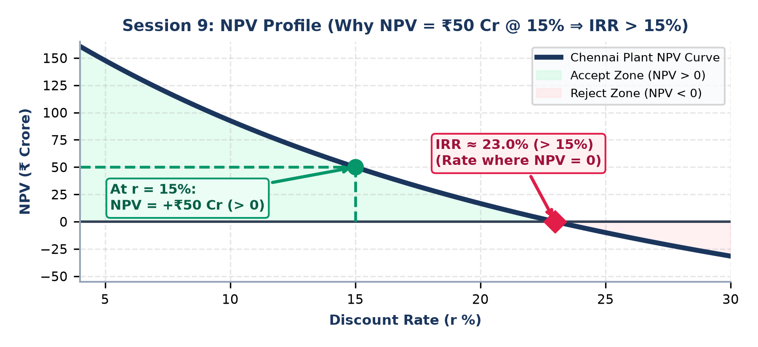
Slide 6: Capital Budgeting Analysis (NPV, IRR, Risk/Uncertainty)
IIIT DHARWAD • DR. K. T. DEEPAK (SESSIONS 1–9)
Task 3A & 3B (Sessions 8–9): Evaluating the ₹200 Crore Chennai Manufacturing Plant
J GANESH KUMAR REDDY 23BDS024
Key Capital Budgeting Verdict (Sessions 8 & 9): Initial Outlay I0 = ₹200 Cr | Discount Rate r = 15% | Expected NPV = +₹50 Cr ⇒ Proves IRR > 15% (~23.0% > 15% hurdle rate). Decision involves BOTH Measurable Risk (Expected Value) and Unmeasurable Uncertainty.
3A. What NPV = ₹50 Cr @ 15% Tells Us About IRR (Session 9)
3B-1. Known Risks (Measurable & Quantifiable Probabilities — Session 8)
Deduction (Session 9 — Capital Budgeting): The project's Internal Rate of Return is STRICTLY GREATER THAN 15% (IRR > 15%, approx. 23.0%).
1. Present Value Math: NPV = PV of Cash Inflows − Initial Outlay (I0). Since NPV = +₹50 Cr and I0 = ₹200 Cr at r = 15%, the PV of Cash Inflows = ₹250 Crore (Profitability Index = 1.25).
2. IRR Definition & Inverse Discounting Rule: IRR is the discount rate where NPV = 0 (where PV of Inflows = ₹200 Cr). Because PV falls as the discount rate rises, reducing PV from ₹250 Cr down to ₹200 Cr requires a discount rate higher than 15% (IRR > 15% ⇒ ACCEPT PROJECT).
Session 8 Definition (Measurable Risk): Risk and Uncertainty are NOT interchangeable! Risks are known, measurable events with historical probability distributions, evaluated via Expected Value E[V] = Σ p_i x_i and mitigated via Insurance, Budget Contingency & Parallel Execution.
1. Lithium-Ion Battery Cell Price Volatility: Historical commodity variance (±15%) modeled probabilistically and hedged via long-term supplier contracts.
2. Chennai Plant Construction & Equipment Delays: 3–6 month schedule delay probability quantified from past factory projects; mitigated via parallel execution and a 10% budget contingency.
3. Interest Rate & Annual Sales Variance: Working-capital interest rate fluctuations and unit demand variance captured in the 15% risk-adjusted discount rate.
3B-2. Unknown Uncertainties (Unmeasurable — No Probability Data)
Session 8 Definition (Unmeasurable Uncertainty): Uncertainty is 'I don't know' — structural future events that cannot be measured or assigned probabilities from past data; managed via Maximin, Maximax & Minimax Regret decision rules.
1. Fiscal Policy & EV Subsidy Reversals (Session 9): Unpredictable discontinuation of Government PM E-DRIVE / FAME subsidies or sudden changes to the 5% EV GST rate.
2. Disruptive Battery Chemistry Breakthroughs: Sudden commercial leap to solid-state or sodium-ion batteries rendering current Li-ion assembly lines obsolete.
3. Geopolitical & Critical Mineral Supply Shocks: Unexpected export bans on lithium/rare-earth imports or macroeconomic black-swan crises.
The "Zenith-V" EV Scooter Launch • E-Mobility India (Bengaluru)
J GANESH KUMAR REDDY 23BDS024
IIIT Dharwad (www.iiitdwd.ac.in) | Slide 6 of 7
Notes:
[J GANESH KUMAR REDDY 23BDS024 — IIIT Dharwad | Submitted to Dr. K. T. Deepak] Slide 6 deduces IRR > 15% (~23.0%) from NPV = +₹50 Cr @ 15% (Session 9) and distinguishes Measurable Risk (Expected Value, Insurance, Contingency, Parallel Execution) from Unmeasurable Uncertainty (Maximin, Minimax Regret) per Session 8.

Slide 7
Slide 7: Final Recommendation & Conclusion
IIIT DHARWAD • DR. K. T. DEEPAK (SESSIONS 1–9)
Integrated Executive Roadmap (Sessions 1–9 Synthesis) • E-Mobility India
J GANESH KUMAR REDDY 23BDS024
FINAL ANALYST VERDICT: APPROVE ('GO') the ₹200 Crore Chennai Manufacturing Plant (NPV = +₹50 Cr, IRR ≈ 23.0% > 15%) and launch the 'Zenith-V' EV Scooter with Penetration Pricing at ₹79,999 to achieve 1,00,000-unit Break-Even and capture 10%+ share in India's EV Oligopoly.
1. Market & Demand Strategy (25M)
2. Pricing, Profit & Game Theory (30M)
3. Capital Budgeting & Risk Plan (35M)
Oligopoly Entry (Session 4): Enter the concentrated Indian EV market (CR4 = 83%) as a high-value mass commuter disruptor.
Cross-Elasticity (Session 2): Capitalize on high petrol prices (Exy > 0) and low EV charging complement costs (₹0.25/km; Exy < 0).
Fiscal Policy (Session 9): Leverage 5% EV GST & PM E-DRIVE subsidies to accelerate commuter switching from petrol.
Penetration Price (Session 5): Launch at ₹79,999 (+₹20k margin over ₹60k cost) to maximize value perception & scale.
Break-Even & Profit (Session 6): Reach 1,00,000-unit Break-Even (TR = TC = ₹800 Cr) quickly with a wide Margin of Safety.
Game Theory Defense (Session 7): Counter Ola/Ather price-matching via 5-yr warranty, BaaS EMI plans & Phase-2 'Zenith-V Pro'.
Approve Plant (Session 9): Positive NPV (+₹50 Cr @ 15%) proves IRR > 15% (~23.0%) and adds ₹50 Cr net economic wealth.
Mitigate Known Risks (Session 8): Use supplier hedging, budget contingency & parallel execution for Chennai plant construction.
Buffer Uncertainties (Session 8): Apply Minimax Regret / Maximin by building modular assembly lines adaptable to new battery tech.
COMPLETE RUBRIC & LECTURE SESSION SYNTHESIS MATRIX (100 MARKS)
IIIT DHARWAD • ASSIGNMENT SUBMISSION
Assignment Module | Core Economic & Lecture Concepts | Final Strategic Recommendation
1. Market & Demand (25M) | Oligopoly DNA (CR4 = 83%); Demand Shift; Cross-Elasticity (Exy > 0 Petrol; Exy < 0 EV) | Target petrol commuters with ₹0.25/km running cost & home charger bundle
2. Pricing & Game Theory (30M) | Penetration (₹79,999), Break-Even (100k units), Strategic Interdependence, Kinked Demand, Nash Eq. | Scale ₹200 Cr plant LRAC; counter Ola & Ather via warranties & BaaS
3. Capital Budgeting (35M) | NPV = +₹50 Cr @ 15% ⇒ IRR > 15% (~23.0%); Measurable Risk (E[V]) vs Uncertainty (Maximin) | Approve Chennai plant; hedge cell cost risks & build modular factory lines
J GANESH KUMAR REDDY
REG NO: 23BDS024
Submitted to: Dr. K. T. Deepak
Associate Dean (Innovation, Entrepreneurship & IDRP)
IIIT (Triple-IT) Dharwad - 580009 (www.iiitdwd.ac.in)
Thank You!
The "Zenith-V" EV Scooter Launch • E-Mobility India (Bengaluru)
J GANESH KUMAR REDDY 23BDS024
IIIT Dharwad (www.iiitdwd.ac.in) | Slide 7 of 7
Notes:
[J GANESH KUMAR REDDY 23BDS024 — IIIT Dharwad | Submitted to Dr. K. T. Deepak] Slide 7 synthesizes all 3 project tasks across Sessions 1–9 and presents the final recommendation by J GANESH KUMAR REDDY 23BDS024 to Dr. K. T. Deepak, IIIT Dharwad.

