Slide 1
AI Data Center Sustainability
& Energy Intelligence
Where is AI infrastructure being built, and does it line up with electricity cost,
carbon intensity, and renewable availability worldwide?
Final Individual Project · Data Visualization · Winter 2025/2026
AI Data Center Sustainability & Energy Intelligence · Final Project
1

Slide 2
AGENDA
What this deck covers
1
Problem & Data Sources
The business question, and the 4 datasets combined to answer it
2
Methodology
Cleaning pipeline + how the analysis was structured
3
Key Questions & Findings
All 10 analytical questions, with 4 explored in depth
4
Interactive Dashboard
The Streamlit app — what each of its 5 tabs does
5
Conclusions & Limitations
What the data actually supports, and what it doesn't
AI Data Center Sustainability & Energy Intelligence · Final Project
2

Slide 3
1
SECTION 1
Problem & Data Sources
Why this analysis matters, and where the data comes from.
AI Data Center Sustainability & Energy Intelligence · Final Project
3

Slide 4
THE PROBLEM
AI's compute boom has a resource cost
Training and running frontier AI models requires enormous GPU clusters,
concentrated in data centers that consume:
Electricity
Water
Capital
Chips
Huge and growing power draw — single sites now exceed 1 GW
Large cooling volumes, depending on site design
Tens of billions of dollars in build-out costs
Thousands to hundreds of thousands of GPUs per site
The question this project answers:
“As AI adoption accelerates, what factors make a country an ideal location
for efficient and sustainable AI data centers — and does today's build-out
actually reflect those factors?”
AI Data Center Sustainability & Energy Intelligence · Final Project
4

Slide 5
DATA
No single dataset covers this — four sources, combined
Epoch AI — AI Data Centers
CC BY
6 datasets: data centers, GPU clusters, timelines, chip deployments, chillers, cooling towers
Our World in Data — Energy
Open, CC BY
Renewable share of electricity + carbon intensity, by country/year
Our World in Data — CO2
Open, CC BY
Total CO2 emissions + per-capita, by country/year
GlobalPetrolPrices.com
Manually compiled snapshot
Residential electricity price by country (USD/kWh)
Merging required aligning inconsistent country-name spellings across all four sources (formal ISO names vs. common names) — handled once in the cleaning pipeline via a shared join key.
AI Data Center Sustainability & Energy Intelligence · Final Project
5

Slide 6
2
SECTION 2
Methodology
How the raw data becomes a clean, analysis-ready pipeline.
AI Data Center Sustainability & Energy Intelligence · Final Project
6

Slide 7
APPROACH
From raw data to interactive dashboard
1. Clean
2. Analyze
3. Present
clean_data_centers.ipynb, run first: coerce types, snake_case columns, split confidence tags, filter non-country aggregate rows, align country naming across all 4 sources. Produces every file in data/processed/.
02_EDA.ipynb, organized in 3 parts: (1) core dataset EDA, (2) mining fields that existed but were never used, (3) the 10 analytical questions, each with the chart type the question calls for and a written finding.
Streamlit dashboard (dashboard/app.py), 5 tabs, for interactive exploration: filter by operator/country, compare countries side-by-side, drill into any finding without reading code.
AI Data Center Sustainability & Energy Intelligence · Final Project
7

Slide 8
3
SECTION 3
Key Questions & Findings
10 analytical questions from the project brief — each with the right chart type and a written conclusion.
AI Data Center Sustainability & Energy Intelligence · Final Project
8

Slide 9
OVERVIEW
All 10 questions, at a glance
Q1
Which countries host the most AI infrastructure?
Choropleth
Q6
Where are new data centers built fastest?
Timeline
Q2
Does cheap electricity predict AI capacity?
Scatter
Q7
How does renewable use relate to emissions?
Regression
Q3
Which operators lead on renewable adoption?
Bar chart
Q8
Which regions suit future AI expansion?
Ranking
Q4
How does carbon intensity vary by country?
Heatmap
Q9
How do cloud providers compare?
Treemap
Q5
Best balance of cost + sustainability?
Bubble chart
Q10
Can countries be grouped into profiles?
K-Means
4 explored in depth on the next slides — full findings for all 10 in the notebook and README.
AI Data Center Sustainability & Energy Intelligence · Final Project
9

Slide 10
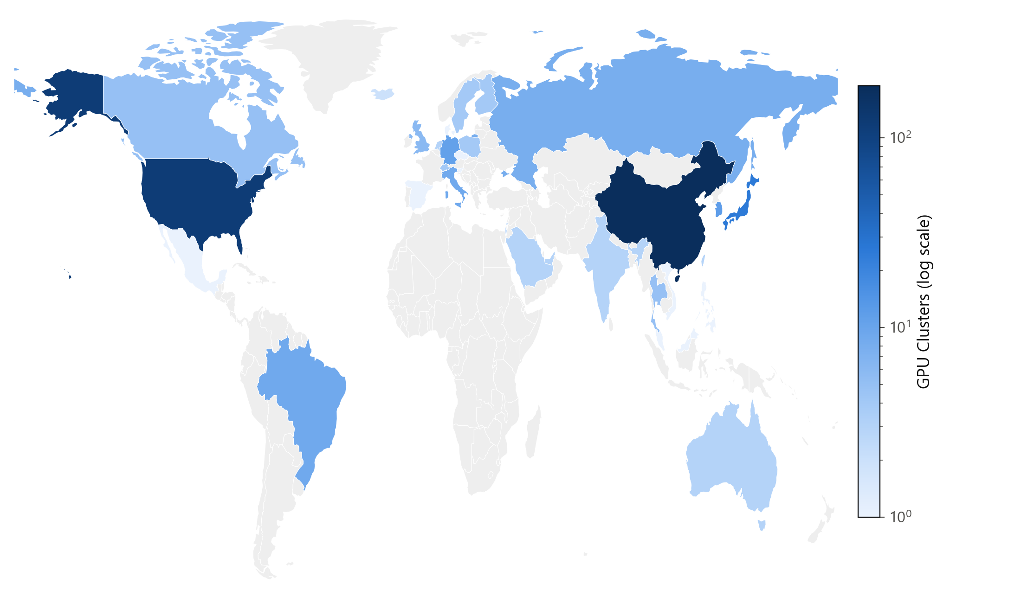
FINDING · Q1
China outnumbers the US on AI cluster count — not just power
China: 188 GPU clusters
United States: 119
Japan: 25 · France: 14 · Germany: 11
But the US still leads on total power capacity (1,963 MW vs. 297 MW) — fewer, much larger US sites vs. many smaller Chinese ones.
This is gpu_clusters_clean.csv (482 sites, broad survey), which tells a very different story than the curated 74-site Epoch AI table used elsewhere (almost entirely US hyperscalers).
AI Data Center Sustainability & Energy Intelligence · Final Project
10

Slide 11
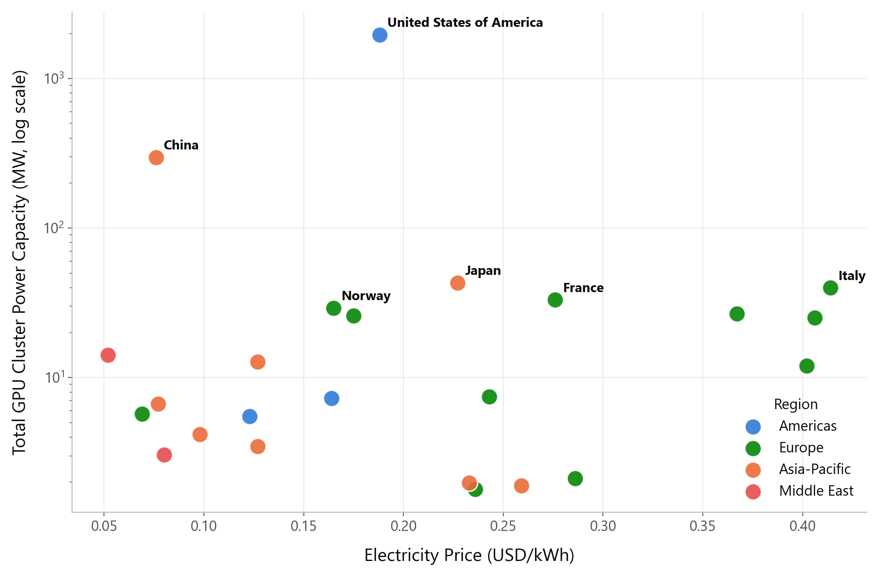
FINDING · Q2
Cheap electricity does not predict AI capacity
r = −0.05 — essentially zero correlation.
The US pays 0.188 USD/kWh, more than Russia (0.069), India (0.077), Taiwan (0.098), and Saudi Arabia (0.052) — all of which host far less AI capacity.
Takeaway: whatever drives where AI infrastructure concentrates, it isn't raw electricity price. Capital availability, existing cloud ecosystems, chip supply access, and policy plausibly matter far more.
AI Data Center Sustainability & Energy Intelligence · Final Project
11

Slide 12
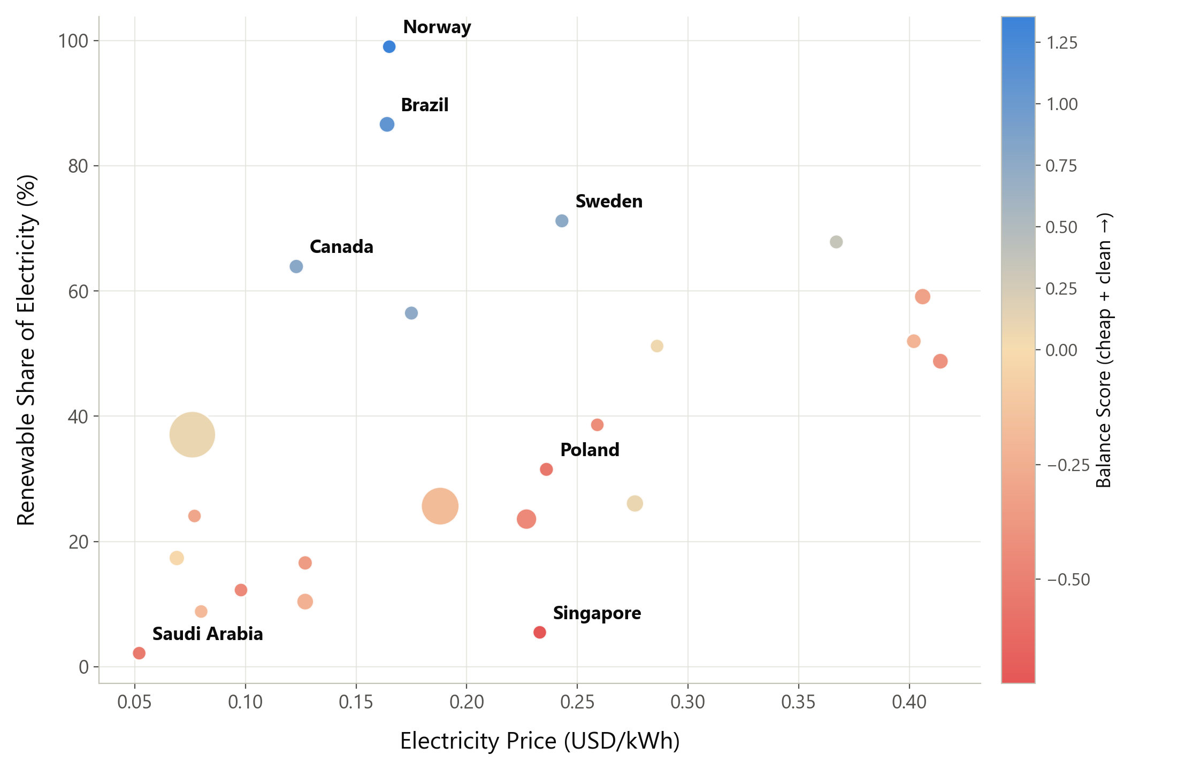
FINDING · Q5
Cost and sustainability don't reward the same countries
Norway and Brazil lead a composite score (cheap electricity + high renewable share + low carbon intensity).
China ranks notably higher here than on sustainability alone — it's genuinely cheap (0.076 USD/kWh) even though its grid isn't especially clean.
The US ranks below average on this composite despite hosting the most capacity by far — today's build-out doesn't track this balance.
AI Data Center Sustainability & Energy Intelligence · Final Project
12

Slide 13
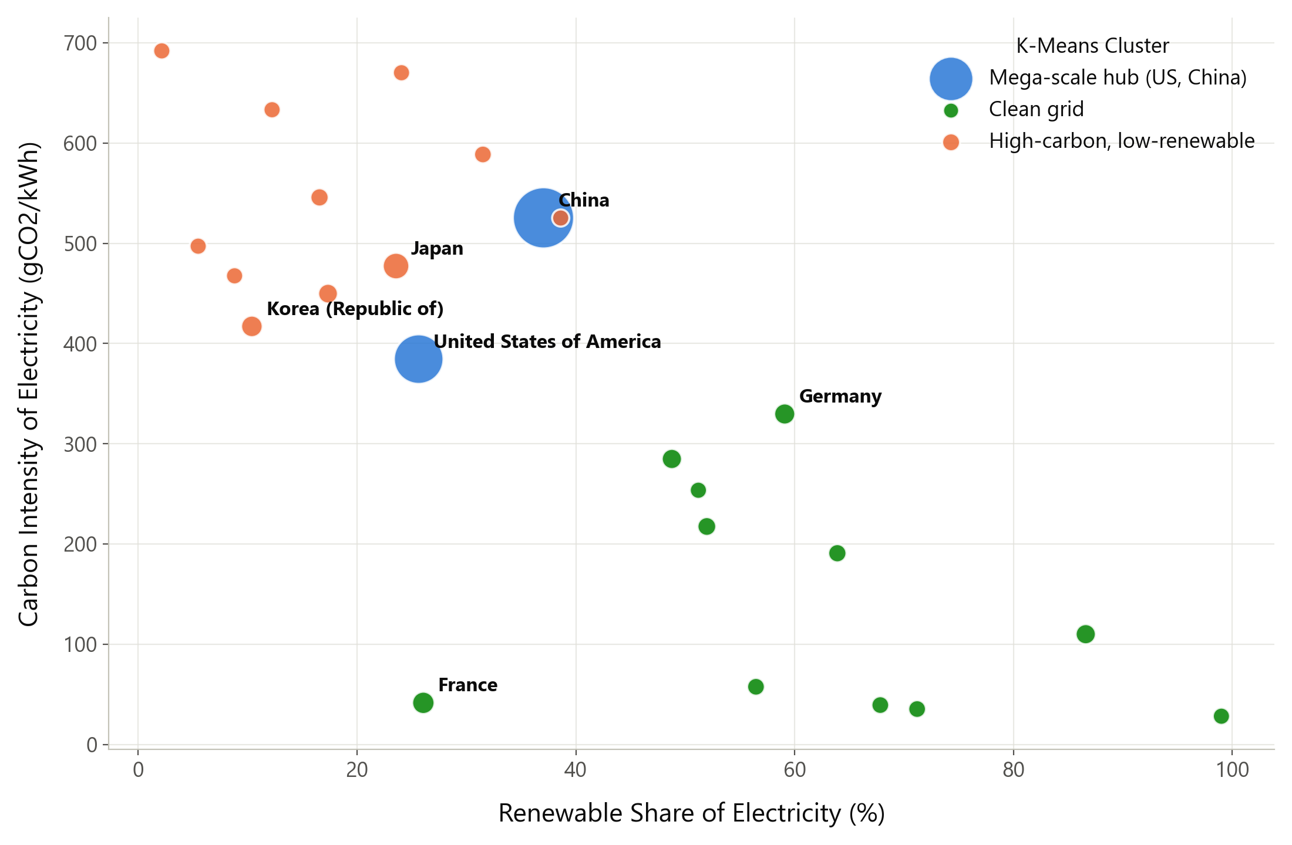
FINDING · Q10
Scale — not sustainability — is what separates countries
K-Means (k=3, silhouette-selected) finds:
• Mega-scale hub — just US & China, separated by raw scale alone
• Clean grid — 11 countries, avg 62% renewable
• High-carbon, low-renewable — 11 countries, avg 17% renewable
Today's two largest AI hosts aren't chosen for grid cleanliness — they're just where the scale already is.
AI Data Center Sustainability & Energy Intelligence · Final Project
13

Slide 14
4
SECTION 4
Interactive Dashboard
A Streamlit app for exploring every finding without reading code.
AI Data Center Sustainability & Energy Intelligence · Final Project
14

Slide 15
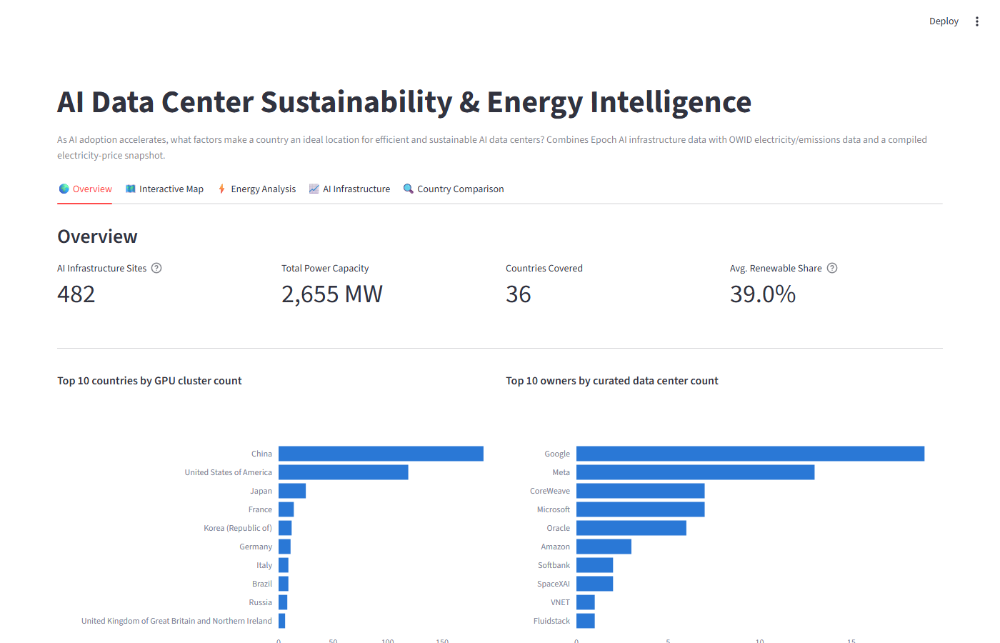
DELIVERABLE
Interactive dashboard
5 tabs: Overview · Interactive Map · Energy Analysis · AI Infrastructure · Country Comparison
AI Data Center Sustainability & Energy Intelligence · Final Project
15

Slide 16
DELIVERABLE
What each tab does
🌍 Overview
KPI cards + top-10 breakdowns by country and owner
🗺️ Interactive Map
True choropleth (log-scaled) + filterable site-level map
⚡ Energy Analysis
Price, renewable share, and CO2-weighted emissions bubble chart
📈 AI Infrastructure
Capacity trend, provider treemap, cost+sustainability ranking
🔍 Country Comparison
Pick 2+ countries → table + normalized radar chart
AI Data Center Sustainability & Energy Intelligence · Final Project
16

Slide 17
5
SECTION 5
Conclusions & Limitations
What the data actually supports — and where it falls short.
AI Data Center Sustainability & Energy Intelligence · Final Project
17

Slide 18
CONCLUSIONS
What actually predicts a good AI data center location
• Scale, not sustainability, explains where AI infrastructure sits today — the US and China form their own cluster purely on raw capacity.
• Electricity price shows no meaningful relationship with where capacity concentrates (r = -0.05).
• Renewable share alone is a misleading “clean grid” proxy — France's nuclear-heavy grid beats most higher-renewable countries on actual carbon intensity.
• If sustainability and cost were the deciding factors, Norway and Brazil — not the US or China — would be where new capacity goes.
• 24x spread in carbon intensity (Norway 28 vs. Saudi Arabia 692 gCO2/kWh) among countries already hosting meaningful AI infrastructure — there's real room to choose better.
AI Data Center Sustainability & Energy Intelligence · Final Project
18

Slide 19
HONESTY CHECK
Known limitations
• No live electricity price feed — the price data is a manually compiled, point-in-time snapshot (2023-2026 average), not a live API.
• Two AI infrastructure tables tell different stories: the curated 74-site Epoch AI table is heavily US-weighted; the 482-site GPU cluster survey is broader but less curated.
• ~60 of 482 GPU cluster sites have no reported power capacity — they appear on the map but contribute 0 to capacity totals.
• CO2 emissions figures are national totals, not attributable to AI infrastructure specifically.
• Country-level analysis (24 countries with 3+ clusters) trades off granularity for statistical reliability — smaller markets are excluded from rankings.
AI Data Center Sustainability & Energy Intelligence · Final Project
19

Slide 20
Links
GitHub repository
https://github.com/manya-25/AI_Data_Centers_Analytics
Live dashboard (Streamlit Community Cloud)
<< ADD URL AFTER DEPLOYING — see deployment steps >>
Analysis notebook
notebooks/02_EDA.ipynb (HTML/PDF export included in repo)
Thank you
AI Data Center Sustainability & Energy Intelligence · Final Project
20

