Slide 1
SAMSUNG PRISM · GENERATIVE AI HACKATHON
3RD EDITION 2026–27
Sentry
A troubleshooting engine that verifies before it answers.
Theme ID: Theme 02 · Smart Guided Troubleshooting Engine
Team Ember · VIT Vellore
Manya Singh · manya.praveensingh2024@vitstudent.ac.in
Krishita Gupta · krishita.anandgupta2024@vitstudent.ac.in
Muskaan Arora · muskaan.arora2024@vitstudent.ac.in
GitHub: https://github.com/manya-singh7/Sentry
Notes:
Open with the one-liner. Pause on 'verifies before it answers' — that's the whole pitch.

Slide 2



02 / THEME
Smart Guided Troubleshooting Engine
Theme 02 · Vague device complaints in, validated one-tap troubleshooting plans out.
Input
Output
Speed
WHAT COMES IN
WHAT GOES OUT
THEME TARGETS
A free-text complaint, plus optional SIIS reference text that the plan must be built from.
Pure JSON: goal, ordered actions, UI steps, catalog deeplinks, 8–10 query variations.
P95 ≤ 300 ms for issues seen before. P95 ≤ 8 s for brand-new ones.
SENTRY · TEAM EMBER 02/21

Slide 3
03 / PROBLEM STATEMENT
“Screen flickers and the battery dies fast.”
MANUAL TRIAGE · PER SCENARIO
~15 min
That's how customers really talk. Today an agent reads SIIS knowledge-base articles, works out the cause and picks the steps by hand: about 15 minutes per scenario.
Then the customer still digs through nested Settings menus to apply the fix.
INTERACTIONS · GLOBALLY
Millions
Two problems, one sentence, zero structure. That's the input we have to handle.
Source: Samsung PRISM Theme 2 problem statement
SENTRY · TEAM EMBER 03/21

Slide 4
04 / EXISTING SOLUTIONS & GAPS
Why not search, or a chatbot?
 | GOOGLE | SENTRY
You give it | Keywords you have to guess | Your complaint, typed, spoken or photographed
It gives you | Ten links to read and compare | Ranked causes with a confidence score
The last mile | You dig through Settings yourself | One tap straight to the exact screen
Trust | You judge every source | Every link checked against the real catalog
When unsure | Always returns something | Asks one question, or says no match
Today's baseline is manual: an agent reads SIIS articles, about 15 minutes per scenario. Generic LLM chatbots are faster but invent help URLs and steps, which Theme 2 forbids. Sentry makes the decision, verifies it, and hands you the fix one tap away.
SENTRY · TEAM EMBER 04/21

Slide 5
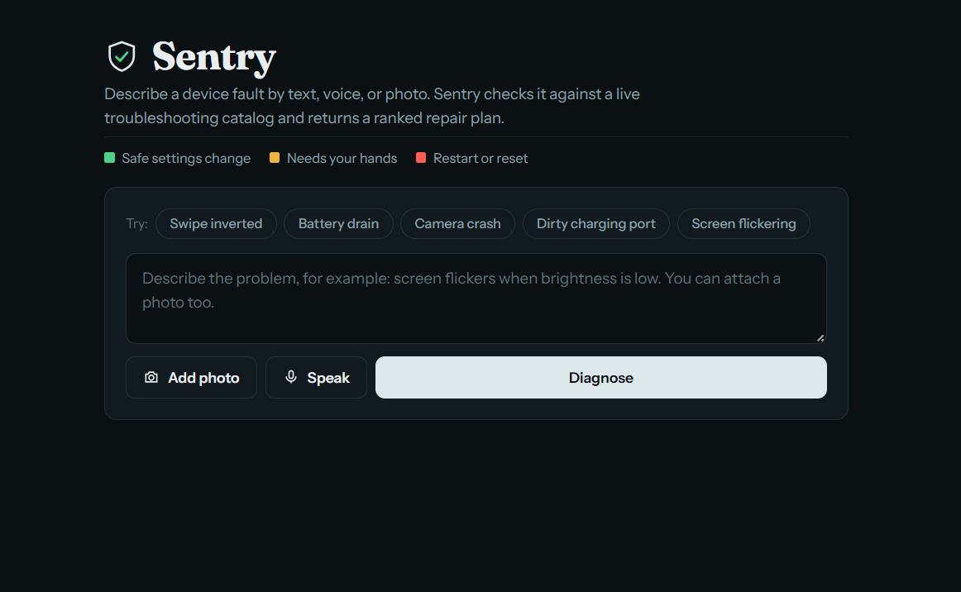



05 / OUR SOLUTION
Complaint in. Fix out.
One API call turns a messy complaint into a ranked, validated, one-tap fix deeplinked straight to the right Settings screen.
Multimodal input
Verified cache
Text, voice, photo, or photo + sentence
Paraphrases served from cache, no LLM call
Self-critique
Honest fallback
Catches and surfaces its own bad guesses
Asks, or admits no match, instead of guessing
SENTRY · TEAM EMBER 05/21

Slide 6
06 / THE NAME
sen·try /ˈsen-trē/ noun
A guard posted to watch, check whoever approaches, and stop what doesn't belong.
Watches
Verifies
Stops
SELF-CRITIQUE
DEEPLINK VALIDATION
OFF-DOMAIN REFUSAL
Rescores its own hypotheses against the complaint and shows you what it threw out.
Every link is matched against the real 578-entry catalog. It never invents a URI.
Not a device problem? It says so, enforced by the prompt and a keyword backstop.
SENTRY · TEAM EMBER 06/21

Slide 7
07 / ARCHITECTURE
Six stages. One guarded pipeline.
every LLM call wrapped in dual-key failover
01
02
03
04
05
06
Complaint
Enrich
Cache lookup
Extract
Retrieve + map
Order + rank
text · voice · image + SIIS
canonical query · 8–10 variations
similarity + polarity veto
LLM · grounded in SIIS text
BM25 · catalog deeplinks
safe first · critical last · optional critique
hit
Served from cache
0 LLM calls · $0 · < 25 ms
Validated JSON, or no_match
zero URL leaks · catalog deeplinks · meta
SENTRY · TEAM EMBER 07/21

Slide 8
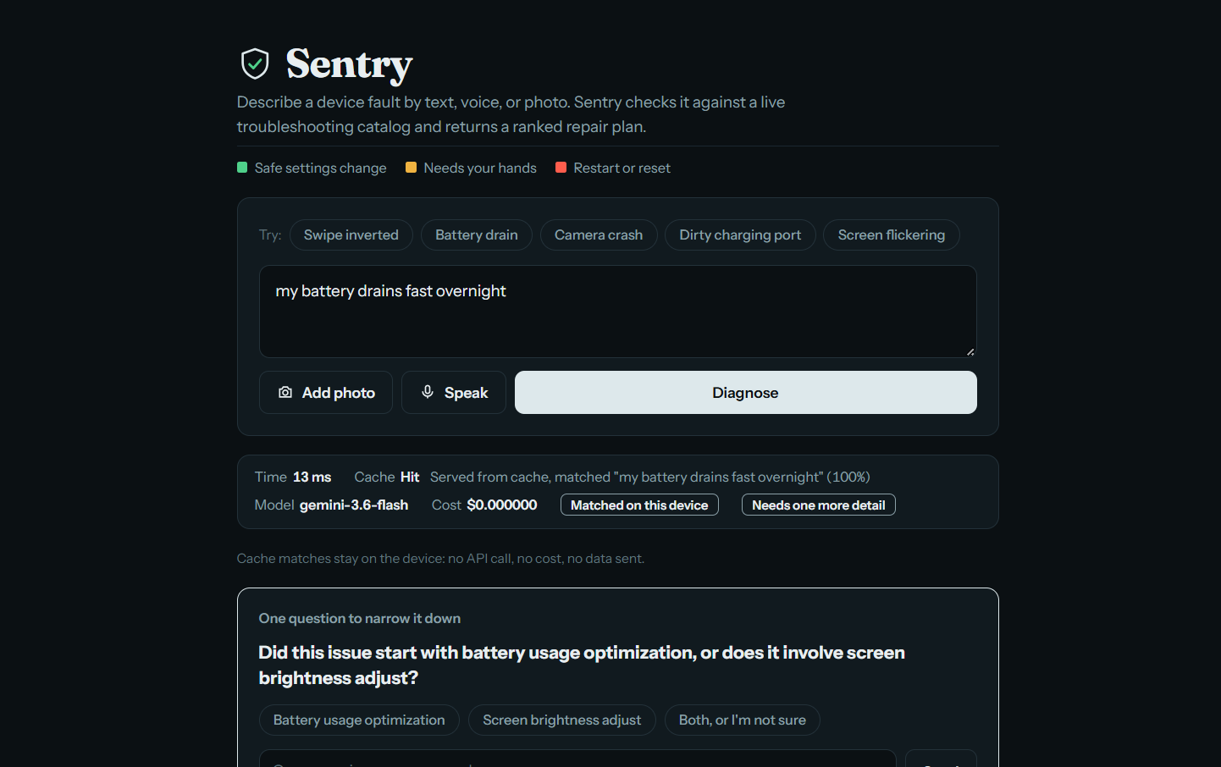
08 / DEMO · THE VERIFIED CACHE
< 25 ms
cache lookup, P95 on unseen paraphrases
$0
per cached answer, no API call
≤ 300 ms
Theme 2 cache-hit target (P95)
“turn Bluetooth on” ≠ “off”
A polarity + entity veto stops near-identical embeddings from serving the wrong fix.
SENTRY · TEAM EMBER 08/21

Slide 9
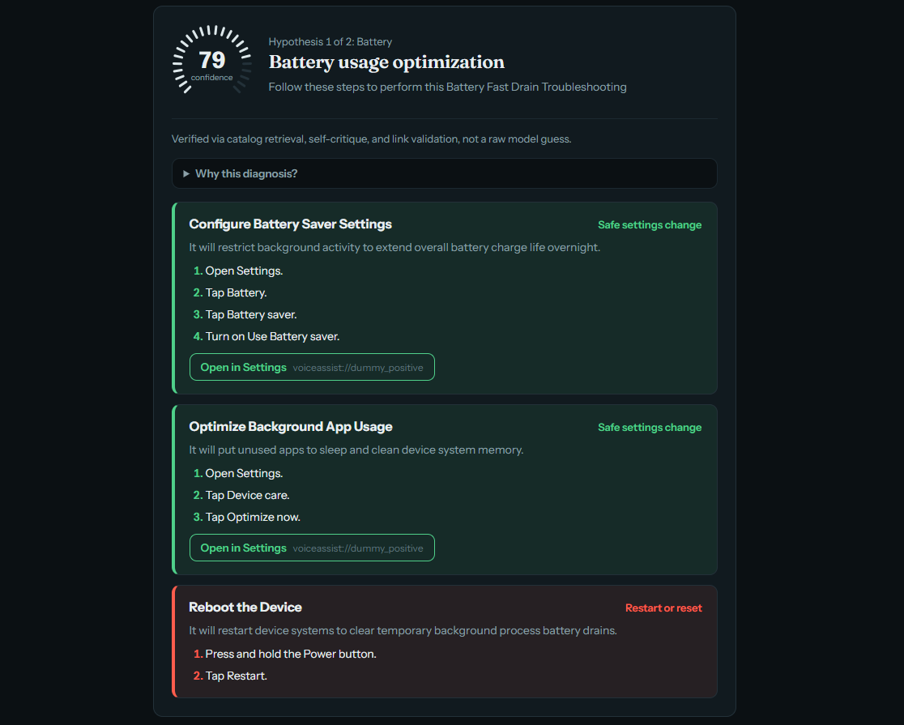
09 / DEMO · RANKED HYPOTHESES
It shows you how sure it is.
One bold design choice: a radial gauge per hypothesis, instead of a buried number. Colour tells you at a glance whether to tap or to double-check.
≥ 0.90
50% land on the exact screen
0.70–0.89
25% exact, rest fall back safely
0.50–0.69
routes to a safe parent screen
Sample data, n = 3 / 4 / 1 goals per band; directional only. “Exact” = a specific catalog screen. Self-critique is optional (off by default).
SENTRY · TEAM EMBER 09/21

Slide 10
10 / DEMO · SELF-CRITIQUE
It catches itself, out loud.
HOW IT'S VERIFIED
Automated tests (test_self_critique.py, 7/7 passing), including a mocked rejection of a weak hypothesis.
Not shown live: a live rejection only happens when the model produces a genuinely weak hypothesis.
Off by default. Enabled with ENABLE_SELF_CRITIQUE=true.
01
Rescore
A second pass checks each hypothesis against the original complaint.
02
Reject visibly
Discarded guesses are shown to the user, not quietly hidden.
03
Stay in budget
Runs only if under 4 s so far, with a hard 2 s timeout.
SENTRY · TEAM EMBER 10/21

Slide 11
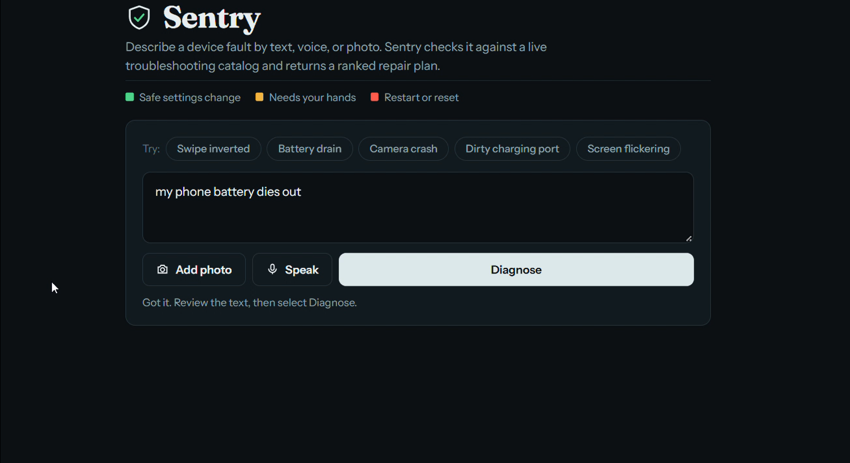
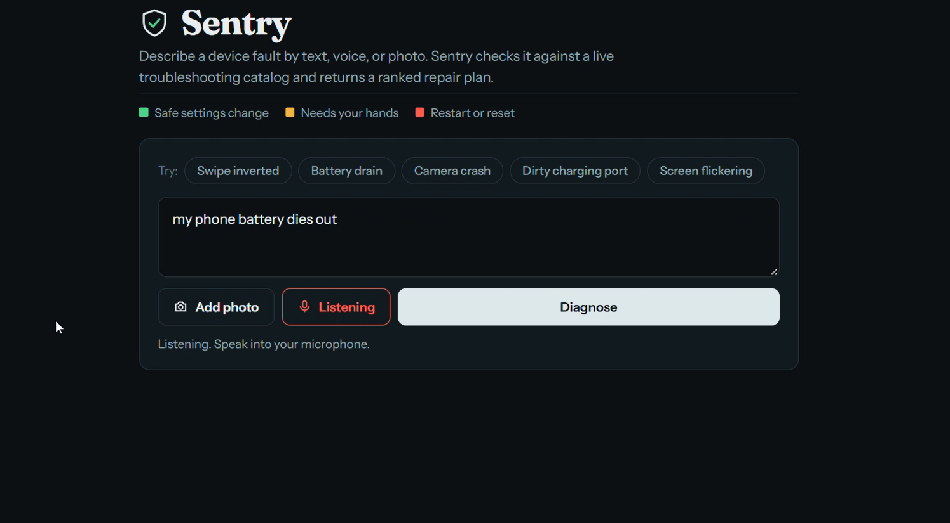
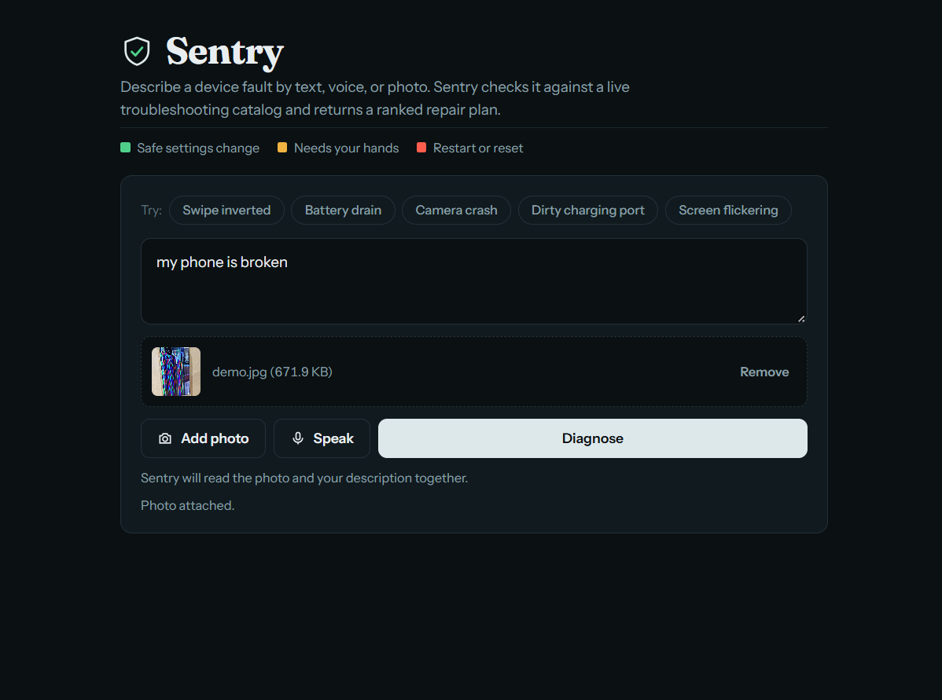



11 / DEMO · MULTIMODAL INPUT
Describe it however it's easiest.
Type it
Say it
Show it
“phone gets hot while charging”
Voice, transcribed in the browser, then enriched
A photo of the problem, with or without a sentence
SENTRY · TEAM EMBER 11/21

Slide 12
12 / TOOLS & TECH STACK
Tools & tech stack
FastAPI + Uvicorn
Pydantic
Google Gemini · gemini-3.6-flash
BM25 · rank_bm25
fastembed · all-MiniLM-L6-v2
Docker
Web Speech API
HTML / JS demo UI
Service
POST /v1/troubleshoot · GET /health · pure-JSON responses with latency, cache-hit and cost metadata.
Semantic cache is in-memory on the server. Dense embeddings are used for cache matching; deeplink retrieval is BM25.
SENTRY · TEAM EMBER 12/21

Slide 13
13 / IMPACT & USE CASE
From 15 minutes to seconds.
Use cases: agent assist in support centres, and self-service straight from the device's Settings or support app.
~15 min
5.04 s
< 25 ms
manual triage per scenario today
cold-path P95 for a brand-new complaint
repeat issues from cache, $0 per answer
Sources: Theme 2 problem statement (15 min); team latency benchmarks. Industry context: TELUS × Google Cloud report 87% faster resolution and $53.9M in annual savings with Gemini-based customer care (cloud.google.com/customers/telus-gemini-enterprise-cx).
SENTRY · TEAM EMBER 13/21

Slide 14
14 / RESULTS VS. THEME 2 TARGETS
Measured against the brief.
METRIC | THEME 2 TARGET | OURS
Schema conformance | 100% | 100% (sample set)
Web-URL leaks | 0 | 0
Deeplinks valid in catalog | 100% | 100% (9/9, sample set)
Exact-screen resolution | Exact screen, not parent menu | 69/73 offline mapping · end-to-end: MISSING
Step accuracy (0–3) | vs. reference samples | MISSING — needs to be measured
Cache-hit latency, P95 | ≤ 300 ms | < 25 ms (unseen paraphrases)
Paraphrase cache hit rate | ≥ 80% | MISSING — needs to be measured
Cold-path latency, P95 | ≤ 8 s | 5.04 s
Cost per query | Tracked | $0.00027 cold · $0 cache hit
SAMPLE SET = TEAM SAMPLE QUERIES (SMALL N). MISSING ROWS WILL BE MEASURED ON THE OFFICIAL DATASET.
SENTRY · TEAM EMBER 14/21

Slide 15
15 / RESULTS · ABLATION
We ran the ablation. Retrieval wins.
VARIANT | SCHEMA | CATALOG-VALID | P95 | COST / QUERY
A · BM25 + label match (ours) | 100% | 100% (9/9) | 5.0 s | $0.00027
B · LLM only | 70% | 56% (5/9) | 6.3 s | $0.00084
C · Rules only | 100% | 78% (7/9) | 5.0 s | $0.00018
CATALOG · ACTION → SCREEN
100%
held-out · 18/18
94%
development · 31/33
LLM-only invented non-catalog URIs on 3 queries and attached deeplinks to reboot steps. Rules-only mapped “app” and “camera” to the wrong screens.
91%
calibration · 20/22
69/73 correct, offline. 1 wrong screen; the other misses fell back to a safe screen.
Ablation on the sample query set (9 actions). Step accuracy per variant: MISSING — needs to be measured.
SENTRY · TEAM EMBER 15/21

Slide 16
16 / RESULTS · RELIABILITY
Every failure has a ceiling.
COLD PATH, P95 vs. 8 s SPEC CEILING
5.04 s
8.0 s
WHAT BREAKS | WHAT SENTRY DOES | BOUND
Primary key hits quota (429) | Backup key takes over inside the same request | invisible
Both keys exhausted | Fails fast, no backoff; clean honest response | < 500 ms
Upstream 503 / timeout | One retry, then a clean fallback | ≤ 8 s
Self-critique runs slow | Skipped past 4 s elapsed; hard 2 s timeout | ≤ 8 s
SENTRY · TEAM EMBER 16/21

Slide 17
17 / LIMITATIONS
What we'd tell you before you asked.
Late dataset
Free-tier Gemini
One action per screen
The official PRISM dataset arrived mid-hackathon. We built on sample data, then benchmarked against the real catalog once it landed.
Low per-minute and per-day request limits. The dual-key failover exists because of this, and it's tested, not theoretical.
Theme 2 requires one action per screen. We check it in code, but today a violation raises a warning instead of rejecting the plan. Hard enforcement is next.
Also open: small test sets; step accuracy, paraphrase hit rate and voice/photo accuracy not yet measured. None of these need an architecture change.
SENTRY · TEAM EMBER 17/21

Slide 18
18 / WHAT'S NEXT
Yes.
01
Swap in the full catalog
Retrieval was built on the same schema from day one. The official 578-entry catalog already runs with zero code changes.
Can it become a worklet? The path is short, not theoretical.
02
Move the cache on-device
Today the cache runs in our backend: a hit makes no LLM call. Running the same lookup on the phone would keep repeat complaints private, in line with Galaxy AI.
03
Harden retrieval for real phrasing
Production users are messier than any hackathon set. The architecture absorbs more data without a redesign.
SENTRY · TEAM EMBER 18/21

Slide 19
19 / BROWNIE POINTS
Beyond the brief.
Self-critique
Cache veto
01
02
Optional second pass rescores hypotheses and shows rejections. Verified by a mocked test.
Polarity + entity rules stop “Bluetooth on” getting the “off” fix.
Six things we built that Theme 2 didn't ask for.
03
Dual-key failover
04
Multimodal input
A quota hit on one key switches to the backup inside the same request.
Text, voice, photo, or a photo plus a sentence.
05
Clarifying question
06
Off-domain refusal
When two causes are too close to call, it asks one question.
Non-device complaints get no_match, not invented steps.
SENTRY · TEAM EMBER 19/21

Slide 20
20 / CHECKLIST
Theme 2 checklist.
REQUIREMENT | HOW | STATUS
Zero web-URL leaks | Programmatic scrub on every generated step | ✓ Done
Catalog-only deeplinks | Matched on catalog descriptions; every URI validated | ✓ Done
dummy_positive for unindexed screens | Used only when no catalog entry exists | ✓ Done
No hallucinated steps | No viable fix → contexts: [] + fallback: no_match | ✓ Done
Pure JSON delivery | Pydantic-validated, no markdown wrapping | ✓ Done
Action order | Safe settings first, critical / destructive last | ✓ Done
8–10 query variations | Generated at enrichment (ENABLE_QUERY_VARIATIONS) | ✓ Implemented
One Action = One Screen | Checked in code; raises a warning, not a rejection | Partial
REST API | POST /v1/troubleshoot · GET /health | ✓ Done
Containerised | Dockerfile with health check | ✓ Done
Latency targets (P95) | ≤ 300 ms cache hit · ≤ 8 s cold → < 25 ms · 5.04 s | ✓ Met
Hit rate · step & screen accuracy | See slide 14 | MISSING
SENTRY · TEAM EMBER 20/21

Slide 21
21 / THANK YOU
Thank you.
Team Ember
Manya Singh · Krishita Gupta · Muskaan Arora · VIT Vellore
https://github.com/manya-singh7/Sentry
Demo & project files (Google Drive)
SENTRY · TEAM EMBER 21/21

