Slide 1
SAMSUNG PRISM GENAI HACKATHON · THEME 2
Sentry
A troubleshooting engine that verifies before it answers.
Team Ember
VIT Vellore · Manya Singh, Krishita Gupta, Muskaan Arora
Notes:
Open with the one-liner. Pause on 'verifies before it answers' — that's the whole pitch.

Slide 2
SENTRY

Slide 3



03 / THE NAME
sen·try /ˈsen-trē/ noun
A guard posted to watch, check whoever approaches, and stop what doesn't belong.
Watches
Verifies
Stops
SELF-CRITIQUE
DEEPLINK VALIDATION
OFF-DOMAIN REFUSAL
Rescores its own hypotheses against the complaint and shows you what it threw out.
Every link is matched against the real 578-entry catalog. It never invents a URI.
Not a device problem? It says so, enforced by the prompt and a keyword backstop.
SENTRY · TEAM EMBER 03/17

Slide 4
04 / PROBLEM STATEMENT
“Screen flickers and the battery dies fast.”
COST PER TICKET · HUMAN
$6–13
That's how customers actually describe problems. Turning it into a fix today means an agent spends ~15 minutes triaging it by hand.
Then the customer still hunts through nested Settings menus to apply the fix themselves.
COST PER TICKET · AI
$0.50–2
Two problems, one sentence, zero structure. That's the input we have to handle.
Source: Aissist.io support cost benchmark
SENTRY · TEAM EMBER 04/17

Slide 5
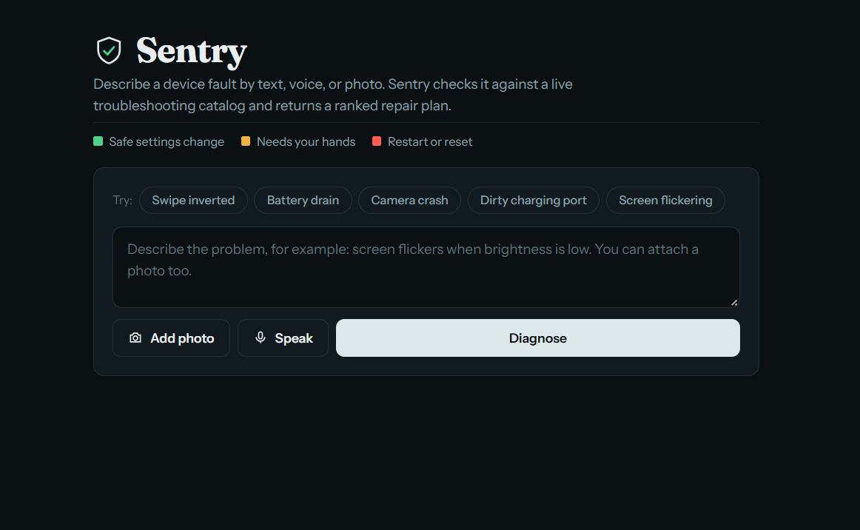



05 / WHAT WE BUILT
Complaint in. Fix out.
One API call turns a messy complaint into a ranked, validated, one-tap fix deeplinked straight to the right Settings screen.
Multimodal input
Verified cache
Text, voice, photo, or photo + sentence
Paraphrases served on-device, no LLM call
Self-critique
Honest fallback
Catches and surfaces its own bad guesses
Asks, or admits no match, instead of guessing
SENTRY · TEAM EMBER 05/17

Slide 6
06 / ARCHITECTURE
Six stages. One guarded pipeline.
every LLM call wrapped in dual-key failover
01
02
03
04
05
06
Complaint
Enrich
Cache lookup
Extract
Retrieve + map
Critique + rank
text · voice · image
Hinglish-tolerant intent
similarity + polarity veto
LLM · up to 2 hypotheses
BM25 · catalog deeplinks
rescore · calibrate
hit
Served on-device
0 LLM calls · $0 · < 25 ms
Validated JSON
ranked goals · deeplinks · telemetry
SENTRY · TEAM EMBER 06/17

Slide 7
07 / THE OBVIOUS QUESTION
Isn't this just Google search?
 | GOOGLE | SENTRY
You give it | Keywords you have to guess | Your complaint, typed, spoken or photographed
It gives you | Ten links to read and compare | Ranked causes with a confidence score
The last mile | You dig through Settings yourself | One tap straight to the exact screen
Trust | You judge every source | Every link checked against the real catalog
When unsure | Always returns something | Asks one question, or says no match
Google finds information for you to interpret. Sentry makes the decision and hands you the fix, already verified, already one tap away.
SENTRY · TEAM EMBER 07/17

Slide 8
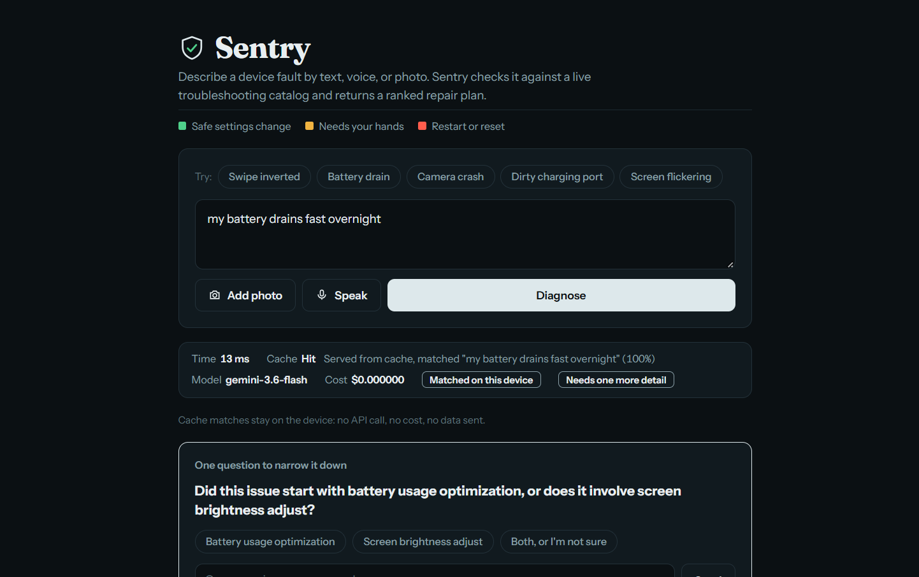
08 / THE VERIFIED CACHE, LIVE
< 25 ms
cache lookup, P95 on unseen paraphrases
$0
per cached answer, no API call
0 bytes
of the complaint leave the device
“turn Bluetooth on” ≠ “off”
A polarity + entity veto stops near-identical embeddings from serving the wrong fix.
SENTRY · TEAM EMBER 08/17

Slide 9
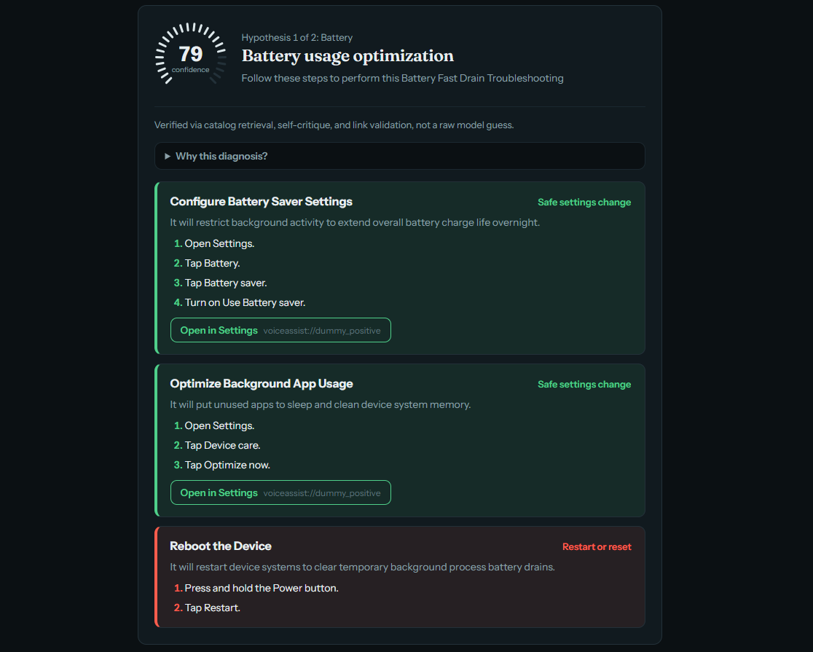
09 / RANKED HYPOTHESES + CONFIDENCE
It shows you how sure it is.
One bold design choice: a radial gauge per hypothesis, instead of a buried number. Colour tells you at a glance whether to tap or to double-check.
≥ 0.90
50% land on the exact screen
0.70–0.89
25% exact, rest fall back safely
0.50–0.69
routes to a safe parent screen
Calibration measured on sample data; small n, directional only.
SENTRY · TEAM EMBER 09/17

Slide 10
10 / SELF-CRITIQUE
It catches itself, out loud.
Purple “Self-Critique in Action” banner rejecting a hypothesis live
This feature is implemented and verified in our automated test suite (test_self_critique.py, 7/7 passing), including a mocked rejection scenario. A live rejection is probabilistic, it depends on the model generating a genuinely weak hypothesis, and we weren't able to reliably reproduce one on demand for this screenshot.
01
Rescore
A second pass checks each hypothesis against the original complaint.
02
Reject visibly
Discarded guesses are shown to the user, not quietly hidden.
03
Stay in budget
Runs only if under 4 s so far, with a hard 2 s timeout.
SENTRY · TEAM EMBER 10/17
Notes:
CAPTURE BEFORE FINALISING: set ENABLE_SELF_CRITIQUE=true (it's off by default) and deliberately trigger a rejection. This slide has no visual proof until that screenshot exists.

Slide 11
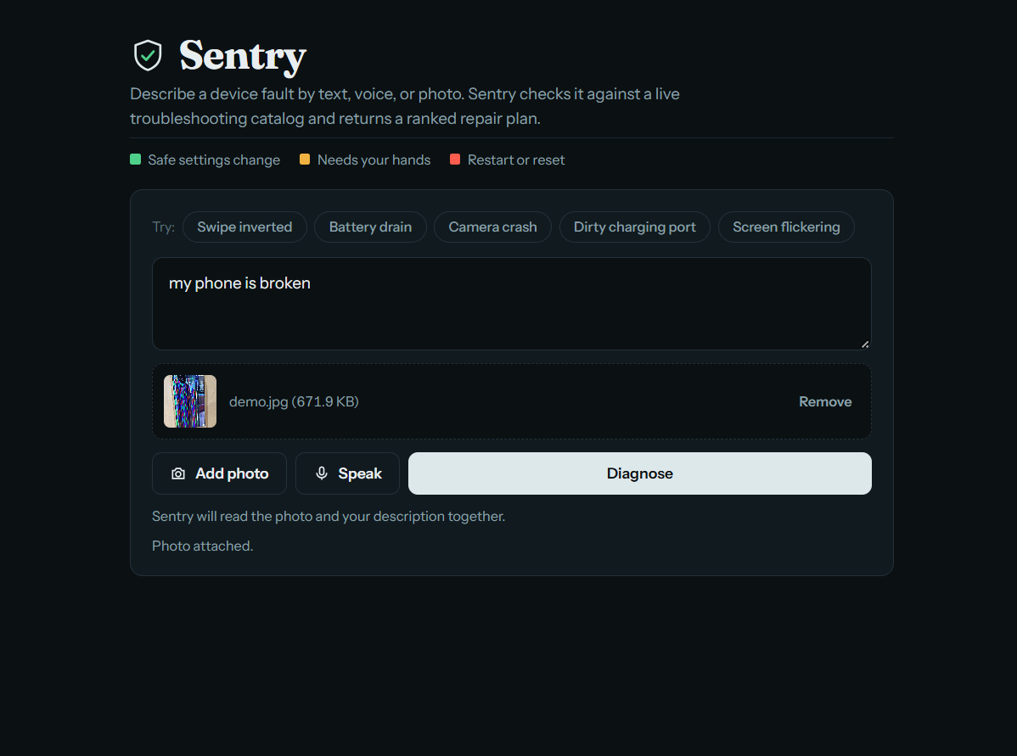
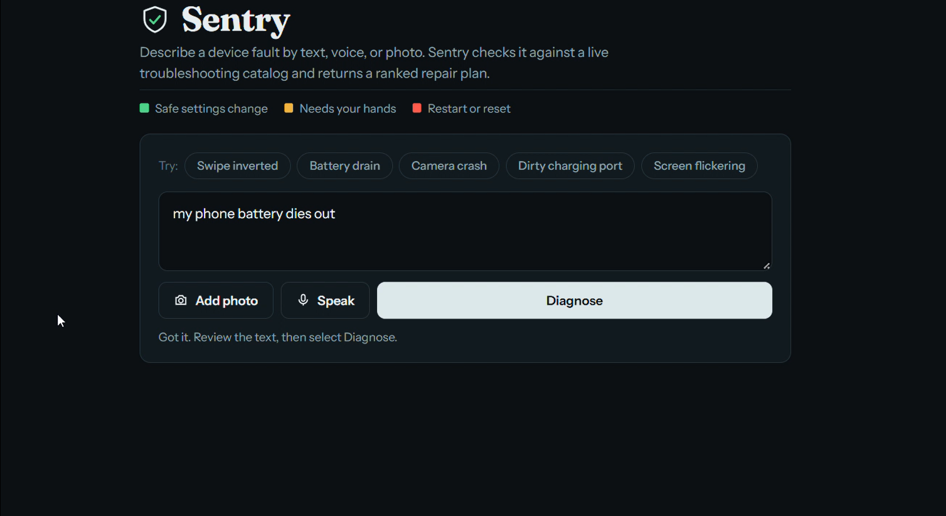
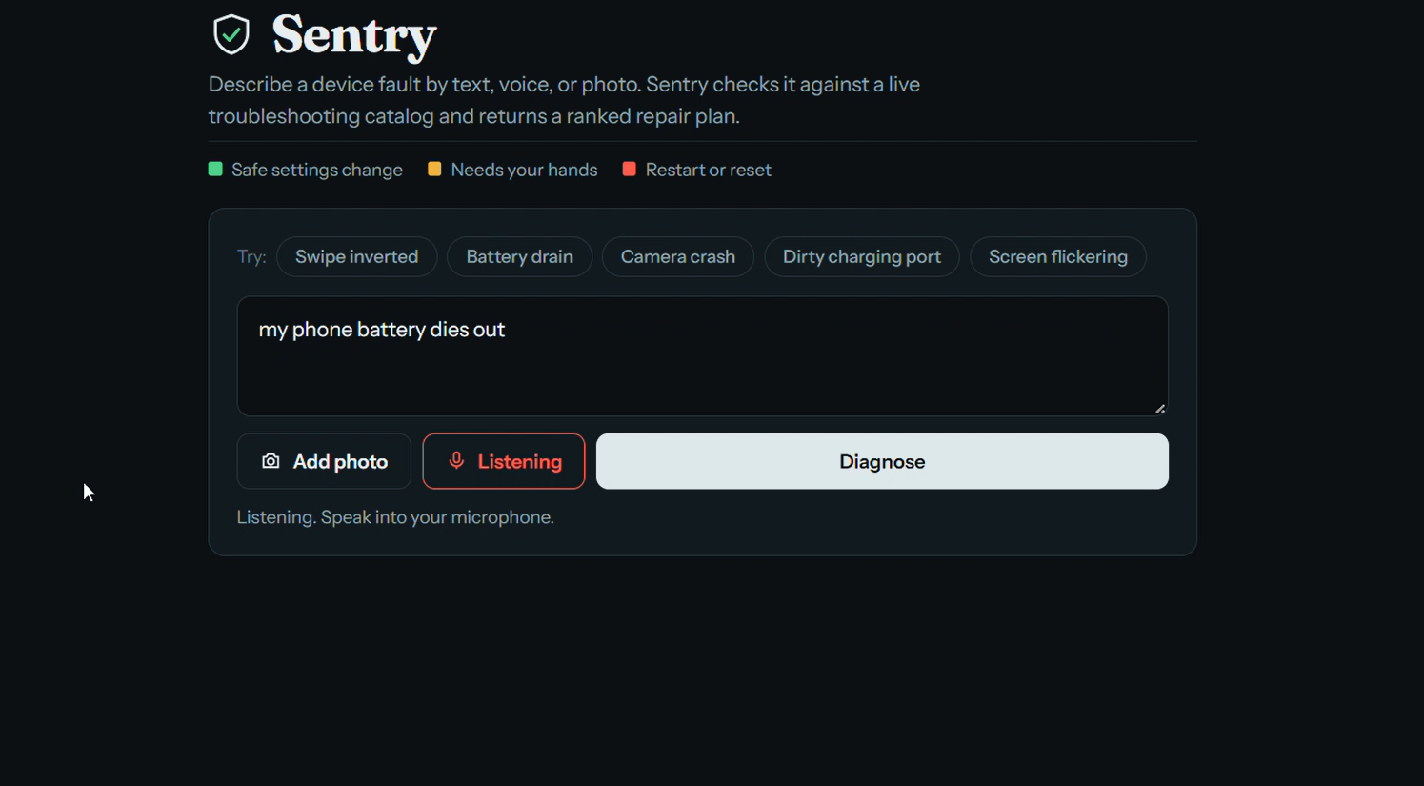



11 / MULTIMODAL INPUT
Describe it however it's easiest.
Type it
Say it
Show it
“phone gets hot while charging”
Voice complaint, transcribed and enriched
A photo of the problem, with or without a sentence
SENTRY · TEAM EMBER 11/17

Slide 12
12 / PROOF AT SCALE
It already works at scale.
TELUS runs AI-assisted support on the same Gemini model family Sentry is built on.
87%
$53.9M
30%
faster resolution
saved
of issues resolved autonomously
Source: TELUS × Google Cloud customer case study. Same model family, not the same product.
SENTRY · TEAM EMBER 12/17

Slide 13
13 / RESULTS
We ran the ablation. Hybrid wins.
VARIANT | SCHEMA | DEEPLINK ACC. | P95 | COST / QUERY
A · Hybrid BM25 (ours) | 100% | 100% (9/9) | 5.0 s | $0.00027
B · LLM only | 70% | 56% (5/9) | 6.3 s | $0.00084
C · Rules only | 100% | 78% (7/9) | 5.0 s | $0.00018
OFFICIAL 578-ENTRY CATALOG
100%
held-out · 18/18
94%
development · 31/33
LLM-only invented non-catalog URIs on 3 queries and attached deeplinks to reboot steps. Rules-only mapped “app” and “camera” to the wrong screens.
91%
calibration · 20/22
1 wrong screen in 73 cases. Misses fall back safely.
Ablation on the sample query set.
SENTRY · TEAM EMBER 13/17

Slide 14
14 / RELIABILITY ENGINEERING
Every failure has a ceiling.
COLD PATH, P95 vs. 8 s SPEC CEILING
5.04 s
8.0 s
WHAT BREAKS | WHAT SENTRY DOES | BOUND
Primary key hits quota (429) | Backup key takes over inside the same request | invisible
Both keys exhausted | Fails fast, no backoff; clean honest response | < 500 ms
Upstream 503 / timeout | One retry, then a clean fallback | ≤ 8 s
Self-critique runs slow | Skipped past 4 s elapsed; hard 2 s timeout | ≤ 8 s
SENTRY · TEAM EMBER 14/17

Slide 15
15 / CAN THIS BE A WORKLET?
Yes.
01
Swap in the full catalog
Retrieval was built on the same schema from day one. The official 578-entry catalog already runs with zero code changes.
And the path is short, not theoretical.
02
Lead with on-device privacy
A cache hit never calls Gemini and never leaves the phone. That fits how Galaxy AI already talks about on-device processing.
03
Harden retrieval for real phrasing
Production users are messier than any hackathon set. The architecture absorbs more data without a redesign.
SENTRY · TEAM EMBER 15/17

Slide 16
16 / KNOWN LIMITATIONS
What we'd tell you before you asked.
Late dataset
Free-tier Gemini
A heuristic, not a law
The official PRISM dataset arrived mid-hackathon. We built on sample data, then benchmarked against the real catalog once it landed.
Low per-minute and per-day request limits. The dual-key failover exists because of this, and it's tested, not theoretical.
One action, one screen is enforced as a warning check, not a hard rejection. Detecting it from text alone is a judgment call.
None of these touch the architecture. Each one is a next step, not a rewrite.
SENTRY · TEAM EMBER 16/17

Slide 17
17 / BUILT WITH
Thank you.
FastAPI
Pydantic
Google Gemini
BM25 retrieval
Dense embeddings
fastembed
Docker
Team Ember
Manya Singh · Krishita Gupta · Mukaan Arora · VIT Vellore
github.com/manya-singh7/diagnos-ai
SENTRY · TEAM EMBER 17/17

