Slide 1
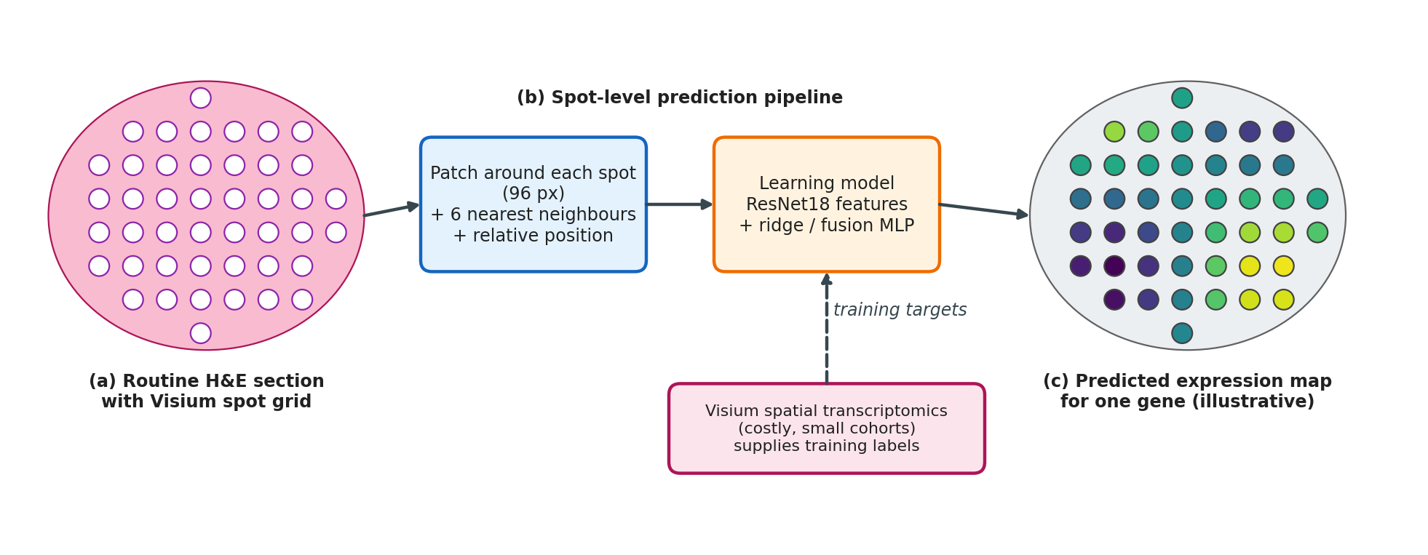
Virtual Spatial Transcriptomics from H&E Histology
By:
Manya Aggarwal (S24CSEU2871)
Aashna Das (S24CSEU0191)

Slide 2
Why predict expression from H&E?
Spatial transcriptomics (ST) maps genes onto tissue, but is costly and available for few cohorts [1, 3]
H&E slides are cheap and routine
Goal: predict 56 genes per spot from the H&E patch
Strict rule: whole tissue sections are held out for testing
19
13,742
56
tissue sections
Visium spots
genes predicted
Notes:
ST is costly and rare [1,3]; H&E is routine. Atopic dermatitis lesional 7, non-lesional 6, healthy 6 sections. Test sections are never seen in training.

Slide 3
Objective and contributions
1. Leakage-aware pipeline
2. Six-model comparison
19 sections, 13,742 spots; scaling fitted on training folds only
Baseline to multimodal fusion under sample-grouped CV
3. Complete per-gene reporting
4 Structure vs inflammation
All 56 genes, including those with R2 below 0
Structural genes recovered inside sections; inflammatory genes between sections
Scope: inspired by OmiCLIP [1] and STPath [2], not a reproduction; fixed 56-gene panel
Notes:
Four contributions. We do not train a foundation model and we do not reproduce OmiCLIP or STPath.

Slide 4
Literature review: key studies
Study | Year | Key idea | Data
ST-Net [4] | 2020 | CNN regression from patches | Breast tumour ST
BLEEP [5] | 2023 | Contrastive imputation from reference | Human liver Visium
OmiCLIP [1] | 2025 | CLIP-style visual-omics model | 2.2 M pairs, 32 organs
STPath [2] | 2025 | Generative slide-level transformer | 983 slides, 17 organs
STFlow [6], SPADE [9] | 2025 | Flow matching; mixture of experts | Whole slides; HEST-1k
Benchmarks [7, 8] | 2025 | Compare methods, complete data | 11 methods; 26 sources
This work | 2026 | Patch + neighbours + position | 19 skin sections
Notes:
Comparative analysis of studies (paper Table 1). Trend toward scale; each relies on large corpora or narrow tissue.

Slide 5
Synthesis and research gap
Supervised and contrastive [4, 5]
Foundation and generative [1, 2, 6, 9]
Predict or retrieve expression from patches; shown on narrow tissue sets
Millions of pairs, many organs; needs huge data and compute
Pathology encoders [10, 11]
Benchmarks [7, 8]
UNI and CONCH give stronger features than ImageNet models
Protocols differ, so conclusions change; strict splits matter
Gap: a small, transparent baseline for inflammatory skin that holds out whole sections and reports every gene
Notes:
Four lines of work. Benchmarks show protocol changes conclusions, motivating sample-grouped splits.

Slide 6
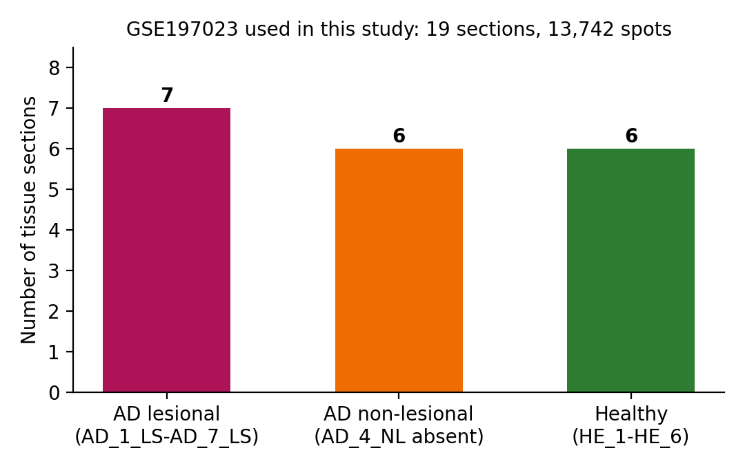
Dataset: GSE197023 skin Visium
Public 10x Visium skin data [12]
Upper-arm biopsies: AD lesional, AD non-lesional, healthy
Spots about 55 um wide, several cells each
96 px patch per spot; 13,742 valid spots
AD_4_NL absent, so 19 sections
Notes:
GSE197023 [12]: upper-arm biopsies. AD_4_NL is absent from our files, so 19 sections. Spots are about 55 micrometres with several cells each.

Slide 7
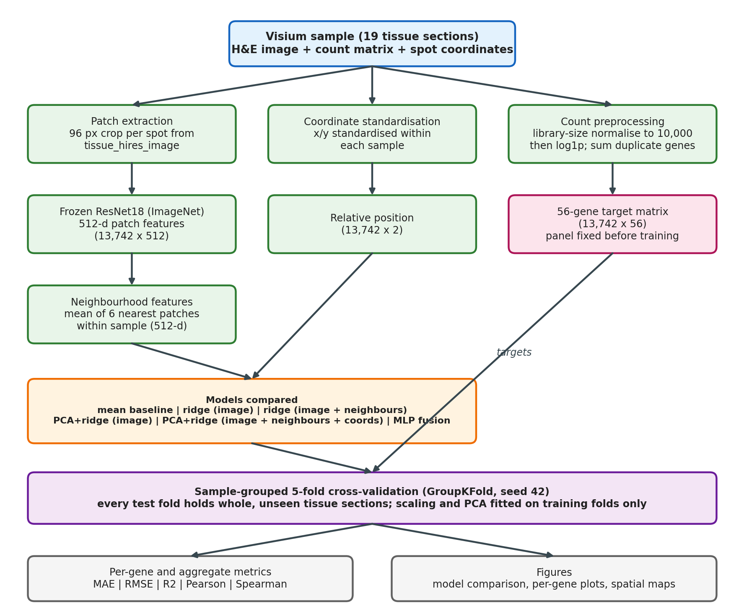
Proposed pipeline
Image branch: 96 px patch, frozen ResNet18, neighbour mean
Coordinate branch: x, y standardised per section
Count branch: normalise, log-transform, 56-gene targets
Models: six, from baseline to fusion MLP
Evaluation: sample-grouped 5-fold CV
Notes:
Image, position and count branches are separate and joined only at the model stage. Targets are used only for training and scoring.

Slide 8
Preprocessing and features
y = log(1 + 10,000 x c / sum of c)
Patch appearance (512)
Frozen ImageNet ResNet18 [13] on the 96 px patch
c: spot counts for one gene; sum over the spot's genes
Position (2)
Neighbourhood (512)
Standardised x and y within the section
Mean features of the 6 nearest spots in the same section
Scaling and PCA fitted on training folds only
No expression-derived input is used
Duplicate gene symbols summed
Coordinates standardized per section
Notes:
Counts normalised per spot to 10,000 then log. Duplicate gene symbols summed. Scaling, PCA and target scaling fitted on training folds only. A neighbour-averaged expression score exists as a diagnostic and is never an input.

Slide 9
Model comparison
Model | Inputs | Idea
mean_baseline | none | Training-fold mean per gene
ridge_image | 512 | Multi-output ridge on patch features
ridge_image_neighbor | 1,024 | Adds neighbourhood features
pca_ridge_image | 128 PCs | PCA fitted per training fold
pca_ridge_image_neighbor_coords | 128 PCs | Adds neighbours and coordinates
mlp_fusion | 512 + 512 + 2 | Multimodal fusion network
Notes:
Linear models were chosen for stability with 512 to 1,026 correlated inputs and few sections. Ridge penalties chosen on training data only.

Slide 10
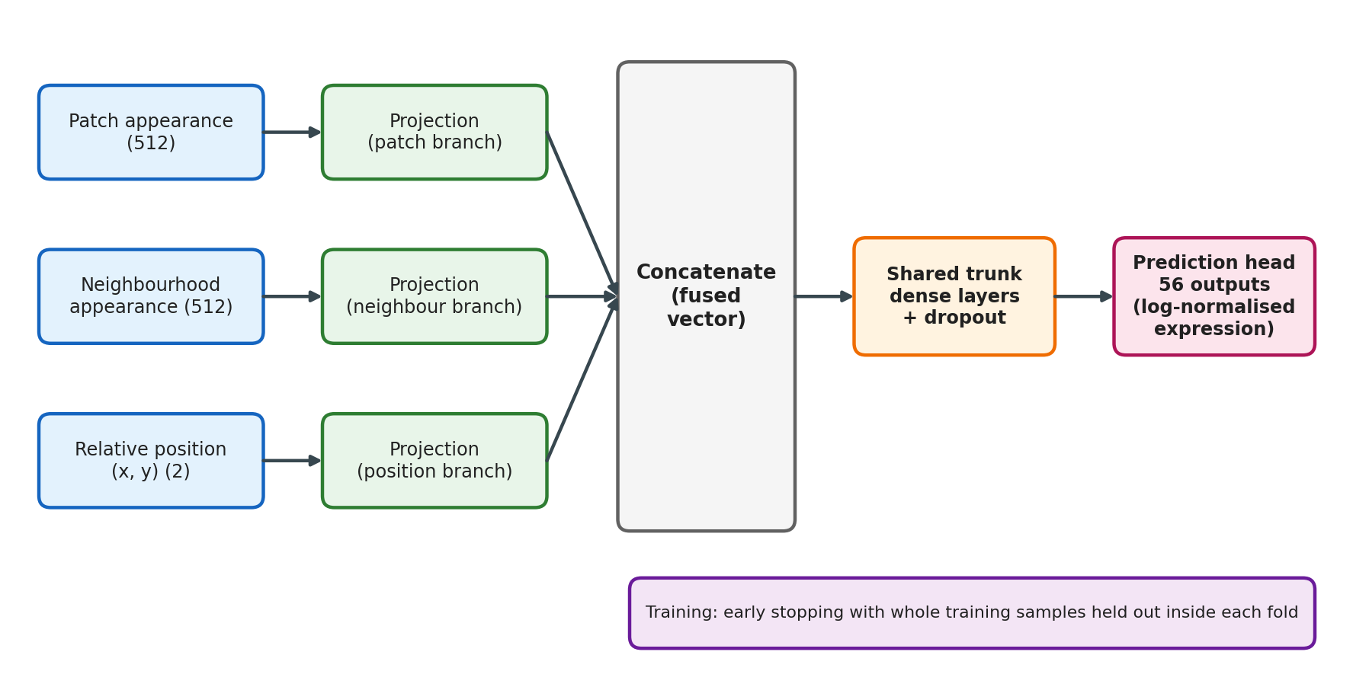
Multimodal fusion network
A separate projection per input block
Concatenate, then shared trunk with dropout
Head with 56 outputs
Early stopping on held-out training sections
Test fold never used for model selection
Notes:
Separate projections stop the 512-d blocks swamping the 2-d position block. Early stopping uses whole training sections held out inside each fold; the test fold is never used for selection.

Slide 11
Evaluation protocol and metrics
Protocol
Metrics
GroupKFold, 5 folds, grouped by section, seed 42
Every section is in a test fold once
Optional leave-one-section-out (19 folds)
Random spot splits avoided: neighbours leak
MAE and RMSE
R2 (negative: worse than the mean)
Pearson and Spearman
Within-sample Pearson: is the pattern inside one section recovered.
Notes:
Random spot-level splits leak because neighbouring spots share tissue context [7, 8]. A negative R2 means worse than a constant mean.

Slide 12
Results: model comparison
Model | MAE | RMSE | R2 | R2>0 | Pearson | Within r
mlp_fusion | 0.7246 | 0.9478 | 0.0842 | 48/56 | 0.2843 | 0.2158
pca_ridge_image_neighbor_coords | 0.7252 | 0.9521 | 0.0704 | 39/56 | 0.2821 | 0.2031
pca_ridge_image | 0.7275 | 0.9518 | 0.0718 | 43/56 | 0.2754 | 0.2012
ridge_image | 0.7298 | 0.9562 | 0.0624 | 40/56 | 0.2716 | 0.1987
ridge_image_neighbor | 0.7377 | 0.9691 | 0.0366 | 33/56 | 0.2696 | 0.1928
mean_baseline | 0.8251 | 1.0239 | -0.0295 | 0/56 | -0.1997 | n/a
Best model: MAE about 12% below the baseline; 48 of 56 genes with R2 above 0
Notes:
Table 3 of the paper. Fusion is best on every metric. Baseline within-sample correlation is undefined (constant prediction).

Slide 13
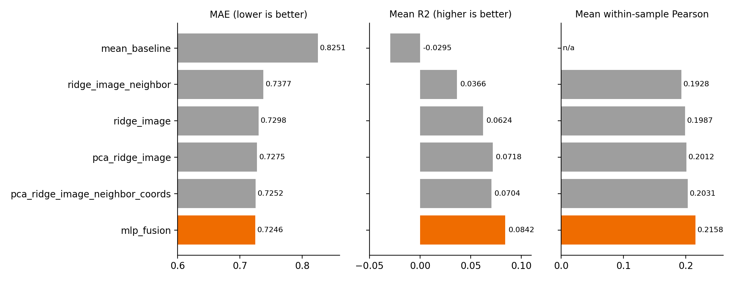
Results: fusion model is best
MAE 0.7246 vs 0.8251
Mean R2 0.0842
48 of 56 genes
about 12% below baseline
small but positive
with R2 above 0
Notes:
Fusion beats all linear models, but its lead over PCA-ridge is small and uses one seed, so we do not claim statistical significance.

Slide 14
What the model comparison teaches
Neighbours hurt plain ridge
PCA to 128 helps
R2 0.0624 to 0.0366; positive genes 40 to 33 (inputs double, 19 sections)
R2 0.0718 and 43 positive genes
Coordinates raise ranking
Fusion leads narrowly
Pearson 0.2821, but R2 0.0704
MAE 0.7246 vs 0.7252; one seed
* Spatial context helps only when it is regularized
Notes:
Spatial context improved ranking more than calibration. With one seed and 19 sections the fusion lead is described as consistent, not statistically established.

Slide 15
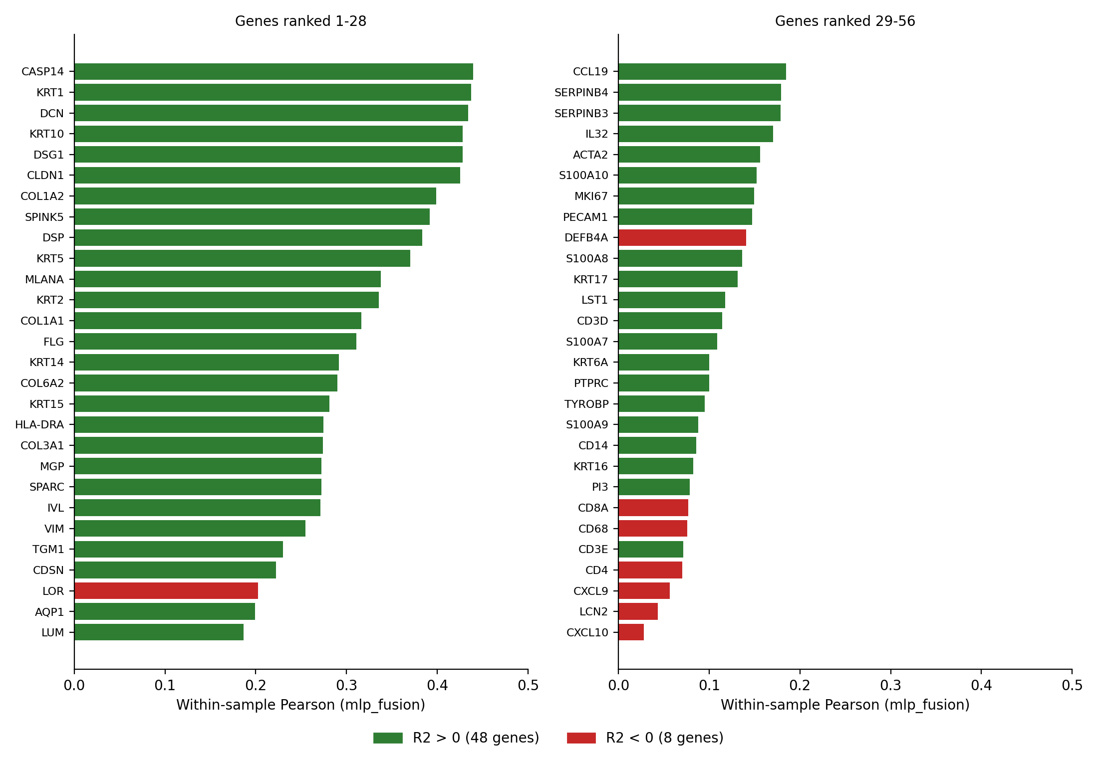
Per-gene performance
Top within-sample r: CASP14 0.4394, KRT1 0.4376, DCN 0.4340
Top R2: S100A8 0.2703, KRT6A 0.2283, DSG1 0.2210
R2 below 0 (8 genes): LOR, DEFB4A, CD8A, CD68, CD4, CXCL9, LCN2, CXCL10
Notes:
All 56 genes are in RESULTS.md. Eight genes have negative R2 and are reported unchanged.

Slide 16
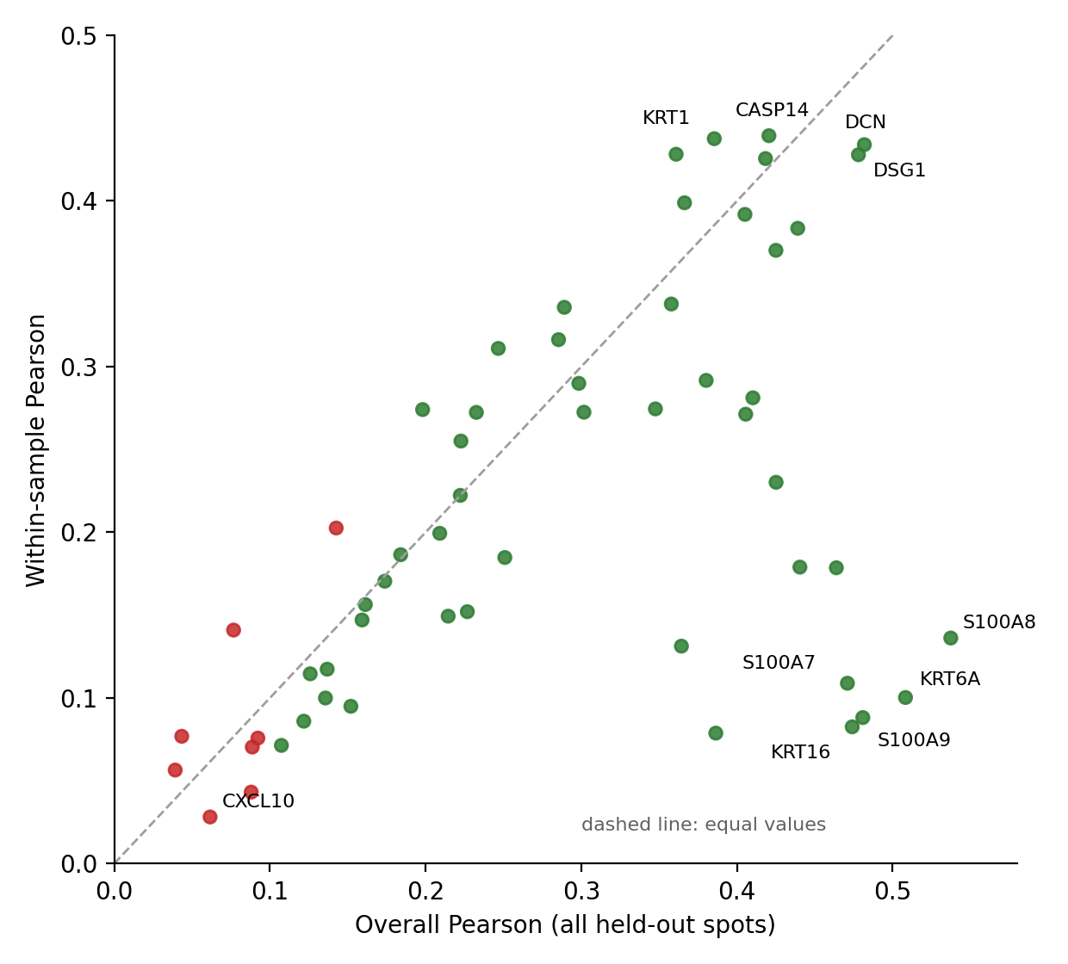
Which genes are recoverable?
Structure genes (CASP14, KRT1, DCN, DSG1): recovered inside a section, r about 0.43
Inflammatory genes (S100A8, S100A9, KRT6A, KRT16): overall r 0.47 to 0.54, within-section r 0.08 to 0.14; likely between-section differences (hypothesis)
Sparse immune genes (CD8A, CD4, CXCL9, CXCL10): not predictable
Notes:
Points below the dashed line have higher pooled than within-section correlation. Pooled correlation mixes sections, so the inflammatory pattern is consistent with, but does not prove, between-section effects.

Slide 17
Limitations and future work
Limitations
Future work
19 sections, one public dataset
Frozen ImageNet ResNet18, not a pathology encoder
Fixed 56-gene panel, spot-level only
High-res image; alignment checked for 3 sections
One seed, one CV setting
UNI and CONCH encoders [10, 11]
Graph neural networks on spot adjacency
End-to-end fine-tuning, multi-scale patches
External validation, for example HEST-1k [3]
Calibration and uncertainty estimates
Notes:
Biological interpretation is exploratory. Next steps use pathology encoders and external validation.

Slide 18
Conclusion
0.7246
0.0842
48 / 56
MAE vs 0.8251 baseline
mean R2
genes with R2 above 0
A multimodal fusion network gives a modest but real morphology-to-expression signal under strict sample-grouped testing. Structural genes are recovered inside sections, inflammatory genes mainly between sections, and sparse immune genes not at all.

