Slide 1
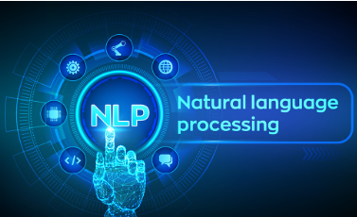

NLP PROJECT - DECEPTION DETECTION
Group Numbers -
Mohmmad Ayaan (2022302)
Manya Agrawal (2022281)
Shubham Kumar Dwivedi(2022494)

Slide 2

PROBLEM DEFINITION
Problem: Predict deceptive vs. truthful messages in Diplomacy game communications
OBJECTIVE
Key Objectives:
Build a predictive model for deceptive vs. truthful messages.
Leverage textual content, metadata, and game dynamics.
Address labeling ambiguity due to sender intentions and receiver interpretations.
Our research focuses on resolving the labeling ambiguity which occurs because sender intentions and receiver interpretations influence the provided deception annotations

Slide 3
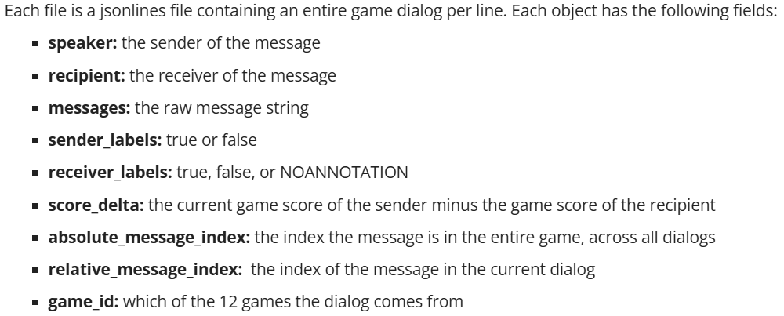
ABOUT DATASET
QANTA Diplomacy Dataset:
17,289 messages across 12 games.
Annotated for sender’s intent and receiver’s perception.
Features: Text, sender-receiver pairs, game scores.
Challenge: Subjective labels cause inconsistencies.
Train,Test and Validation jsonl files

Slide 4
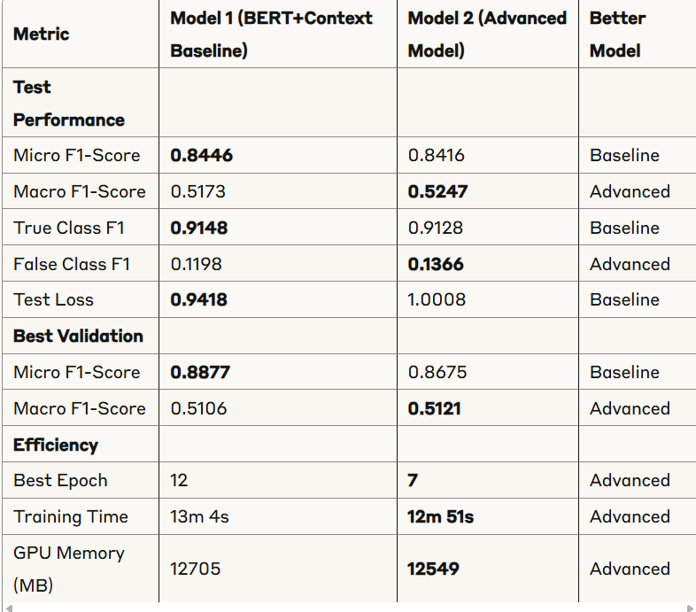
METHODOLOGY
Models Implemented:
Baseline Model-1: Context LSTM with GloVe embeddings
Baseline Model-2: Context LSTM + BERT encoder
Advanced Model: RoBERTa-based architecture with dual classification heads
Key Features:
Message context incorporation
Speaker/receiver embeddings
Focal loss for class imbalance
AdamW optimizer with learning rate scheduling

Slide 5

ANALYSIS & CHALLENGES
Linguistic Markers of Deception:
Hedging statements ("maybe")
Flattery techniques
Keywords like "trust" and "promise"
01
Contextual Insights:
Higher-scoring players deceive with greater confidence
Power disparities influence deception patterns
System identifies straightforward messages more accurately than ambiguous ones
02
Challenges:
Annotation inconsistency between sender and receiver perspectives
Class imbalance (fewer deceptive messages)
Inability to detect non-verbal cues
03

Slide 6
LIMITATIONS & FUTURE WORK
Current Limitations:
Subjective human annotation introduces inconsistency
Limited to textual/metadata features (no visual/vocal cues)
Game-specific nature may limit real-world application
Future Directions:
Incorporate more game dynamic information
Explore model interpretability for deception markers
Expand to other strategic communication contexts
Address class imbalance with advanced techniques

Slide 7

REFERENCES
Peskov, D., et al. (2020). It Takes Two to Lie: One to Lie, and One to Listen.
Ekman, P. (1992). Telling Lies: Clues to Deceit in the Marketplace, Politics, and Marriage.
Newman, M. L., et al. (2003). Lying Words: Predicting Deception from Linguistic Styles.
Wang, W. Y. (2017). LIAR: A Benchmark Dataset for Fake News Detection.
THANK YOU

