Slide 1
DISASTER RESPONSE
INTELLIGENCE REPO HUB
AI-Powered Developer Onboarding & Intelligence Tool
Project Group: 7
Depender Singh
Manya Agarwal
Anmol Chaturvedi
01

Slide 2
Problem Statement
The Ushahidi codebase is a large and complex PHP system used for crisis mapping and disaster response. For a new developer, understanding how controllers, classes, methods and APIs interact requires manually searching and tracing thousands of lines of unfamiliar code. Traditional keyword search is often too broad or misses semantically related logic. We therefore built an AI-powered developer onboarding tool that lets developers ask plain-English questions, retrieves the most relevant source-code evidence, and generates grounded explanations with visual architecture diagrams.
02

Slide 3
Objectives
01
Enable natural-language questions about an unfamiliar PHP codebase.
02
Convert source code into searchable, meaning-aware representations.
03
Retrieve relevant code using semantic and code-level signals.
04
Use an LLM to rerank evidence and generate grounded answers.
05
Present simple explanations, technical details, source evidence and visual diagrams.
03

Slide 4
Research Question
How does hybrid retrieval — combining semantic code search with explicit AST identifier/structural matching — coupled with an LLM re-ranking step improve the accuracy of retrieving relevant code snippets compared to raw vector semantic search alone?
Experimental alignment
Problem
Pure vector search can struggle with exact code names and implementation-level distinctions.
Method
Hybrid scoring retrieves Top 10 candidates; Groq/Qwen reranks them to Top 3.
Experiment
33 realistic developer questions compare ranking before LLM reranking with final reranked ranking.
04

Slide 5
Target Repository & Use Case
TARGET REPOSITORY
USE CASE
Ushahidi
Developer asks:
“How does the LanguagesController work?”
Open-source crisis-mapping platform used in disaster-response contexts.
AI retrieves relevant code → explains it → shows evidence → draws a diagram
Primary challenge
Complex PHP classes, methods, controllers and relationships.
05

Slide 6
Technology Stack
What each technology does in the project
BACKEND & API
RAG & RETRIEVAL
LLM & GENERATION
FRONTEND & DEVOPS
Python 3.11
Tree-sitter
LangChain
HTML5
Core backend language and project logic.
Parses PHP into AST-based logical code units.
Orchestrates prompts, retrieved context and LLM calls.
Structures the web interface.
Vanilla JavaScript
FastAPI
SentenceTransformers
Groq
Sends API requests and renders AI responses.
Exposes /api/ask and connects UI to the AI pipeline.
Creates semantic embeddings for code and queries.
Provides fast LLM inference through its API.
Vanilla CSS
Uvicorn
BGE-base-en-v1.5
Qwen
Provides the glassmorphism UI and animations.
Runs the FastAPI application server.
Embedding model used for semantic retrieval.
Performs candidate re-ranking and final answer generation.
Pytest
ChromaDB
Mermaid.js
Tests extraction, parsing and repository behavior.
Stores vectors, source code and metadata for search.
Renders AI-generated architecture/flow diagrams.
GitHub Actions
Automates CI/testing workflows.
_{Ruff}
Lints code and suggests fixes on PRs.
06

Slide 7
Technical Implementation
Backend
Python 3.11 • FastAPI • Uvicorn
Code Extraction
Tree-sitter / AST-based PHP extraction into logical classes, methods and functions
Embeddings
SentenceTransformers with BAAI/bge-base-en-v1.5
Vector Store
ChromaDB stores code embeddings, source content and metadata
Retrieval
Hybrid scoring combines semantic distance with identifier, filename, class/method and structural matches
Re-ranking
LangChain + Groq/Qwen reads Top 10 candidates and selects the most relevant Top 3
Generation
Final LLM produces structured JSON: Simple Summary, Technical Details and Mermaid.js diagram code
API + Frontend
FastAPI /api/ask connects the pipeline to HTML5, Vanilla JS and CSS UI
10

Slide 8
Methodology — Project Pipeline
End-to-end flow from repository ingestion to an explainable developer answer
Ushahidi
PHP Repo
PHP
Extraction
BGE-base
Embeddings
ChromaDB
Vector Store
Hybrid
Retrieval
LLM
Re-ranking
Grounded
Answer
Repository → structured AST code units → vectors + code signals → Top 10 evidence → Top 3 reranked context → explainable response
AST-based extraction
5,698 code & doc chunks stored in ChromaDB
07

Slide 9
Grounded Answer Generation
RAG pipeline: retrieve first, then generate from repository evidence
1. User Question
2. ChromaDB
Top 10
3. Groq / Qwen
Re-ranking
4. Top 3
Evidence
5. Final LLM
Generation
WHAT THE LLM RETURNS
WHY IT IS GROUNDED
EVIDENCE SHOWN
• Simple Summary
• Technical Details
• Mermaid.js diagram code
The final answer is generated from retrieved Ushahidi source-code context rather than relying only on general model knowledge.
• Exact source files
• Retrieved code context
• Visual relationship / flow
08

Slide 10
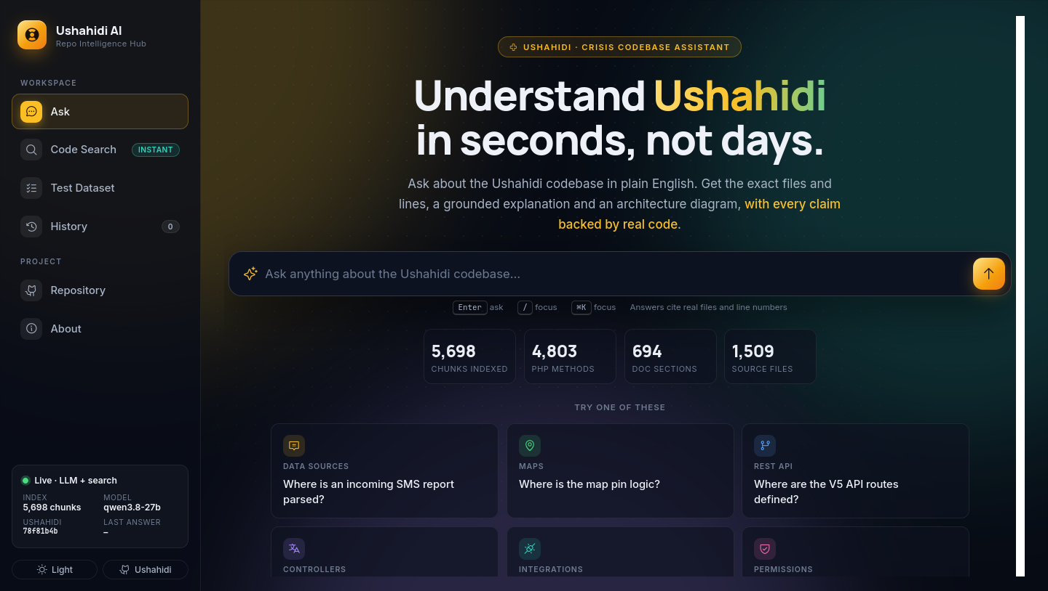
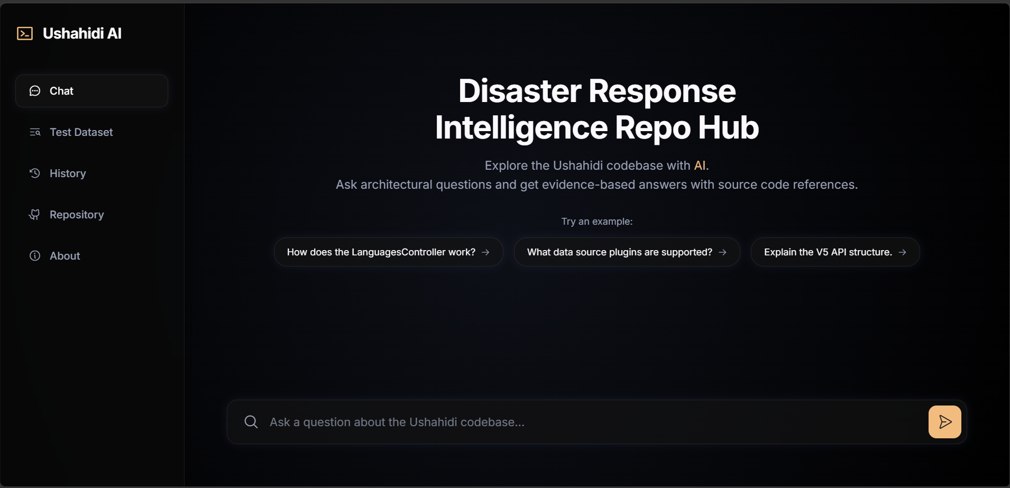
User Interface
Chat interface • AI answer • source evidence • Mermaid visualization
09

Slide 11
Experiments & Evaluation
33-query benchmark aligned with the research question
Dataset
33 repository-specific developer questions covering contracts, implementations, permissions, use cases and entity-loading behaviour.
Baseline
Semantic / hybrid retrieval ranking before LLM reranking.
Proposed
Same Top 10 candidates passed to Groq/Qwen for strict reranking to Top 3.
Metrics
Mean Reciprocal Rank (MRR) and Top-1 Accuracy.
Experimental question: does LLM reranking move the correct implementation closer to rank #1?
11

Slide 12
Quantitative Results
33 queries • baseline vs. LLM-reranked retrieval
MRR
Top-1 Accuracy
0.6135
0.8026
51.52%
75.76%
Baseline
Proposed
Baseline
Proposed
+0.1891
+24.24 percentage points
Interpretation
Semantic/hybrid retrieval provides coarse filtering, while LLM reranking substantially improves precision by distinguishing concrete implementations from interfaces, base classes and test files. The MRR relative gain is 30.82%.
12

Slide 13
Limitations & Failure Analysis
Context overload
Large retrieved files can exceed the LLM payload/token limit; file contents are aggressively truncated.
Diagram failures
Mermaid syntax can occasionally be invalid, causing frontend diagram rendering failures.
Latency
SentenceTransformer loading plus two sequential LLM calls creates a typical 3–5 second delay.
Abstract vs implementation bias
Vector retrieval can still favor documentation or abstract interfaces over concrete business-logic classes.
13

Slide 14
Conclusion & Future Work
The experiment supports the two-stage retrieval design: semantic/hybrid retrieval efficiently narrows the search space, while LLM reranking substantially improves the ranking of the correct implementation. Across 33 developer questions, Top-1 accuracy increased from 51.52% to 75.76%.
Future Work
• Expand evaluation with Recall@K, nDCG and answer-faithfulness/citation correctness.
• Introduce dependency-graph retrieval for deeper code relationships.
• Support additional programming languages and repositories.
• Enable incremental indexing as repositories evolve.
14

Slide 15
Team Responsibility Matrix
Depender Singh
Manya Agarwal
Anmol Chaturvedi
Primary Area
RAG & Backend
LLM & Answer Generation
Frontend & Evaluation
Key Work
PHP extraction
Embeddings
ChromaDB
FastAPI
Retrieval
LangChain
Groq / Qwen
Re-ranking
Grounded prompts
Mermaid generation
UI & Visualization
33-question benchmark
Pytest & evaluation
Bug fixing & data coverage
Result validation
Reranking & diagram fixes
Must Explain
Ingestion → retrieval
Context → reranking → answer
UI → results → evaluation
All three members should be able to explain the complete project pipeline.
15

