Slide 1
Artificial Intelligence and Machine Learning
Project
Semester-IV (Batch-2024)
Movie Recommendation System
Team Members: Mannat(2210990557)
Manya(2210990561)
Manya(2210990562)
Department of Computer Science and Engineering
Chitkara University Institute of Engineering & Technology,
Chitkara University, Punjab

Slide 2
CONTENT
Abstract
Introduction
Objective
Problem statement
Data Set
EDA Analysis
Methodology
Models used
Conclusion

Slide 3
ABSTRACT
In an era where access to diverse entertainment choices is vital for individual and societal enrichment, fair and unbiased content recommendation systems are crucial. To tackle this issue, we introduce our AI Movie Recommendation System to transform the way users discover and enjoy movies. Our system utilizes advanced machine learning techniques to analyze user preferences , considering factors such as genre preferences or movie ratings etc.
Through this project, we aim to contribute to a more inclusive and enriching movie-watching experience, where users are presented with a wide range of movie options tailored to their individual tastes and interests. Join us on this journey towards equitable and diverse movie recommendations, promoting cultural diversity and cinematic appreciation.

Slide 4
INTRODUCTION
In today's digital age, the entertainment industry is booming with an abundance of movies and TV shows available across various platforms. However, with this plethora of content comes the challenge of navigating through the vast library to find movies that match individual preferences. This challenge is further compounded by the diverse tastes and preferences of users. Our project typically involves:
Genre Based Recommender
Movie Rating Based Recommender

Slide 5
OBJECTIVE
The key objectives of our project include:
Developing a robust movie recommendation system capable of delivering recommendations according to users preference.
Improving user engagement and satisfaction by providing relevant and timely movie suggestions.
Enhancing the overall user experience by streamlining the movie discovery process and reducing decision fatigue.
Implementing state-of-the-art machine learning algorithms and techniques to enhance recommendation accuracy and effectiveness.

Slide 6
Problem Statement
The traditional approach of browsing through endless lists of movies often leads to frustration and dissatisfaction among users. Many users struggle to find movies that align with their interests, resulting in a suboptimal viewing experience.
The primary objective of project is to mitigate these challenges by providing movie recommendations based on users preferences such as genre or rating or keyword . By delivering relevant and engaging recommendations, project seeks to enhance user satisfaction and promote discovery of new and exciting content.

Slide 7
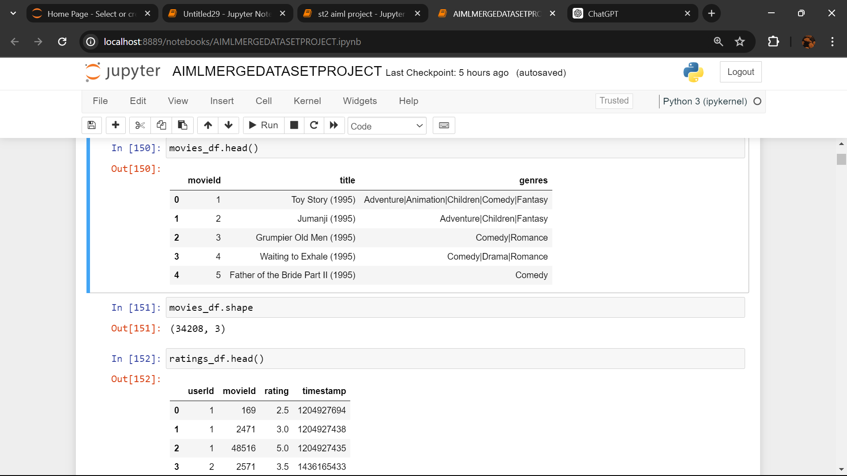
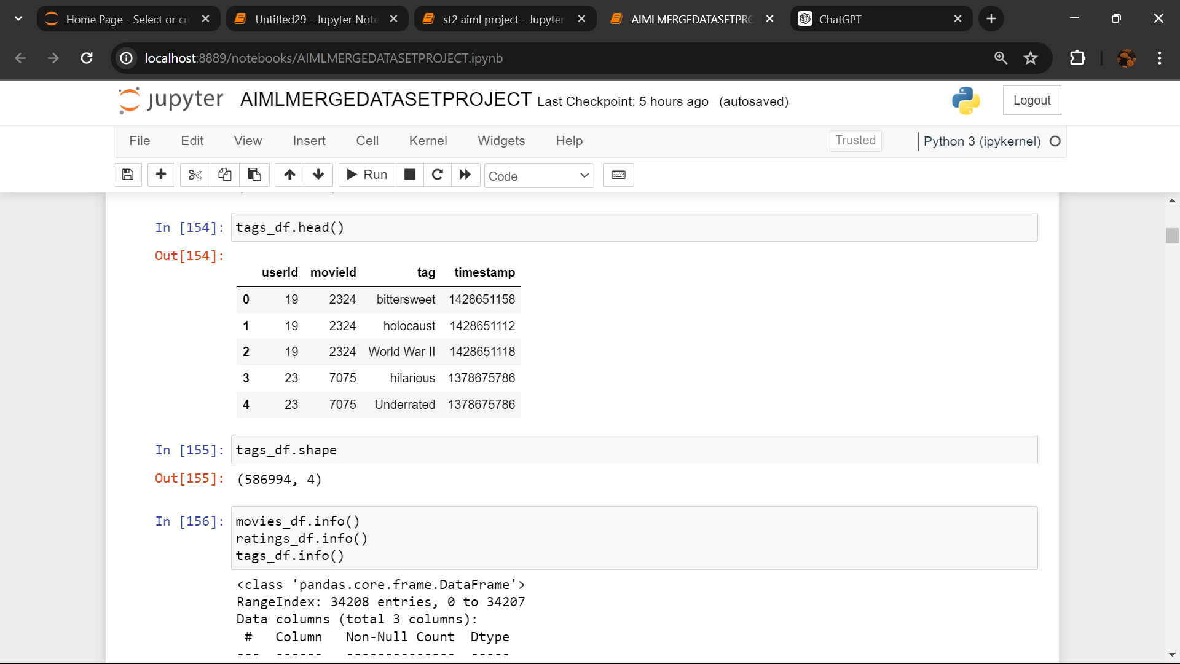
Data Set
We are working on four datasets that are movies, link, rating, tags. Each dataset is of min 3ooo rows.
We have merged all the four datasets so that we could work on a single dataset. Reading and working on separate datasets individually would be complex, so we combined them to avoid that complexity.

Slide 8
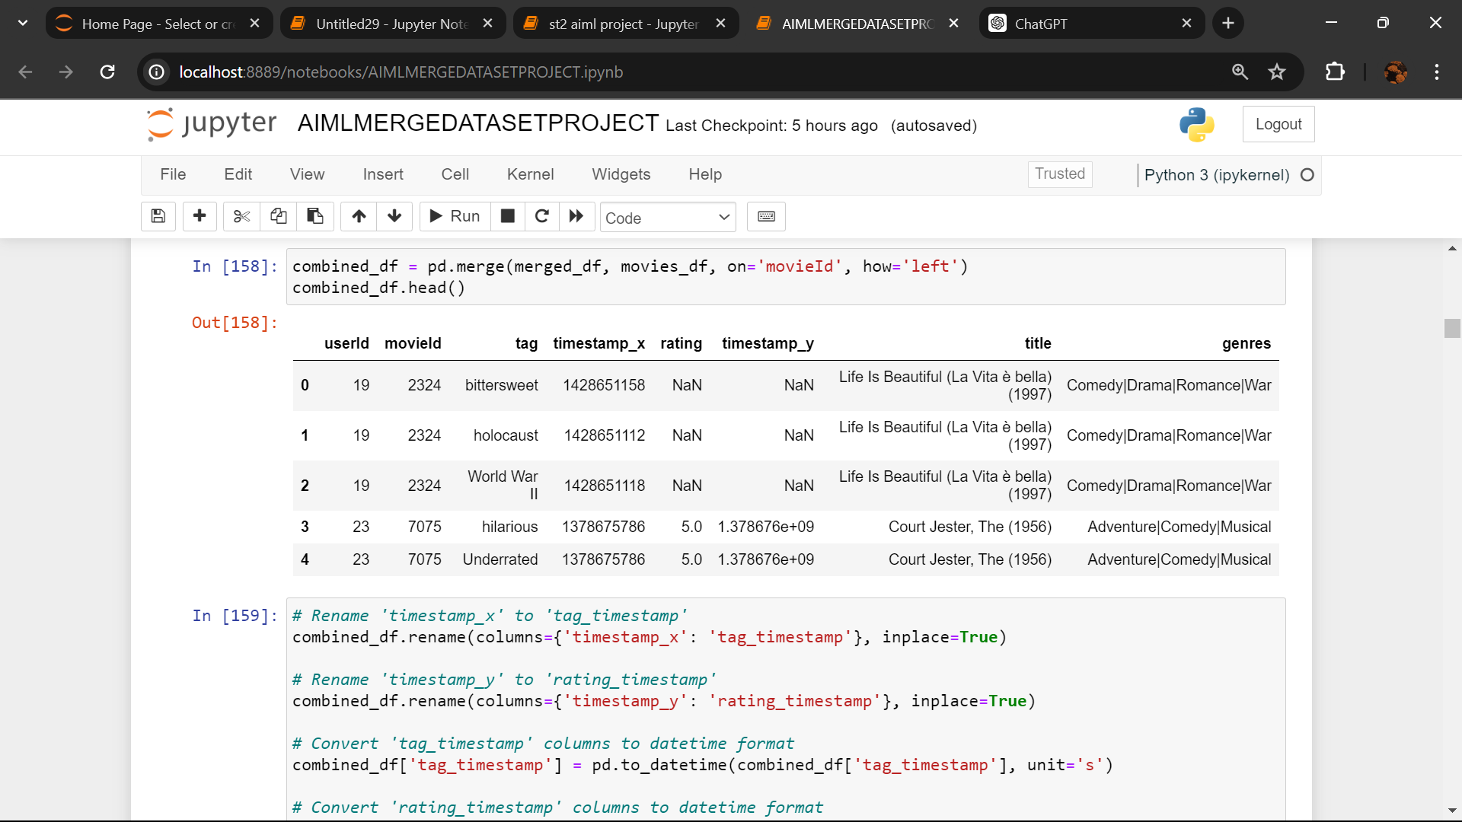
Merge Data Set

Slide 9
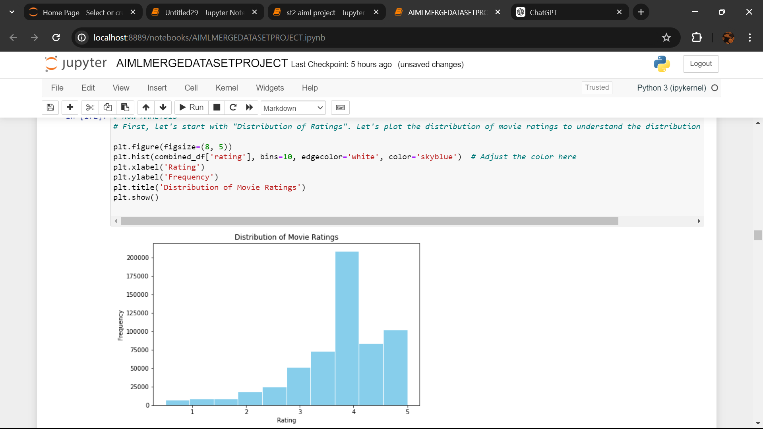
Some EDA Analysis

Slide 10
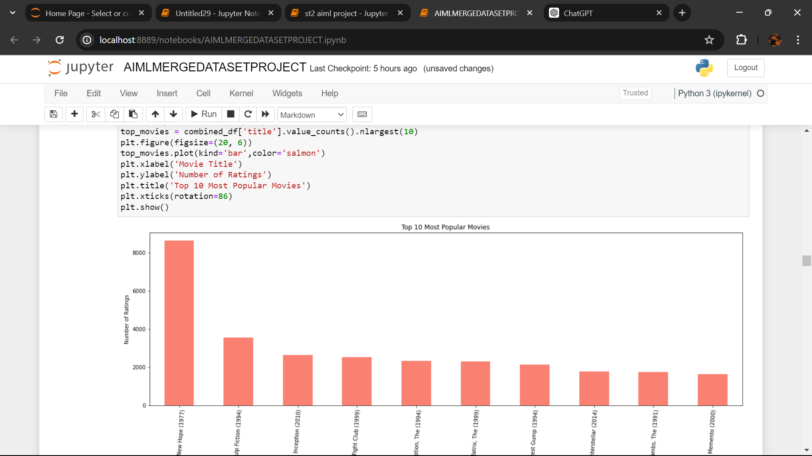
Continue…

Slide 11
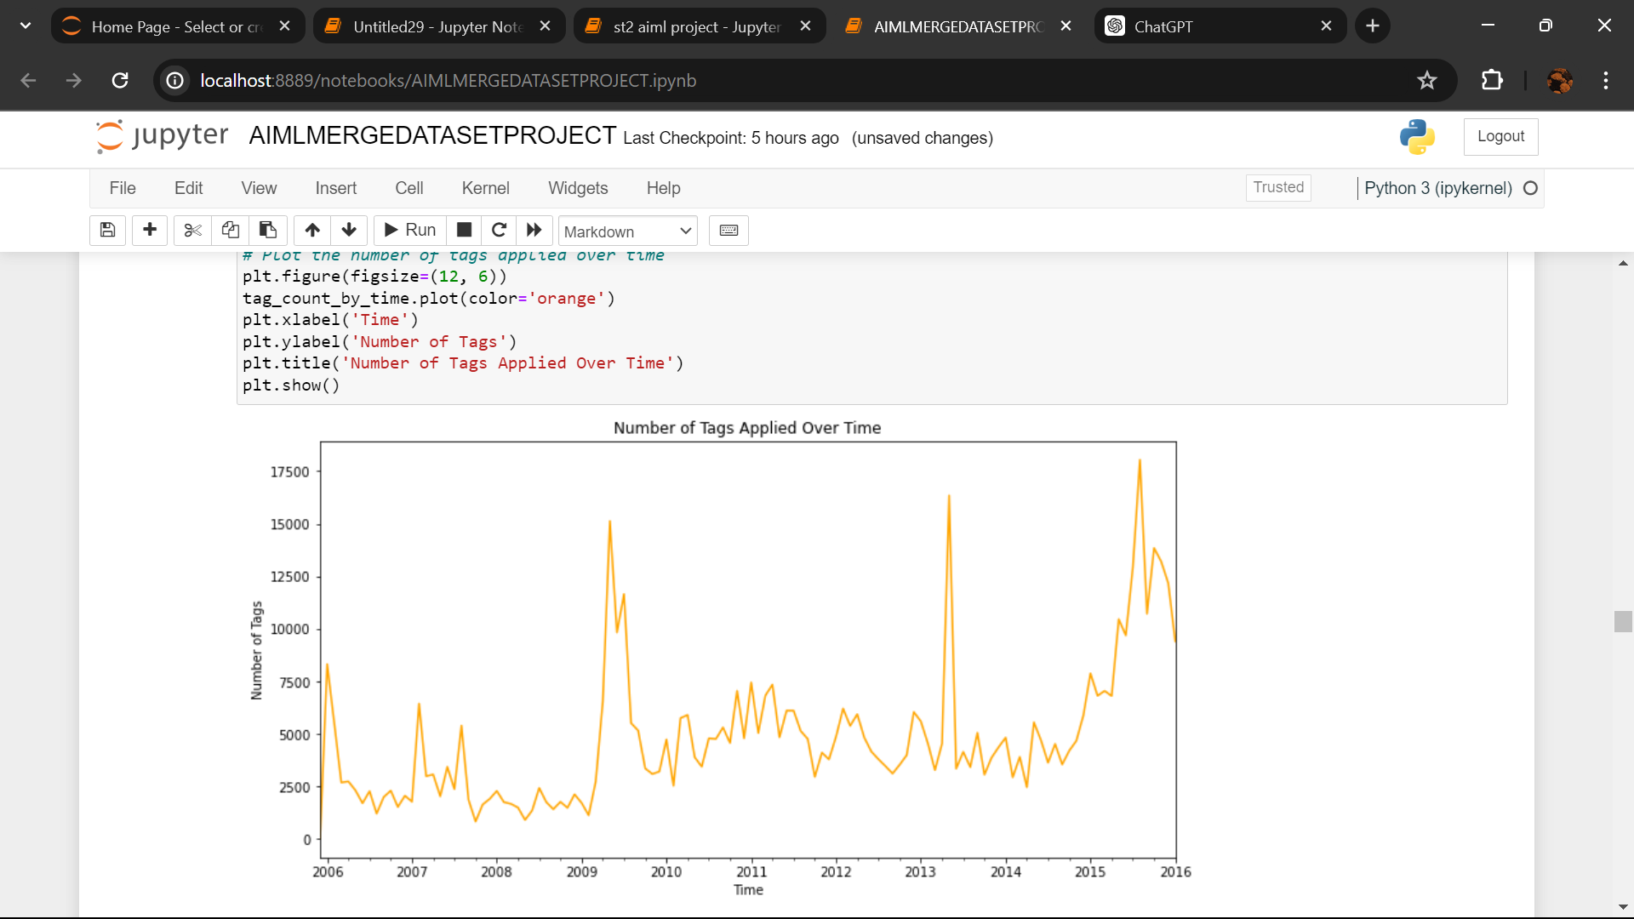
Continue…

Slide 12
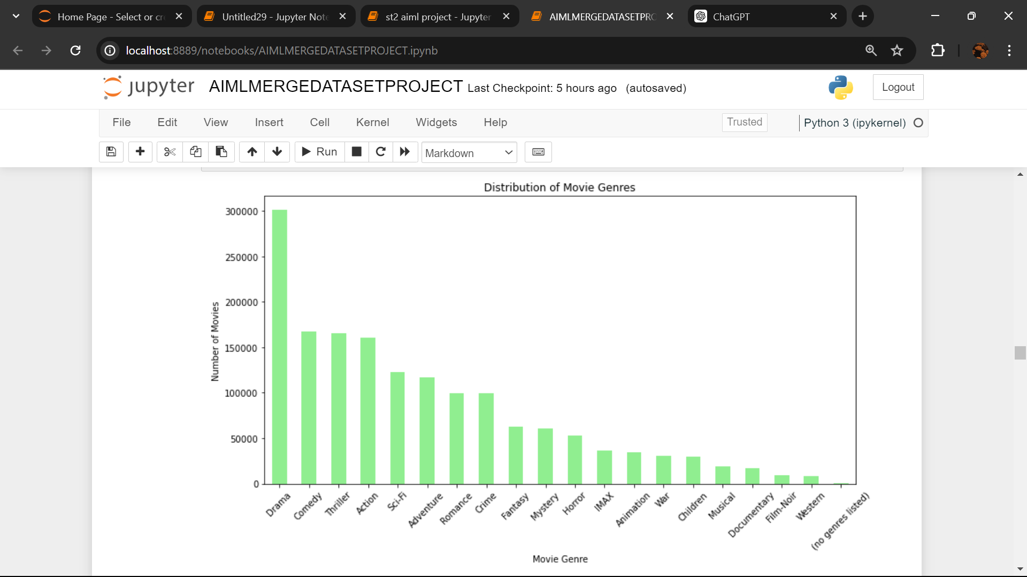
Continue…

Slide 13
Software/Hardware Requirements
Software: Python, Jupyter Notebooks, Pandas, Matplotlib/Seaborn, Scikit-Learn
Hardware: A machine with at least 16GB RAM and a multi-core processor
Datasets: Publicly available fitness datasets or custom datasets created by the project team

Slide 14
Proposed Design / Methodology
The methodology employed in it will involve several stages, including:
Data collection: Gathering movie data from publicly available sources and datasets.
Data preprocessing: Cleaning and preprocessing the collected data to ensure consistency and quality.
Feature engineering: Extracting relevant features from the movie data to facilitate recommendation.
Model development: Implementing machine learning models and algorithms for recommendation generation.
Evaluation: Assessing the performance of the recommendation system using appropriate metrics and techniques.

Slide 15
Tool Used
Jupyter Notebook is used as IDE.
Pandas and NumPy are used for Data Manipulation & Pre-processing and Mathematical functions respectively.
For visualization of the plots, Matplotlib, Seaborn are used.
Scikit Learn is used for Regression Models for predictions.

Slide 16
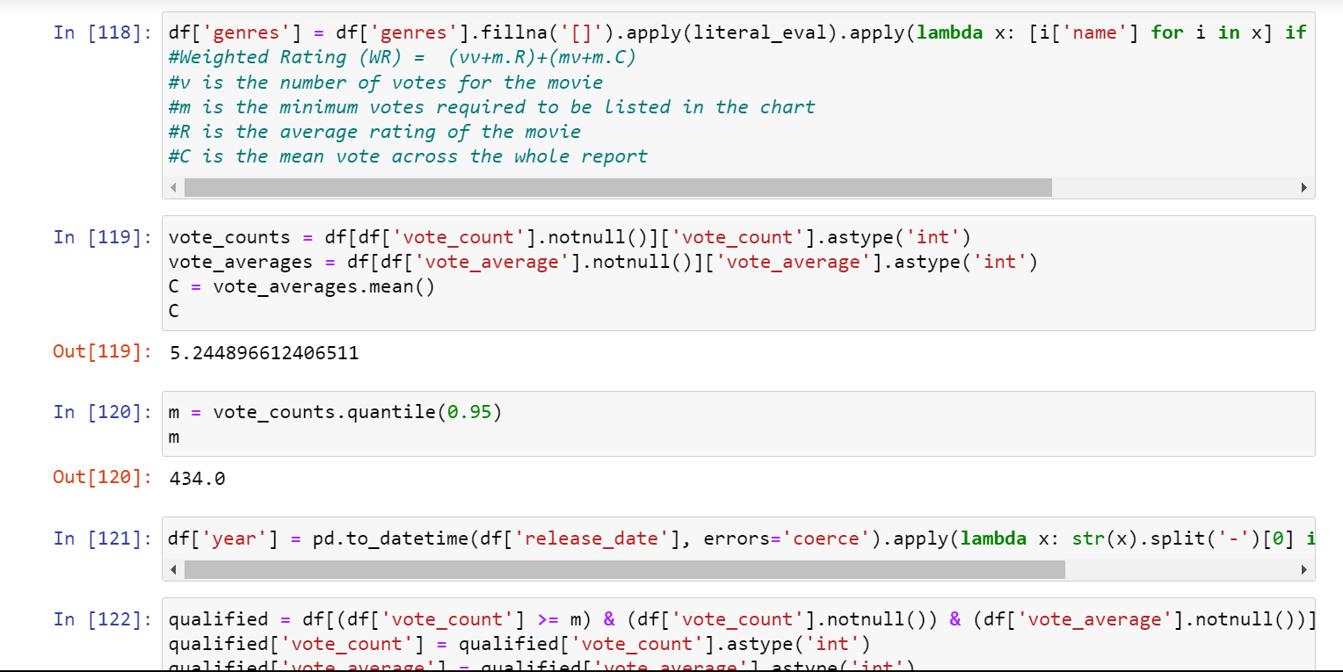
Models Used
1. Weighted Rating:
A simple yet effective method for to rank items based on user ratings and engagement metrics like the number of votes.

Slide 17
FUTURE SCOPE
Our project will focus on recommending movies from a diverse range of genres, including but not limited to action, comedy, drama, thriller, and science fiction.
The recommendation system will utilize a combination of collaborative filtering, genre based filtering, and rating based filtering.
The project will involve collecting and preprocessing movie data from various sources, including online databases.

Slide 18
CONCLUSION
In the conclusion of our movie recommendation system AIML project, we summarize the key achievements and outcomes of the project. Here's a brief explanation of each section:
Our system has successfully addressed the challenge of navigating the vast landscape of movie content, empowering users to discover relevant and engaging movies tailored to their preferences.
The implementation of state-of-the-art machine learning algorithms has enabled our system to achieve high levels of accuracy and effectiveness in generating recommendations, ensuring that users receive relevant and timely suggestions.
Expanding the dataset to include additional data sources and features can further enrich the recommendation process and enhance recommendation quality.
Throughout this project, we've emphasized the importance of fairness, efficiency, and customer-centricity, aiming to provide a seamless searching experience for all.

