Slide 1

OPTIMIZATION AND SEGMENTATION OF LLMs ON EDGE DEVICE
Department of Artificial Intelligence and Machine Learning
Team Members
1. Chethana R Kini - 4NM21AI018
2. Manya Hegde - 4NM21AI038
3. Reyona Elza Sabu - 4NM21AI059
Dr. Rashmi Adyapady R.
Asst. Professor Grade III
Department of AIML
NMAMIT-Nitte

Slide 2
CONTENTS
Introduction
- Overview
- Challenges
- Motivation
Problem Statement
- Objectives
Literature Survey
Proposed Methodology
Experiment Results
Conclusion
Future Work
References

Slide 3
INTRODUCTION
Overview
Large Language Models (LLMs) handle tasks like text generation, translation, and summarization.
The large size and high computational demands limit use on small devices.
This project aims to optimize LLMs for efficient performance on edge devices.
Challenges
Edge devices have limited memory and processing power.
High processing needs lead to excessive energy consumption.
Reliance on cloud processing introduces latency and privacy concerns.

Slide 4
INTRODUCTION (Cont’d)
Motivation
Increasing need for real-time AI on resource-limited devices
Expanding AI access in healthcare, smart cities, and IoT without cloud dependence
On-device processing enhances data privacy and reduces reliance on external servers

Slide 5
PROBLEM STATEMENT
Design and development of optimized LLM’s using Evolutionary Algorithms on Edge Devices.
Objectives
To reduce the suitable for execution on devices with limited resources.
Develop techniques to split models into smaller components for efficient processing across multiple devices.
Enable real-time deployment of LLMs on edge devices like smartphones, IoT, and embedded systems for advanced AI capabilities.

Slide 6
LITERATURE SURVEY
Optimization
Author and Year | Approaches Used | Remarks
Wu, X., Wu, S. H., Wu, J., Feng, L., & Tan, K. C. (2024) | Evolutionary Algorithms for optimizing LLMs | Highlights the combination of LLMs and EAs for guiding complex problem solutions but notes limitations in handling highly complex optimizations.
Chen, J. F., Do, Q. H., & Hsieh, H. N. (2015) | Hybrid PSO-CS algorithm for training neural networks | Achieved better performance and accuracy in training FNNs, balancing exploration and convergence.
Wang, J., Wang, X., Li, X., & Yi, J. (2023) | Dynamic Weight PSO (DWPSO-SVM) for SVM optimization | Enhanced global search and avoided local minima, outperforming traditional PSO-SVM methods.

Slide 7
LITERATURE SURVEY (Cont’d)
ii. Segmentation
Author and Year | Approaches Used | Remarks
Harlap, A., Narayanan, D., Phanishayee, A., Seshadri, V., Devanur, N., Ganger, G., & Gibbons, P. (2018) | PipeDream's pipeline parallelism | Enhanced distributed training for DNNs, reducing latency and overlapping computation with communication.
Huang, Y., Cheng, Y., Bapna, A., Firat, O., Chen, M. X., Chen, D., et al. (2019) | GPipe's pipeline parallelism with micro-batching | Managed memory effectively for large models, facilitating parallel training and improving performance.

Slide 8
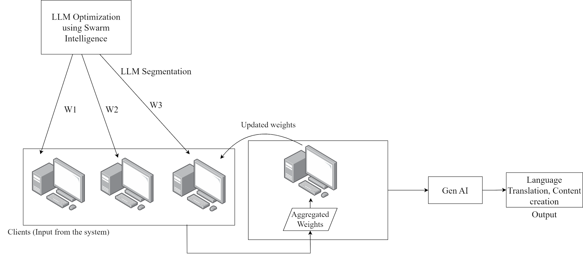
PROPOSED METHODOLOGY
Fig 1: Overall Architecture

Slide 9
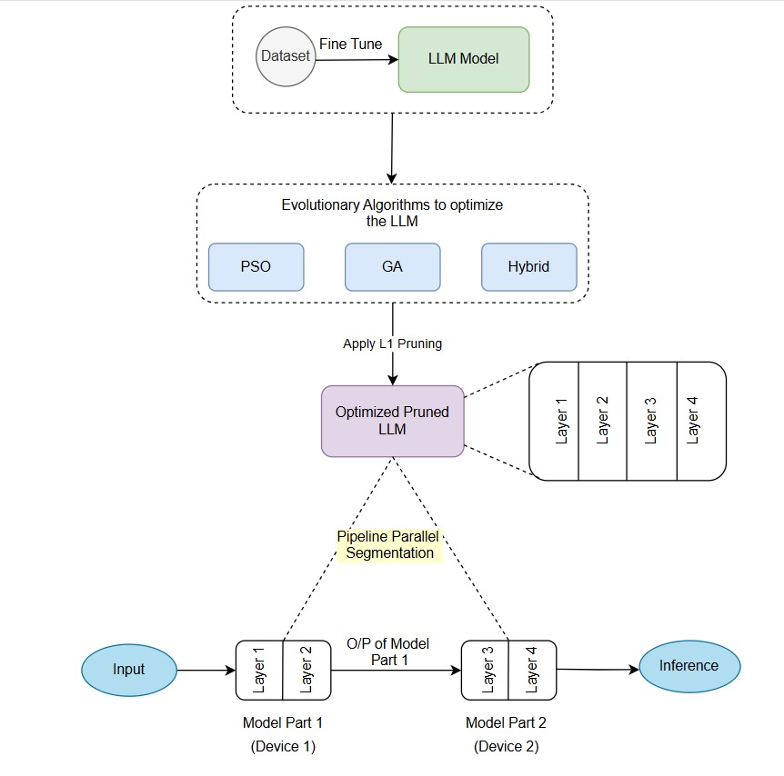
PROPOSED METHODOLOGY (Cont’d)
Fig 2: Proposed Methodology

Slide 10
PROPOSED METHODOLOGY (Cont’d)
Dataset Description
Dataset: IMDB Movie Reviews
Type: Text-based dataset for sentiment analysis
Content: 50,000 movie reviews labeled as positive or negative
Split: 25,000 reviews each for training and testing
Purpose: Used to train and evaluate model performance in classifying sentiment
Model Description
Model: TinyBERT
Architecture: 4-layer Transformer model
Purpose: Lightweight version of BERT, designed for efficient processing on resource-limited devices

Slide 11
PROPOSED METHODOLOGY (Cont’d)
Optimization Techniques Used
Genetic Algorithm (GA): Optimizes hyperparameters using a natural selection-inspired process to improve model performance.
Bat Algorithm (BA): Simulates echolocation behaviour to optimize hyperparameters, enhancing classification accuracy.
Particle Swarm Optimization (PSO): Optimizes model hyperparameters by simulating social behavior, improving performance and convergence speed.
Hybrid Approach: Combines PSO with other optimization techniques like GA or Adam for improved exploration and convergence.
Selected Approach: The project proceeds with PSO due to its effective balance between exploration and exploitation of the hyperparameter space.

Slide 12
PROPOSED METHODOLOGY (Cont’d)
Segmentation Technique: Pipeline Parallelism
Divides the model into multiple stages, each running on different devices.
Process:
- Each stage processes a part of the model sequentially.
- Intermediate outputs from one stage are passed to the next stage for further processing.
Benefits:
- Distributes the computation load across devices.
- Reduces latency and improves processing speed by overlapping computation and communication.
Implementation: Used to run different layers of TinyBERT on two devices, ensuring efficient resource utilization.

Slide 13
EXPERIMENTAL RESUTS
Experiment 1: Optimization
1. Genetic Algorithm (GA)
Model | Accuracy
ANN | 56%
CNN | 51%
2. BAT Algorithm
Model | Accuracy
ANN | 85%

Slide 14
EXPERIMENTAL RESULTS (Cont’d)
3. Particle Swarm Optimization (PSO)
Techniques used | Accuracy
ANN | 87.49%
CNN | 74%
SVM | 88.7%
TinyBERT | 85%
4. Hybrid Approach
Model | Optimization Technique used | Accuracy
ANN | PSO+Adam | 85.34%
ANN | PSO+GA | 85.42%

Slide 15
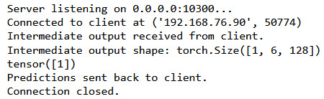
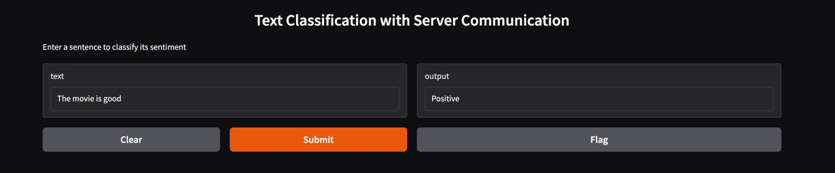
EXPERIMENTAL RESULTS (Cont’d)
Experiment 2: Segmentation - Pipeline Parallelism
Fig 3: Server Side
Fig 4: Client Side

Slide 16
COMPARISON OF TECHNIQUES
Evolutionary Algorithm Utilized | Model Utilized | Accuracy
GA | ANN | 56%
PSO | ANN | 87.49%
BAT | ANN | 85%
PSO + GA | ANN | 85.42%

Slide 17
CONCLUSION
Optimized a fine-tuned TinyBERT model on the IMDB dataset using various techniques.
Particle Swarm Optimization (PSO) improved accuracy and training efficiency.
Pipeline parallelism reduced memory usage and training time by partitioning the model across GPUs.
Combined PSO and pipeline parallelism effectively optimizes large language models for limited-resource environments.

Slide 18
FUTURE WORK
Investigate advanced model partitioning strategies for TinyBERT optimization.
Implement model splitting based on specific task requirements.
Expand the implementation to multiple devices for improved parallelism.
Optimize layer distribution according to the capabilities of edge devices.
Explore dynamic layer allocation based on the specific demands of tasks.

Slide 19
REFERENCES
Wu, X., Wu, S. H., Wu, J., Feng, L., & Tan, K. C. (2024). Evolutionary computation in the era of large language model: Survey and roadmap. arXiv preprint arXiv:2401.10034.
Chen, J. F., Do, Q. H., & Hsieh, H. N. (2015). Training artificial neural networks by a hybrid PSO-CS algorithm. Algorithms, 8(2), 292-308.
Wang, J., Wang, X., Li, X., & Yi, J. (2023). A hybrid particle swarm optimization algorithm with dynamic adjustment of inertia weight based on a new feature selection method to optimize SVM parameters. Entropy, 25(3), 531.
Harlap, A., Narayanan, D., Phanishayee, A., Seshadri, V., Devanur, N., Ganger, G., & Gibbons, P. (2018). Pipedream: Fast and efficient pipeline parallel dnn training. arXiv preprint arXiv:1806.03377.
Huang, Y., Cheng, Y., Bapna, A., Firat, O., Chen, M. X., Chen, D., ... & Chen, Z. (2019). GPipe: Easy scaling with micro-batch pipeline parallelism. proceeding of Computer Science> Computer Vision and Pattern Recognition.

Slide 20
THANK YOU

