Slide 1

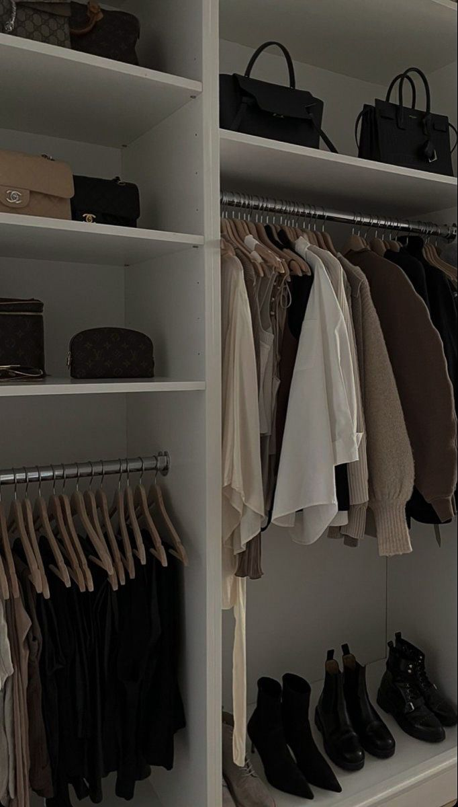
STYQLO Your Personal AI Fashion Stylist
School of Computer Science and Engineering
Department of Computer Science and Engineering
Submitted By: Manya Jain
2427030674
Supervised By: Ms. Babita Tiwari

Slide 2

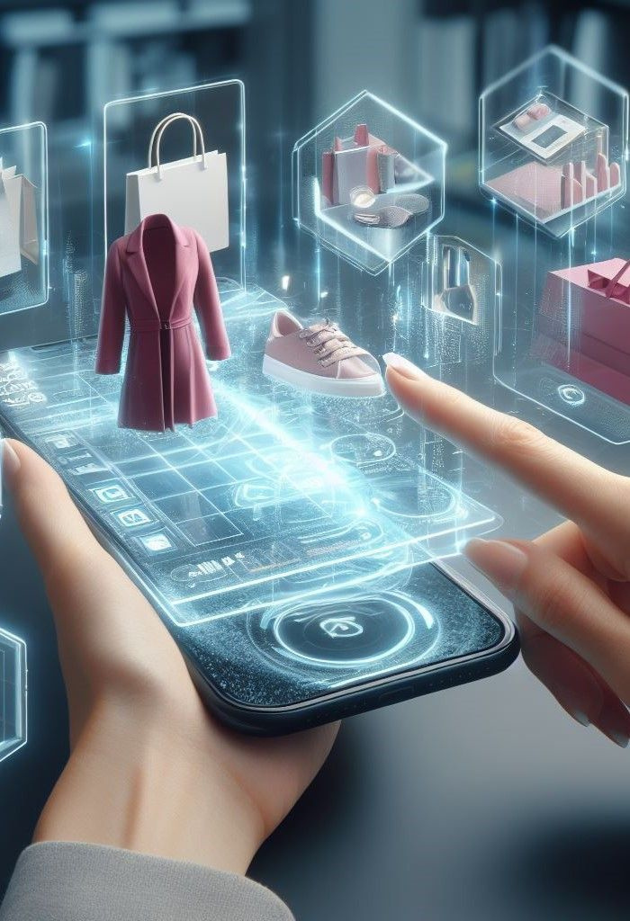
1
STYQLO is about more than just clothes — it’s about helping you feel confident, stylish, and ready for anything.
Introduction
In today’s busy world, picking the perfect outfit can be both exciting and stressful. With so many styles, colors, and trends to consider, finding a look that truly suits your personality, body type, and the occasion can feel overwhelming. That’s where STYQLO comes in — an AI-powered fashion assistant designed to make dressing stylishly easy, personalized, and fun.
2
It understands your personal style, body shape, and the event you’re dressing for, giving suggestions that are customised just for you.
3
It considers weather, season, and event type, making sure your outfit is not just fashionable but also practical.

Slide 3
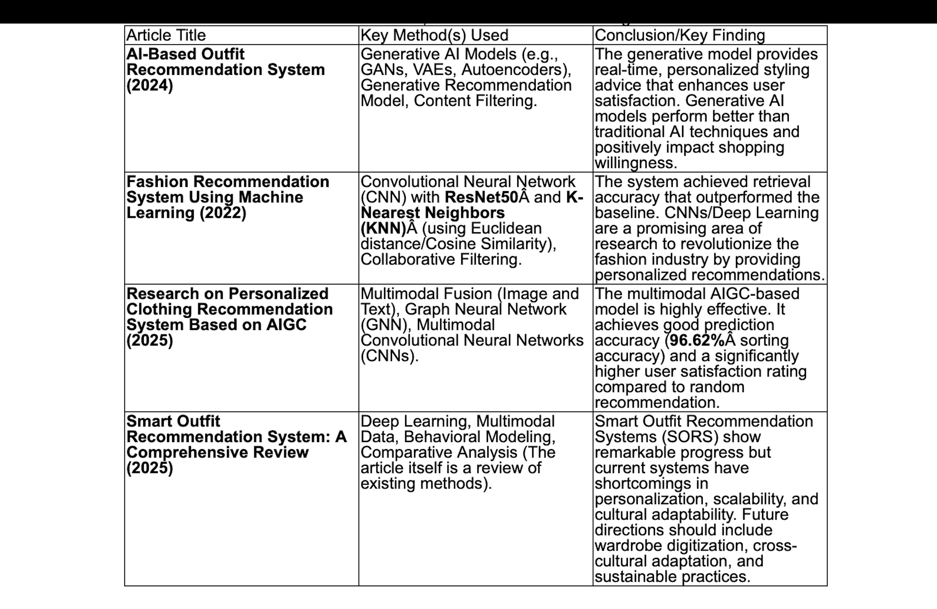

Literature
Survey

Slide 4
Research gaps and need for STYQLO
1) STYQLO gives suggestions based on current weather, season and occasion.
2) Existing research does not make sense for the user’s real life situation.
3) STYQLO focuses on real time data including brand availability, prices and direct shopping links.
4) It creates a complete look that includes clothing, footwear, and accessories.
# STYQLO IS MADE FOR USERS WHO WANT COMPLETE FASHION OUTFIT INSTEAD OF SINGLE ITEM SUGGESTION.

Slide 5
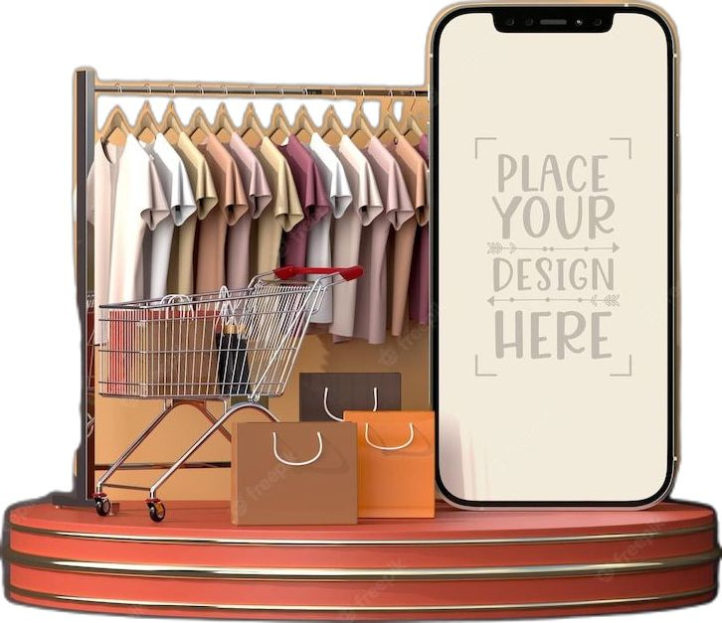
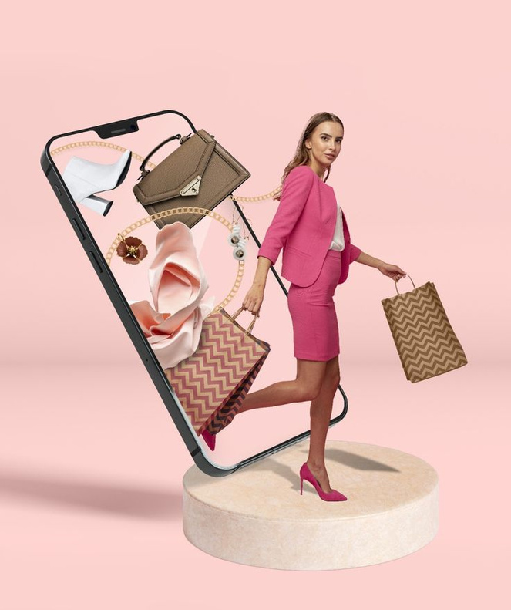
Problem Statement
Picking the right outfit can be exciting, but it’s often a stressful and time-consuming process. Many people struggle with questions like, 'What should I wear to this event?' Does this outfit suit my body type? Will it match the weather or the occasion? Traditional fashion apps usually show generic suggestions or individual clothing items, without considering your personal style, body shape, or the context. There’s a clear need for a smart, AI-powered fashion assistant that can understand your preferences, suggest full outfits, provide virtual try-on experiences, and integrate shopping options seamlessly.

Slide 6
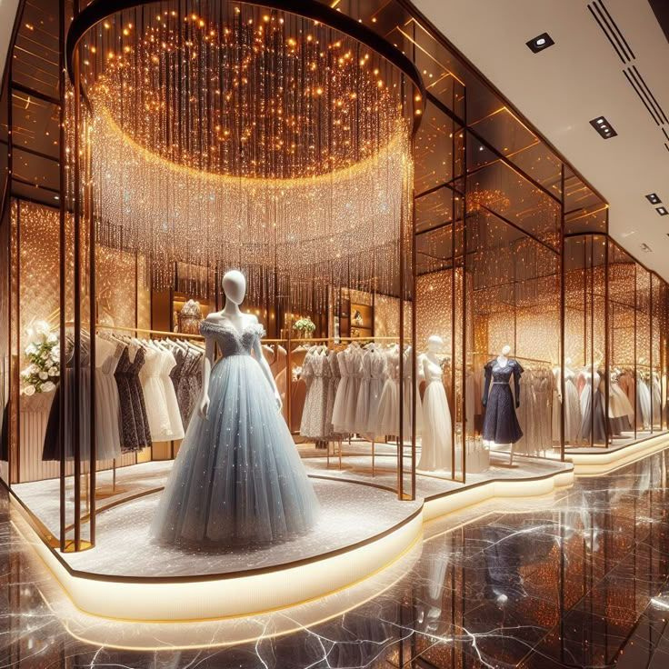
1
Personalised Outfit Suggestions – To give users fashion recommendations that truly fit their body type, style preferences, and the occasion.
2
Smart Styling for Any Situation – To factor in weather, season, and event type, ensuring outfits are not only stylish but practical.
3
To show brands, prices, and links, so users can easily find and compare the recommended outfits.
4
Complete Looks, Not Just Items – To create coordinated outfits, including clothing, accessories, and shoes, so users always have a ready-to-wear style.
Objectives

Slide 7
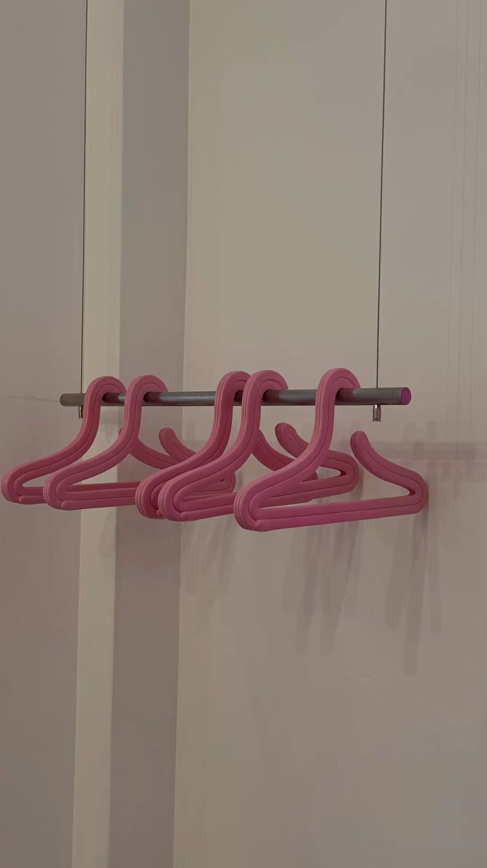
Methodology
1 Understanding the User
We start by asking simple, familiar questions:
• What’s your preferred style?
• What kind of event are you dressing for?
• What’s the weather like today?
• What colors make you feel confident?
This gives STYQLO a clear picture of who the user is.
2 Extracting Style Intelligence
Once the information is collected, STYQLO analyzes:
• Body shape and fit requirements
• Color preferences and patterns
• Style personality: casual, chic, formal, trendy
• Environmental factors like climate and season

Slide 8
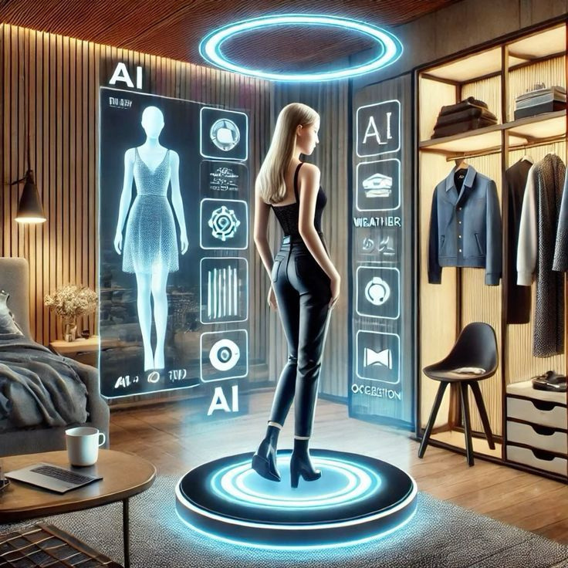
3 AI-Driven Outfit Curation
The AI looks through patterns in fashion, current trends, and user behavior.
Then it:
• Selects suitable clothing categories
• Matches top + bottom + accessories
• Ensures color harmony
• Ensures the outfit makes sense for the occasion
4 Creating a Complete Look
The system doesn’t just suggest one piece.
It builds a full, ready-to-wear outfit with:
• Clothes
• Shoes
• Accessories
Everything is curated as if a personal stylist assembled it.

Slide 9
Proposed Solution
• User Profile Creation
The system begins by creating a detailed user profile that includes body type, preferred colours, fabric choices, comfort level, style preferences, and budget constraints.
• Behaviour-Based Learning
Machine learning techniques are used to analyse user interactions, selections, and feedback to understand fashion behaviour and continuously refine recommendations over time.
• Context Awareness Integration
The solution incorporates real-time contextual data such as weather conditions, temperature, season, and occasion (college, office, party, travel, etc.) to ensure practical and comfortable outfit suggestions.
• Occasion-Based Styling Logic
Outfits are classified and generated based on the selected or inferred occasion, ensuring suitability for formal, casual, festive, or daily wear scenarios.
• Complete Outfit Generation
Instead of suggesting individual clothing items, the system creates full, coordinated outfits including topwear, bottomwear, footwear, and accessories.

Slide 10
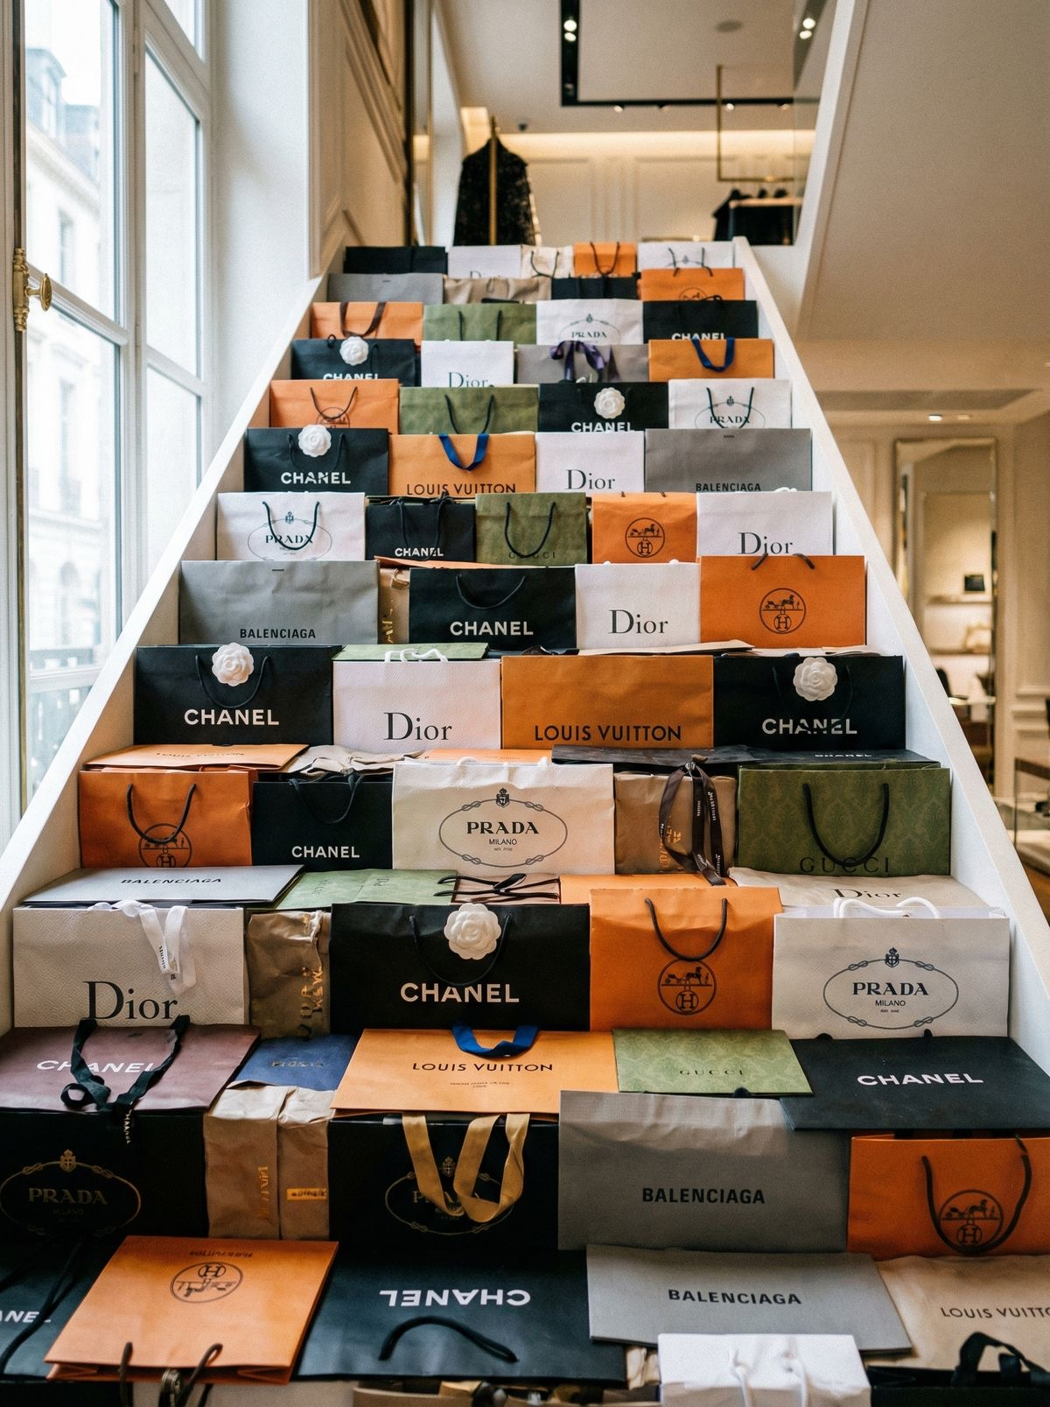
• Fashion Compatibility Rules
Colour harmony, fabric pairing, fit alignment, and trend compatibility rules are applied to ensure visually balanced and aesthetically pleasing outfits.
• Smart Shopping Assistance
The system provides brand alternatives, approximate prices, and availability information to help users easily purchase the recommended outfits within their budget.
• Fast Recommendation Pipeline
The entire recommendation process is optimised to deliver 2–3 ready-to-wear outfit suggestions within seconds, making it suitable for daily use.
• Feedback and Improvement Loop
User feedback on suggested outfits is collected and used to improve future recommendations, making the system adaptive and personalised.
• User-Friendly Experience
The solution reduces decision fatigue, saves time, and increases user confidence by simplifying the outfit selection process into a quick and intelligent experience

Slide 11
References
1) Yaswanthraj, M., Nadar, P., Sathiya Moorthy, M., & Sivakumar, S. (2024, December 19). AI-based outfit recommendation system. https://doi.org/10.13140/RG.2.2.26202.25287
2) Sivaranjani, L., Rachamadugu, S., Reddy, B. V., Avula, B. R., Muthusamy, S., & Depuru, S. (2023, September 20). Fashion recommendation system using machine learning. Proceedings of the IEEE International Conference on Smart Electronics and Communication (ICOSEC), 1367–1374. https://doi.org/10.1109/ICOSEC58147.2023.10275967
3) Lu, X. (2025, September 26). Research on personalized clothing recommendation system based on AIGC. Applied Mathematics and Nonlinear Sciences, 10. https://doi.org/10.2478/amns-2025-1038
4) Kushwaha, R., Kumtekar, R., More, A., & Gaikwad, M. (2025, September 21). Smart outfit recommendation system: A comprehensive review. https://doi.org/10.13140/RG.2.2.29554.36804

Slide 12
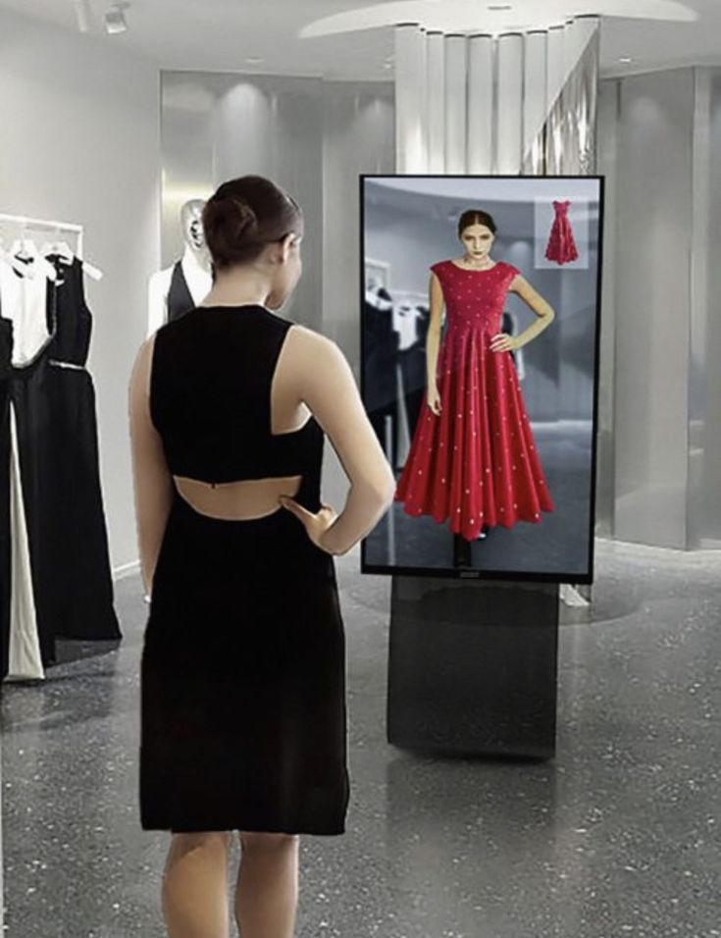

Thank you

