Slide 1
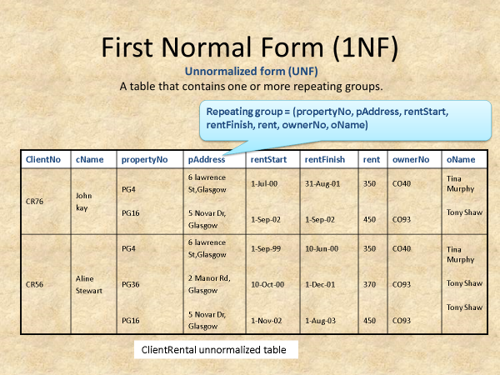
Normalize the below using the Functional dependency techniques

Slide 2
1 NF
ClientNo | CName | propertyNo | pAddress | rentStart | rentFinish | rent | ownerNo | oName
CR76 | John kay | PG4 | 6 Lawrence St, Glasgow | 1-Jul-00 | 31-Aug-01 | 350 | CO40 | Tina Murphy
CR76 | John kay | PG16 | 5 novar Dr, Glasgow | 1-Sep-02 | 1-Sep-02 | 450 | CO93 | Tony Shaw
CR56 | Aline Stewart | PG4 | 6 lawrence St, Glasgow | 1-Sep-99 | 10-Jun-00 | 350 | CO40 | Tina Murphy
CR56 | Aline Stewart | PG36 | 2 Manor Rd, Glasgow | 10-Oct-00 | 1-Dec-01 | 370 | CO93 | Tony Shaw
CR56 | Aline Stewart | PG16 | 5 Novar Dr, Glasgow | 1-Nov-02 | 1-Aug-03 | 450 | CO93 | Tony Shaw

Slide 3
2 NF
Client : (ClientNo, CName)
Rental Property : (propertyNo, ClientNo, rentStart, rentFinish)
Owner : (propertyNo, pAddress, ownerNo, oName, rent)
3NF
Client : (ClientNo, CName)
rental : (ClientNo, propertyNo, rentStart, rentFinish)
Property_Rent : (propertyNo, pAddress, ownerNo, rent, )
Owner : (ownerNo, oName)

