Slide 1

Private Banking Advisers at BCB Edmonton
Group : 6
Manya Sangal
Meghashree Manjunath
Rajasree Katari
Siril Sai Alpuri

Slide 2
Overview
Company: Big Canadian Bank
Scenario: How many PBAs the Edmonton area would need.
Company Goals: Optimize the number of PBAs

Slide 3
Goals And Objectives
Optimize the number of PBAs
Enhance business profits

Slide 4

There are 35 branches of BCB located in Edmonton Area
There is a need to assign PBAs to these 35 branches to serve individual clients
The volume of business per branch is different.
Each advisor has a “Home Branch” and various “ Satellite Branches”
We need to come up with a minimum number of PBAs to cater the business needs.

Slide 5
Tools Used
Python
R Programming
Excel
Tableau

Slide 6
Data
Categorical Data:
Branch Id
Postal Code
Numerical Data:
Average Volume/Month
Average Time Required in days
Average No Of Trips/Month
Latitude
Longitude

Slide 7
Descriptive Analysis
The monthly cost of each advisor is $7000
On an average month, an adviser had an equivalent of 17 eight-hour working days(136 hrs) available to meet with clients
The remaining five workdays per month were reserved for internal meetings, vacations, training, and other activities.

Slide 8
Descriptive Analytics & Visualization
The relationship between average volume and average time required is linear

Slide 9
Descriptive Analytics & Visualization
The relationship between average volume and average number of trips is nonlinear

Slide 10
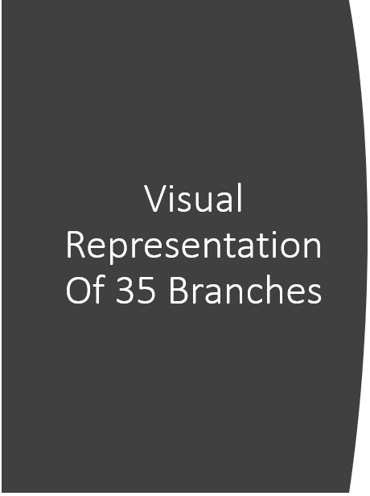
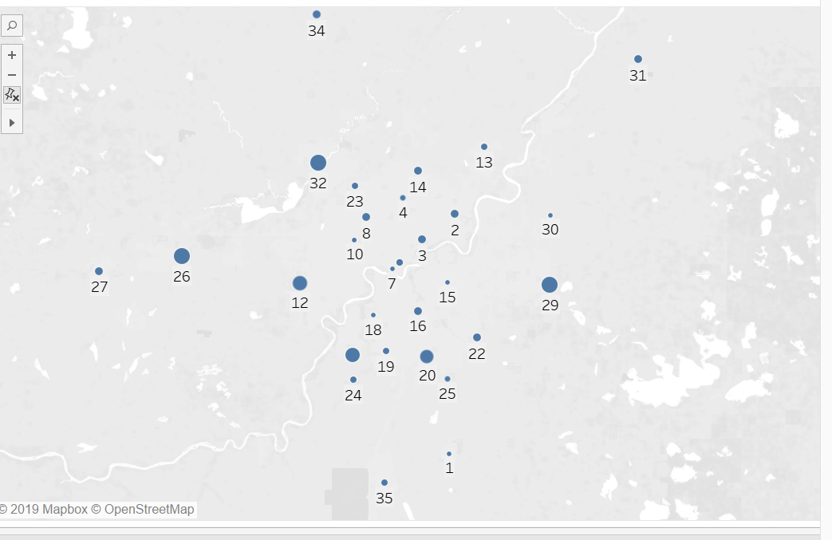

Slide 11
Data Quality
We had a data set of 5 columns - 35 observations.
The data set was clean
No missing values.
No junk values.
It is well structured data.
The data is very precise as per the project needs.
The data is granular enough.

Slide 12
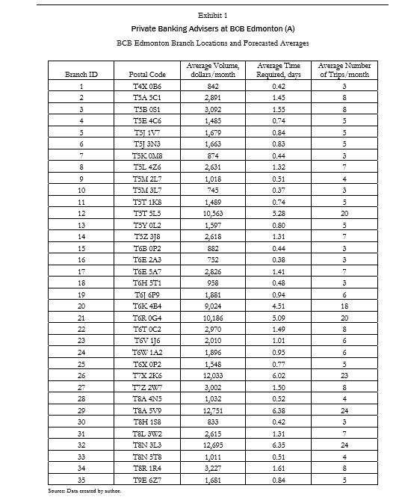
Data Set:

Slide 13
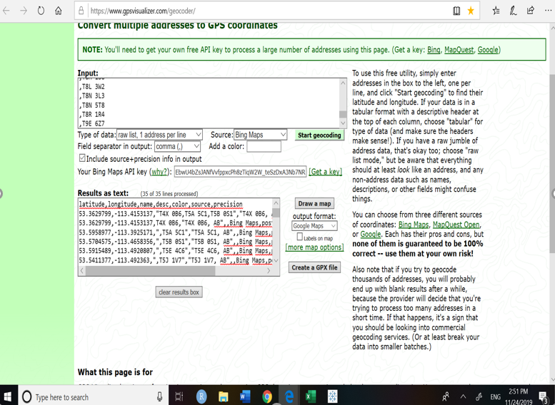
Steps:
We generated the Latitudes and Longitudes from the Postal Codes using BING Microsoft API

Slide 14
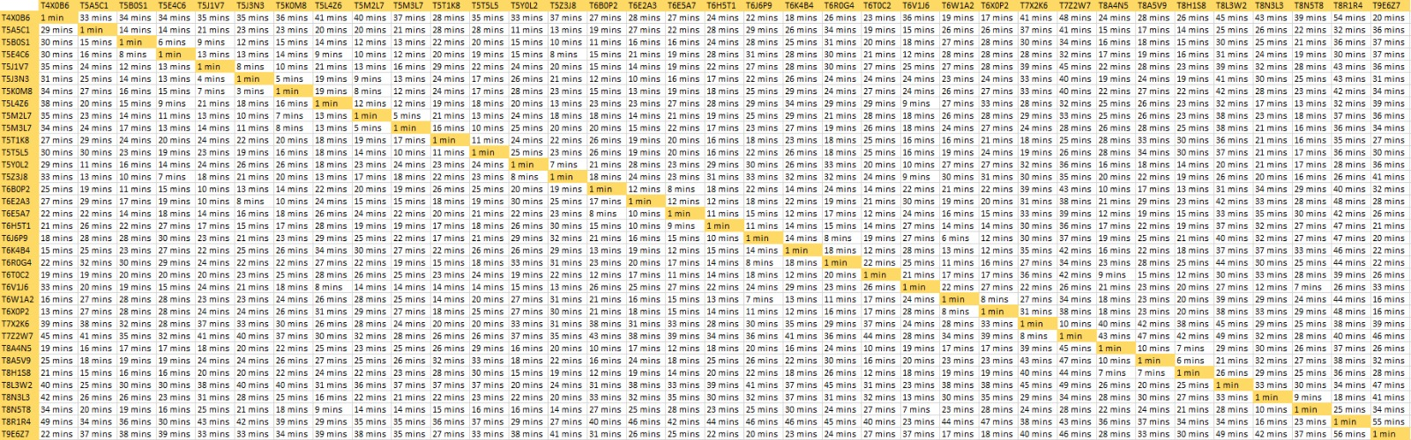
2) We calculated distance between each Location using Google API in Python.

Slide 15
Insights and Recommendations
We recommend 5 PBAs
PBA | Home Branch | Satellite Branches
PBA 1 | T5T5L5 | T5M3L7 T5T1K8 T5M2L7 T5K0M8 T8N5T8 T5E4C6
PBA 2 | T6R0G4 | T6W1A2 T6H5T1 T6X0P2 T6E5A7 T6K4B4 T6E2A3
PBA 3 | T7X2K6 | T7Z2W7 T6J6P9 T5J1V7 T6B0P2 T4XOB6 T9E6Z7
PBA 4 | T8A5V9 | T8A4N5 T6B0P2 T6T0C2 T5A5C1 T5Y0L2 T5B0S1
PBA 5 | T8N3L3 | T6V1J6 T5L4Z6 T8R1R4 T5Z3J8 T8H1S8 T5J3N3

Slide 16
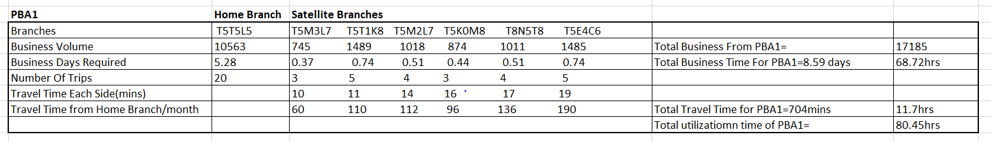
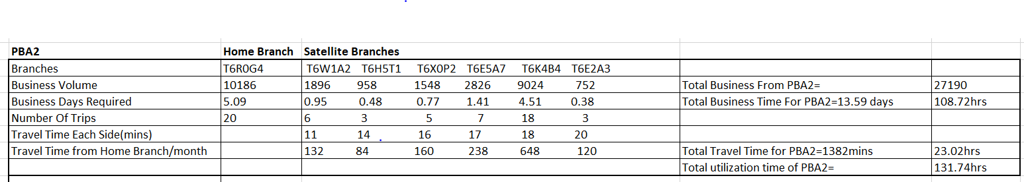
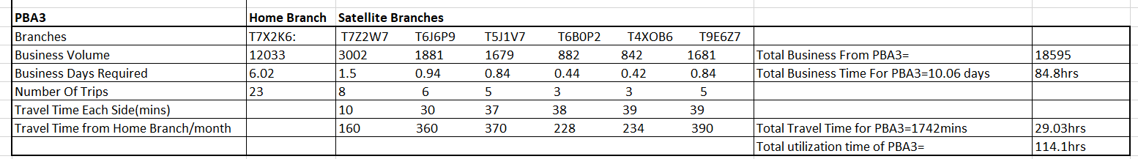

Slide 17
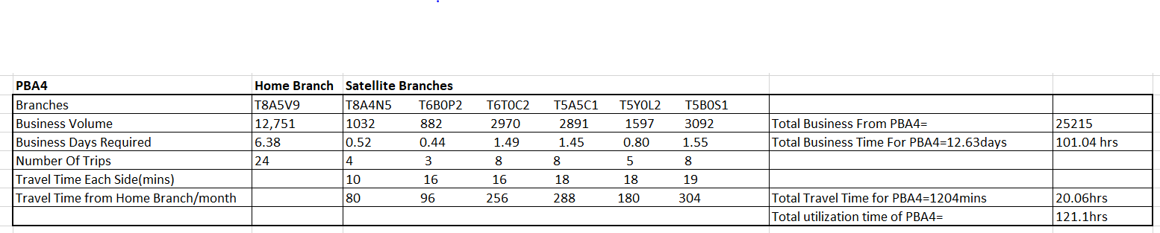
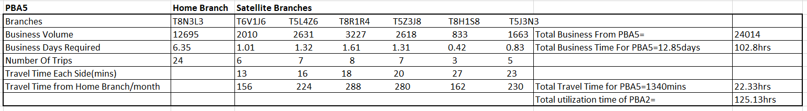

Slide 18
Next steps
Recruit
Recruit 5 PBAs.
Assign
Assign the respective 7 branches to each PBA.
Allocate
Allocate a Home Branch to each of them.
Travel Arrangements
Make necessary travel arrangement to commute between Home And Satellite Branches.

Slide 19

COMPANY:
There is a lot of scope of making business in Edmonton area.
To achieve good profits, it is very important for the company to assign PBAs properly to their respective branches.
DATA:
We had a clean data set.
Though there was a lot of Data Processing
Come up with exact longitude and latitude of each branch
Travel Time between each node.
ANALYSIS:
Conducted Descriptive and Prescriptive analysis of the Problem Statement
Created groups of Branches considering the Business Volume, Number Of Visits, Travel Time And Business time needed in each branch.
TOOLS:
Python: To calculate the travel time between each node.
R : Create clusters
Excel: Data analysis
Tableau: Data Visualization

Slide 20
Appendix
http://www.gpsvisualizer.com/geocoder/
https://developers.google.com/maps/documentation/javascript/get-api-key
https://developer.wepay.com/api/general/api-call
https://hbsp.harvard.edu/cases/
https://stackoverflow.com/questions/12169281/how-to-call-a-google-api

Slide 21


