Slide 1
Collaborative Autonomous Front Estimation
Dario Yazdi and Manyu Belani

Slide 2
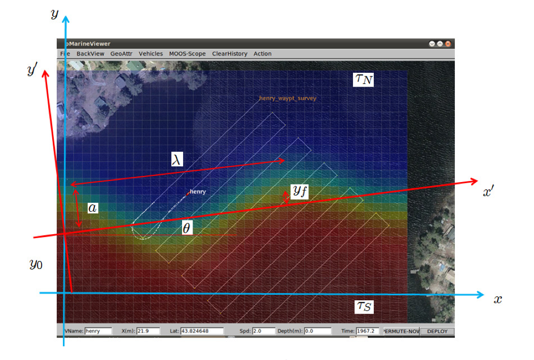
Front Parameters

Slide 3
Front Parameters
Beta: Gradient length scale
Alpha: Propagation delay
Period

Slide 4
Front Estimation Strategy
Specialize behaviors for classifying a few parameters accurately
Utilize a weighted average to combine parameter from specialize behaviors
Two Behaviors, BHV_Circle and BHV_Front

Slide 5
BHV_Front
Oscillates around average of T_NORTH and T_SOUTH
Takes input parameters angle and offset
Travels within specified region using one of 4 headings based off angle parameter

Slide 6
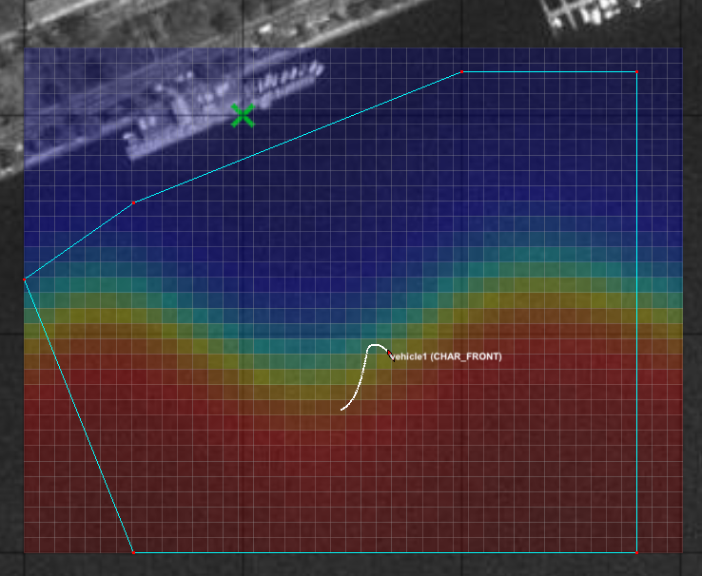
Vehicle 1

Slide 7
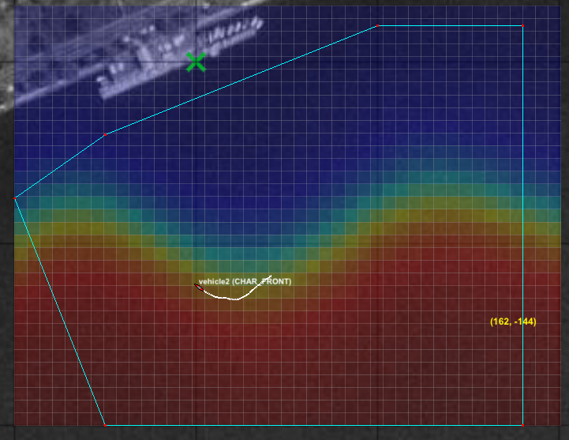
Vehicle 2

Slide 8
Implementation
Problems with collision avoidance and op region

Slide 9
Improvements
Modify BHV_Front to include communications such that vehicles avoid each other and never trigger collision avoidance behavior
Improved front tracking algorithm

