Slide 1

Collaborative Autonomous Front Estimation
Abimanyu Belani and Dario Yazdi

Slide 2
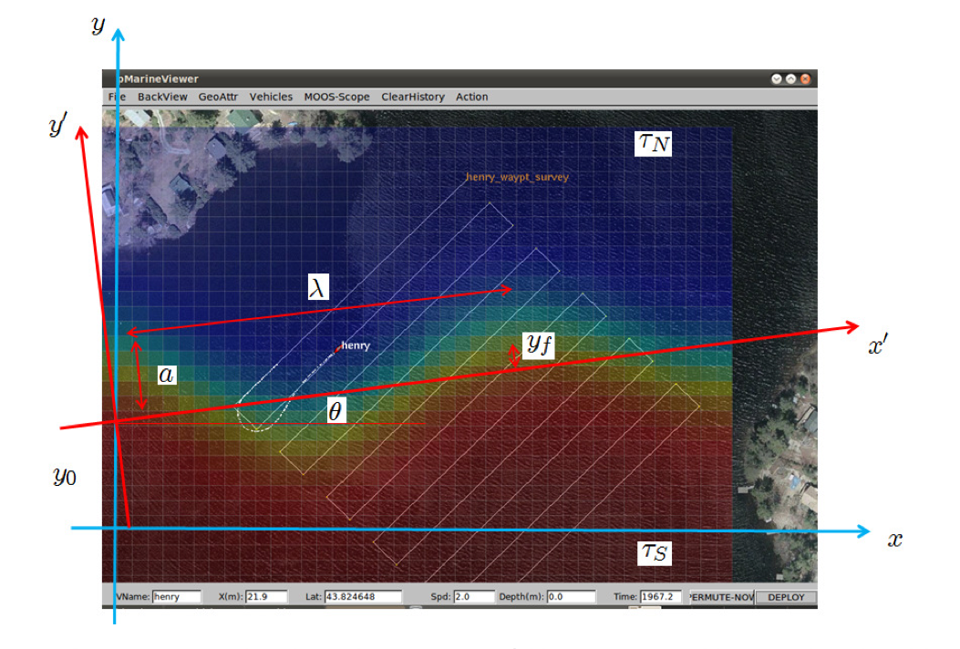
Front Parameters

Slide 3
Front Parameters
Beta: Gradient length scale
Alpha: Propagation delay
Period

Slide 4
Front Estimation Strategy
Specialize behaviors for classifying a few parameters accurately
Utilize a weighted average to combine parameter from specialize behaviors
Two Behaviors, BHV_Circle and BHV_Front

Slide 5
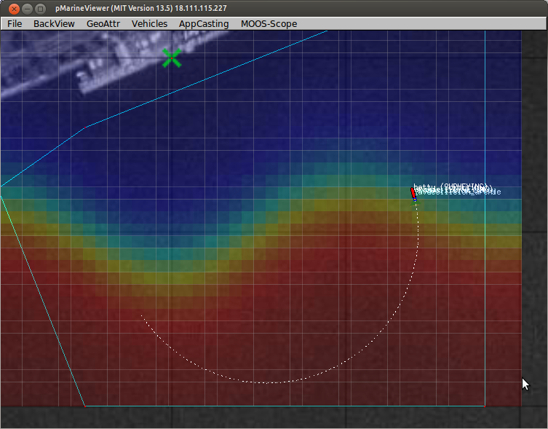
BHV_Circle

Slide 6
BHV_Front
Oscillates around average of T_NORTH and T_SOUTH
Takes input parameters angle and offset
Travels within specified region using one of 4 headings based off angle parameter

Slide 7
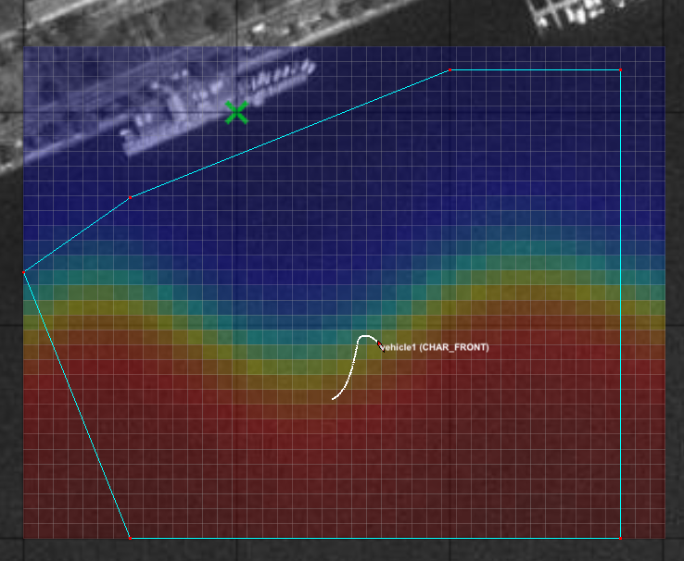
Vehicle 1

Slide 8
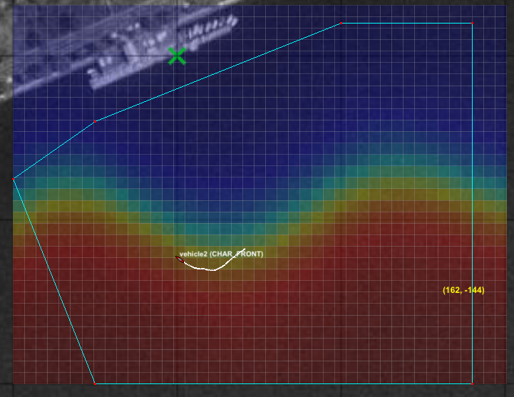
Vehicle 2

Slide 9
Implementation Issues
Problems with collision avoidance and op region

Slide 10
Results
River Tests
Front 1- 78
Front 2- 265
No Mission Completed fully – Return button was used both times
Suspect issues with our use of the temperature sensor to follow the front, or destructive interactions between our Front Behavior and the Collision Avoidance

Slide 11
Improvements
Modify BHV_Front to include communications such that vehicles avoid each other and never trigger collision avoidance behavior
Improved front tracking algorithm

