Slide 1
Computational Tools to unmask Transposable Elements
Kundaje Lab Journal Club
Nov 6 2018

Slide 2
Some History: “Jumping Genes” in maize
Barbara McClintock discovered the first TEs in maize (Zea mays) at the Cold Spring Harbor Laboratory in New York. McClintock was experimenting with maize plants that had broken chromosomes.[5]
In the winter of 1944–1945, McClintock planted corn kernels that were self-pollinated, meaning that the silk (style) of the flower received pollen from its own anther.[5] These kernels came from a long line of plants that had been self-pollinated, causing broken arms on the end of their ninth chromosomes.[5] As the maize plants began to grow, McClintock noted unusual color patterns on the leaves.[5] For example, one leaf had two albino patches of almost identical size, located side by side on the leaf.[5] McClintock hypothesized that during cell division certain cells lost genetic material, while others gained what they had lost.[6] However, when comparing the chromosomes of the current generation of plants with the parent generation, she found certain parts of the chromosome had switched position.[6] This refuted the popular genetic theory of the time that genes were fixed in their position on a chromosome. McClintock found that genes could not only move, but they could also be turned on or off due to certain environmental conditions or during different stages of cell development.[6]

Slide 3
So what exactly are transposable elements
explain relation to viruses,parasites,selfish elements
how they played a role in eukaryokatic genomic expansions
they have been domesticated and now sometimes play useful roles
random transpostions can be dangerous and cause cancers

Slide 4
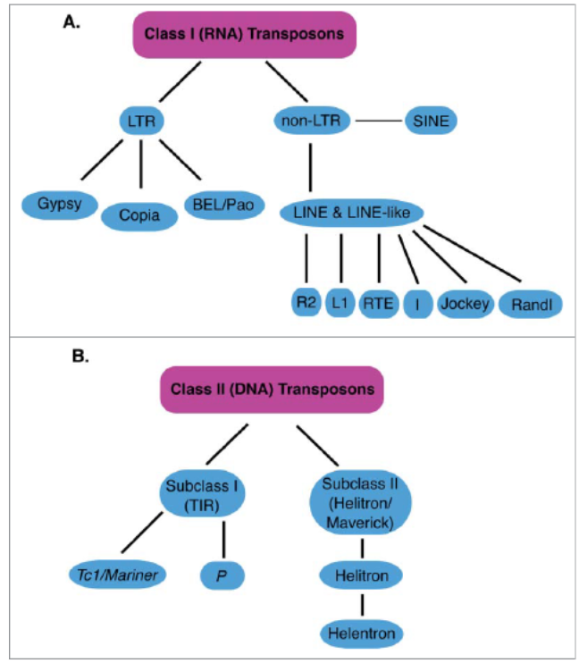
TE families and classification:
Retrotransposons (RNA transposons)
“Copy and paste” mechanism of transposition
LTR TEs account for 95% of plant genomes! (and often active) They are inactive in humans and are 10% of the genome
LINE and SINE Account for 35% of the human genome.
LINE1 family still active in humans, with 1 germline insertion per 95 births
ALUs ,SINEs
DNA Transposons:
“Cut and Paste” mechanism of transposition
Encode for Transposase
Explain how it propogates
Mccullers, Tabitha & Steiniger, Mindy. (2017). Transposable elements in Drosophila. Mobile Genetic Elements. 7. 00-00. 10.1080/2159256X.2017.1318201.

Slide 5
