Slide 1
Exploring optimization with “unusual” Loss functions for Imbalanced biogical datasets
Abhi Banerjee
Feb 13, 2018

Slide 2
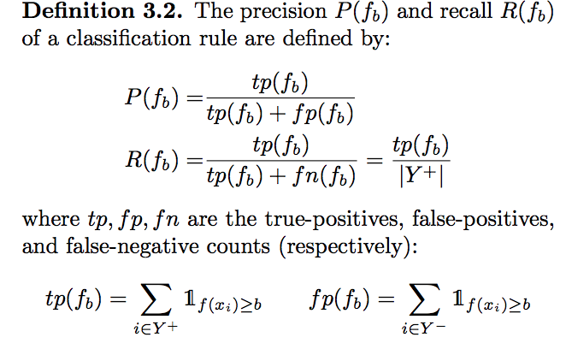
What metrics are useful for classification of imbalanced data ?
When we have class imbalanced data, its useful to look at a metric that reflects the class imbalance
A completely Random Classifier has an AUC_ROC of 0.5; (AUROC is not sensitive to class imbalance)
The AUC_PRC (area under precision-recall curve) is sensitive to class imbalance . If Pos:Neg is 1:N then for a completely random classifier the AUPRC is 1/(N+1)
In practice we might care about something like: What the Recall at 5% FDR (ie. Recall at 95 % Precision). Wouldn’t it be great to directly optimize this?

Slide 3
Optimizing what we care about
The most common loss function we use with Neural Nets is the Cross Entropy Loss. This is well justified as it minimizes the KL divergence between the predicted and label distributions.
Can we try to do better and directly learn with the metrics we care about?
The problem is that AUC_ROC and AUC_PRC are not differentiable functions. Also AUC_PRC has no neat expression that can be written down as a sum of terms
We can make progress by considering surrogates of these quantities and optimize those

Slide 4
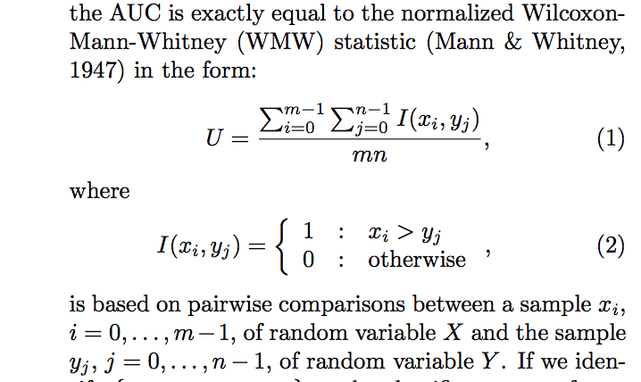
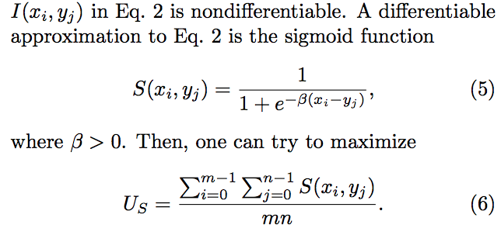
Learning to optimize AUC_ROC
Optimizing Classifier performance via an approximation to the Wilcoxon-Mann-Whitney Statistic (IMCL 2003, Lian Yan, Robert Dodier et al)
Mann Whitney form for the AUC_ROC
Relaxing Indicator functions to Sigmoids.
Does not Learn in practice due to vanishing gradients

Slide 5
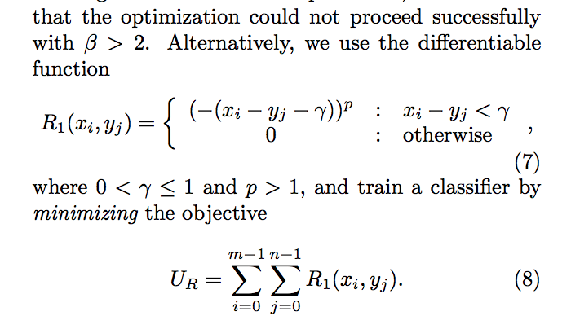
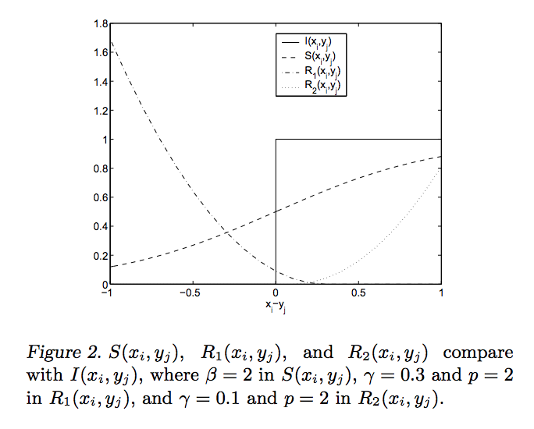
Learning to optimize AUC_ROC
Optimizing Classifier performance via an approximation to the Wilcoxon-Mann-Whitney Statistic (IMCL 2003, Lian Yan, Robert Dodier et al)
Powered hinge loss: works much better in practice
Not hard to implement in Tensorflow. But changing batch size, and the hyper-params \gamma, p will be important for competetive performance

Slide 6
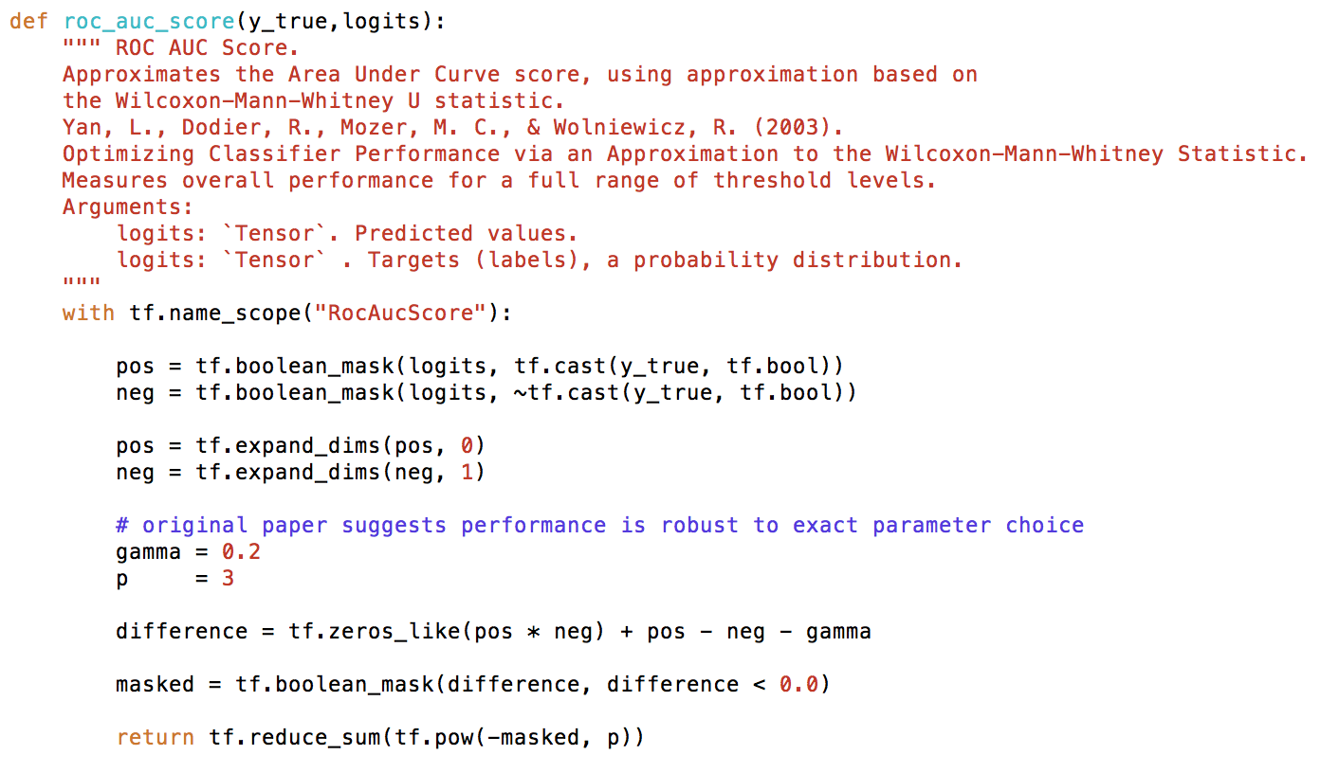
Learning to optimize AUC_ROC
ROC-AUC loss implementation in Tensorflow (this was already implemented in TF-learn)

Slide 7
Learning to optimize Recall@Precision/Precision@Recall and AUC_PR
Scalable Learning of Non Decomposable Objectives: (AISTATS 2017, Elad Eban, Ariel Gordon et al. ,Google Inc)
This paper aims to learn some convex relaxations to the R@P and AUPRC metrics
Improves AUPRC from 82.2% to 83.3% on Imagenet and Improves AUPRC from 42% to 48% on JFT (Google internal image dataset of 300 mil images and 20000 categories)
Write the precision and recall in terms of zero-one loss

Slide 8
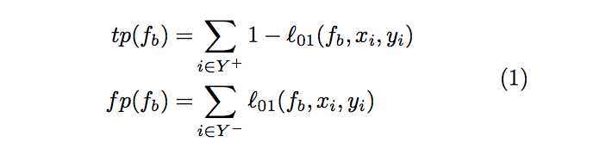
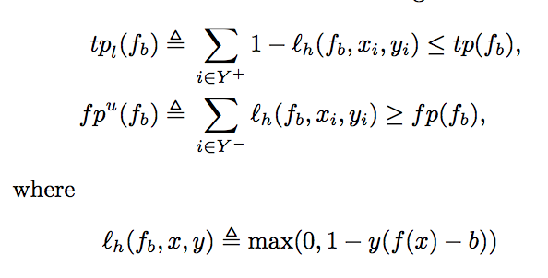
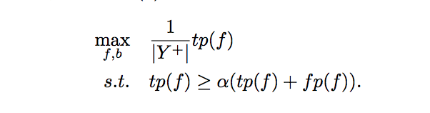
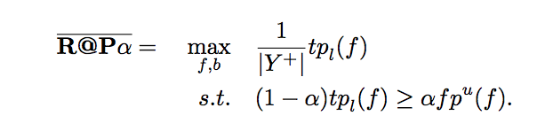
Learning to optimize Recall@Precision
We can write Prec and Recall with 0-1 loss
Hinge loss relaxations for 0-1 loss
Hinge Relaxation
Goal: Maximize R@P: at P=α :
Lower Bound to true P@R objective

Slide 9
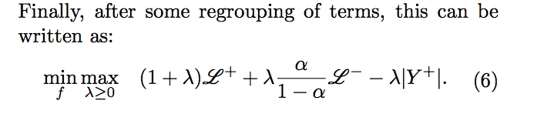
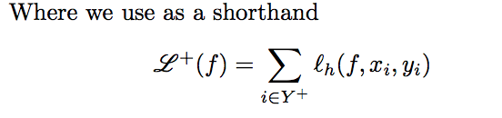
Learning to optimize Recall@Precision
An extra parameter λ(apart from the weights of the model) arises as a Lagrange Multiplier from the constraint on Precision
We can train this with SGD; Loss function can be implemented in Tensorflow

Slide 10
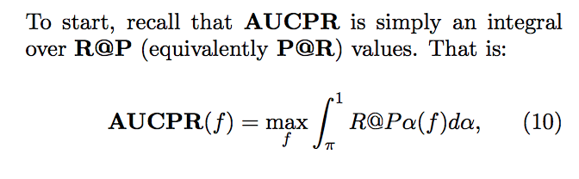
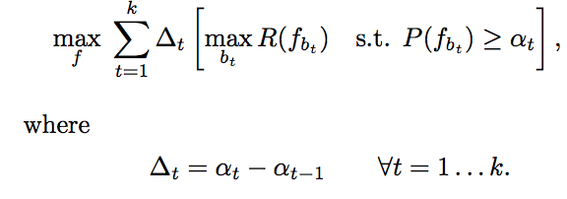
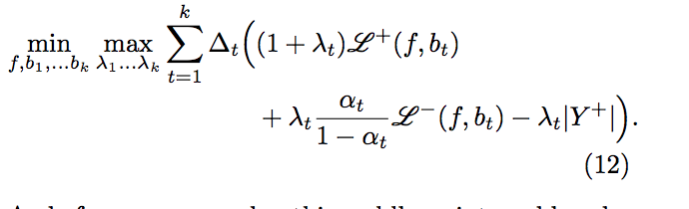
Learning to optimize AUC_PRC
We can extend the previous analysis to maximize AUC_PRC
Approximate the integral by a Riemann Sum, choose a set of Anchor values for the \alpha s
AUPRC loss function, trainable by SGD

Slide 11
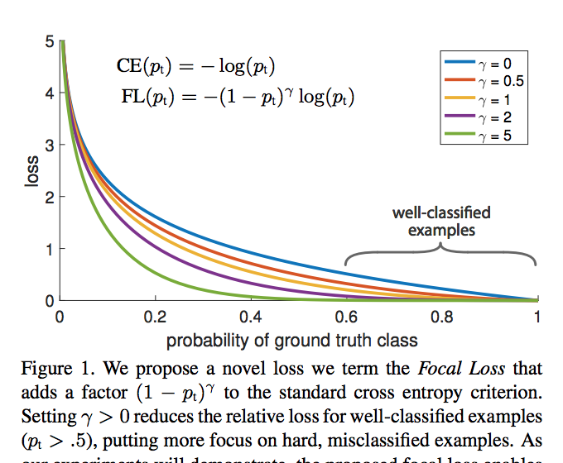
Focal Loss for dense object detection:
https://arxiv.org/pdf/1708.02002.pdf (Lin et al, FAIR)
Reduce the relative loss for well classified example: and focus more on low confidence examples
Proposed for imbalanced classification:
Intuitively, rare and hard positives will have more weight in the loss function by design

Slide 12
Comparing these loss functions on TF binding
I look at a Seq+DNAse model (ZBTB33 in K562), only in DNAse regions. Imbalance is about 1:5
Loss | AUPRC | AUROC
Cross Entropy | 0.948 | 0.974
Focal(\gamma=3,\alpha=.25) | 0.951 | 0.976
R@P (P=.1) | 0.919 | 0.951
roc_auc (\gamma=0.2,p=3) | 0.943 | 0.973
These are very preliminary; I suspect the R@P loss also must have a bug as it isn’t training as well as hoped

