Slide 1
Uncovering DNA-Methylation’s shadowy role in TF Binding with Deep Learning
Abhi Banerjee
Nov 7, 2017
Kundaje Lab Journal Club

Slide 2
The role of DNA methylation in TF binding is complicated
I’m going to review: Transcription Factors as readers and effecters of DNA methylation (Zhu et al, Nature Rev. Genetics)
Talk about using Deep Learning for training and interpreting TF binding models using methylation feature inputs (my project)

Slide 3
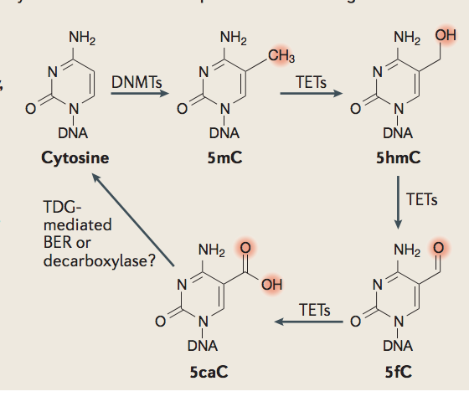
The role of DNA methylation in TF binding is complicated
DNA methylation usually refers to 5mC
Other Cytosine methylation derivatives are less common
In mammals, Methylation occurs mostly at CpG sites
It was believed that only Proteins with a Methyl Binding Domain(MBD) can have interaction with methylated DNA
All MBD proteins bind methylated DNA in a seq. non-specific manner
There are only 5 known MBD proteins in mammals. (MBD1,MBD2,MBD3.MBD4,MeCp2)
Ref: Zhu et al, Nat Rev Genetics

Slide 4
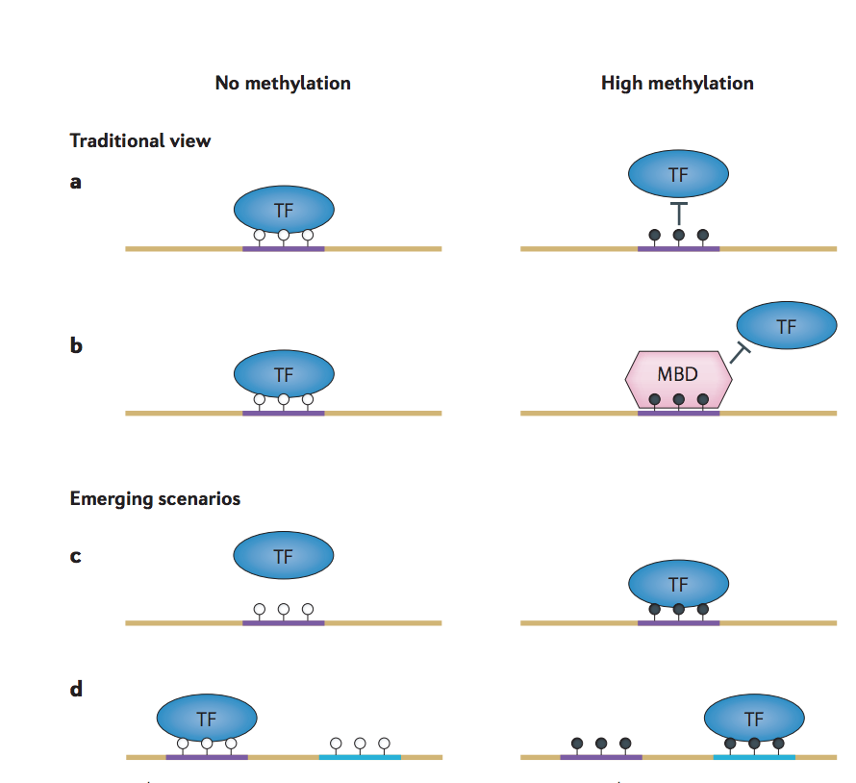
The role of DNA methylation in TF binding is complicated
However there is now increasing evidence of TFs acting as readers and effectors of TF binding (not only MBD proteins)
For example ZBTB33(Kaiso), CEBP-B and CEBP-A are known to bind methylated DNA
Ref: Zhu et al, Nat Rev Genetics
Notes:
A TF may bind a difference sequence motif in the presecence of Methylation

Slide 5
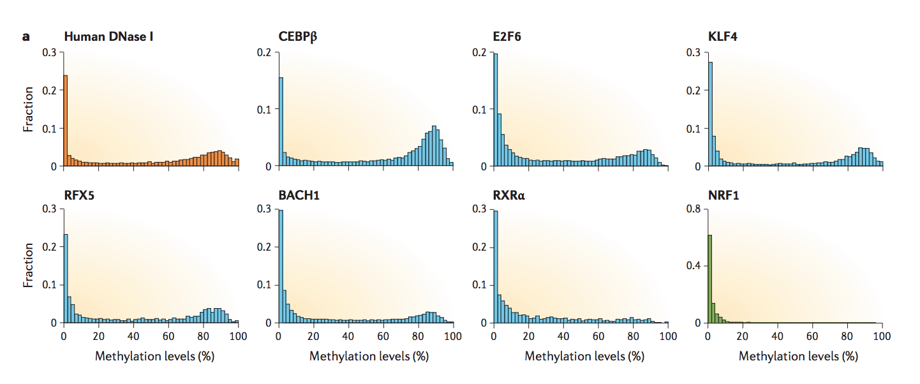
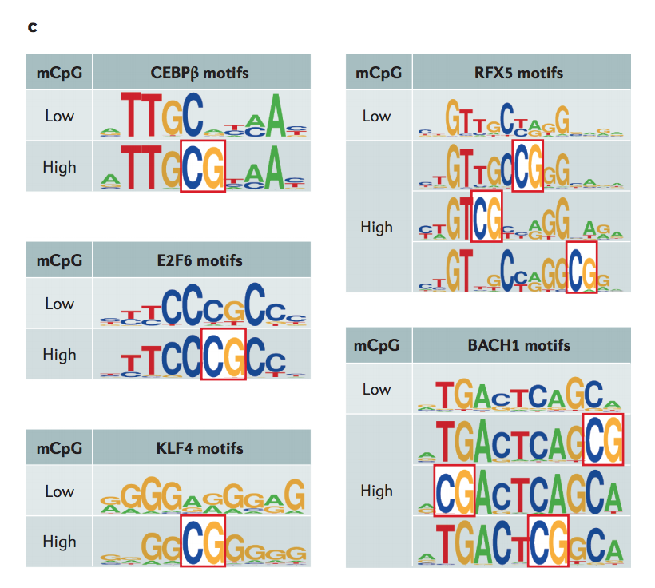
The role of DNA methylation in TF binding is complicated
A good fraction of ChipSeq peaks are enriched for methylation (H1 cells)
Among the peaks with high CpG methylation (>80 percent threshold selected), MEME analysis gives a different consensus motif
Ref: Zhu et al, Nat Rev Genetics
Notes:
This has been done in H1 cells
Avg methylation is done within CpG sites only

Slide 6
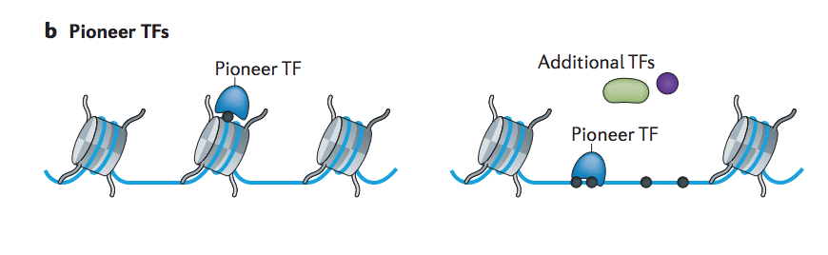
The role of DNA methylation in TF binding is complicated
Many of the known mCpG binding TFs are Pioneer TFs
ZBTB33,KLF4,FOXA1 for example
CEBPB? Some papers report pioneering activity
Do Pioneer TFs generally have the capability to bind mCpG? Being able to bind mCpG could help in binding inaccessible chromatin
Ref: Zhu et al, Nat Rev Genetics

Slide 7
Methylation sensitive TF binding models
Can we “learn” the role of methylation using good predictive models?
I train Deep Learning models comparing Seq(S) only Models to Seq+Methylation models(SM) , and Seq+DNAse models (SA) to Seq+DNAse+Methylation(SAM) models
Whenever methylation gives a boost in performance---it means that the model learns some important correlations, which need interpretation

Slide 8
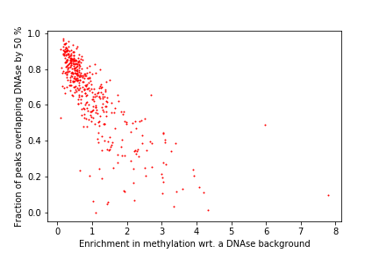
Methylation Enrichment analysis in K562 cells
Enrichment=P/D
P=avg methylation on CpG sites within ChipSeq optimal IDR peaks
D=avg methylation on CpG sites within DNAse peaks
K562 has 450+ TF ChipSeq experiments on ENCODE
I have plotted the fraction of peaks having >50 percent overlap with DNAse regions vs Enrichment in Methylation (with a DNAse background)
Correlation coefficient of -0.77
Since TFs enriched for methylation bind a lot outside DNAse, our models must be trained/evaluated either Genome-wide or some super-set of DNAse regions

Slide 9
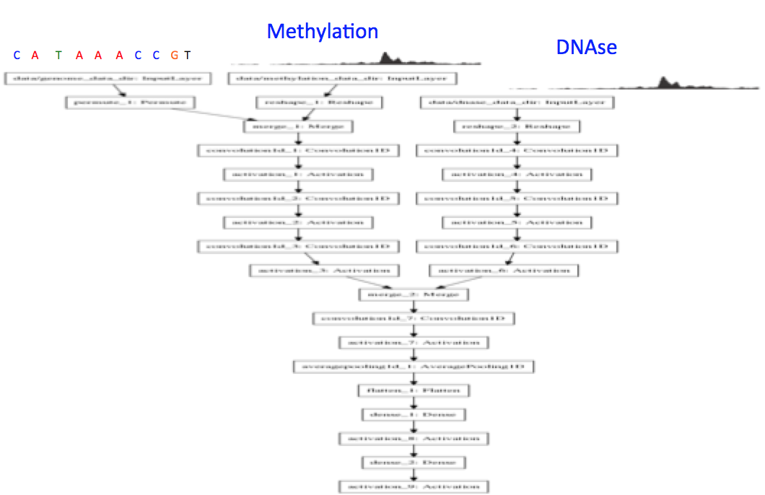
Model Architectures
SAM model: Sequence and Methylation are treated as a single input to the neural net. DNAse is kept as a separate mode

Slide 10
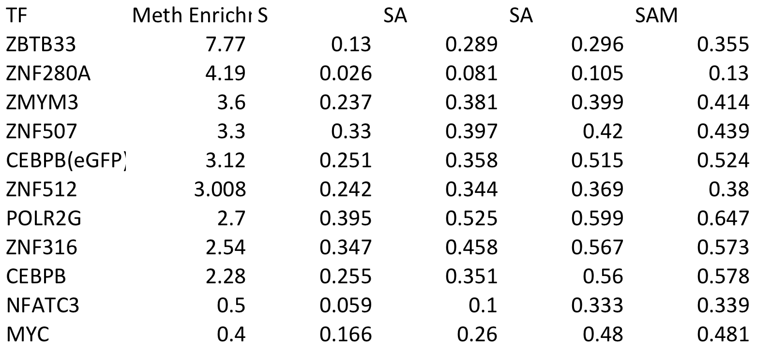
Performance across enriched TFs: AUPRC reported with eval. done genome-wide on chr9
Enrichment in Methylation (DNAse background)
I’ve left out eGFP-fusions ; they seem all very enriched in methylation ; Showing CEBPB (eGFP) for comparison
AUPRC metric reported (data imbalance is 1:1000 for the positive set: negatives)
Notes:
Trainging models optimally is difficult. Lots of fine tuning needed. I have tweaked learning rate between 3e-4 to 1e-6. I’ve seen that 3e-5 is good for Seq, DNAse, Methylation models
But very small learning rates results in local minima
Ideally we want optimally perrforming models

Slide 11
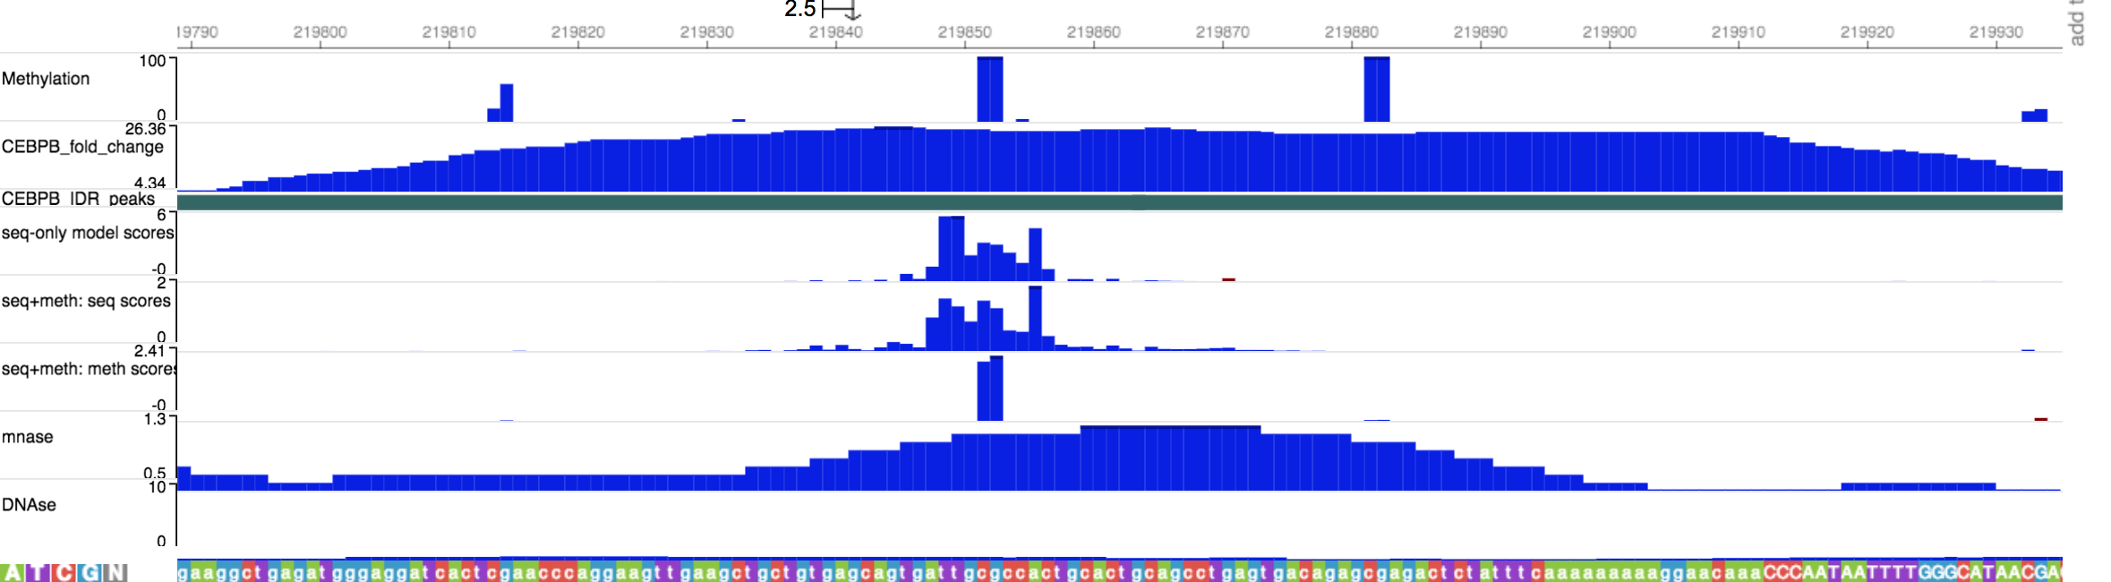
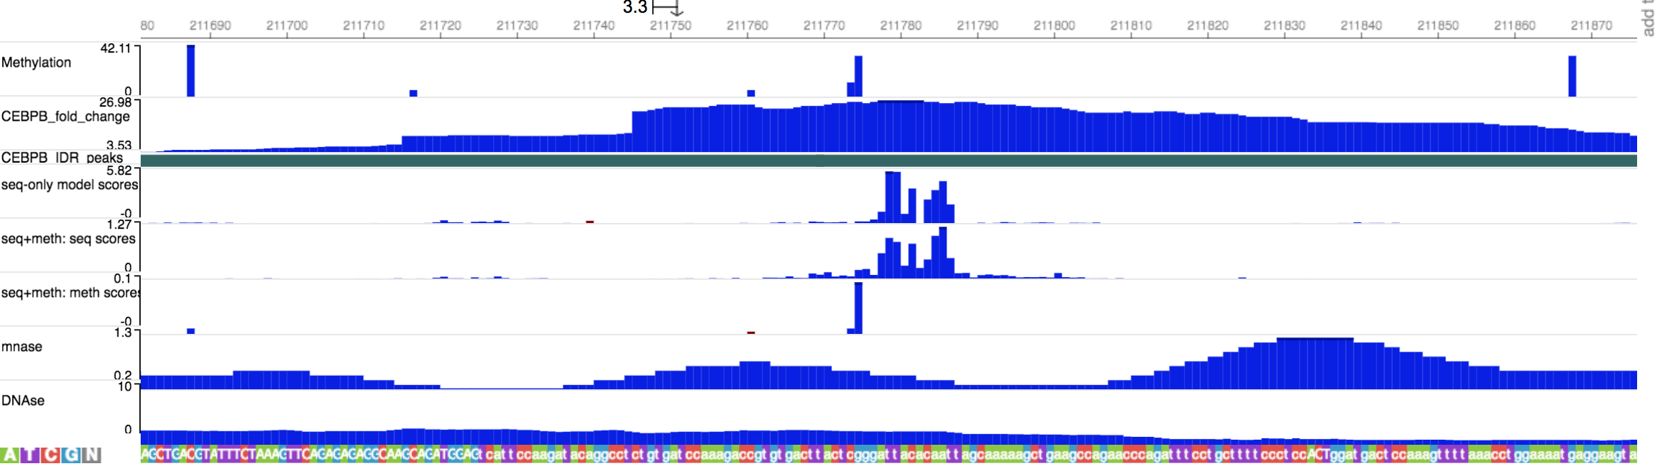
Interpreting models can teach us about TF binding
Notes:
Using Guided backprop to learn the role of methylation for TF binding

Slide 12
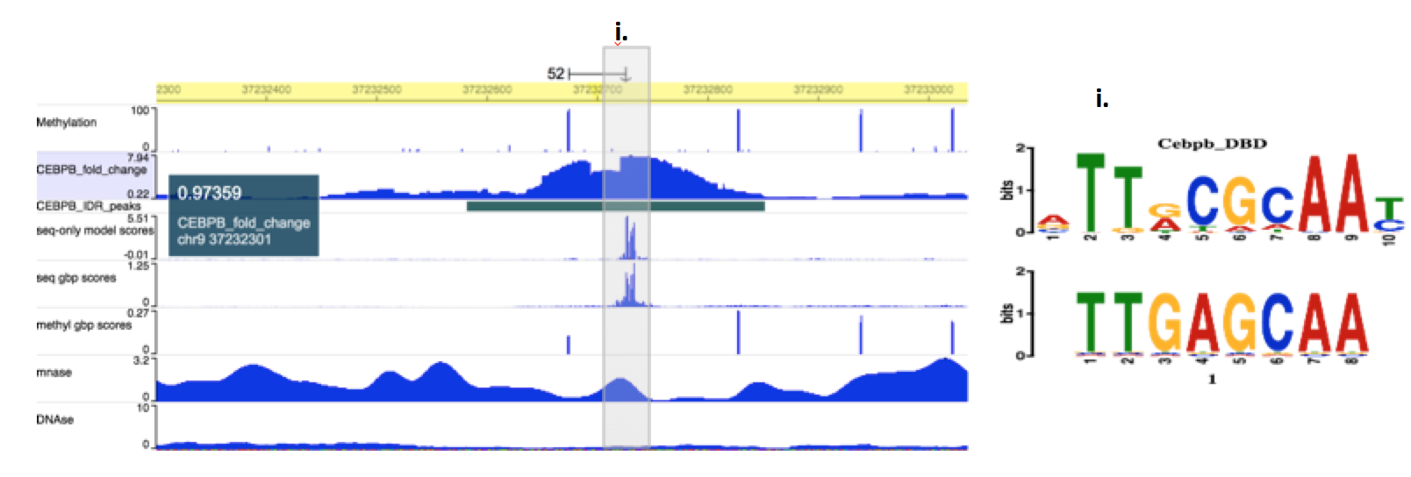
Interpreting models can teach us about TF binding
Seq+Meth model correctly classifies using methylation background which it gives a high importance score to.
However, we’ve seen that NN interpretation methods are fragile—so we can not blindly trust any single interpretation as being conclusive biological evidence. Any claim must be verified to occur repeatedly over the genome ---(for example saying that methylation within 50 bp is important to binding for ex)
Can we average importance scores across several good models? Use test time dropout on interpretation scores?
Notes:
Ide

Slide 13
Current Issues:
Reprocessed Methylation data: I re-processed the Methylation data to trim off ends of reads in the WGBS experiment ( to remove biases in the experimental procedure). Using both replicates now . I used only rep1 in my previous analysis (which is the processed version available from ENCODE)
WGBS experiments are in-homogenous and not every genomic location has equal coverage. We ideally want to filter out CpGs with <10 read coverage. But these are spread out all over the genome– and throwing out intervals containing these causes a loss of lot(about 60%) of data
Notes:
WGBS: Whole Genome Bisulfite Sequencing is an experiment to calculate genome wide methylation status

Slide 14
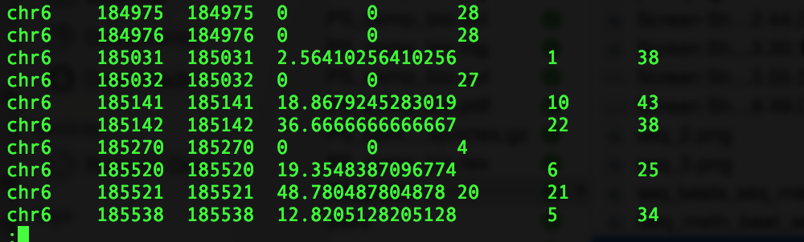
Current Issues:
Bismark processed output file sample
Ideas:
Train a model that has a 4th input—which is the total reads /100 for every CpG ; and hope that the NN learns the importance of coverage
Including error as a 4th input (The methylation is computed from a binomial distribution)

