Slide 1
Co-expression patterns define epigenetic regulators associated with neurological dysfunction
Kundaje Lab journal club
23 July 2019
Abhi

Slide 2
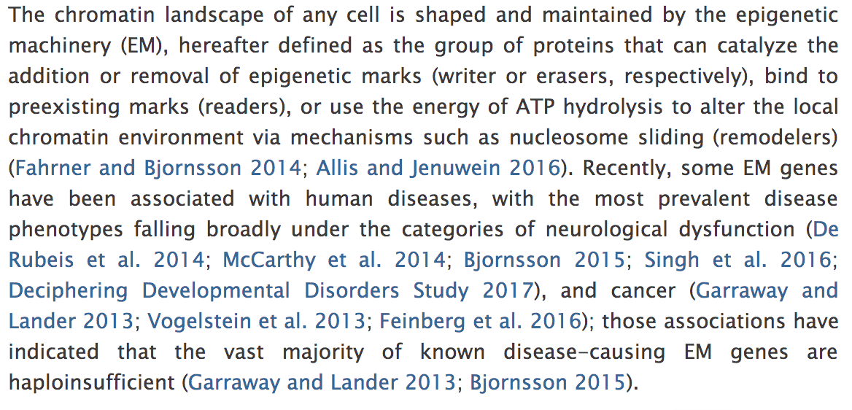
Introduction

Slide 3
Three Questions addressed in this study
. First, how many additional disease candidate EM genes are there?
Existing estimates (Khare et al. 2012; Medvedeva et al. 2015) suggest that EM genes with ascribed roles in disease only form a minority of the whole group.
It is also unknown whether disease genes tend to be evenly distributed among classes (e.g., erasers versus remodelers) and subclasses (e.g., histone methyltransferases versus histone acetyltransferases) of the machinery
Second, is the lost epigenetic function of these genes the most likely cause of disease?
Studies in model systems have indicated that the domains mediating the epigenetic function can sometimes be dispensable (Dorighi et al. 2017; Rickels et al. 2017).
This raises the possibility that, even among known EM disease genes, the phenotype might have some alternative mechanistic basis.
Third, are there expression signatures characteristic of disease candidates?
In other words, are the expression patterns of EM genes that are intolerant to variation different from those of variation-tolerant EM genes?

Slide 4
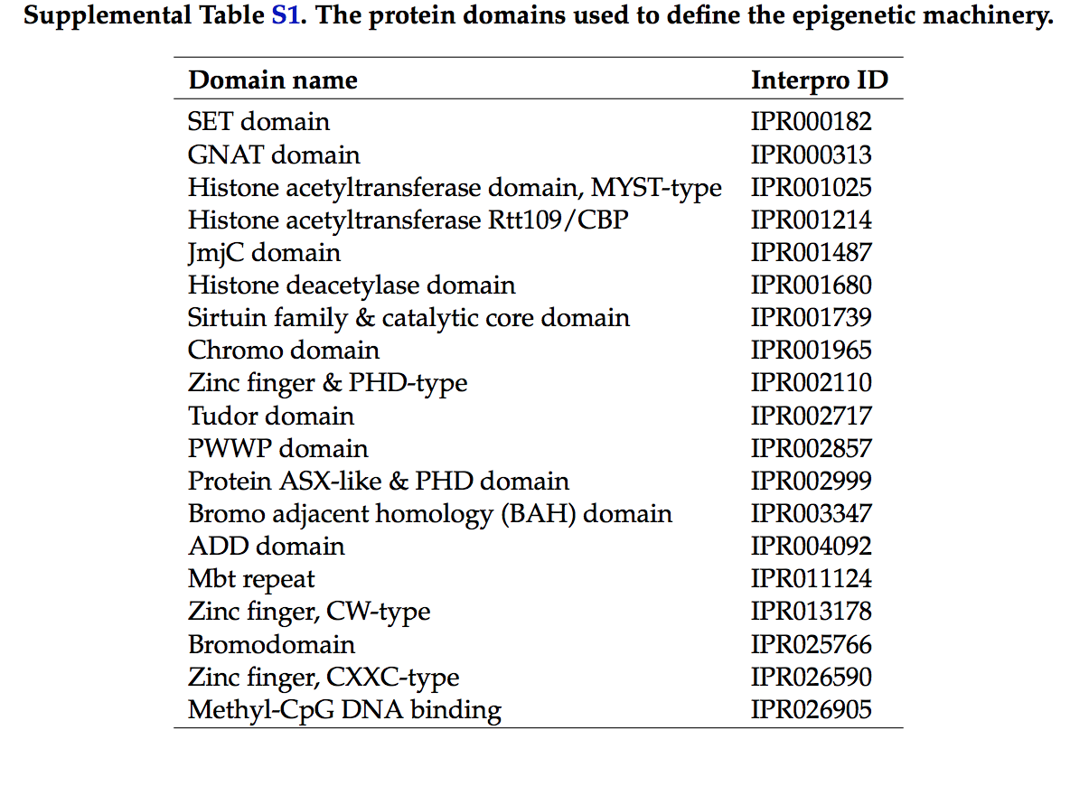
Interpro domain annotations used to curate EM genes

Slide 5
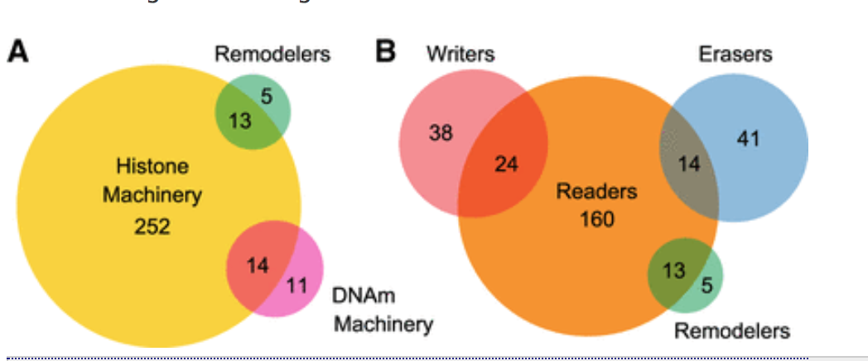
EM(epigenetic machinery genes)
Finally, using a previously generated, high-confidence list of 1254 human transcription factors (Vaquerizas et al. 2009; Barrera et al. 2016), we found that 20 EM genes (12 of which are members of the PRDM family of histone methyltransferases) have a DNA-binding domain found in transcription factors, suggesting their involvement in more than one aspect of transcriptional regulation

Slide 6
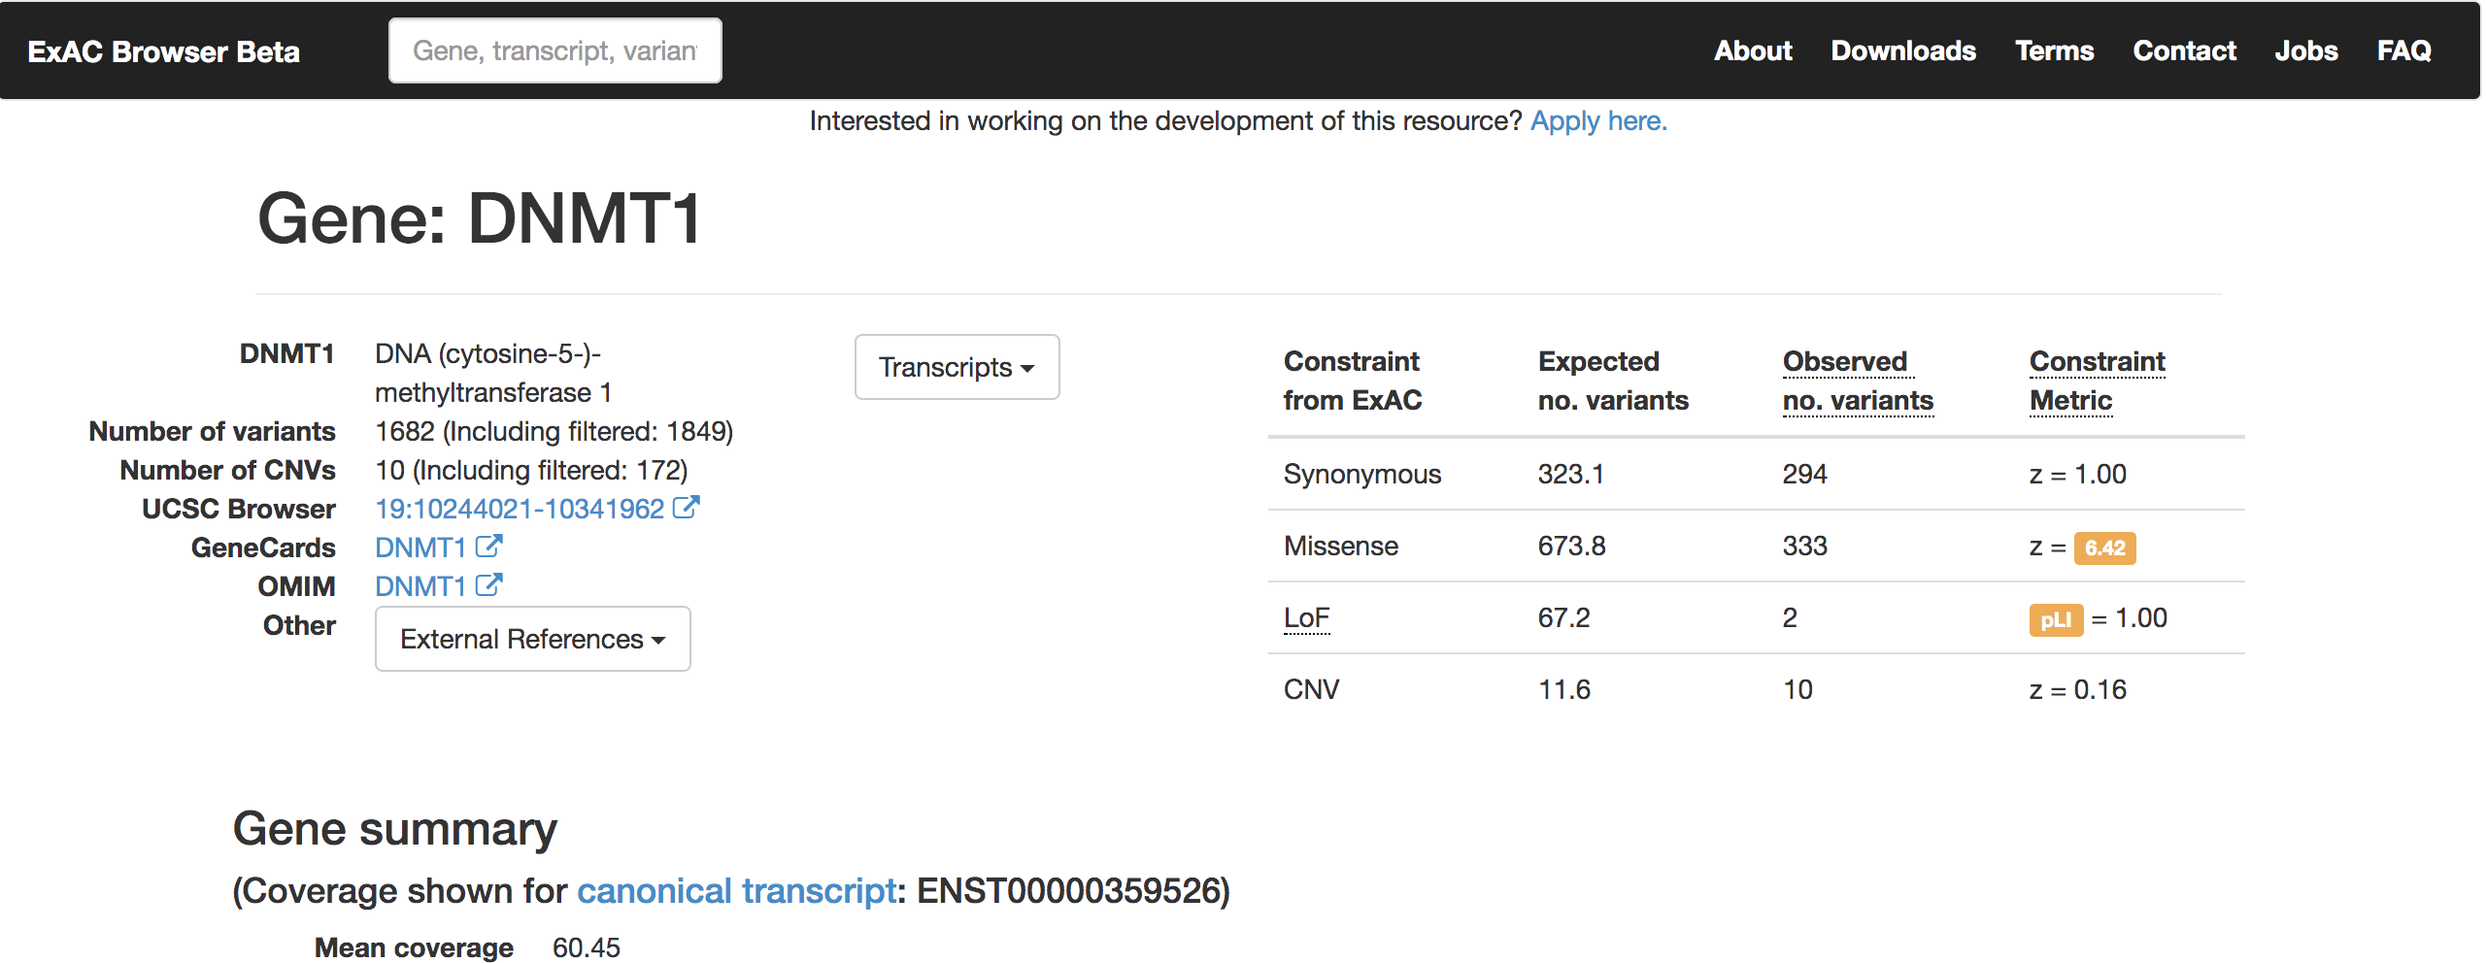
ExAC pLI score to quantify variation
To identify novel EM disease candidates, we systematically investigated the tolerance of the entire EM group to loss-of-function variation.
To achieve this, we used the ExAC database coupled with the pLI score (Lek et al. 2016), a metric which ranges between 0 and 1 and measures the extent to which a given gene tolerates heterozygous loss-of-function variants.
In particular, genes with a pLI of more than 0.9 have been described as highly dosage sensitive

Slide 7
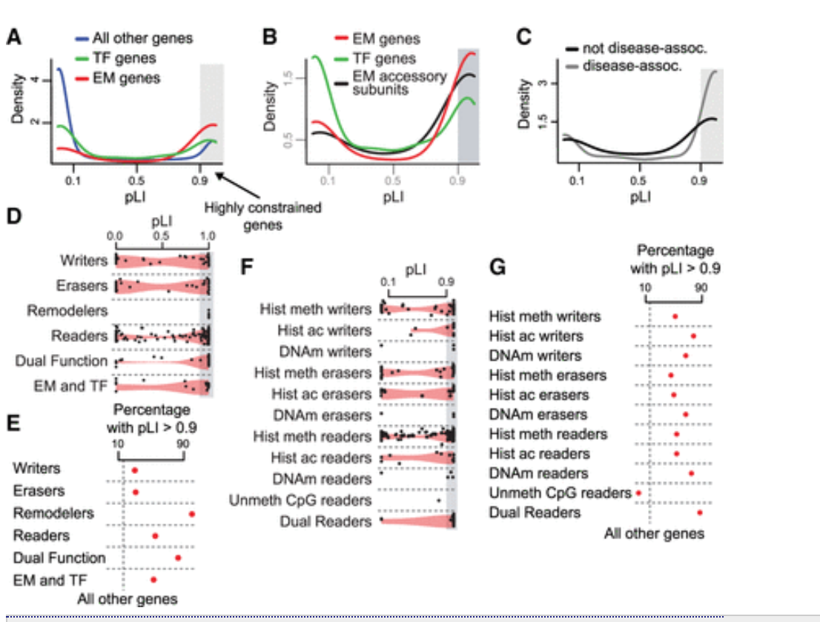
pLI scores of EM genes

Slide 8
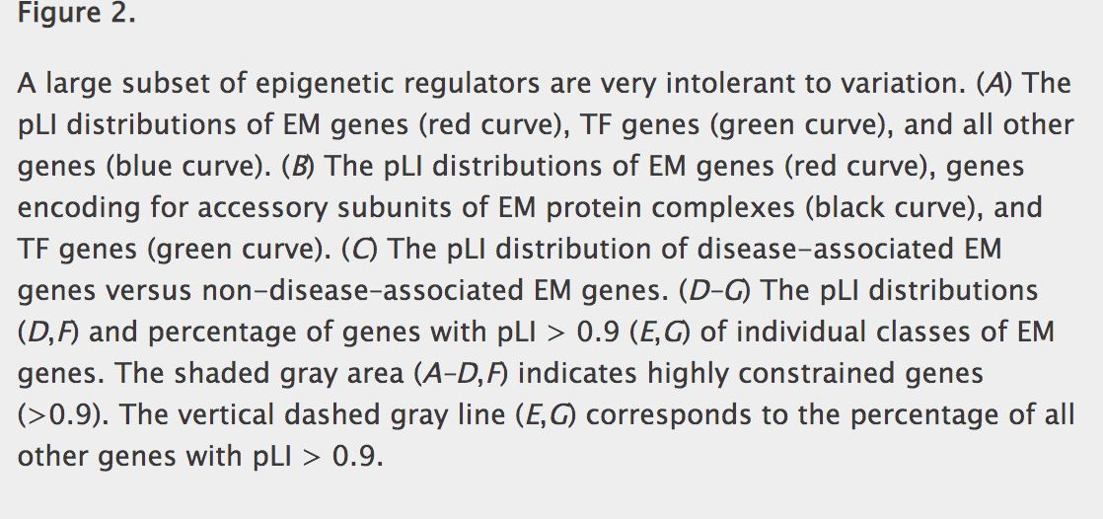

Slide 9
EM genes with possible disease associations
Among 162 EM genes in ExAC with no reported link to disease, 78 have a pLI greater than 0.9 (percentage with pLI > 0.9 = 78/162 = 48%).
Additionally, there are 24 EM genes that have only been associated with cancer but whose pLI is greater than 0.9, suggesting that they also cause some other disease phenotype.
In total, this leads to 102 novel EM disease candidates (Supplemental Table S6). Finally, the same approach for the EM accessory subunits (Methods) highlighted 39 new disease candidate genes whose phenotypic consequences are likely to arise through similar mechanisms as in the case of EM genes

Slide 10
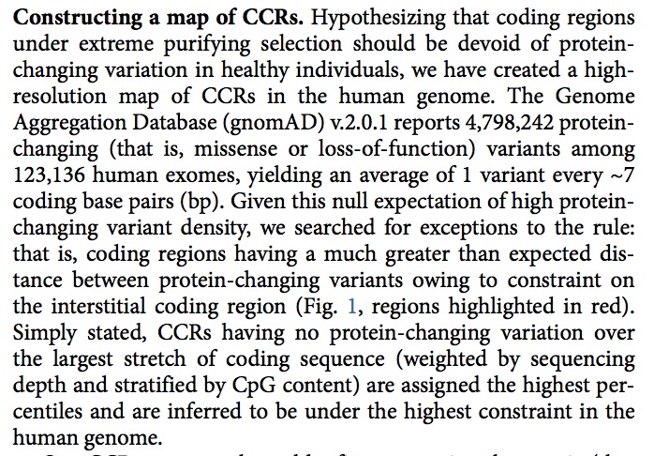
Identifying Constrained Coding regions(CCR) that are under strong selection
The pLI score is at a gene level and does not tell us about domains within a gene that are specifically under strong selection
The authors ask if the high pLI EM genes intolerant to variation due to the specific EM domains being under local selective constraints
The CCR model is used to identify if a specific domain is under strong selective constraints
Havrilla, James M., et al. "A map of constrained coding regions in the human genome." Nat Genet 51.1 (2019): 88-95.

Slide 11
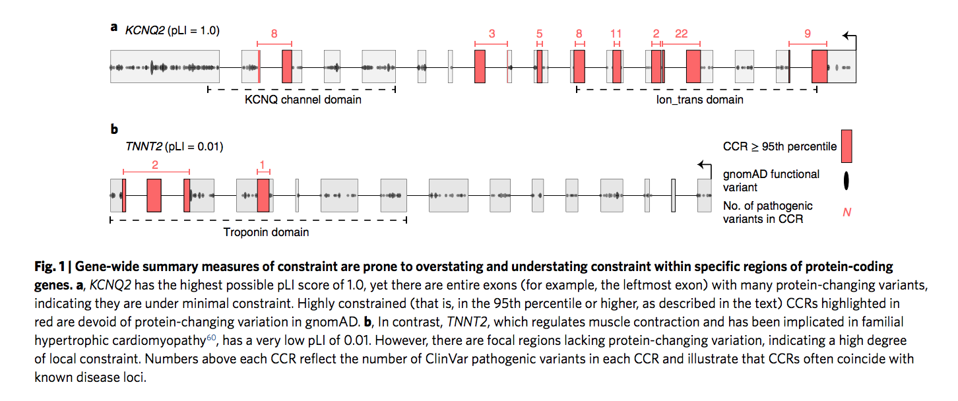
CCR in two genes of High and Low pLI
Havrilla, James M., et al. "A map of constrained coding regions in the human genome." Nat Genet 51.1 (2019): 88-95.

Slide 12
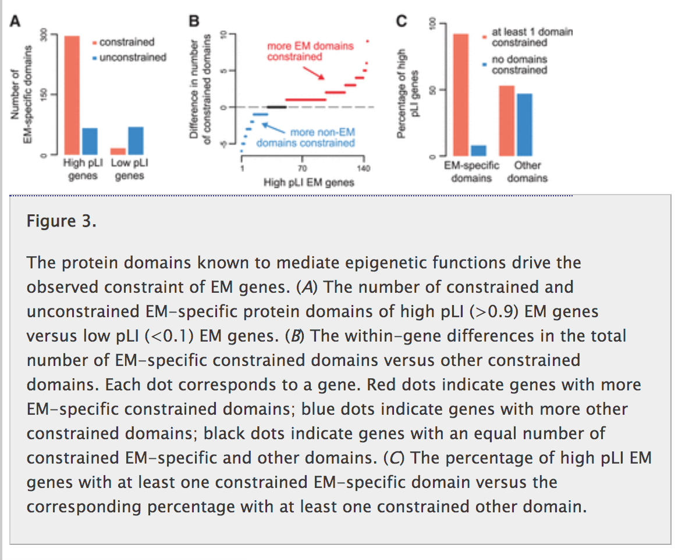
EM domains in high pLI EM genes are highly constrained
Furthermore, almost all high pLI EM genes (92%) have at least one constrained EM-specific domain, whereas approximately half (47%) have no other constrained domains (Fig. 3C). In fact, there are 54 high pLI EM genes that do not contain other domains. Notable exceptions in this analysis are four high pLI members of the PRDM family, for which the C2H2-like zinc fingers are the main drivers of variation intolerance

Slide 13
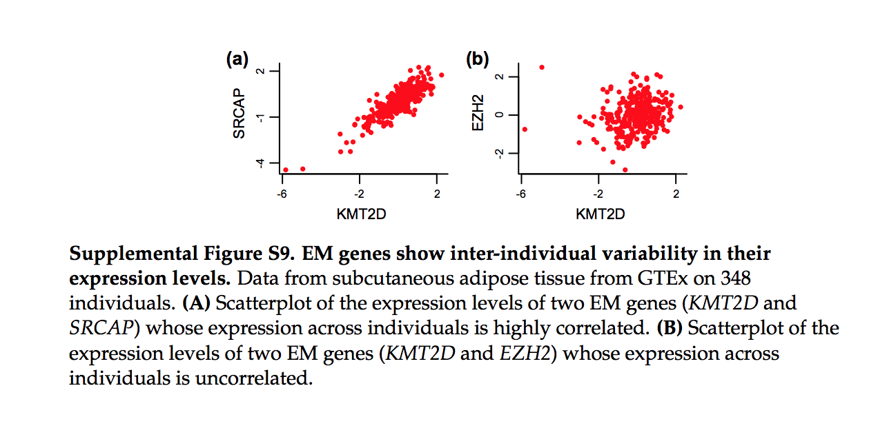
A large subset of EM genes are co-expressed
To identify functional properties specific to variation-intolerant EM genes, we systematically explored the expression patterns of the whole group across a spectrum of adult tissues, using publicly available RNA-seq data (The GTEx Consortium 2015).
We selected 28 tissues on the basis of sample size and diversity in physiological function (Methods; Supplemental Table S9).
First, we discovered that virtually all EM genes are expressed in a non-tissue-specific manner
However, although EM genes show ubiquitous expression, within any given tissue there is inter-individual variability in their expression levels (Supplemental Fig. S9).
We noticed that in several cases, EM genes show coordinated fluctuations in their expression levels across individuals (Supplemental Fig. S9A).

Slide 14
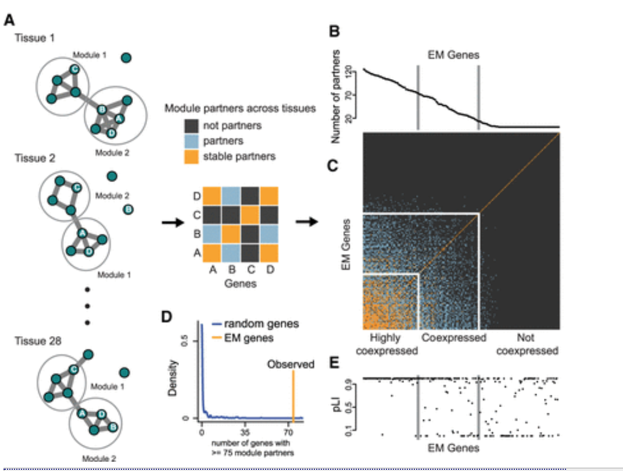
Constructing tissue specific co-expression networks
We then divided EM genes into three groups: (1) a group of 74 genes with at least 75 module partners; we call this group of EM genes “highly coexpressed”; (2) a group of 83 genes with between 15 and 74 module partners; we call this group “coexpressed”; and (3) a group of 113 genes with fewer than 15 module partners; we call this group “not coexpressed.”

Slide 15
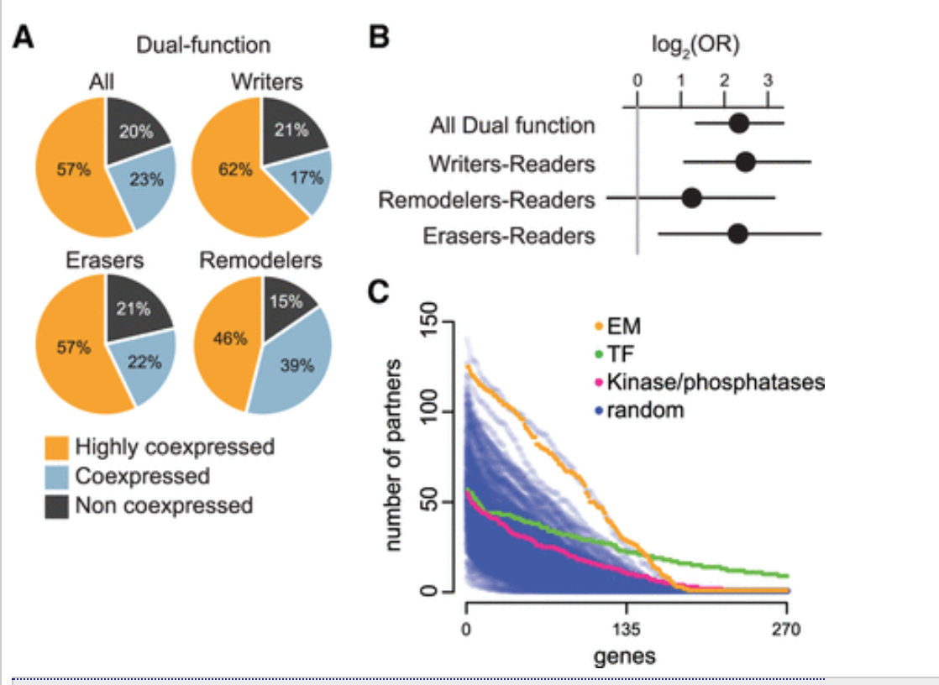
Dual Function EM genes enrich for co expression
EM genes are more enriched for co-expression than TFs

Slide 16
