Slide 1
Regulatory evolution of innate immunity through co-option of endogenous retroviruses http://science.sciencemag.org/content/351/6277/1083
26 March 2019
Science 04 Mar 2016:
Vol. 351, Issue 6277, pp. 1083-1087
DOI: 10.1126/science.aad5497

Slide 2
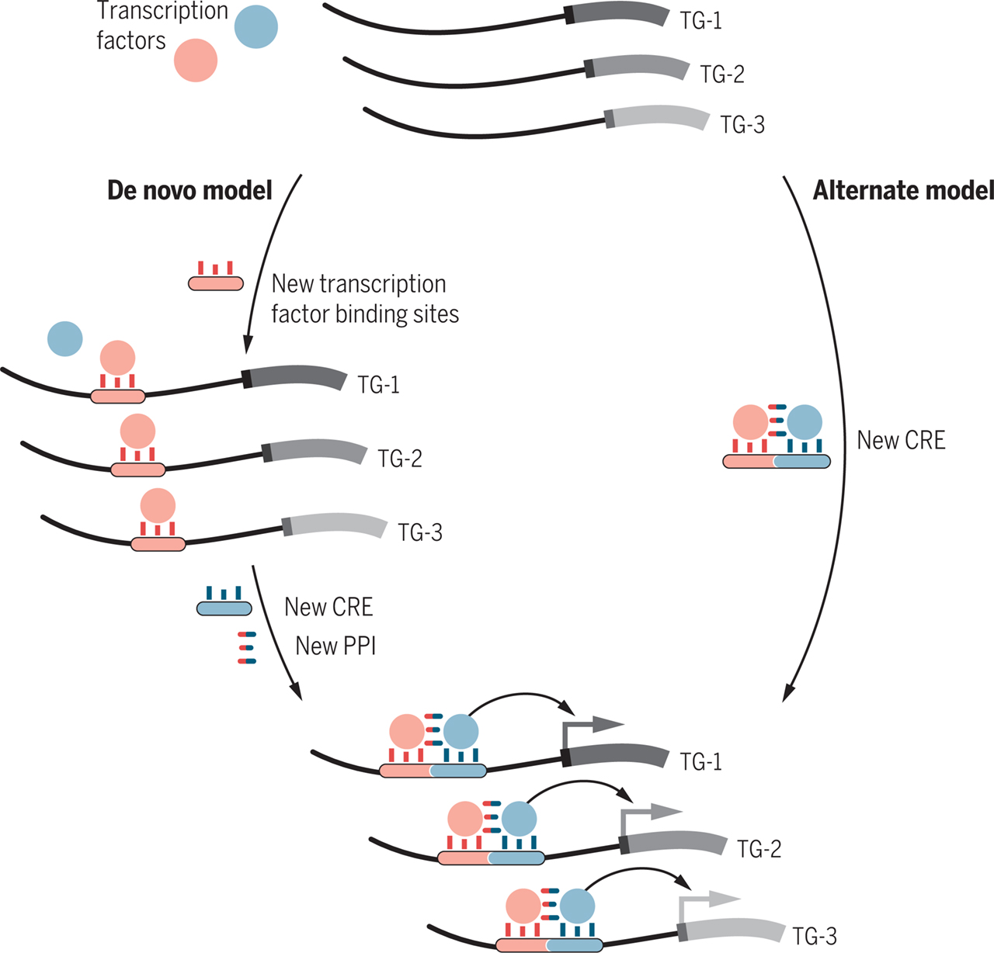
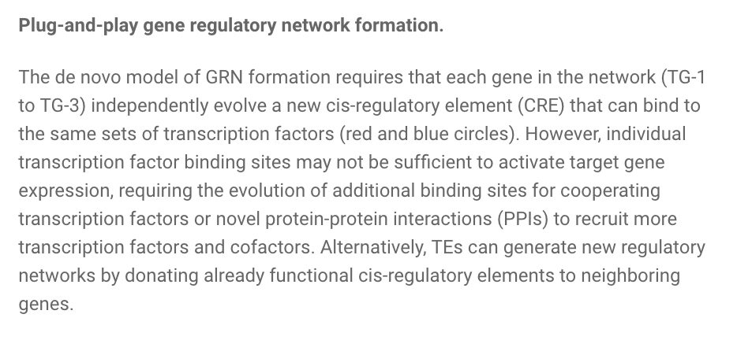
Some Background: How do Gene Regulatory Networks Evolve?
Ref: Perspective by Vincent Lynch

Slide 3
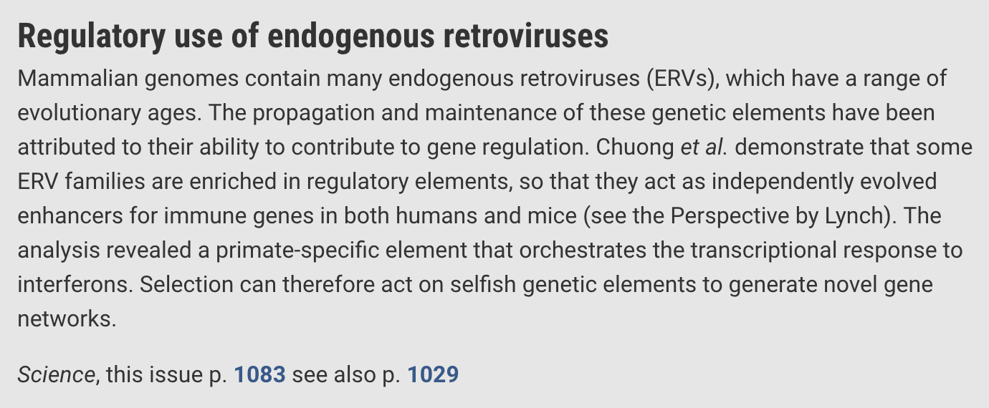

Slide 4
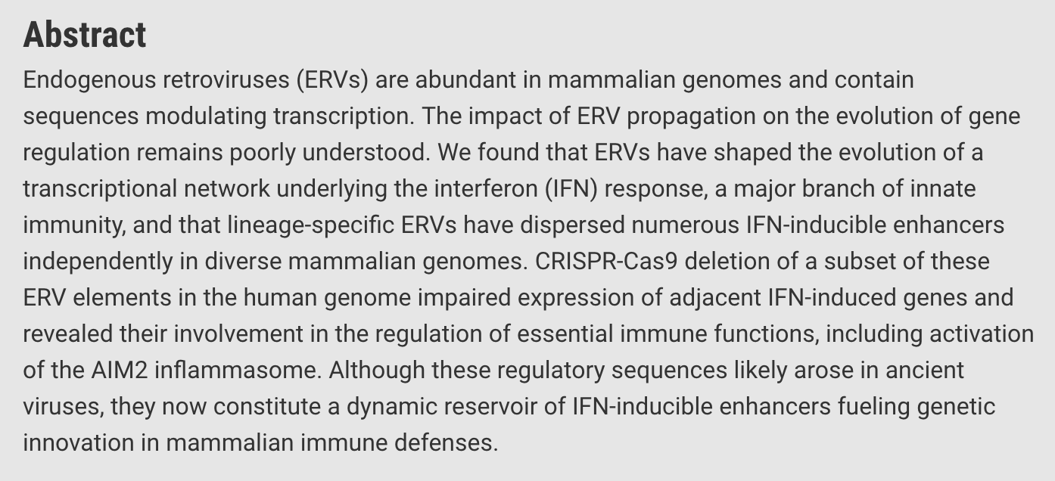

Slide 5
Gene regulatory networks induced by Interferons post infection
Interferons are pro-inflammatory signaling molecules that are released upon infection to promote transcription of innate immunity factors, collectively defined as IFN-stimulated genes (ISGs)
They investigate the evolution of gene regulatory networks induced by the pro inflammatory cytokine interferon-g (IFNG)
ISGs are regulated by cis-regulatory elements that are bound by IRF (interferon regulatory factor) and STAT (signal transducer and activator of transcription) transcription factors upon activation of IFN signaling pathways
Although innate immune signaling pathways are conserved among mammals, the transcriptional outputs of these pathways differ across species (14, 15), likely reflecting lineage-specific adaptation in response to independent host-pathogen conflicts
Notes:
what happens after an infection? Interferon signaling moelcules are produced, which trigger IFN stimulated genes (ISGs) These Genes need cis-regulatory elements; bound by the TFs IRF and STAT

Slide 6
Studying IRF1 and STAT1 binding after IFNG treatment in human cell lines
To study the influence of TEs on IFNG-inducible regulatory networks, they examined their contribution to IRF1 and STAT1 binding sites with the use of published chromatin immunoprecipitation sequencing (ChIP-seq) data for three human cell lines treated with IFNG: K562 myeloid-derived cells, HeLa epithelial-derived cells, and primary CD14+ macrophages (16, 17).
Initial analysis revealed 27 TE families enriched within IFNG-induced binding peaks in at least one of the data sets examined (18) (table S1 and fig. S1, A and B) and included TEs previously predicted to be cis-regulatory elements (11, 19). These sequences contained evolutionarily young to ancient TE families, of which the majority (20 of 27) originated from long terminal repeat (LTR) promoter regions of ERVs (Fig. 1A)

Slide 7
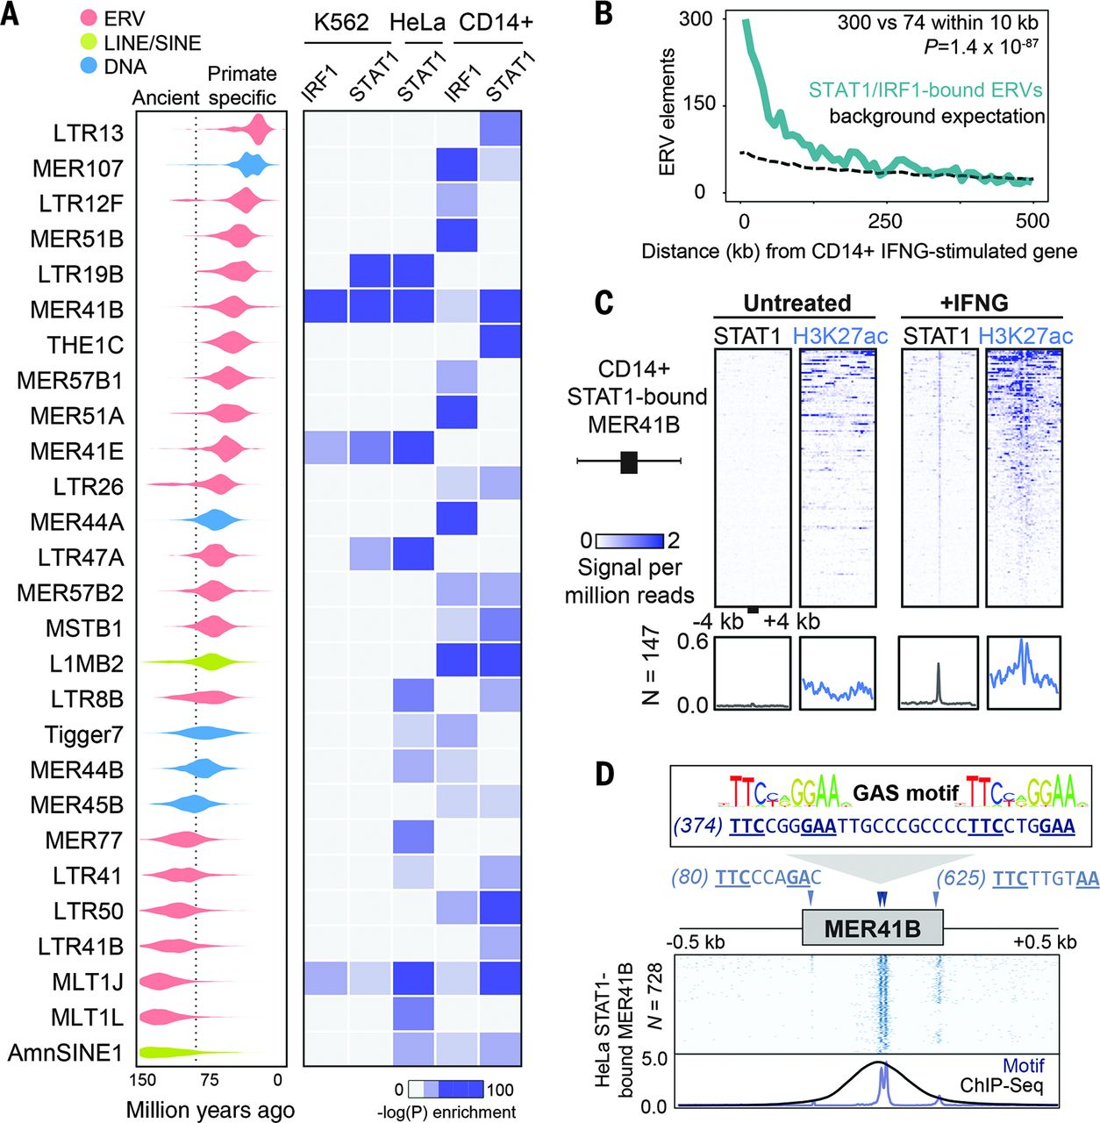
IFNG induced binding of STAT1,IRF1 highly enriched in specific ERVs
specific ERV elements highly enriched in INFG induced STAT/IRF binding sites
ERVs bound by STAT1 and/or IRF1 in CD14+ macrophages were strongly enriched near ISGs (binomial test, P = 1.4 × 10−87; Fig. 1B and fig. S2), determined from a matched RNA-seq data set
MER41B after IFNG treatment contributes enhancer(H3K27ac) STAT1 sites (in CD14 macrophages)

Slide 8
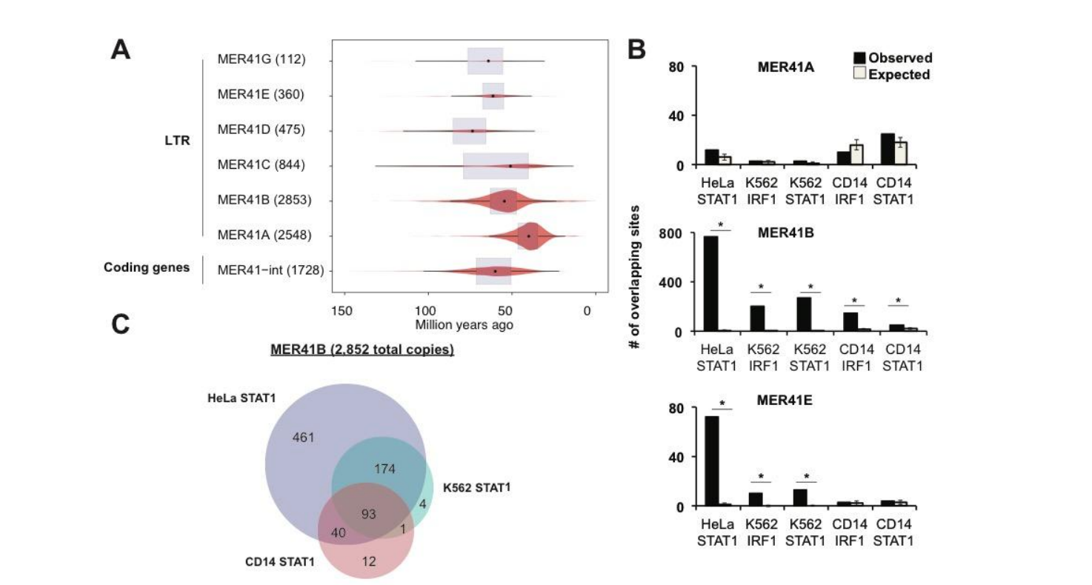
MER41 retrovirus contributes hundreds in IFNG inducible binding sites
MER41 is an endogenized gammaretrovirus that invaded the genome of an anthropoid primate ancestor ~45 to 60 million years ago with 7190 LTR elements, from six subfamilies (MER41A, B, C, D, E, and G), now fixed in the human genome.
Our analysis revealed the primate-specific MER41B,E family of ERVs as a source of IFNG-inducible binding sites (fig. S4B), with nearly 1000 copies in humans (N = 962) bound by STAT1 and/or IRF1 in at least one cell type (table S3 and fig. S4C).
MER41A sites show no enrichment, as it has a 43 bp deletion (lacks binding motif)

Slide 9
MER41B alters INF induced gene regulatory circuit for the AIM2 gene
Focus on the MER41.AIM2 ERV, which is located 220 bp upstream of the gene Absent in Melanoma 2 (AIM2), an ISG that encodes a sensor of foreign cytosolic DNA and activates an inflammatory response (24).
AIM2 is IFNG-inducible in humans but is constitutively transcribed in mice (24). In humans, MER41.AIM2 appears to provide the only STAT1 binding site within 50 kb of the AIM2 gene, and the element gained H3K27 acetylation upon IFNG stimulation (Fig. 2A).
Therefore, the regulation of AIM2 has undergone evolutionary divergence across mammalian lineages, which in turn suggests that the transposition of MER41 upstream of AIM2 may have conferred regulation by IFN signaling in anthropoid primates
CRISPR-Cas9 system to delete the MER41.AIM2 element in HeLa cells (fig. S6) (18). Cells homozygous for the MER41.AIM2 deletion (ΔMER41.AIM2) failed to express AIM2 upon IFNG treatment, in contrast to control cells in which AIM2 transcript levels were robustly induced by IFNG (Fig. 2B)

Slide 10
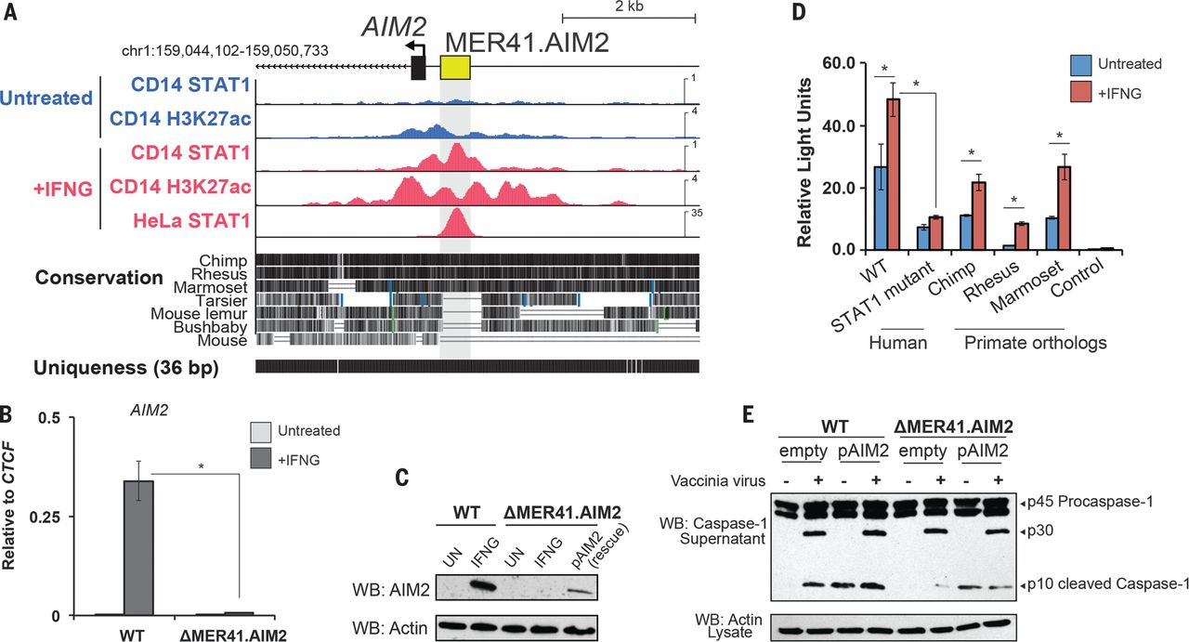

Fig. 2 A MER41 element is essential for AIM2 inflammasome activation.
Edward B. Chuong et al. Science 2016;351:1083-1087
Published by AAAS
Notes:
A MER41 element is essential for AIM2 inflammasome activation. (A) Genome browser view of AIM2. ChIP-seq tracks are normalized per million reads. The “uniqueness” track displays genome-wide short-read alignability. (B) Quantitative polymerase chain reaction (qPCR) of AIM2 levels in wild-type and ΔMER41.AIM2 HeLa cells after 24 hours of IFNG treatment. (C) Western blot of AIM2 in wild-type and ΔMER41.AIM2 cells after IFNG treatment. (D) Luciferase reporter assays of MER41.AIM2, MER41.AIM2 with mutations in the predicted STAT1 sites, and primate orthologs of MER41.AIM2 (see fig. S7A). (E) Western blot of caspase-1 from supernatants of wild-type and ΔMER41.AIM2 cells infected with vaccinia virus (18). *P < 0.05, Student’s t test. Error bars denote SD.

Slide 11
CRISPR deletion of MER41.AIM2 stops AIM2 expression
We further delineated the regulatory activity of MER41.AIM2 by means of luciferase reporter assays (18). MER41.AIM2 was sufficient to drive IFNG-inducible reporter expression in HeLa cells, and this activity was significantly diminished by point mutations ablating the predicted STAT1 binding motifs (Fig. 2D).
These binding sites are conserved across anthropoid primates (fig. S7A), and IFNG-inducible reporter activity is conserved across orthologous MER41.AIM2 elements cloned from chimpanzee, rhesus macaque, and marmoset (Fig. 2D). We also confirmed that orthologs of AIM2 were all IFNG-inducible in primary fibroblasts from these species (fig. S7B).
These results establish MER41.AIM2 as an IFNG-inducible enhancer and suggest that it was co-opted for AIM2 regulation in an ancestor of anthropoid primates.

Slide 12
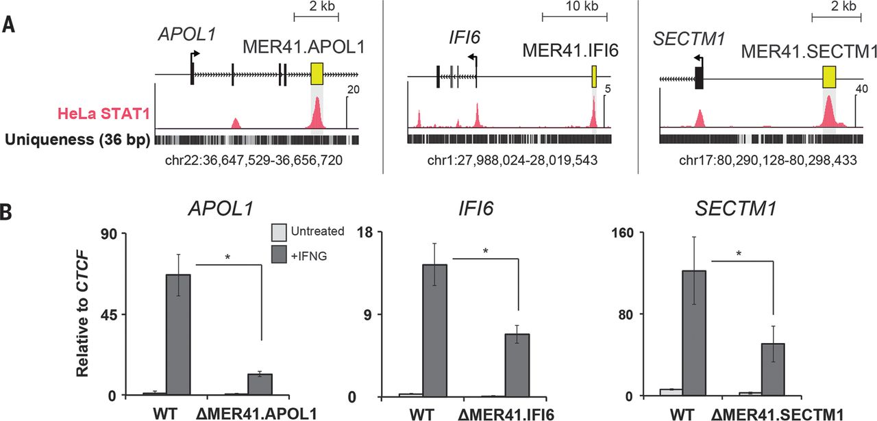
Multiple MER41 elements have been co-opted to regulate IFNG response
Notes:
In this case the difference in expression pre and post deletion is not fully explained. So these sites are perhaps shadow enhancers

Slide 13
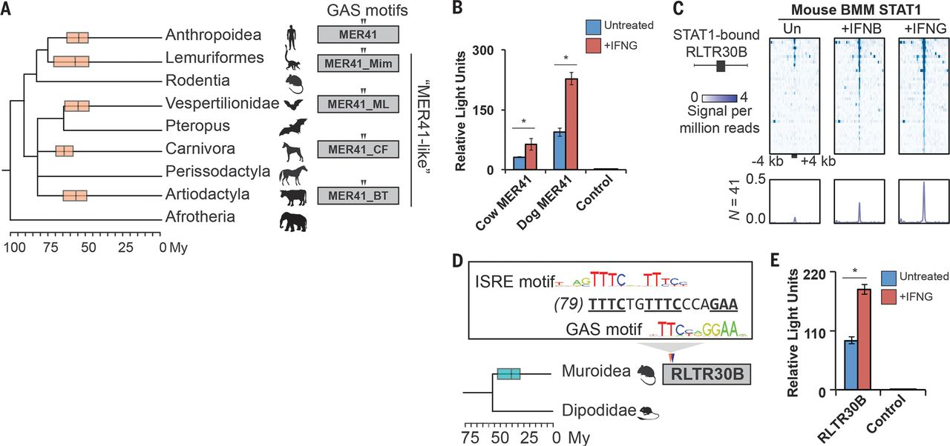
IFNG inducible ERVs are pervasive in mammalian genomes
Notes:
1.MER41 family ERVs are ubiquitious across mammals; all came 50 to 100 mil yrs ago; they also have several intact instances of the STAT1 motif
2.Taking the MER41 sequences from cow and dog gives lucifersase activity in HeLa cells
3. Rodents like mouse were invaded by a separeate ERV family called RLTR 30B; which gives rise to different IFNG inducible binding sites in mouse;
those sequences also show good luciferase activity

