Slide 1
AI UNPLUGGED
Unplugging Artificial Intelligence
Notes:
Quelle: https://docs.google.com/presentation/d/1kSuQyW5DTnkVaZEjGYCkfOxvzCqGEFzWBy4e9Uedd9k/preview?imm_mid=0f9b7e&cmp=em-data-na-na-newsltr_20171213&slide=id.g1e301fae90_1_568

Slide 2

Classification with Decision Trees:
The Good-Monkey-Bad-Monkey Game
Instead of using the cut-out picture cards, you can use this presentation for the monkey game. Feel free to adapt it to your needs.
Annabel Lindner
Stefan Seegerer

Slide 3
Version 1

Slide 4
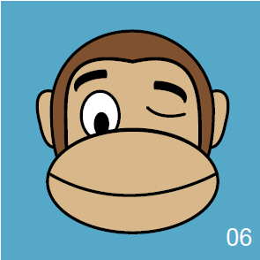







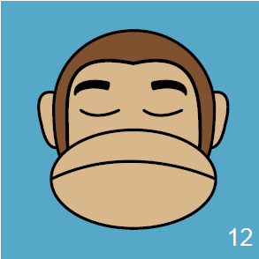
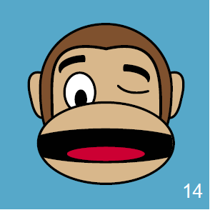
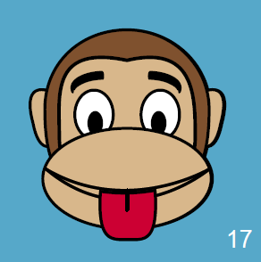
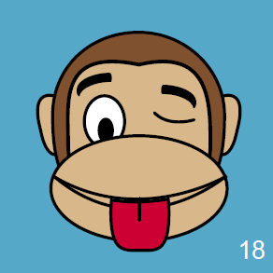
Biting
Non-biting
Notes:
Trainingsdaten

Slide 5


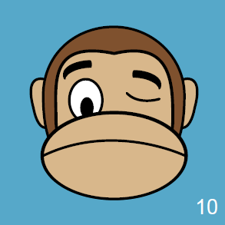

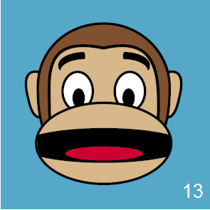
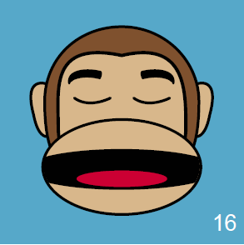


biting
biting
non-biting
biting
non-biting
non-biting
biting
non-biting
Notes:
Testdaten

Slide 6
Version 2

Slide 7
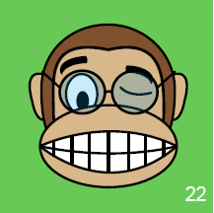
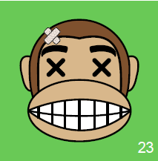
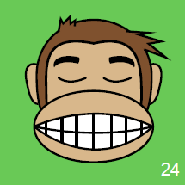
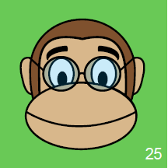
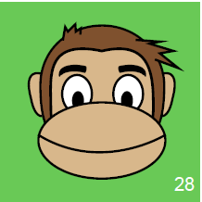
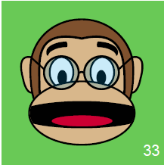
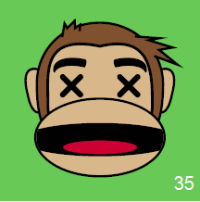
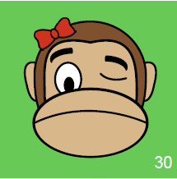
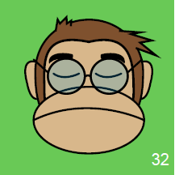
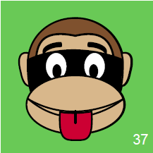
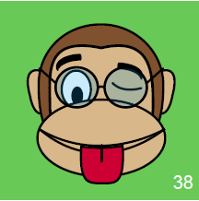
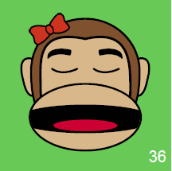
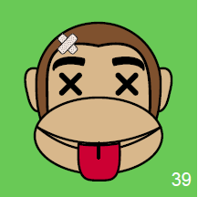
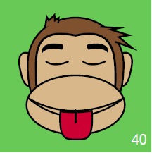
Biting
Non-biting
Notes:
Trainingsdaten

Slide 8
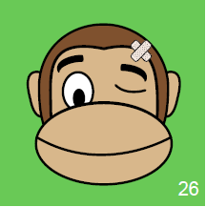
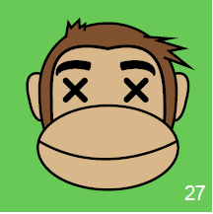
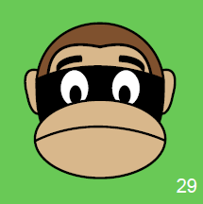
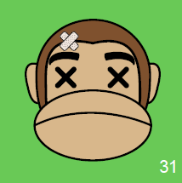
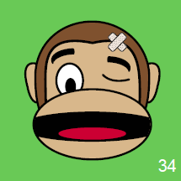
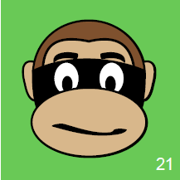
non-biting
biting
non-biting
non-biting
biting
biting
non-biting
non-biting
non-biting
non-biting
non-biting
biting
non-biting
Notes:
Testdaten

