Slide 1
WEB DEVELOPMENT PROJECT
BY:
ABC
ROLL:
SESSION:

Slide 2
OBJECTIVES
WEBSITE OF AN EDUCATIONAL INSTITUTE (RAJSHAHI CANTONMENT PUBLIC SCHOOL and COLLEGE)
LEARN USE OF HTML, CSS.
MAKE A WEBSITE WHICH HAS EASY ACCESS FOR ALL.
BRING GUARDIAN-STUDENTS-TEACHERS IN A COMMON PLATFORM FOR HELP
REGULAR UPDATE OF EVENTS & NOTICES
TEACHERS INFORMATION AVALABILITY
USEFULL LINKS PROVIDED

Slide 3
USED SOFTWARE TOOLS
NOTEPAD++
HTML
CSS 3.0
Javascript

Slide 4
LAPTOP CONFIGURATION
INTEL® CORE™ i3-5005U CPU @2.50GHz
RAM: 4GB
SYSTEM Type: 64-bit Operating System

Slide 5
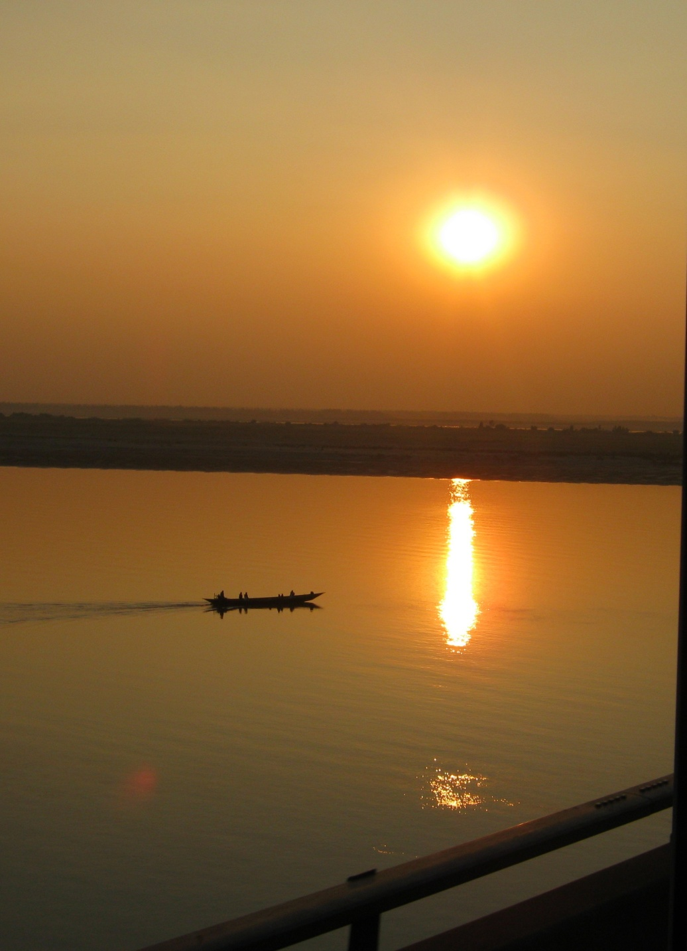
SAMPLE LAYOUT

Slide 6
CONTENTS
MENU BAR: Menu bar has 5 tabs. Viz HOME, Admission, Notices, Faculties, About. ADMISSION section is for different groups, All events are given in NOTICE section, necessary information about faculty members are provided in FACULTIES tab, About tab contains information about school.
ACADEMIC CALENDER: ACADEMIC schedule are being inserted in the calendar.
USEFULL LINKS: Some Links like the facebook page link of college, Education board links have been attached.
Glimpse of college: A glimpse of the school is seen by running slideshow in the homepage.

Slide 7
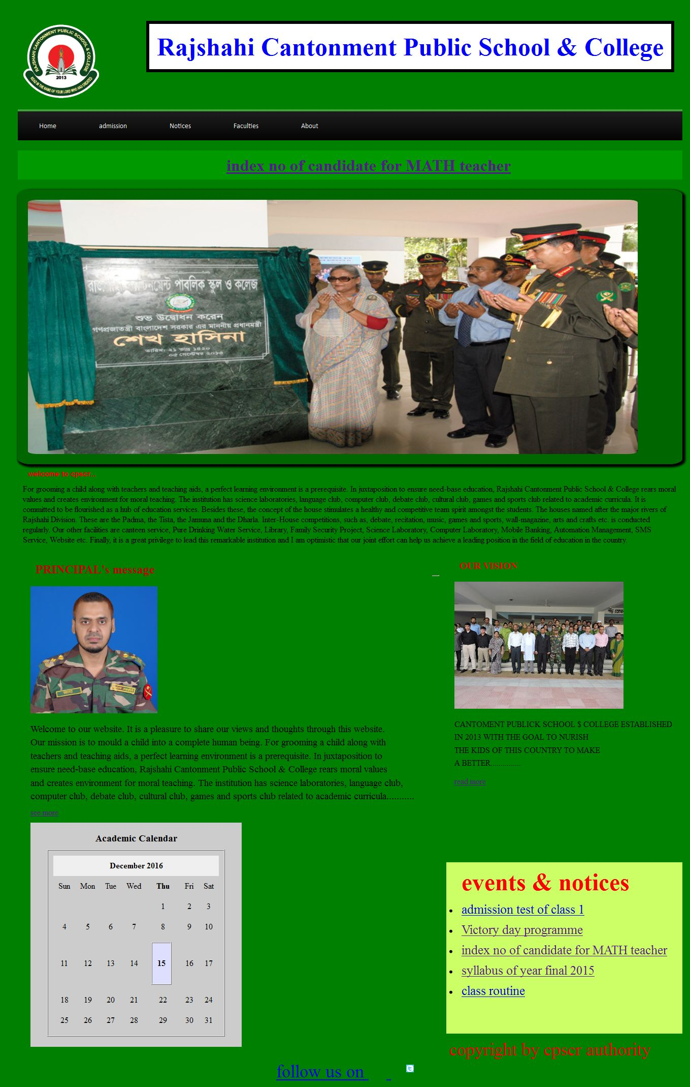
Implemented Screenshots
HOMEPAGE

Slide 8
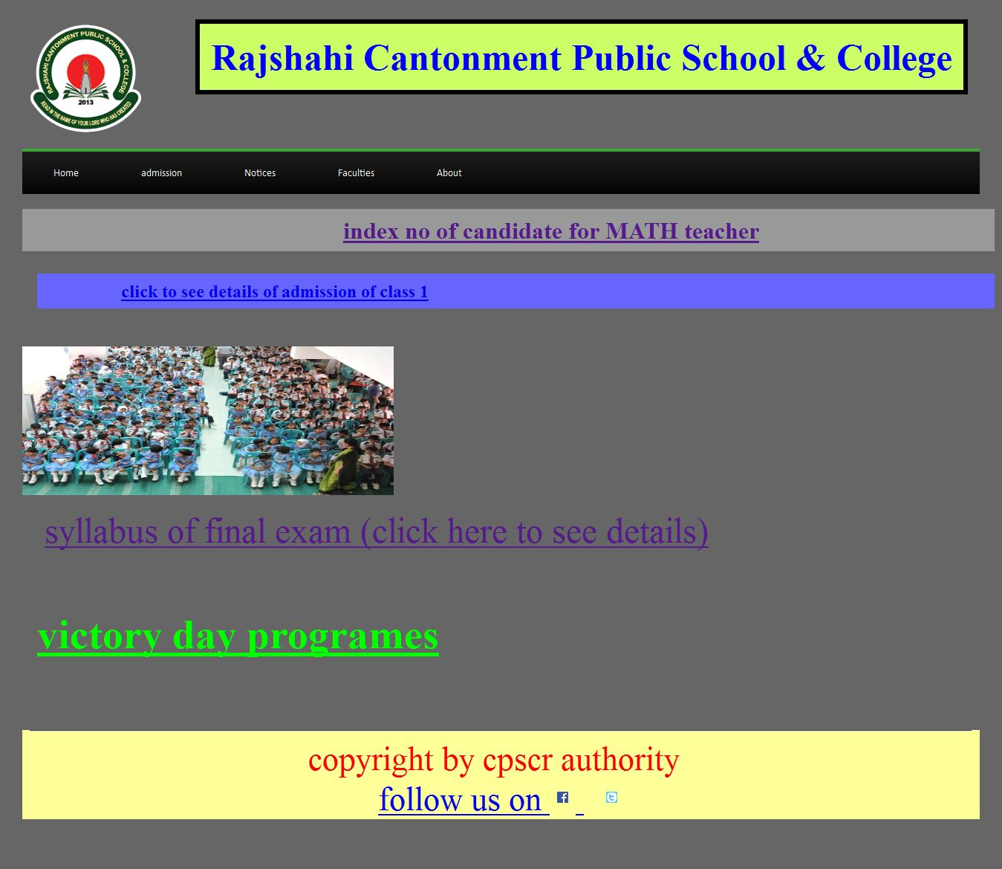
NOTICES

Slide 9
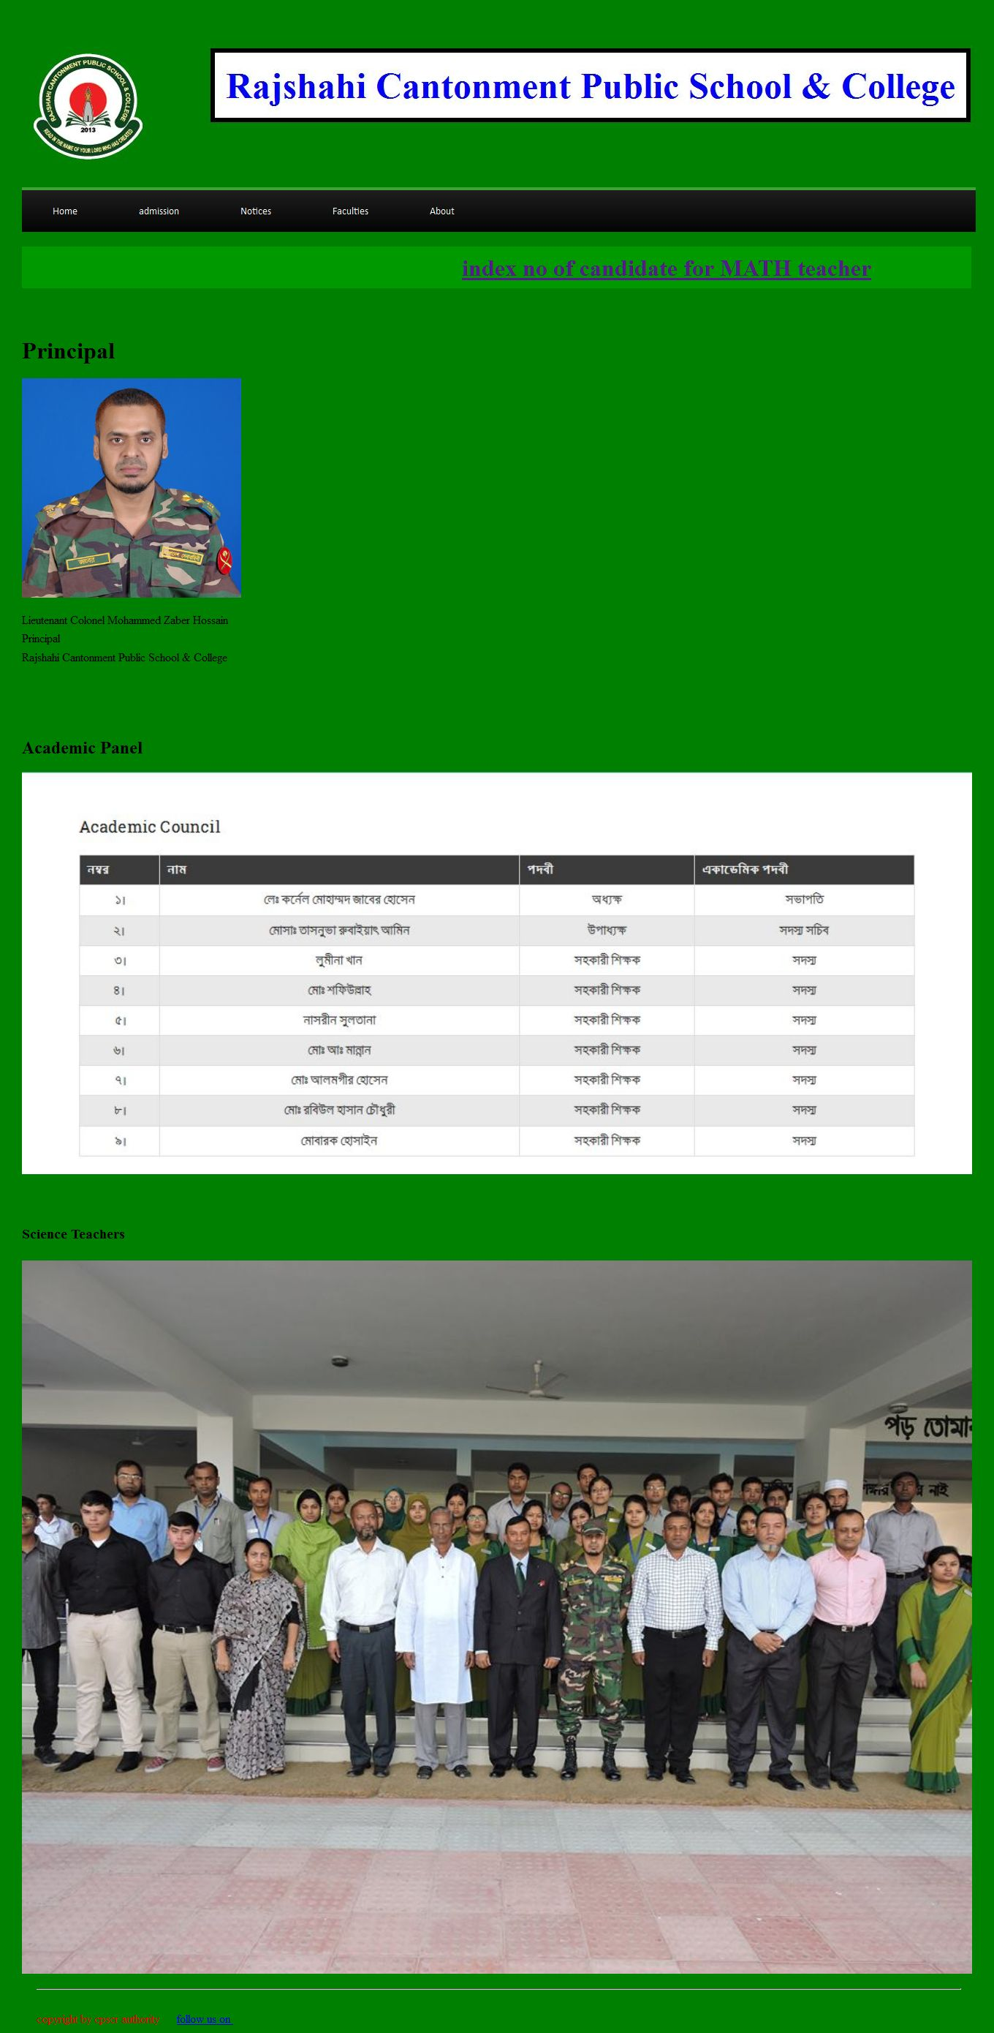
FACULTIES

Slide 10
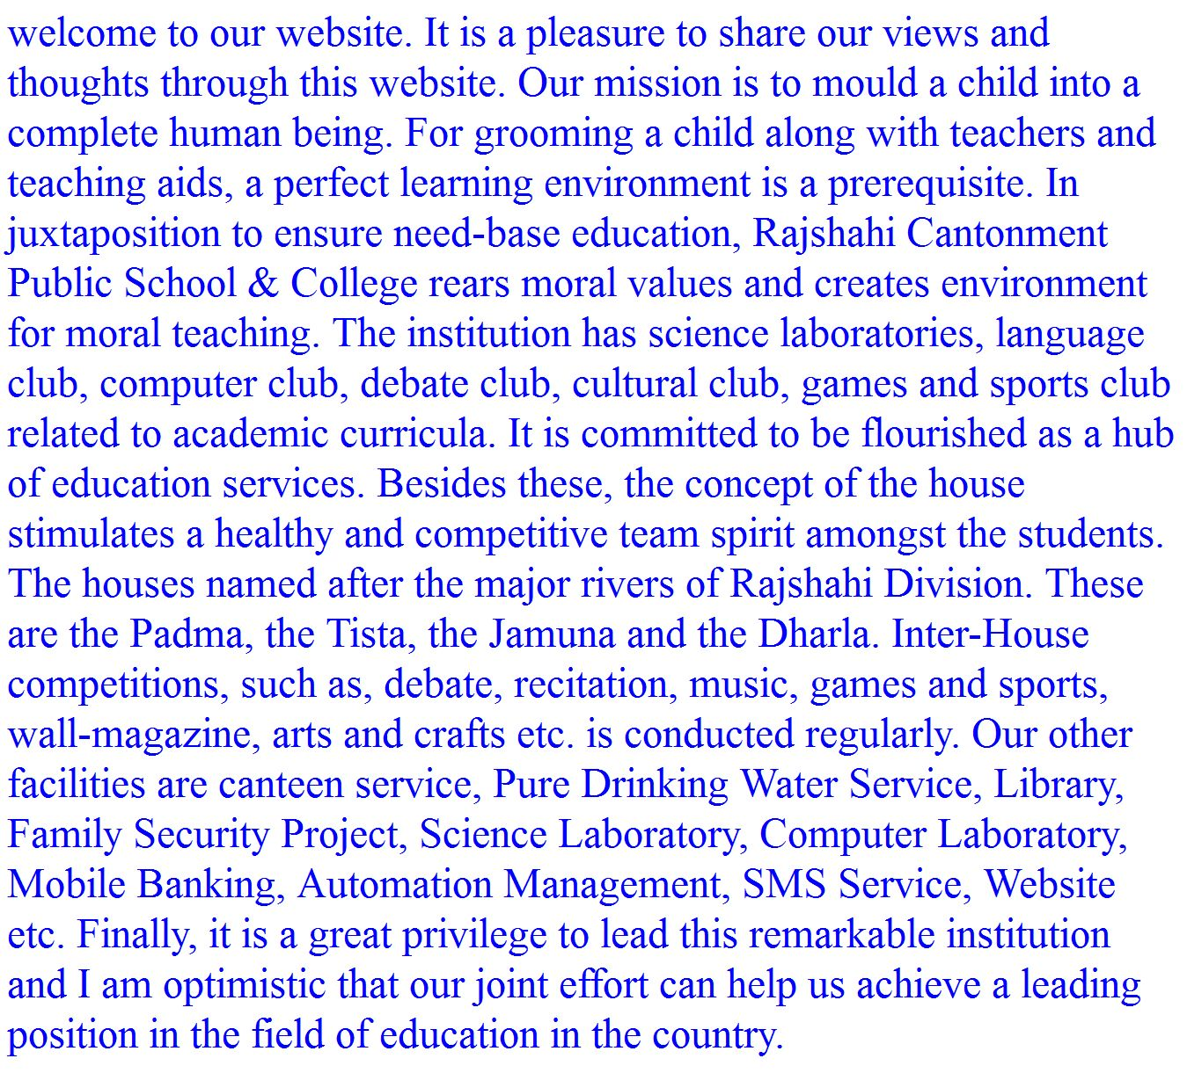
ABOUT

Slide 11
ADVANTAGE
EASY ACCESS FOR ALL.
NO NEED OF SEPARATE LOGIN.
UPDATED NOTICES ARE GIVEN HERE.
RESULTS ARE BEING PUBLISHED HERE.
FACULTIES INFORMATION PROVIDED
GLIMPSE OF THE SCHOOL IS BEING AVAILABLE IN HOMEPAGE.
SCHOOL’S VISION IS CLEARLY SAID.
IMAGES OF VARIOUS EVENTS UPLOADED.
EDUCATIONAL BOARD LINK & ADDITIONAL LINKS PROVIDED

Slide 12
LIMITATION
PHP PROGRAMMING NOT DONE.
NO DATABASE ADDED.
NOT A DYNAMIC WEBSITE.
NO OPEN FORUM for STUDENTS or TEACHERS CREATED

Slide 13
FUTURE ENHANCEMENT
I’ll add a open forum for teacher & students.
I’ll implement PHP & DATABASE on this website.
Try to make it a dynamic one.

Slide 14
Thank you

