Slide 1



RWANDA SOCIAL SECURITY BOARD (RSSB)
20%
Increase
Analysing Medical Claims Data for Cost Reduction Opportunities
~ Patrick Manzi

Slide 2
Demographic information
38747
20%
Increase

Slide 3
Medical claims at a glance
1937436
1937350
86
Total claims
Complete claims
Incomplete claims
Total claims reported
Claims reported with complete information
Total claims reported with missing member identity
489.410B RWF
21.387M RWF
489.431B RWF
40%
489.410B RWF
21.387M RWF
Billed amount:
Billed amount:
Billed amount:
48%
Verified amount:
244.672B RWF
Verified amount:
244.661B RWF
Verified amount:
107.880M RWF
Billed amount value
Billed amount value
Decrease
Increase
Paid amount:
244.759B RWF
Paid amount:
244.749B RWF
Paid amount:
105.997B RWF

Slide 4
Summary statistics
1937350
38747
100
24633
Claims
Members
Stakeholders
Locations
Total claims reported
Total member of all RSSB insurance schemes
Healthcare facilities working with RSSB.
RSSB stakeholder regions
489.410B RWF
21.387M RWF
MUTUELLE claims
40%
48%
RAMA claims
MALE claims
FEMALE claims
MUTUELLE claims
Billed amount value
Decrease
Increase
Number: 50%
Number: 50%
Number:49.84%
Number: 50.16%
Value: 245.111B Rwf
Value: 244.298B
Value:243.921B RWF
Value:245.488B RWF

Slide 5
Medical claims timeseries
20%
Increase
BilledAmount
VerfiedAmount
PaidAmount
Interpretation: The analysis of the claims time series graph indicates a strong relationship between the verifiedAmount and paidAmount variables, as they closely track each other over time, suggesting efficient processing and payment of verified claims despite fluctuations in billed amounts. Additionally, the consistently higher billed amounts compared to verified and paid amounts imply potential challenges or inefficiencies in cost containment and claim verification processes.

Slide 6
Top 5 diagnoses and procedures driving a high proportion of healthcare costs
Diagnosis Code | Billed Amount(RWF)
ICD-J06AA01002 | 5111752850
ICD-J04BA02002 | 5096369155
ICD-J05AG03002 | 5093472260
ICD-J07BC01002 | 5089160145
ICD-J05AR02001 | 5088210710
Procedure Code | Billed Amount(RWF)
CPT-42242000FQZ435 | 5020133075
CPT-42242000FQZ380 | 5016557745
CPT-42242000FQZ406 | 5002706570
CPT-42242000FQZ445 | 4990459705
CPT-42242000FQZ398 | 4989801765
20%
Increase
Interpretation: The data reveals a concentration of healthcare costs within a limited number of medical procedures. The top five procedure codes all incur very high billed charges compared to the mean procedure cost, suggesting they warrant further investigation for potential cost-saving opportunities.
Interpretation:Analysis of claims data reveals that pneumonia, COPD, and Sepsis diagnoses are the top drivers of healthcare costs.

Slide 7
Healthcare costs variation based on age group demographic and gender
20%
Interpretation: The analysis indicates minimal variation in healthcare costs between genders, suggesting that gender-based distinctions may not significantly influence overall cost reduction strategies within the medical claims dataset. Notably, the slightly higher average billing for men could be attributed to potentially higher-cost medications or treatments, despite women's more frequent healthcare facility visits. This insight underscores the complexity of cost determinants and highlights the need for comprehensive analysis beyond gender demographics to effectively target cost-saving initiatives.
Interpretation:The analysis of mean billed amounts by age group demographic shows a relatively consistent pattern across different age categories. Despite minor variations, ranging from 252,360.0 for the "Under 15" age group to 252,885.0 for the "55-65" age group, the differences in billed amounts appear to be minimal. This suggests that age group demographics may not be a prominent factor influencing healthcare costs within the dataset, emphasizing the need to explore other variables for targeted cost reduction strategies.
Increase

Slide 8
Healthcare costs variation based on health facility
20%
Increase
Interpretation: The analysis of mean billed amounts by health facility demographic reveals varying costs across different healthcare facilities. health facilities such as North Clairesit Du Grayscloud and EL Genlrnie and Mat Haven exhibit higher mean billed amounts compared to other facilities like New Gessdon and Brixnessrna. These findings suggest notable differences in healthcare costs based on facility locations within the dataset, highlighting the importance of facility-specific cost management strategies to optimize our costs effectively.

Slide 9
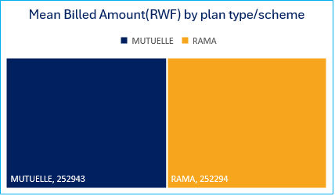
Healthcare costs variation based on plan type and geographic location
Mean billed Amount by geographic location
Location | Billed Amount(RWF)
New Braxtonton | 379238
New Cordellfield | 377660
Lucindachester | 377595
North Oswaldview | 134803
Port Keyonville | 129081
20%
Interpretation: The analysis of mean billed amounts by geographic location reveals substantial variations in healthcare costs across different regions. Locations such as New Braxtonton and New Cordellfield exhibit notably higher mean billed amounts compared to other areas like Port Keyonville and North Oswaldview. These findings highlight geographical disparities in healthcare expenditure within the dataset, suggesting the importance of regional-specific cost management strategies to optimize healthcare budgeting and resource allocation effectively.
Interpretation:The analysis reveals variations in billed amounts based on member plan types. Specifically, individuals under the MUTUELLE scheme exhibit a slightly higher mean billed amount compared to those under the RAMA scheme, highlighting potential differences in healthcare costs associated with different insurance plans within the dataset. Understanding these variations can inform targeted cost reduction strategies tailored to specific plan types to optimize healthcare expenditure management..
Increase

Slide 10
3. Based on the analysis of our medical claims dataset for RSSB insurance members, I have identified several key areas where cost savings can be achieved through strategic negotiations with healthcare providers and targeted disease management programs:
1. Identifying High-Cost Diagnoses and Procedures: By focusing on negotiating lower costs or implementing efficient treatment protocols for high-cost diagnoses and procedures identified in the dataset (e.g., ICD codes and procedure codes), we can optimize expenditures while maintaining quality care.
2. Geographic Cost Management: Targeting areas with notably high mean billed amounts by geographic location (e.g., New Braxtonton, New Cordellfield) enables us to implement region-specific cost-saving initiatives or negotiate favorable provider contracts, enhancing efficiency and resource allocation.
20%
These insights provide concrete avenues for RSSB to engage in proactive negotiations with healthcare providers and implement targeted disease management initiatives aimed at optimizing healthcare expenditure while upholding the quality of care delivered to the insurance members. By leveraging these strategic opportunities, RSSB can achieve sustainable cost savings and enhance the overall value proposition for its members and stakeholders.
Increase

Slide 11
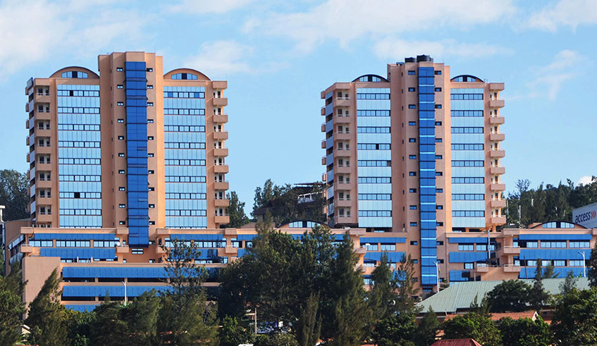
Thank you
20%
Increase

