Slide 1

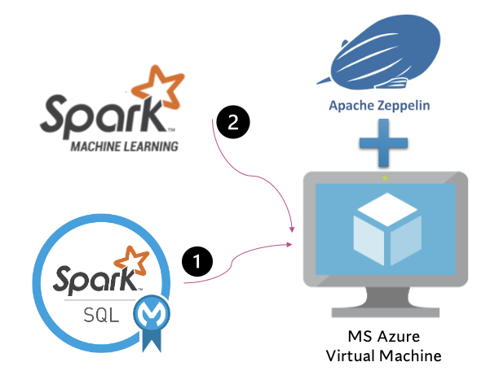

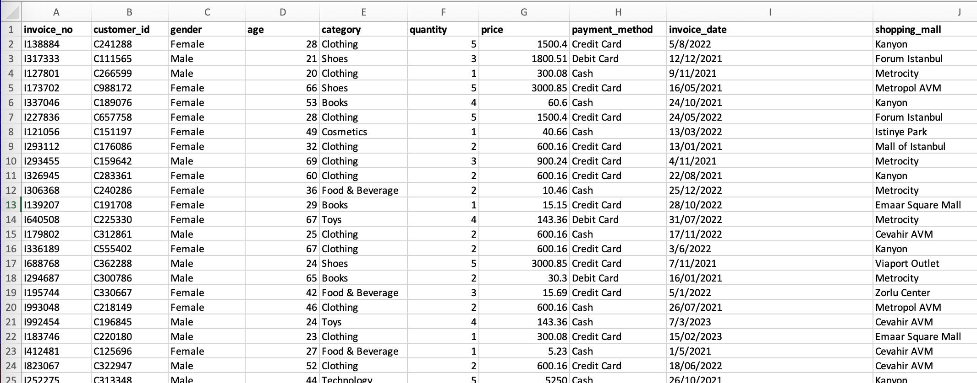
Retail Sales Data Analysis (Istanbul 2021 ~ 2023)
Linear Regression
ECE 552: Big Data Technology
Final Project, Spring 2023
Team 18:
Wenzhe Luo & Aakash Aundhkar
May 1, 2023
Dataset: https://www.kaggle.com/datasets/mehmettahiraslan/customer-shopping-dataset

Slide 2
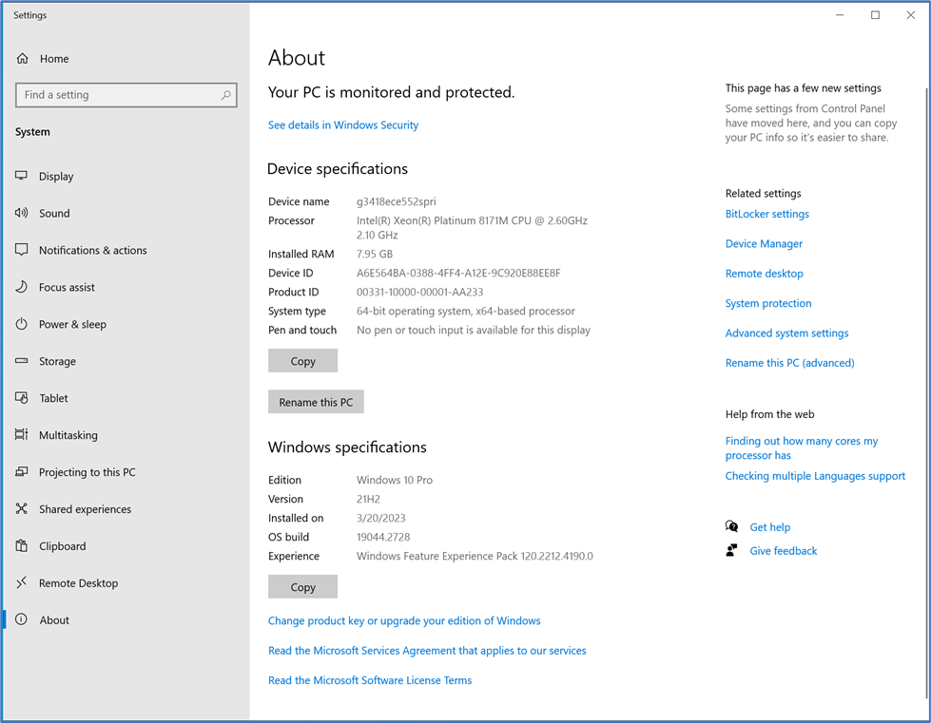
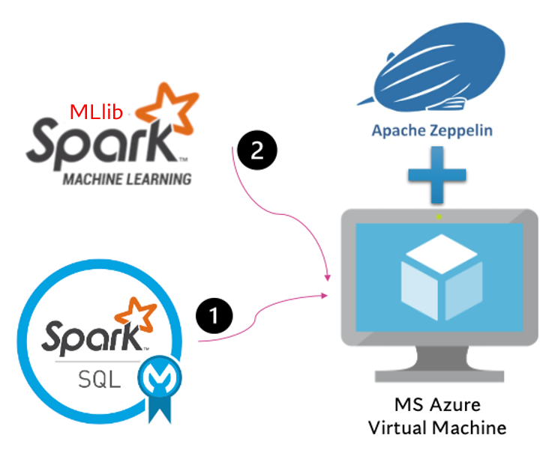
VM Selection and Data Flow
Windows 10 64-bit operating system environment
Import, Clean, Format
(csv)
data cleaning
Split Data
Data Analyze
(Spark.sql)
Visualize
Modelling
ML predict
(Linear Regression)

Slide 3
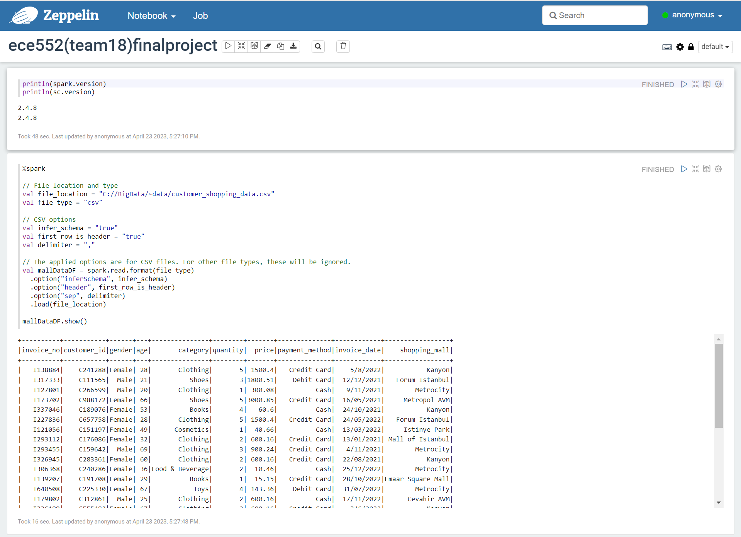
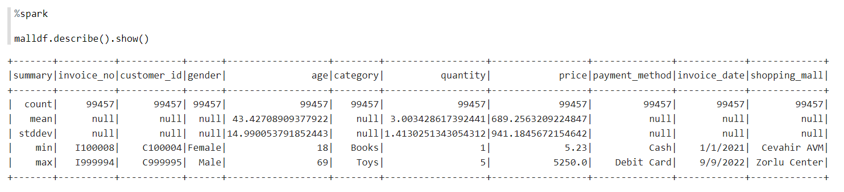
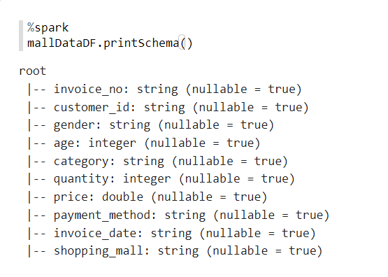
Data Preparation

Slide 4
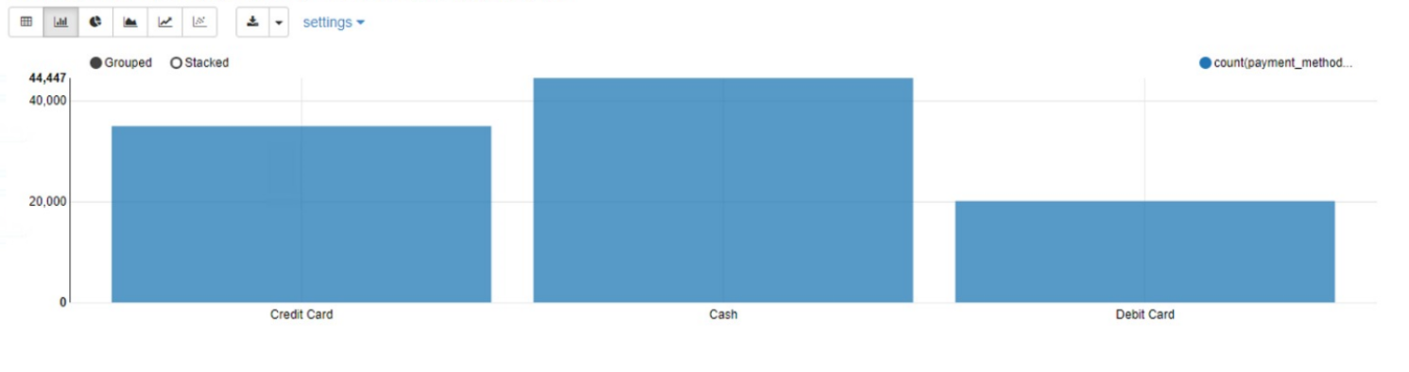
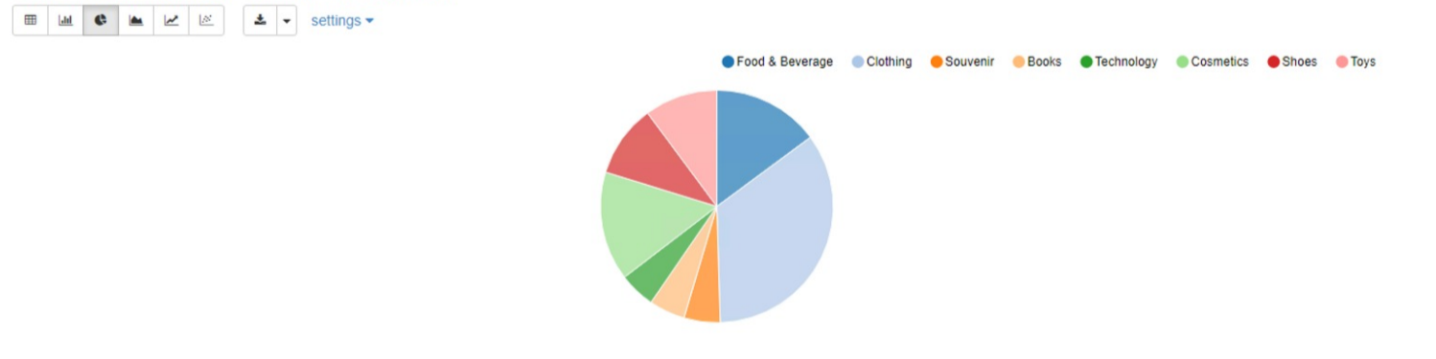
MAIN EXPECTATION PURPOSES Done.
Which payment method is the most popular?
Which type of product is more purchased by customers?
Through the overall data analysis, use spark's unique ML library for data cleaning, training, and testing, and finally predict the total amount of bills a store can get from each customer, which can be used to predict revenue for a day. (solved)

Slide 5
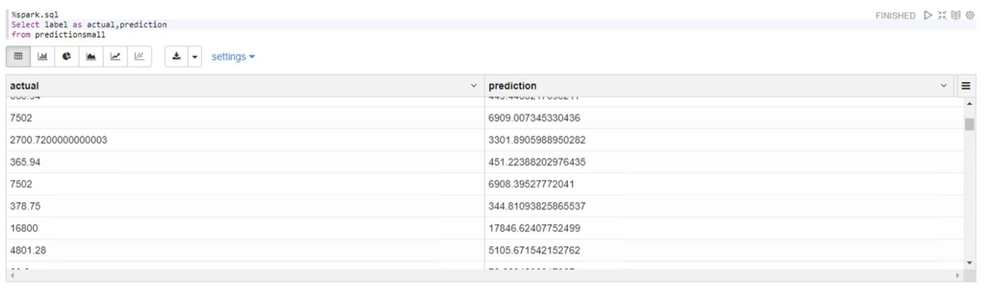
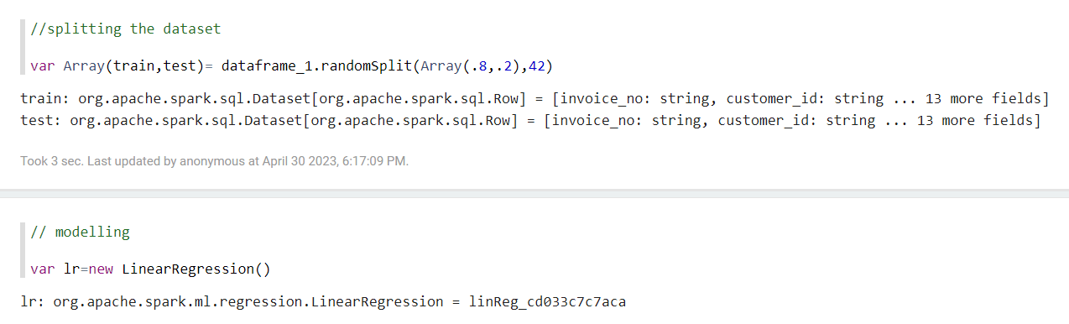
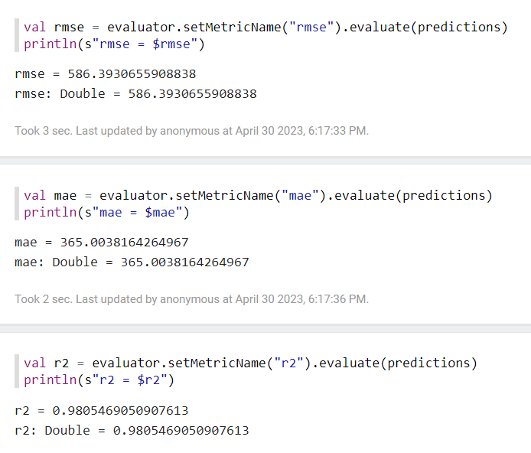
ML prediction
Splitting the dataset into 80:20. where 80% being the training dataset and 20 being the testing dataset
Using Linear Regression as model
Finally predict the total amount of bills a store can get from each customer, which can be used to predict revenue for a day.

