Slide 1

RoboSantral:
An Autonomous Guide Robot
By,
Manzoor Ambekar
Prasad S. Bomble
Kuldeep Tekale
Under The Guidance Of,
Prof. D. G. Ingale

Slide 2
Abstract:
RoboSantral, an autonomous mobile robot which has been designed and realized in order to guide the visitors through A museum . this robot accompanies guests through the museum and gives presentations on predefined locations. Location data is obtained from RFID tags pasted on particular location .
A RFID reader reads the targets such as faculty buildings, museums etc. Are recognized by the pre-defined tags.
A voice playback unit using SD card is used to playback the information of particular location.
IR sensors are used for obstacle detection.

Slide 3
Introduction:
An autonomous mobile robot that is designed and developed to greet and guide the visitors of a university campus is presented. Besides halls, theatres, concert areas, libraries and museums, university campuses are preferred locations of artistic exhibitions and cultural activities. This makes university campuses a center of attraction not only for the students but also for the native and international visitors.
When the required manpower for introduction and guidance of crowded visitors is considered, a mobile robot with navigation capabilities turns out to be a desirable choice.

Slide 4
The autonomous mobile guide robot RoboSantral was designed to fulfill this need. RoboSantral has several different components such as Microcontrollers, LCD screen, sensors, speakers, and DC motor drive controller.
In the design, components were integrated in order to implement a introductive guide robot. Guidance tasks are achieved with the data from surroundings processing on RoboSantral’s software. Following sections of this paper presents information on the design, implementation and the test phases of RoboSantral.

Slide 5
Why We Selected This Project:
It determines new change to the old traditional activity of guide tourist.
Consider the point of smart city reformation, This project idea gives full satisfaction as well as highlighting “Digital India”.
The museum then after can be termed as digit co-ordinated.

Slide 6
Literature Survey:
Sr. No | Author Name | Research Paper Title | Abstract /Summery | Published Month & Year
1 | Asraa Al-Wazzan, Farah Al-Ali, Rawan Al-Farhan, Mohammed El-Abd | Tour-Guide Robot. | In this work, we introduce the implementation of a tour-guide robot using Kinect technology to ease the process of tourist guides. The robot will replace the current human guide. | March 2013
2 | Marc Donner, Marian Himstedt, Sven Hellbach, Hans-Joachim Boehme | Awakening history: Preparing a museum tour guide robot for augmenting exhibits. | While the idea of tour guide robots has been addressed several times, applying a video-projector based augmented reality component to this scenario is rather new. We show requirements of the localization system of the robot and how they can be fulﬁlled, as well as a basic system for projection correction and its suitability for this scenario. | Sept 2014
3 | A.Denker, A. U. Dilek, B. Sarıoğlu, J. Savaş, Y.D. Gökdel | RoboSantral: An autonomous mobile guide robot. | RoboSantral, An autonomous mobile robot which has been designed and realized in order to guide the visitors through a university campus, is presented in this paper. This robot accompanies guests through the campus and gives presentations on predefined locations. | March 2015

Slide 7
Block Diagram:
LCD (16X2)
DC Motor Driver (L293D)
DC Motor
RFID Reader
Microcontroller
IR Sensors
Speaker
Voice Playback Unit

Slide 8
Hardware:
i
PIC 16F877A Microcontroller ,
16x2 LCD
RFID Reader
RFID Tags
Voice Play Unit Using SD Card ,
Speaker
DC Motors & L293D Dc Motor Driver
IR Sensors
LM 386 -2 Watt Audio Amplifier
12 Volt Battery
8 Ohm – 0.5 Watt Speaker
Software:
l
Embedded C or Assembly Language Programming.
Proteus 8.0 For Circuit , Layout, Simulation.

Slide 9
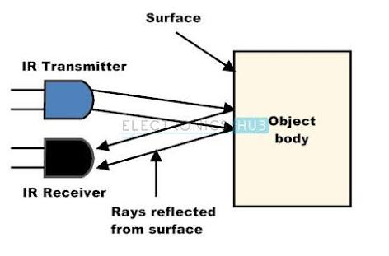
Operating Principle:
Input block that collects the environmental data are RFID reader & IR sensor. These blocks make RoboSantral able to understand different types of environmental data.
Infra-red sensors on the input block are placed on the front side. When this sensor met an obstacle, the robot stops by stopping the DC motors.

Slide 10
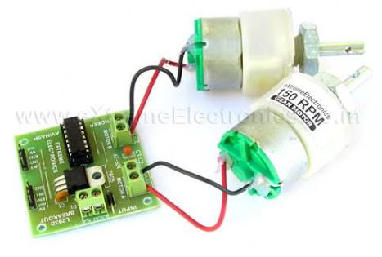
Motor driving is achieved through the DC motor driver (L293D). On the robot 12 V/200-rpm motors are driven by the motor driver. Motor driving manages the currents going to the wheels therefore turns and a balanced straight movement is possible.

Slide 11
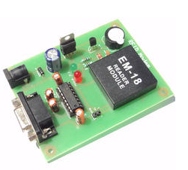
RoboSantral recognizes certain forum in a campus using the predefined location RFID tags. These tags helps to identify the specific location.
Recognition of a RFID tag tends the microcontroller to instruct the Voice playback unit to audio out the saved voice file.

Slide 12
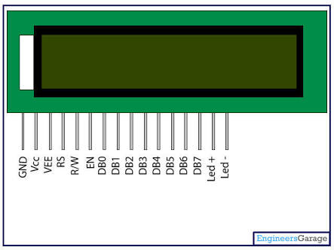
A 16x2 LCD means it can display 16 characters per line and there are 2 such lines. In this LCD each character is displayed in 5x7 pixel matrix. This LCD has two registers, namely, Command and Data.
The command register stores the command instructions given to the LCD. A command is an instruction given to LCD to do a predefined task like initializing it, clearing its screen, setting the cursor position, controlling display etc. The data register stores the data to be displayed on the LCD. The data is the ASCII value of the character to be displayed on the LCD.

Slide 13
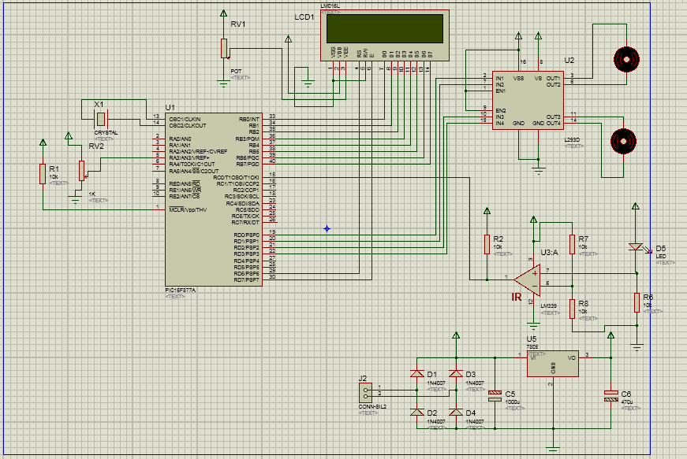
Circuit Schematics:

Slide 14
Advantages:
Totally automated system.
Easy to use & require no special training or equipment.
Reprogramming for different application is possible.
Voice playback can be saved in many languages.
Many other circuits can be implemented in the future for security or interactive response.

Slide 15
Applications:
This robot can be used in hospitals to send medicines to patients.
It can be used for industrial purpose to place the products at particular locations.
It can be used in museums to guide the visitors through different locations with audio playback services.
It replaces human interaction for guiding purpose.

Slide 16
Future Scope:
We can include camera for dual purpose i.e. one for security and other one for image processing.
The robot can be interactive.
We can include visitor counter.
We can include display in order to represent videos.
Touchpad or Keypad can be included for change in destination points.
Auto rechargeable batteries can be implemented.

Slide 17
Approx. Cost Analysis:
Sr. no. | Name | Cost (Rs.)
1 | PIC16F877A | 209
2 | RFID with Tags | 305
3 | Multipurpose IR sensor | 60
4 | Temperature Sensor (LM35) | 70
5 | Voice playback with SD card | 1270
6 | Wireless Headset | 1000-1700
7 | Speaker | 105
8 | DC motor with Motor Driver | 980
9 | Bluetooth Module | 340

Slide 18
References:
B. Sciliano ve and O. Khatib, Springer Handbook of Robotics, 2008, Springer-Verlag.
R. Siegwart, Ir Nourbakhsh Ve and D. Scaramuzza, Introduction to Autonomous Mobile Robots, 2011, MIT Press.
P. Corke, "Robotics Vision and Control" in , 2011, Springer tracts in advanced robotics.

Slide 19
Thank You

