Slide 1
Performance Comparison of Random Forest and Conditional Random Fields Models for Named Entity Recognition using the CoNLL-2003 Dataset
Department of Computer Science
Anthony Bush Castro, 20-CCS-281

Slide 2
Problem Statement
Why is NER still a challenge ?
Lexical ambiguity: (e.g., Apple, Anger)
Domain-Specific Variability: NER trained on news may fail in medical/legal text (e.g., “lead” may denote a business prospect in marketing but refers to a toxic substance in environmental science)
Limited Availability of Annotated Data: Needs extra information
Model Comparison gap: Random Forest VS CRF in NER
To address this, we designed a systematic comparison with clear objectives..."

Slide 3
Objectives and significance of the study
Primary Objectives Evaluate and compare the performance of Conditional Random Fields (CRF) & RF Specific objective To implement CRF and RF models for NER To assess and compare the performance of both models To analyze the strengths and limitations of CRF and RF | Significance This study contributes to the field of Named Entity Recognition by comparing two fundamentally different approaches: Contributions Deepening the understanding of how statistical and machine learning methods behave in NER contexts. Informing model selection strategies. Supporting the development of adaptable and accurate NER systems Providing a practical benchmark | Questions How does the performance of CRF compare to RF in Named Entity Recognition? What are comparative strengths and limitations of CRF and RF for NER tasks? Which model demonstrates better generalization across different entity types in the CoNLL-2003 dataset? What practical insights can be drawn from the comparative analysis to guide future research in NER?

Slide 4
Evolution of NER Approaches & Key Models(Literature Review)
Traditional Methods → ML → Deep Learning
Rule-based systems: Relied on handcrafted linguistic rules (Xu et al., 2016), but struggled with ambiguity (e.g., "Apple") and domain shifts (Magnini et al., 2020).
Machine Learning: Feature-engineered models (SVMs) improved generalization (Yang et al., 2019).
Deep Learning: BiLSTMs/CNNs automated feature extraction; BERT set new benchmarks (Ma & Hovy, 2016).
CRFs vs. RFs in NER
CRFs: Dominant for sequence labeling (CoNLL-2003 F1=91.21% with BiLSTM-CNN-CRF) due to contextual dependency modeling (Peilin et al., 2019).
RFs: Excelled in interpretability and feature importance (Sumathipala et al., 2014: 93.8% precision in biomedical NER).

Slide 5
Research Gaps & Novelty
Identified Gaps (Dong et al., 2022)
No direct CRF vs. RF comparison on CoNLL-2003.
Limited analysis of their trade-offs (sequence modeling vs. interpretability).
Unclear adaptability to entity types (PER/ORG/LOC) and domains.
This Study’s Novelty
First controlled comparison of CRF/RF on CoNLL-2003.
Entity-type breakdown: CRF for LOC (context-heavy), RF for PER (feature-driven).
Hybrid potential: Combines CRF’s sequence awareness + RF’s interpretability (e.g., federated learning CRFs (Mathew et al., 2022)).

Slide 6
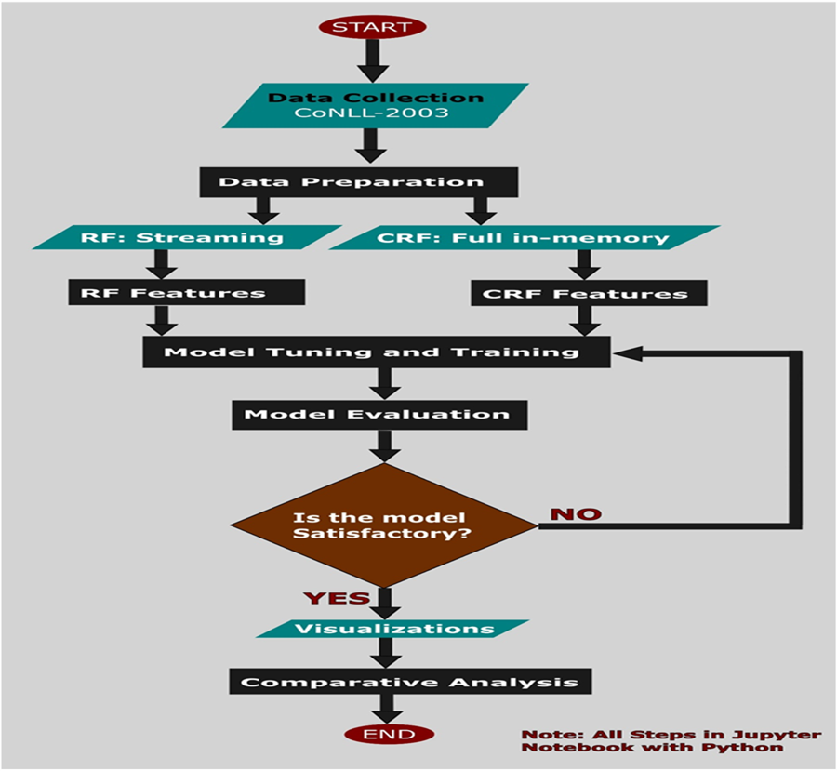
Implementation Flowchart (methodology)

Slide 7
Models and Data
split | Articles | Number of sentences | Number of tokens
Training | 946 | 14, 978 | 203, 621
Validation | 216 | 3, 466 | 51,362
Test | 231 | 3, 684 | 46, 435

Slide 8

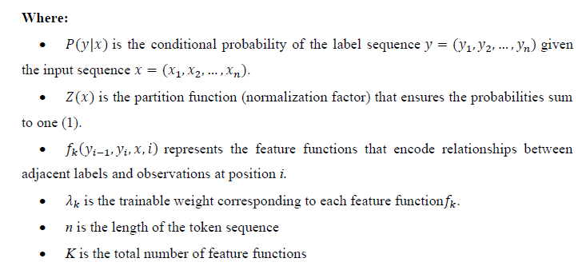
CRF Model

Slide 9
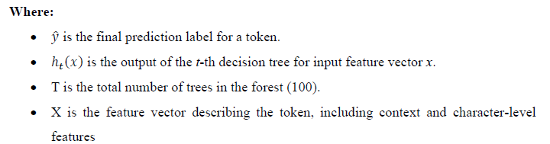
Random Forest Model

Slide 10




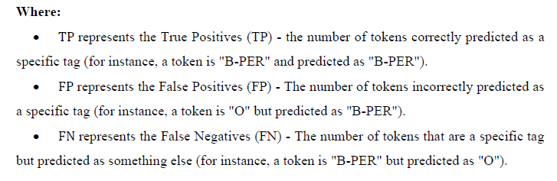
Measuring models performance

Slide 11
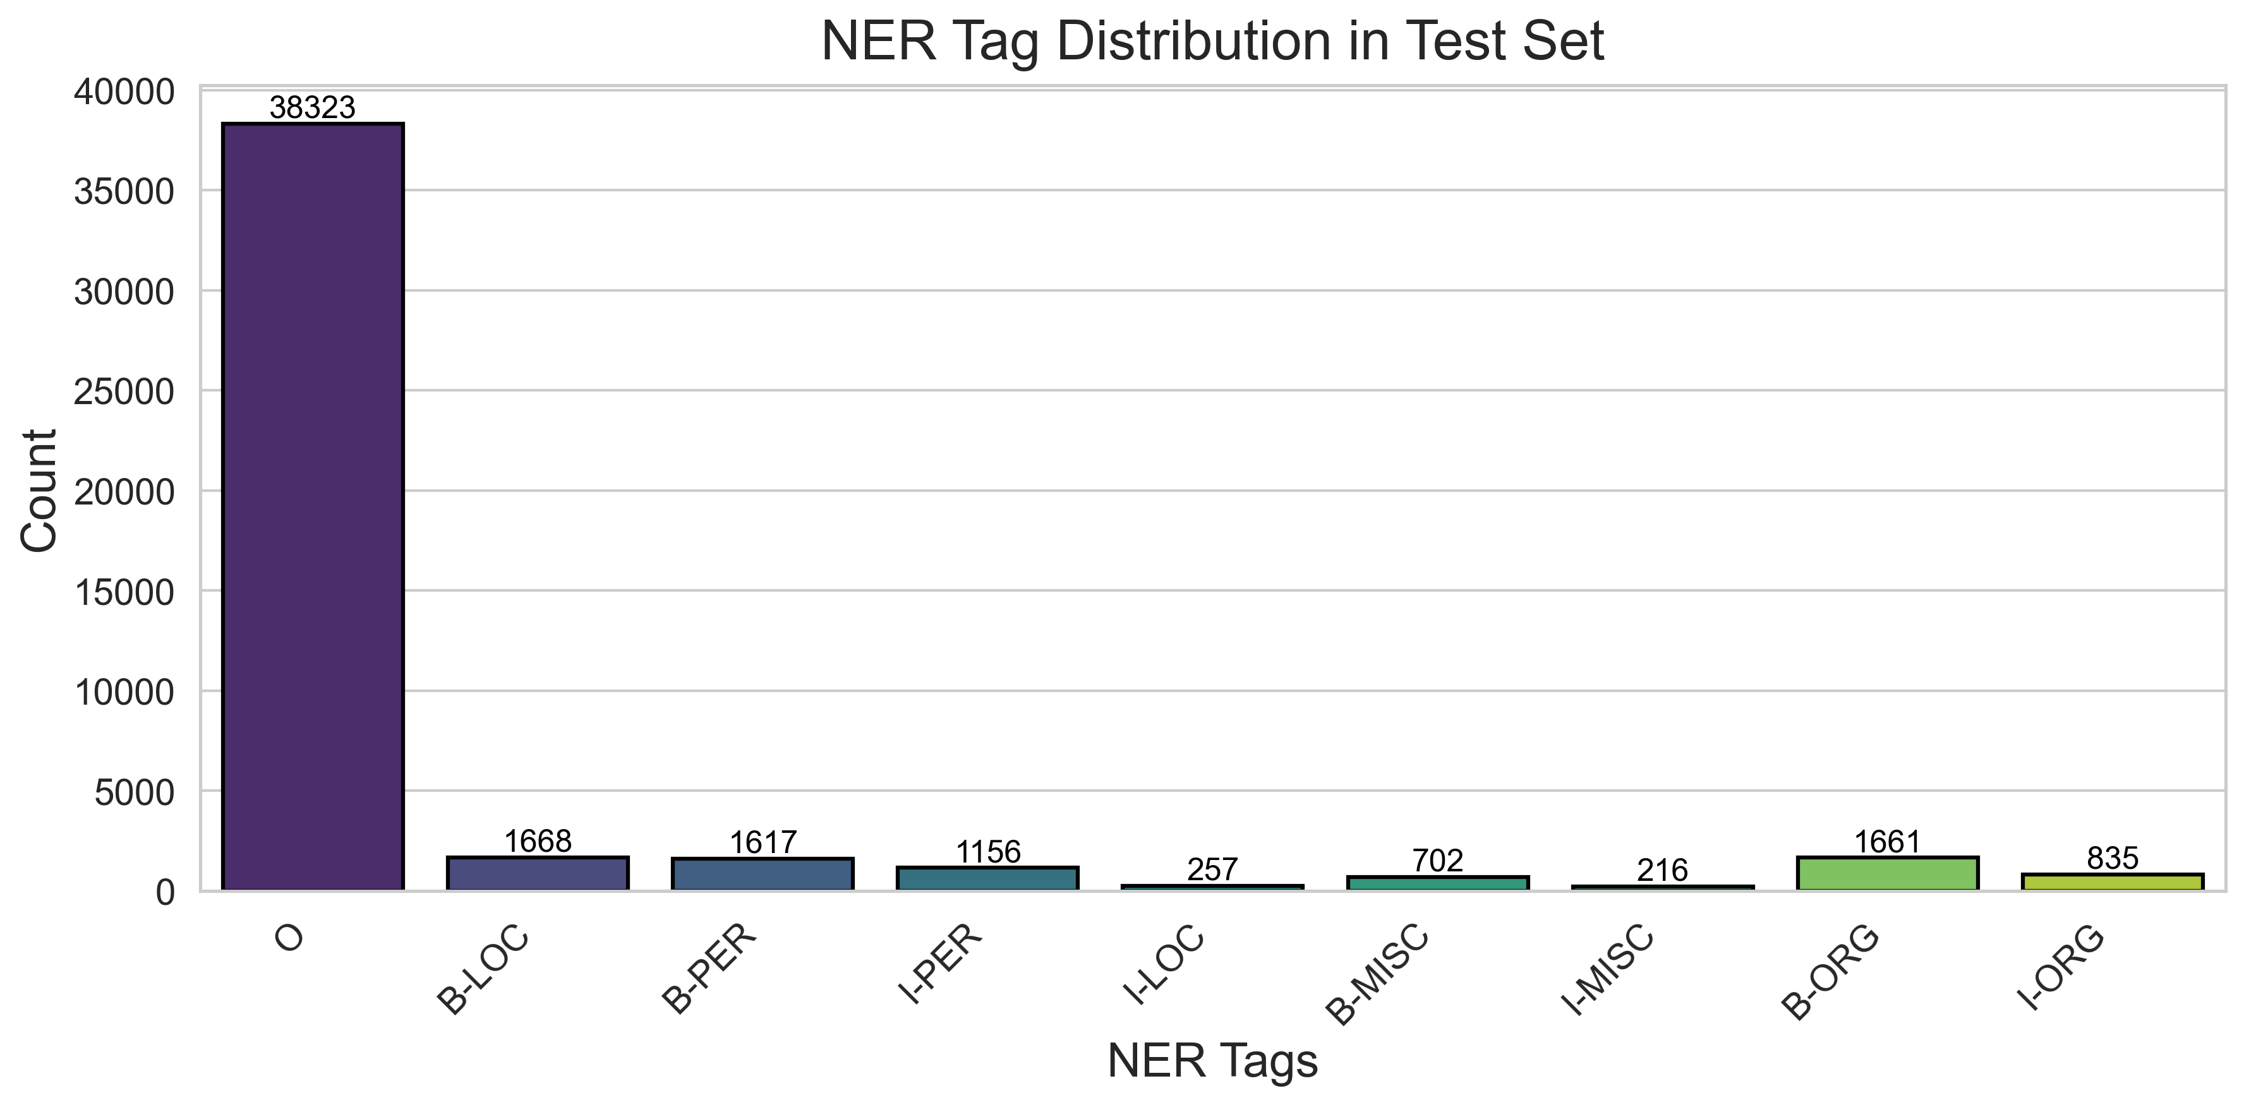
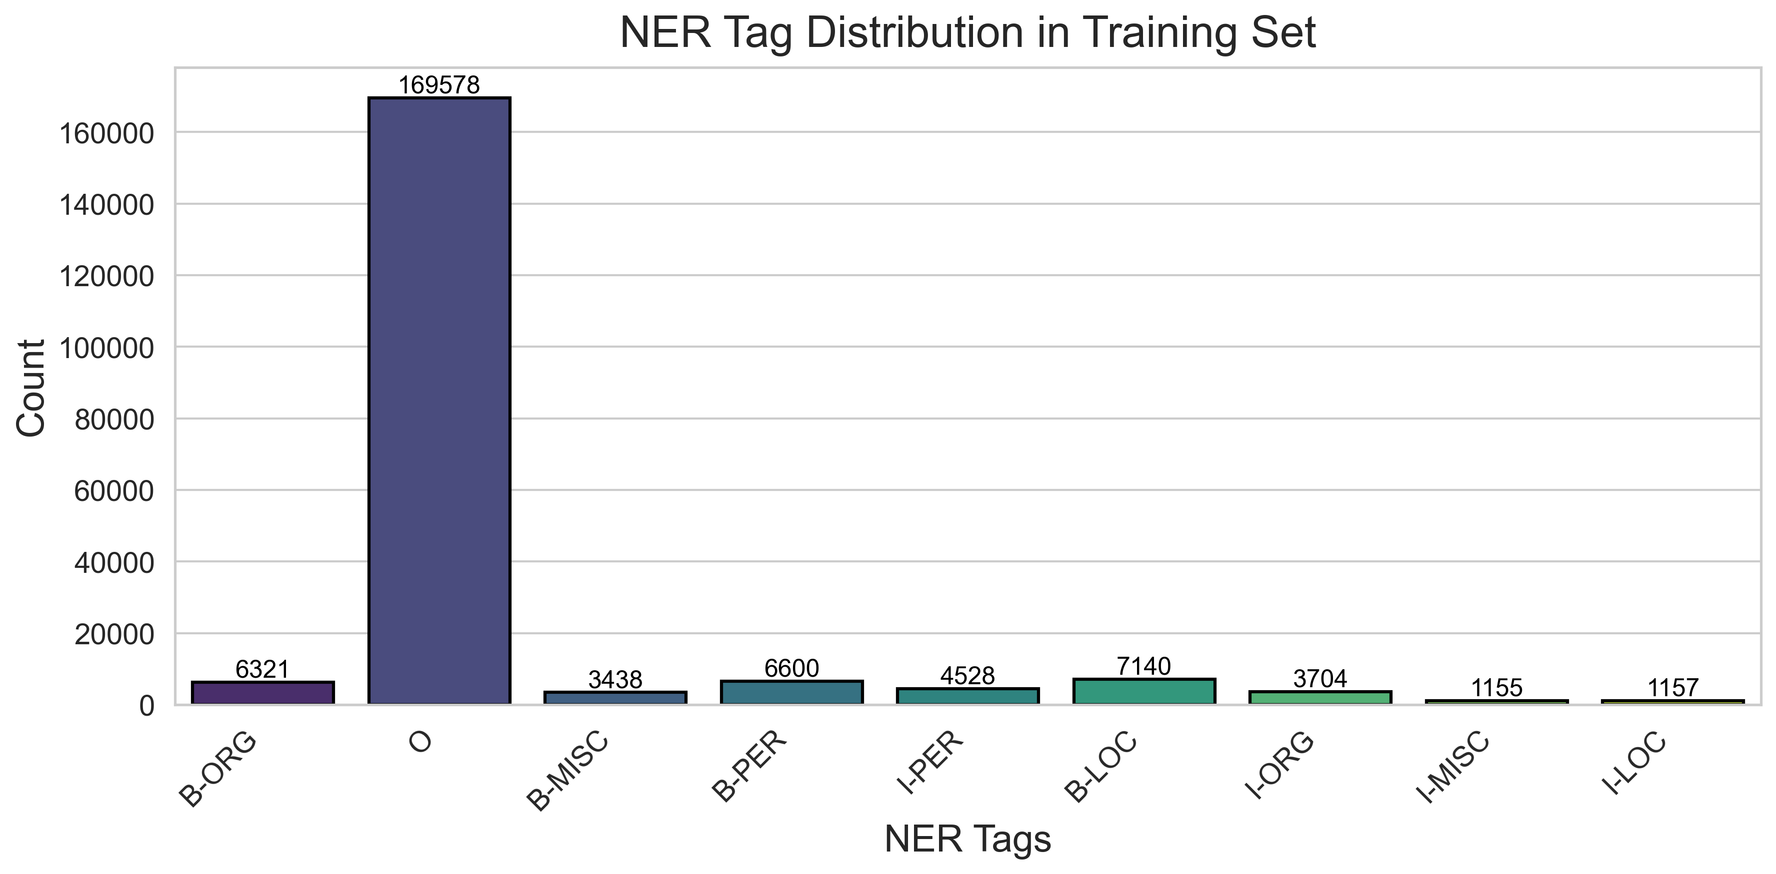
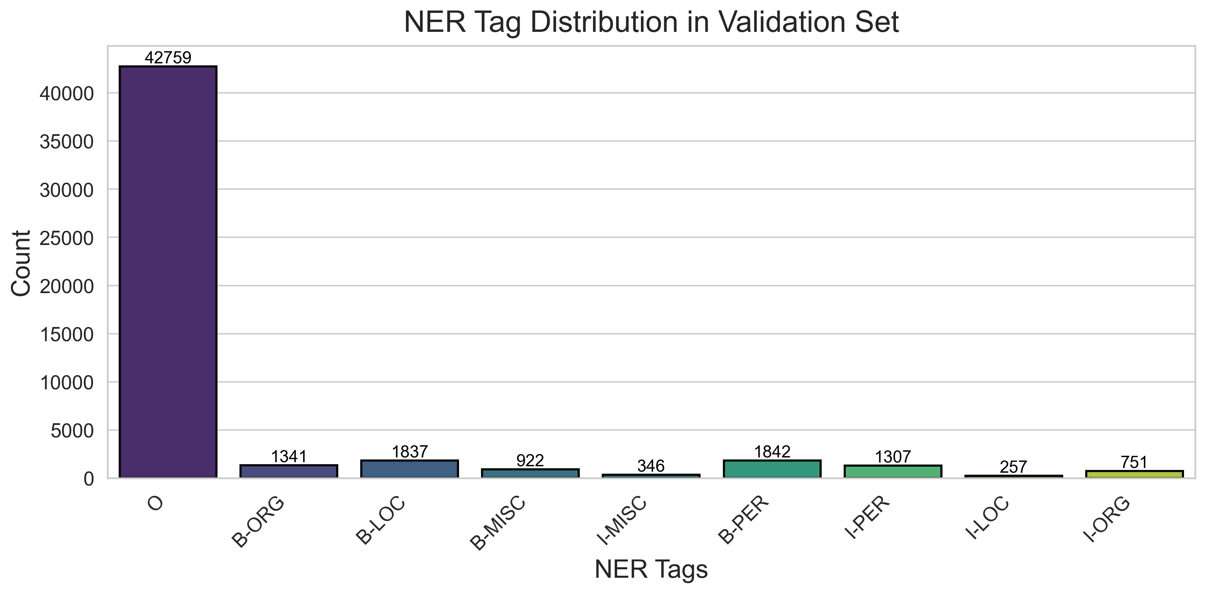
Tag distribution - Training

Slide 12
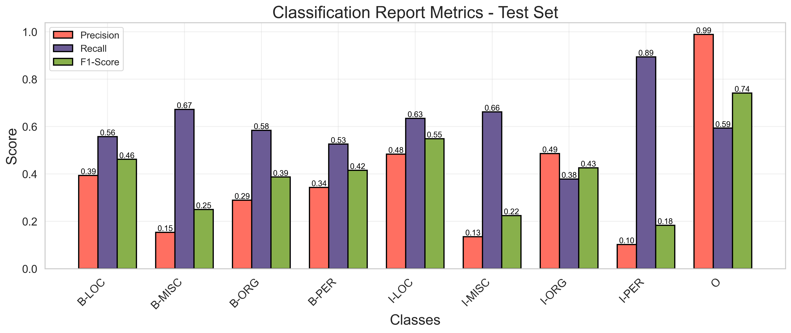
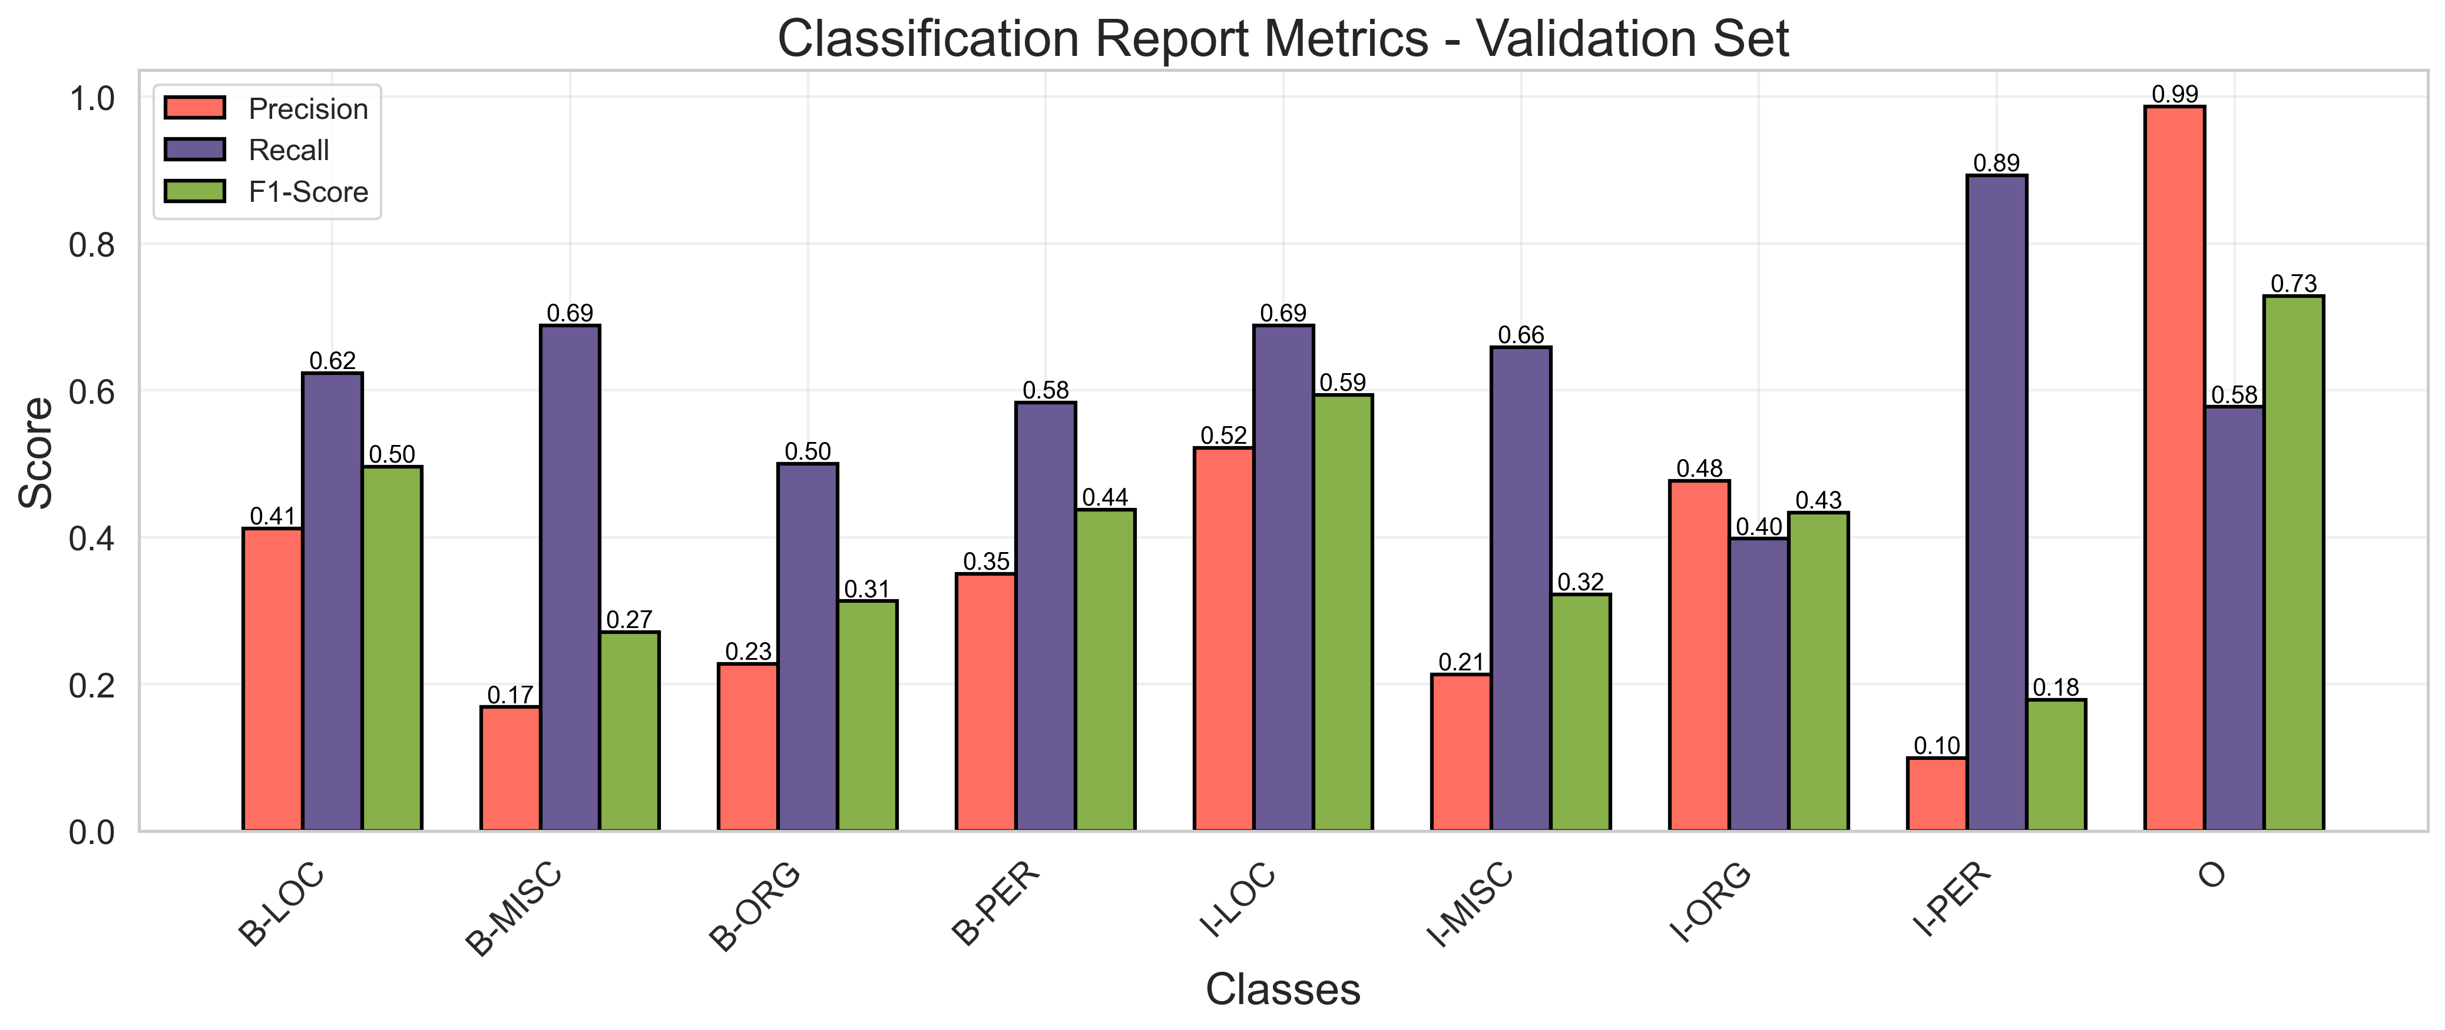
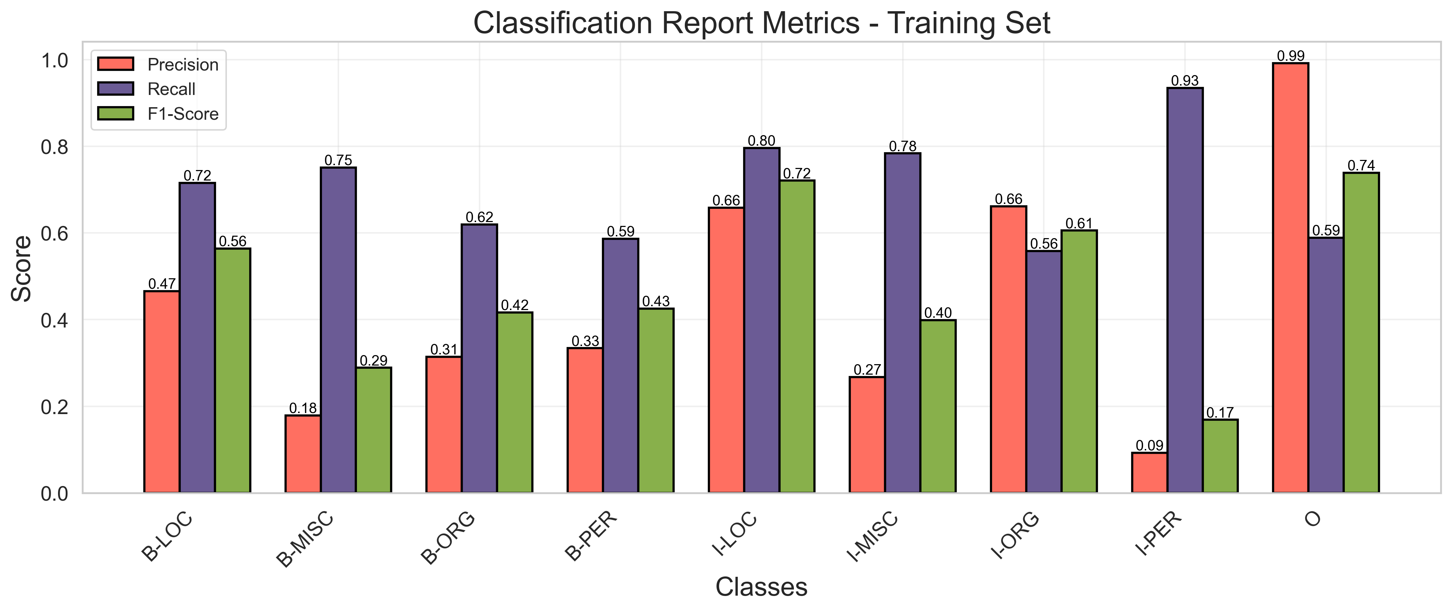
Random Forest Classification Performance
60.6%
Training set
58.6%
Validation set
59.5%
Test set

Slide 13
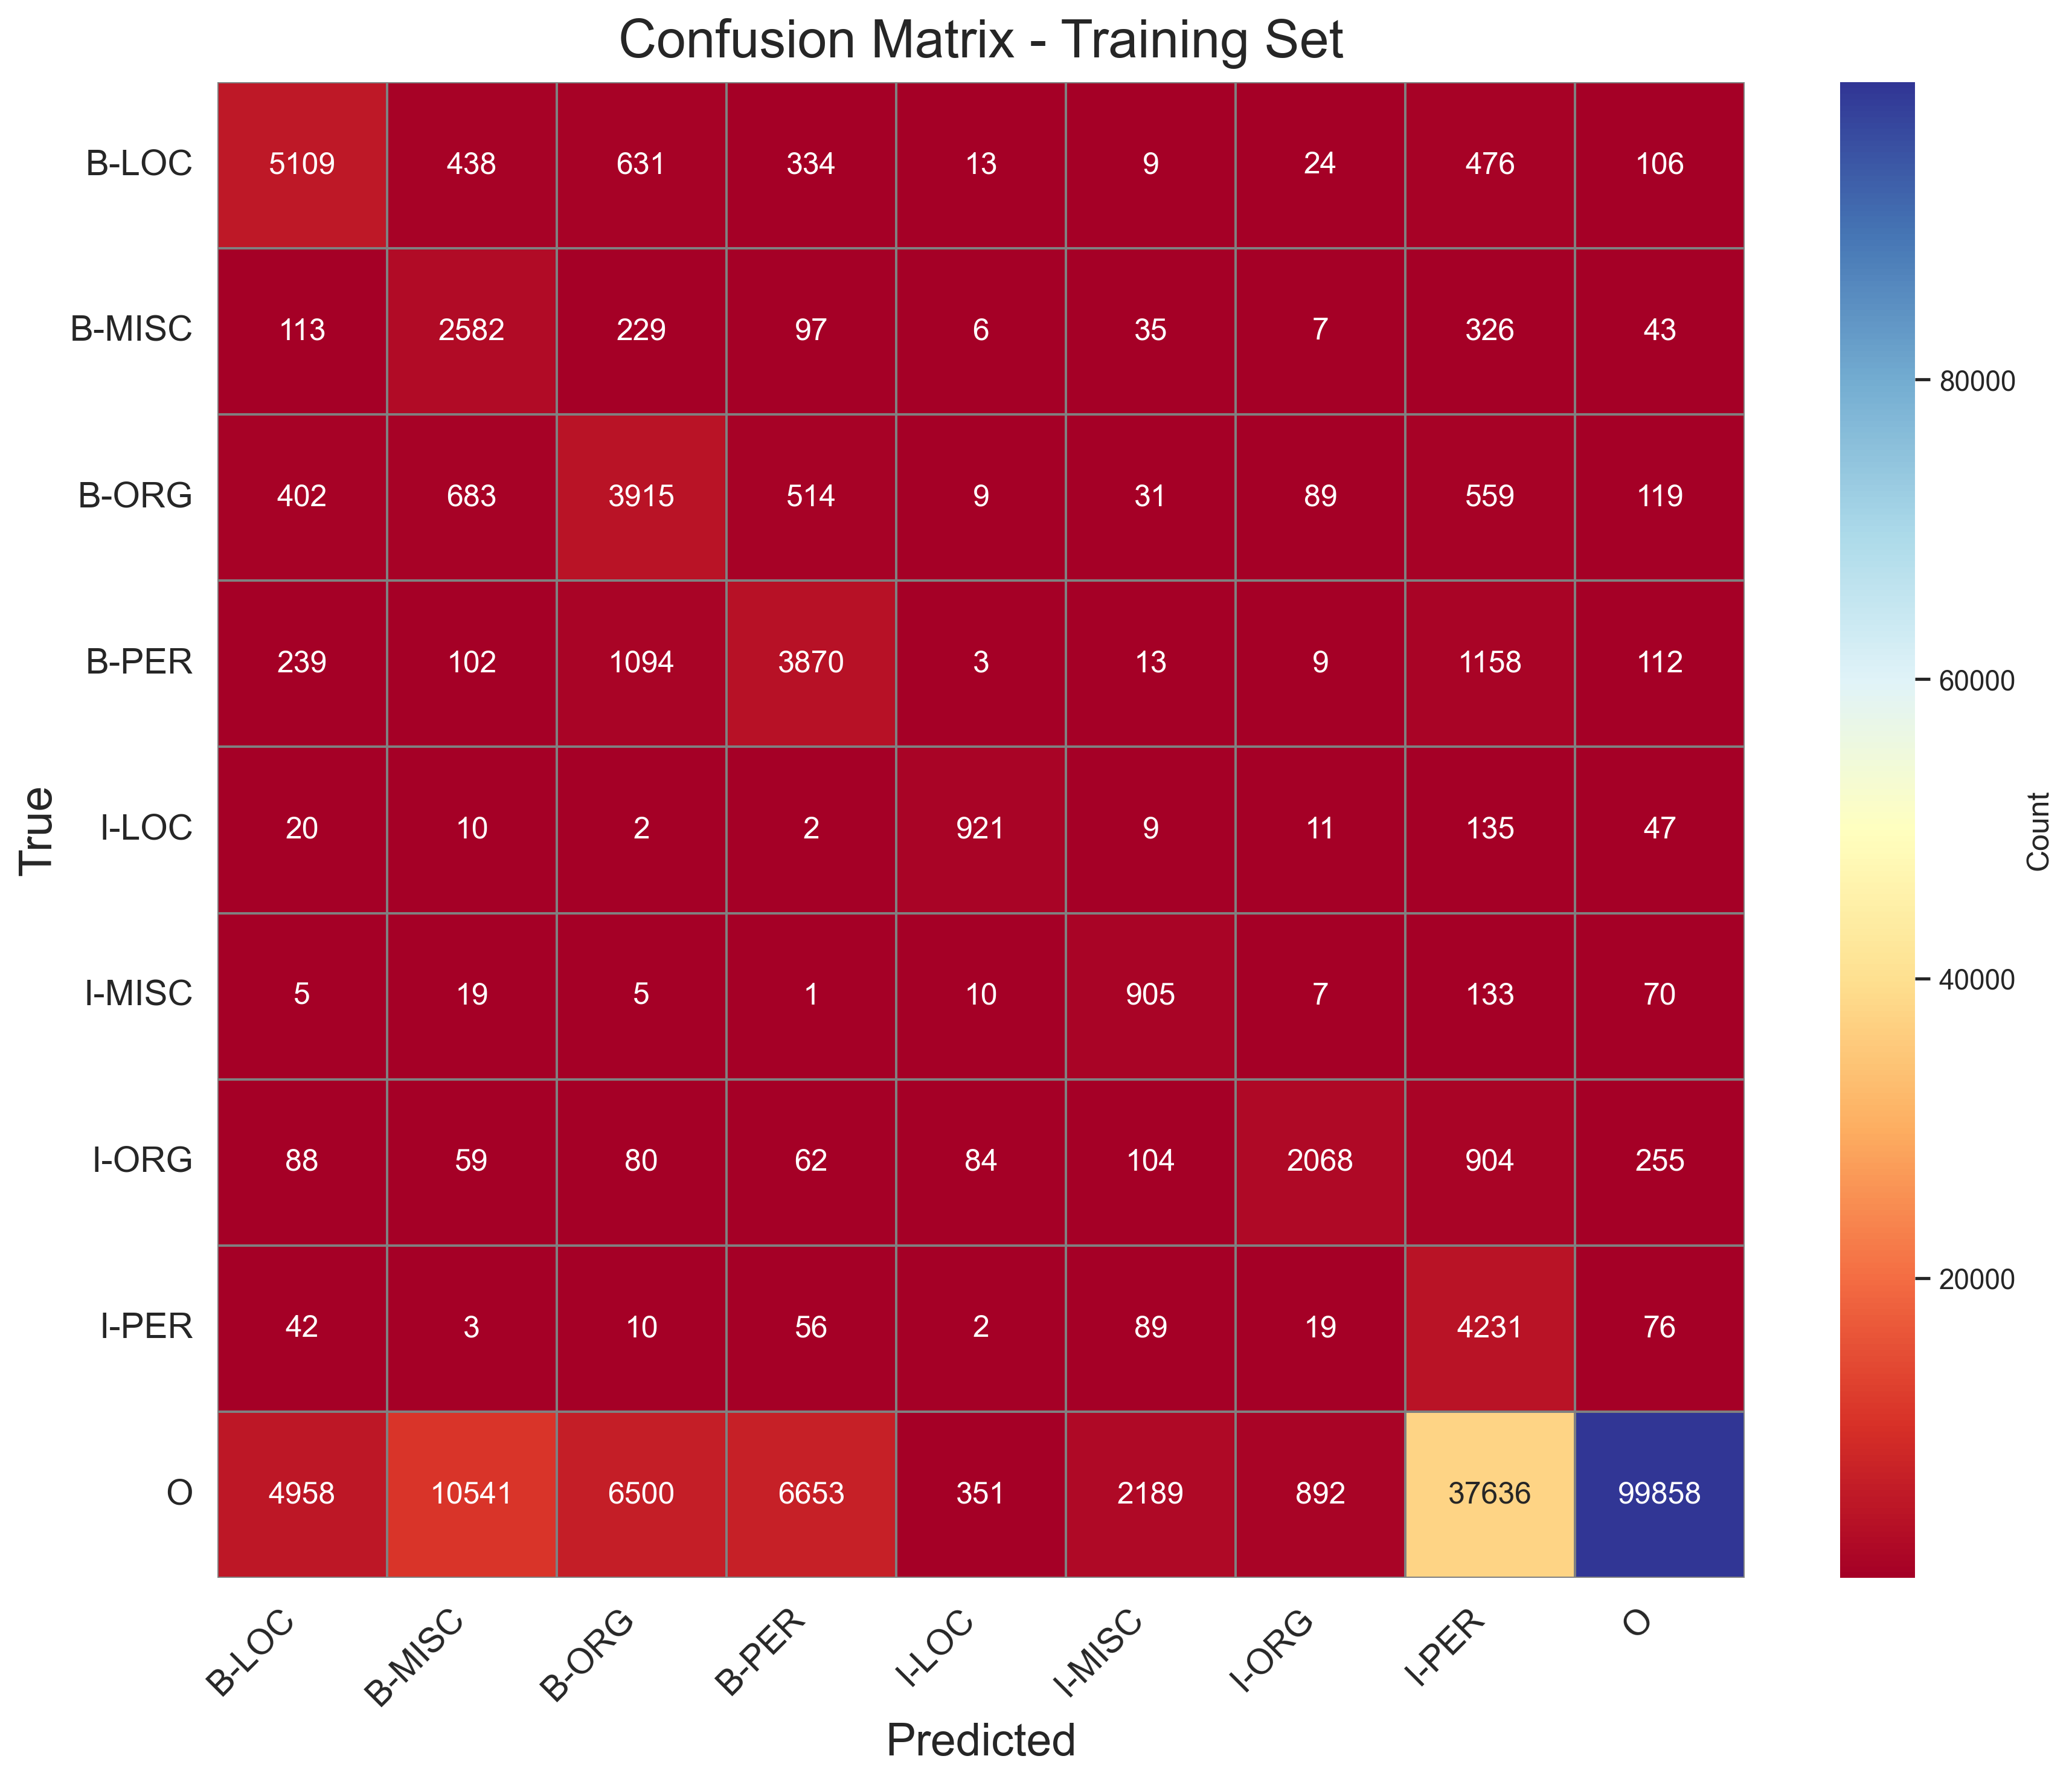
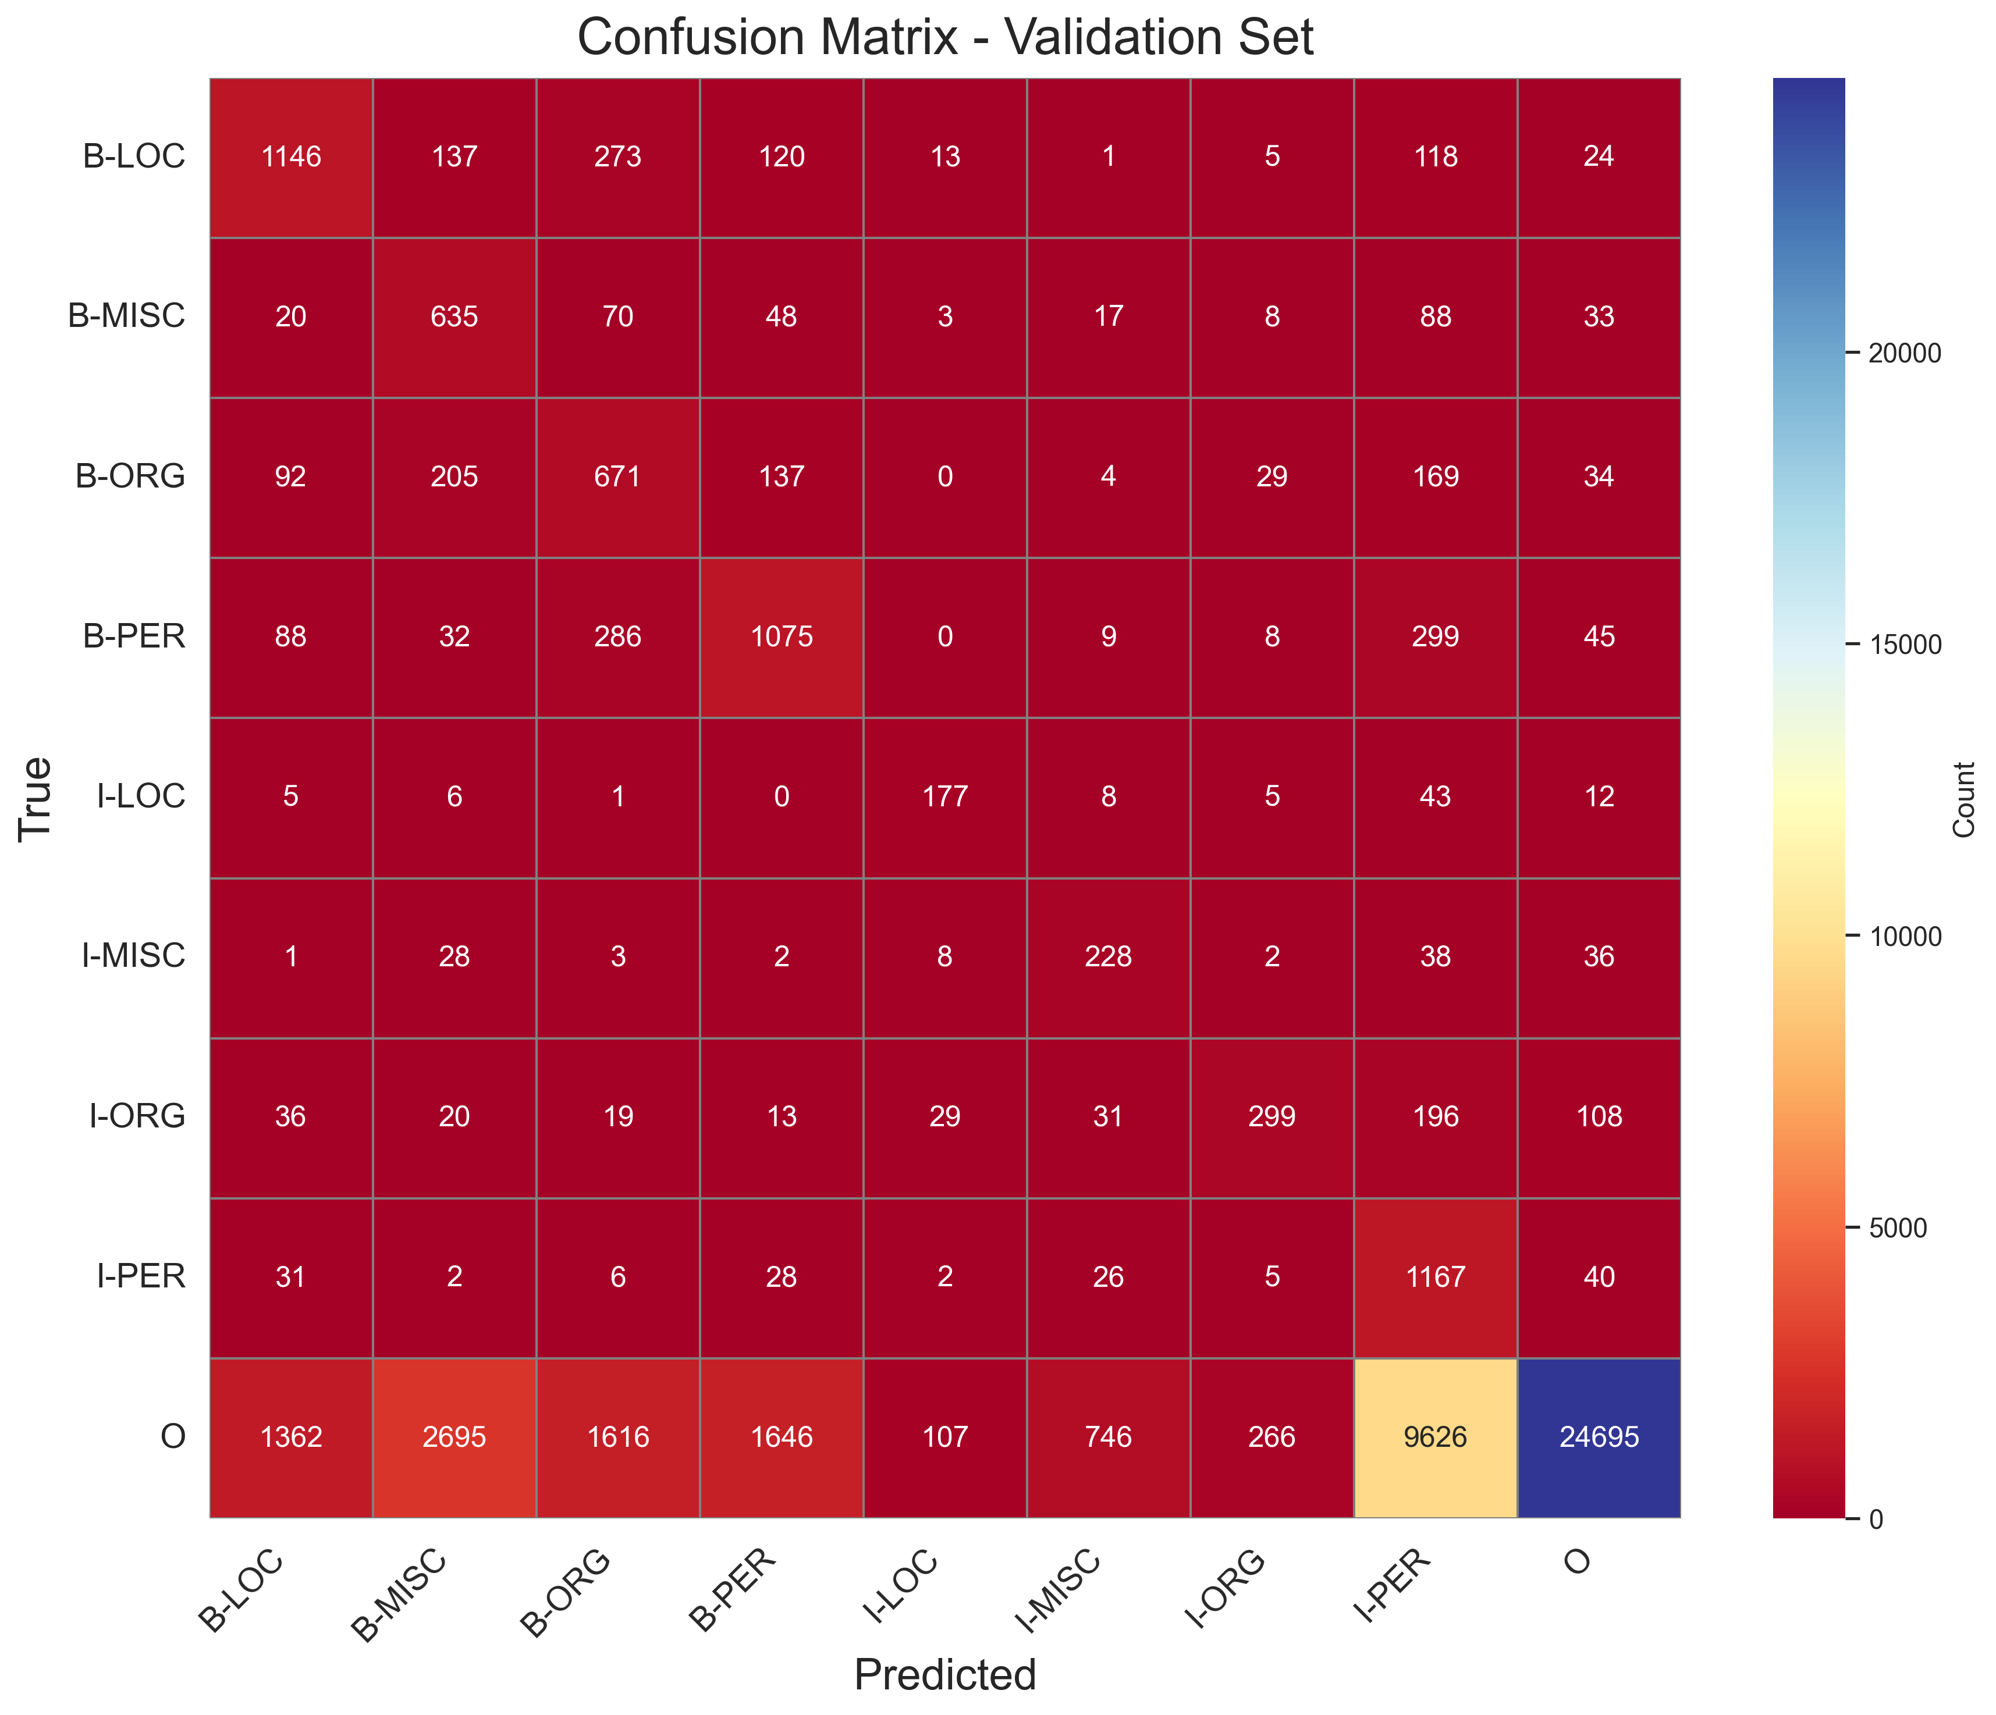
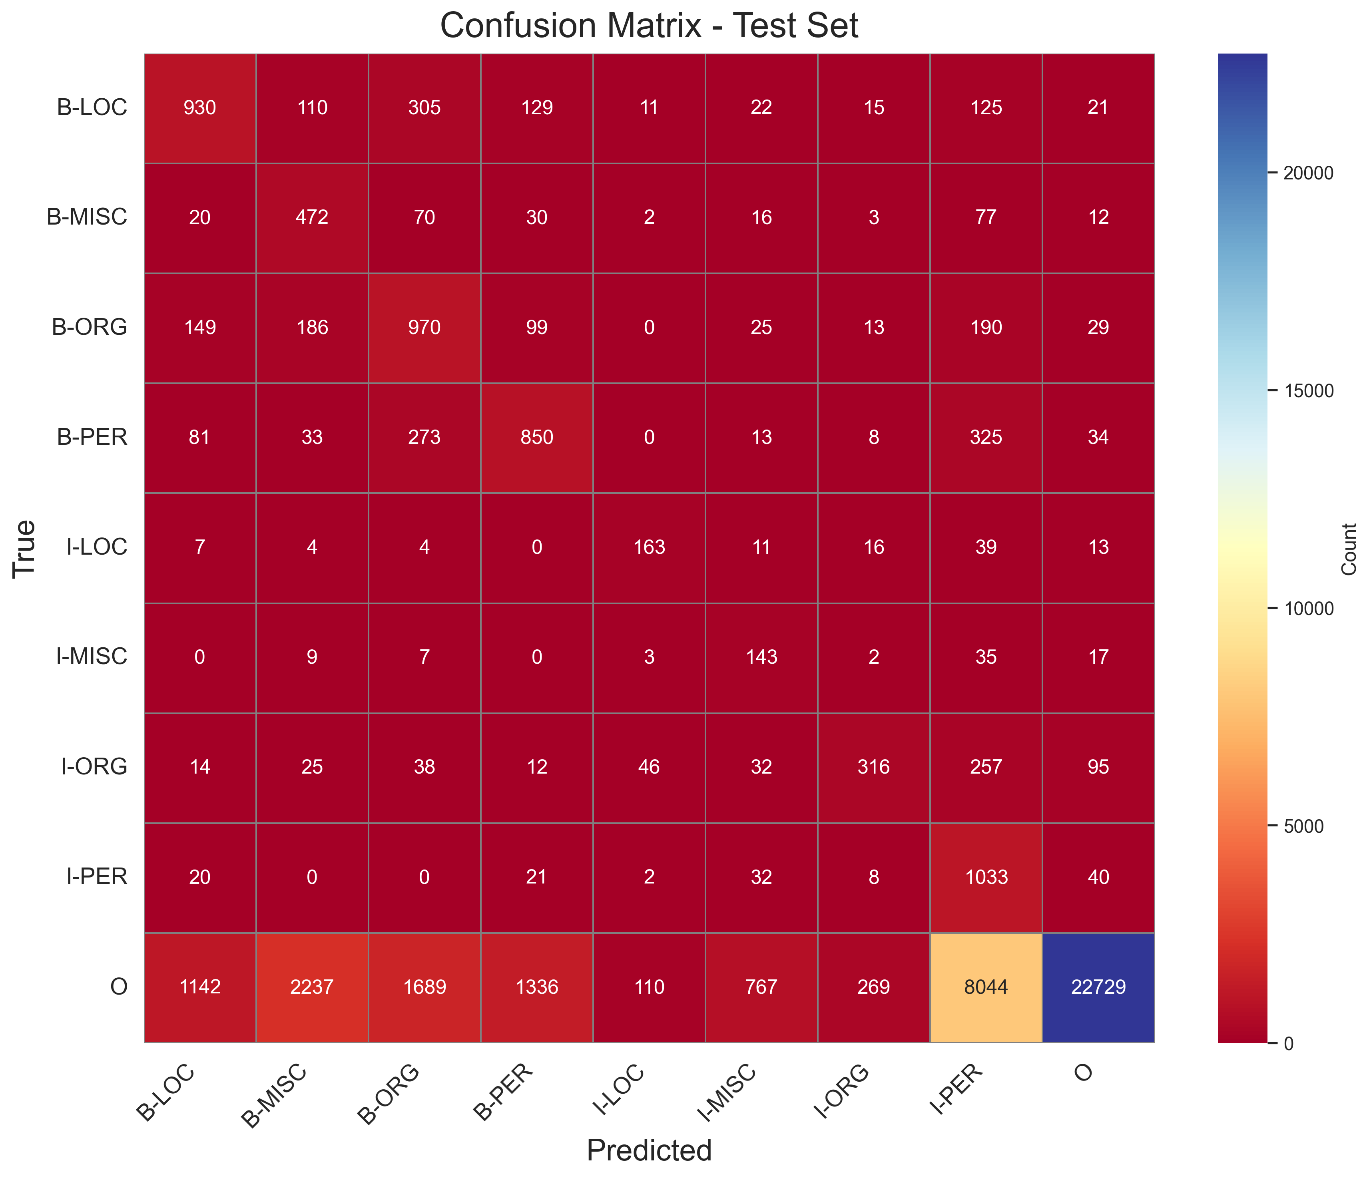
RF Confusion Matrices
Each Matrix represents the true labels (rows) vs predicted labels (columns).
The diagonal elements indicate correct predictions, while off-diagonal elements represent misclassifications
E.G B-LOC predicted true as 5,109, 1,146 and 930 in training, Validation and test sets respectively;
But also misclassified as B-ORG – 402, 92 and 149 in training, validation and testing sets

Slide 14
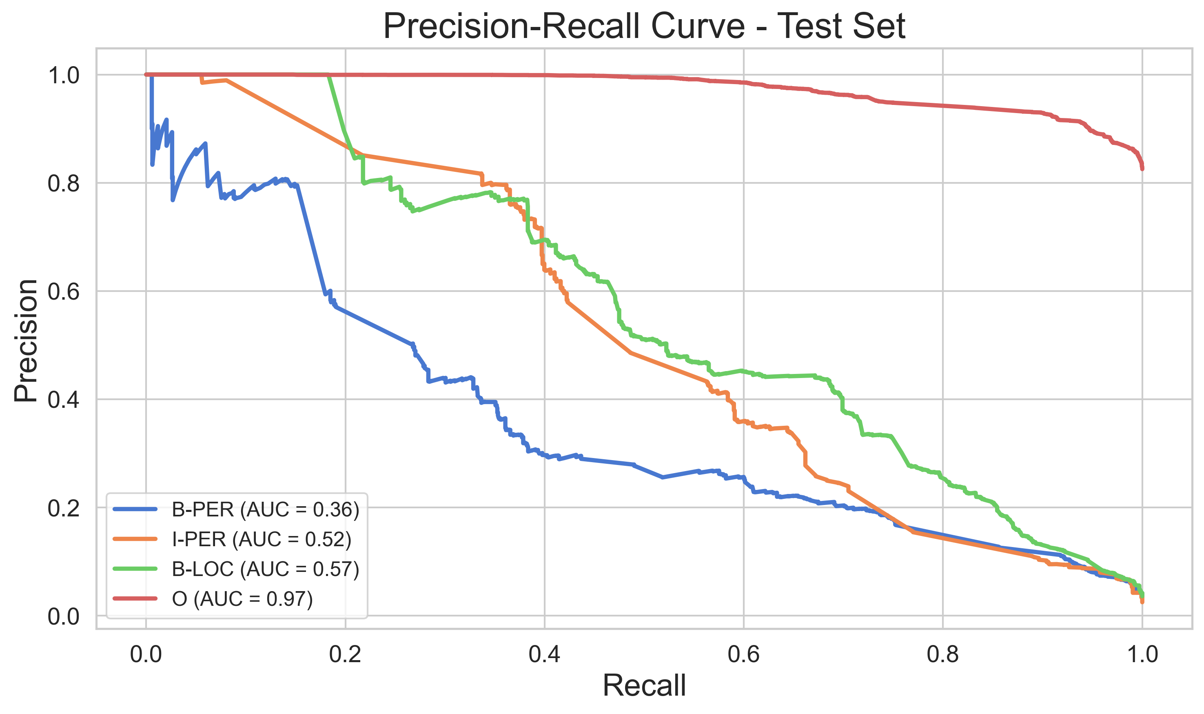
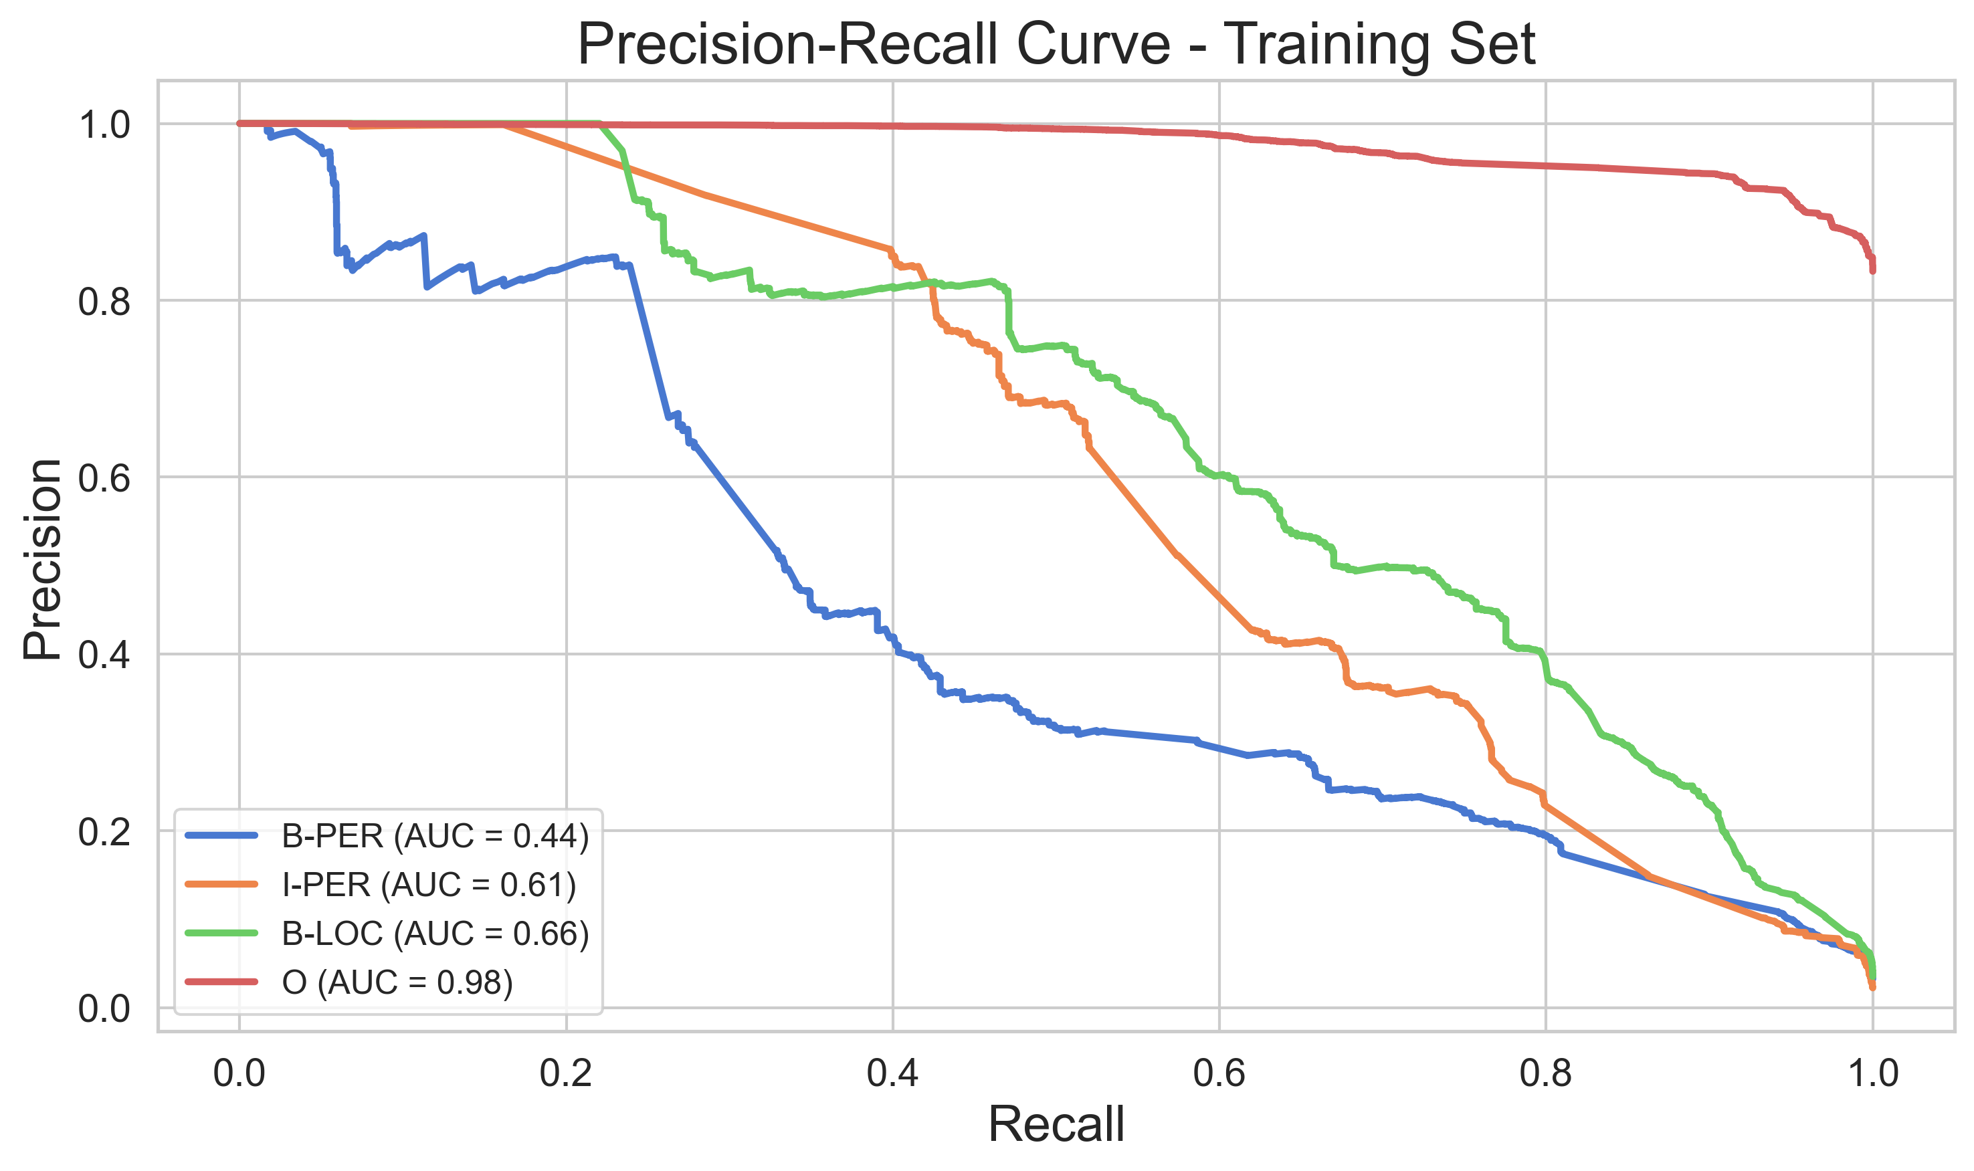
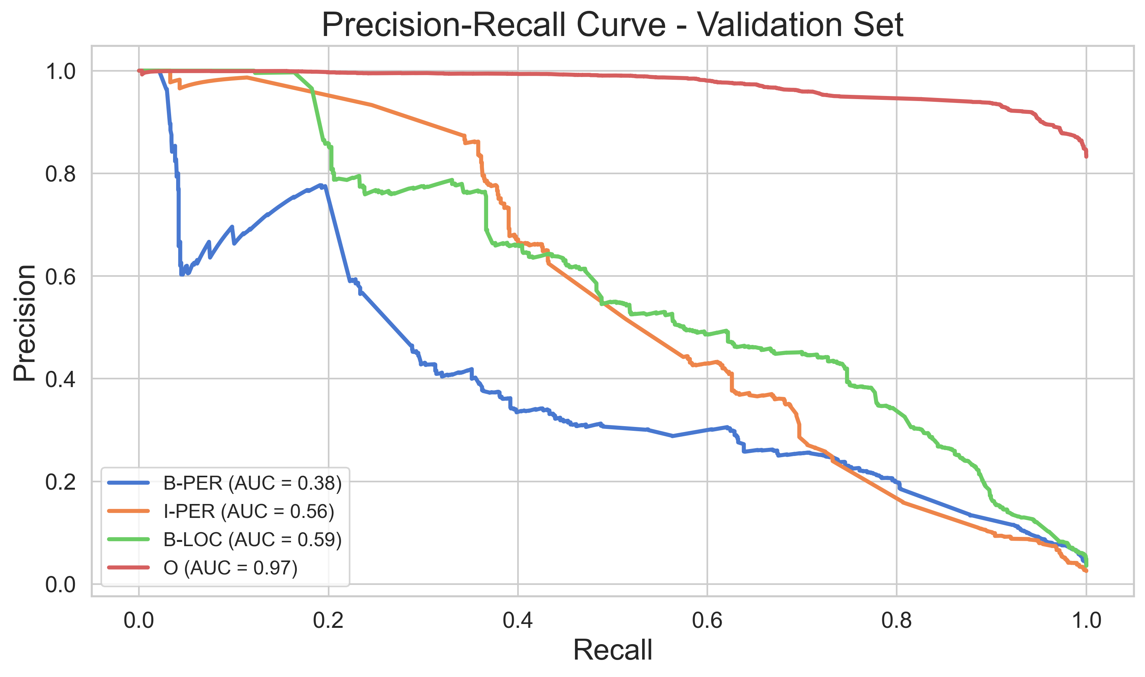
RF F1-Score comparison for Training vs Validation Vs Test sets & RF Precision vs Recall for the Training, Validation and Test sets
Random Forest – Precision vs Recall
High precision but low recall on minority tags
Tends to over-predict entities or misclassify non-entities
Performance drops significantly for entity tags like I-PER (F1 below 20%)

Slide 15
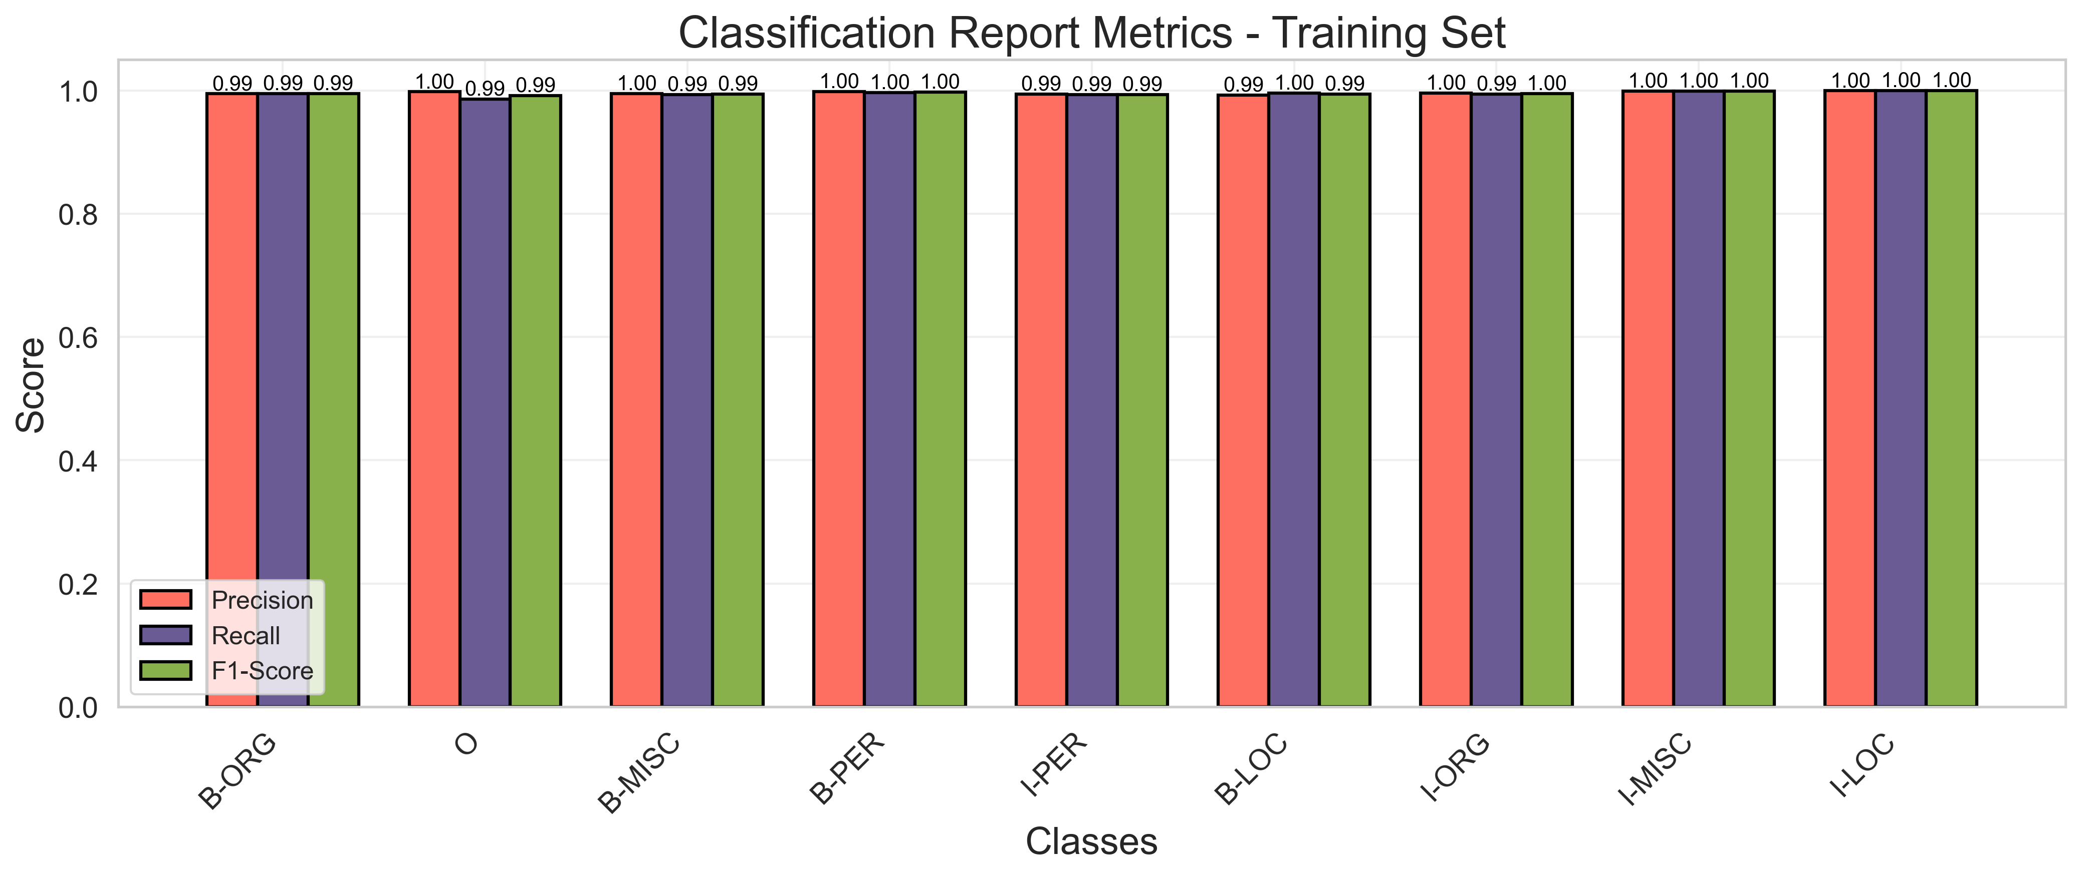
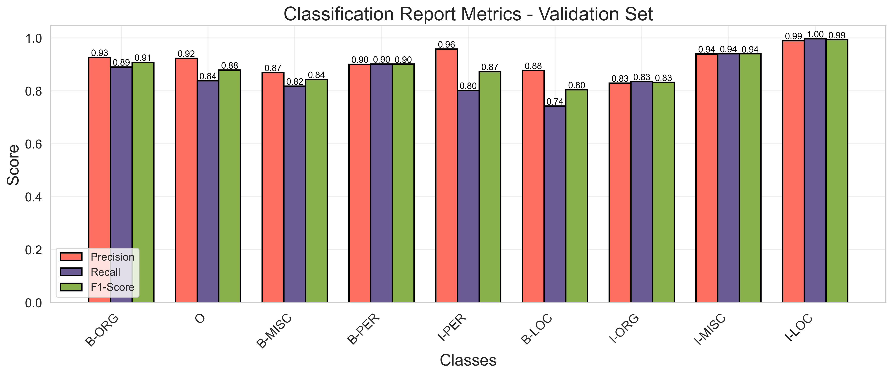
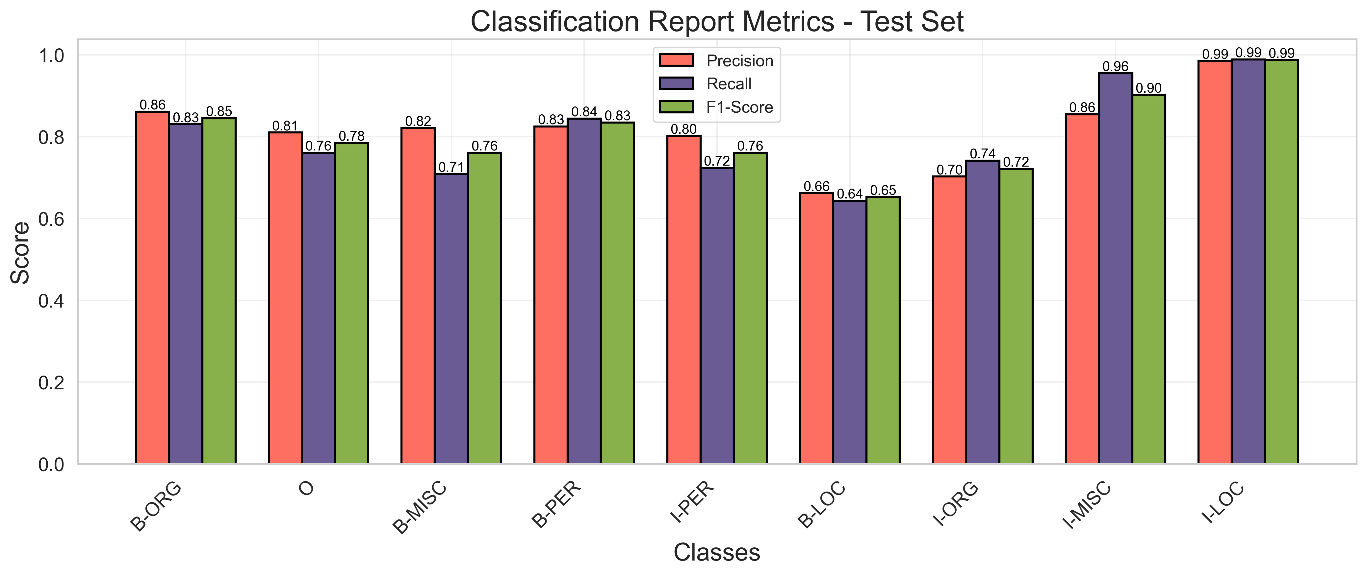
CRF Classification Performance
99.9%
Training set
97.6%
Validation set
95.6%
Test set

Slide 16
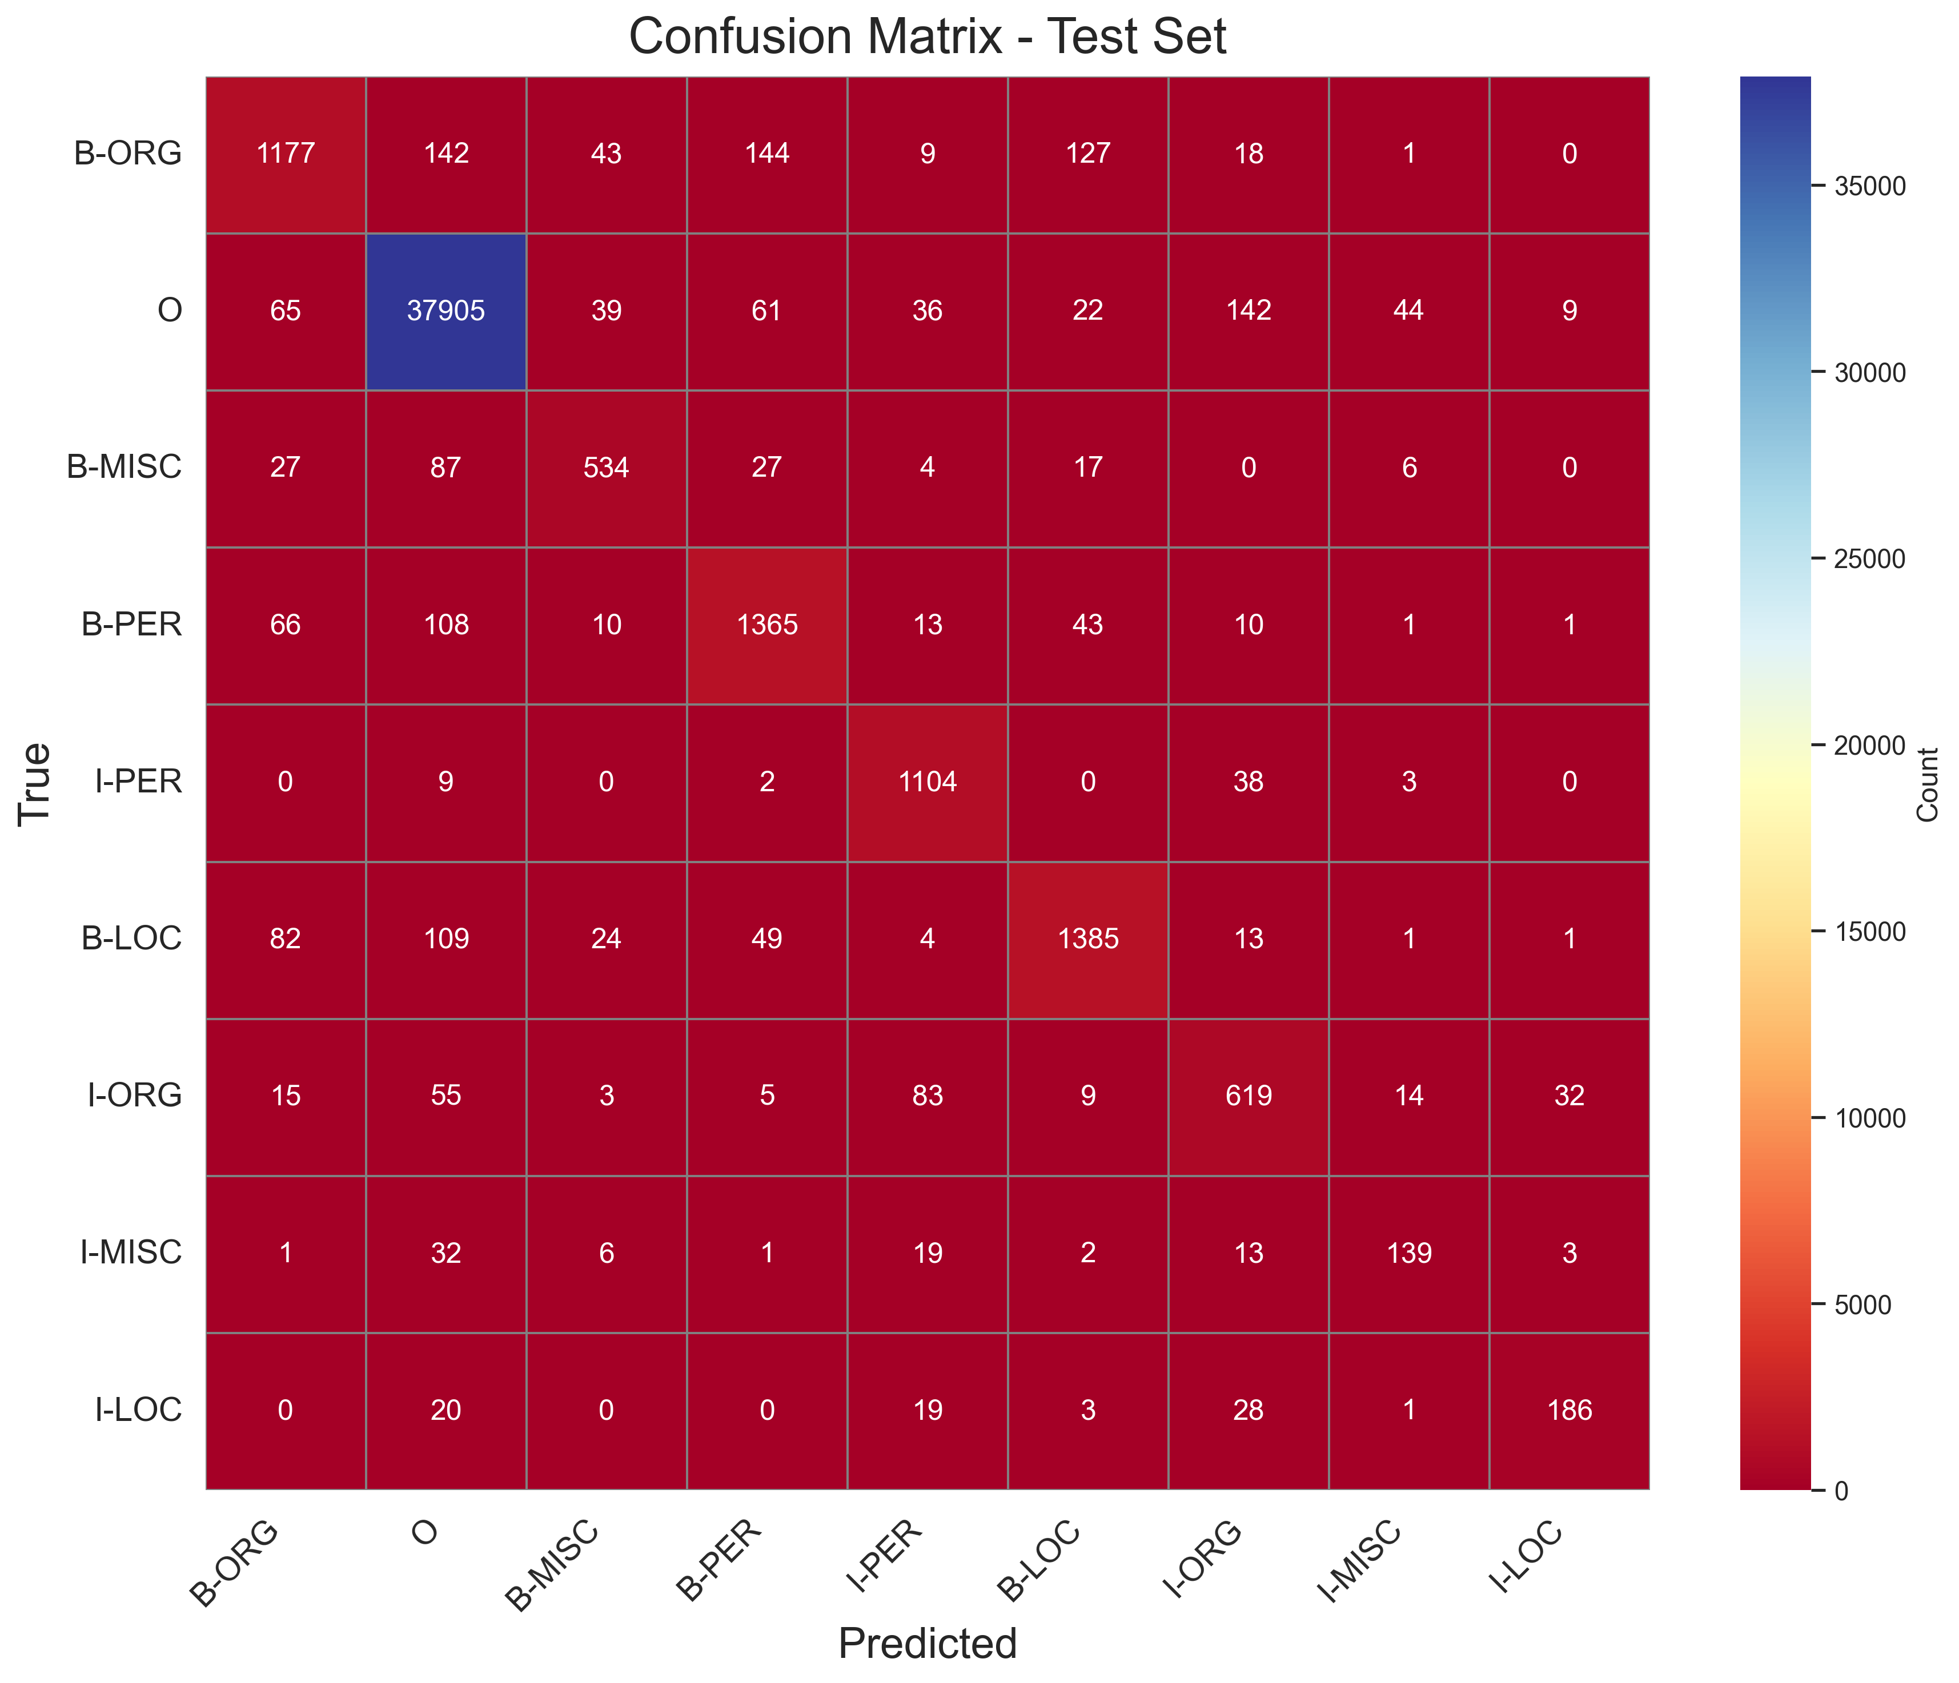
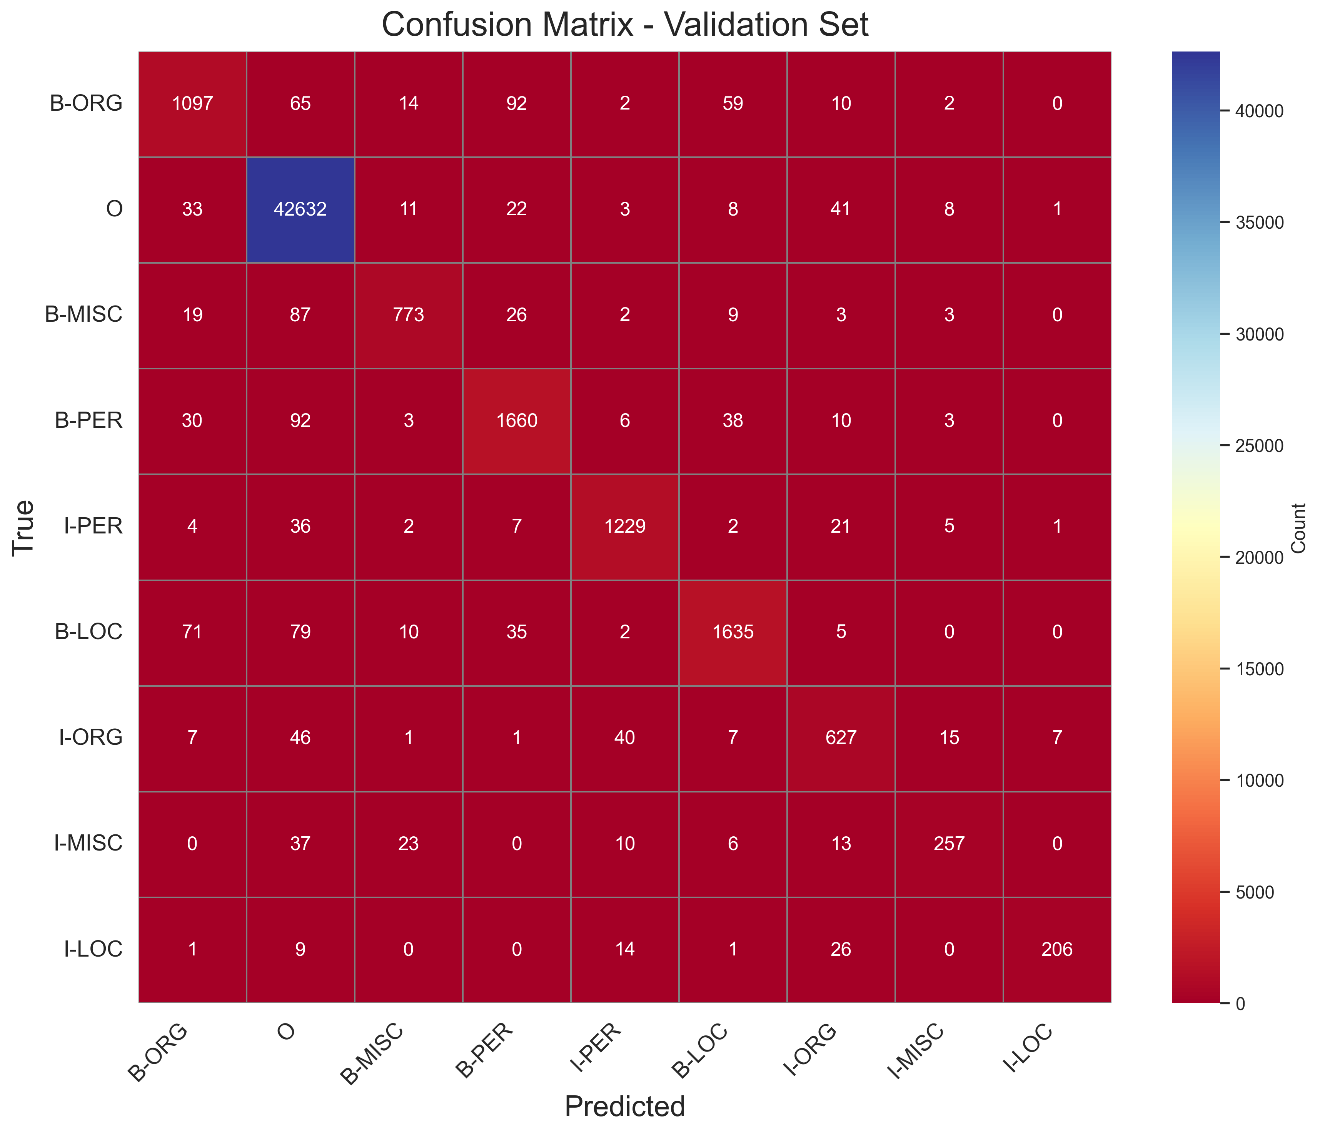
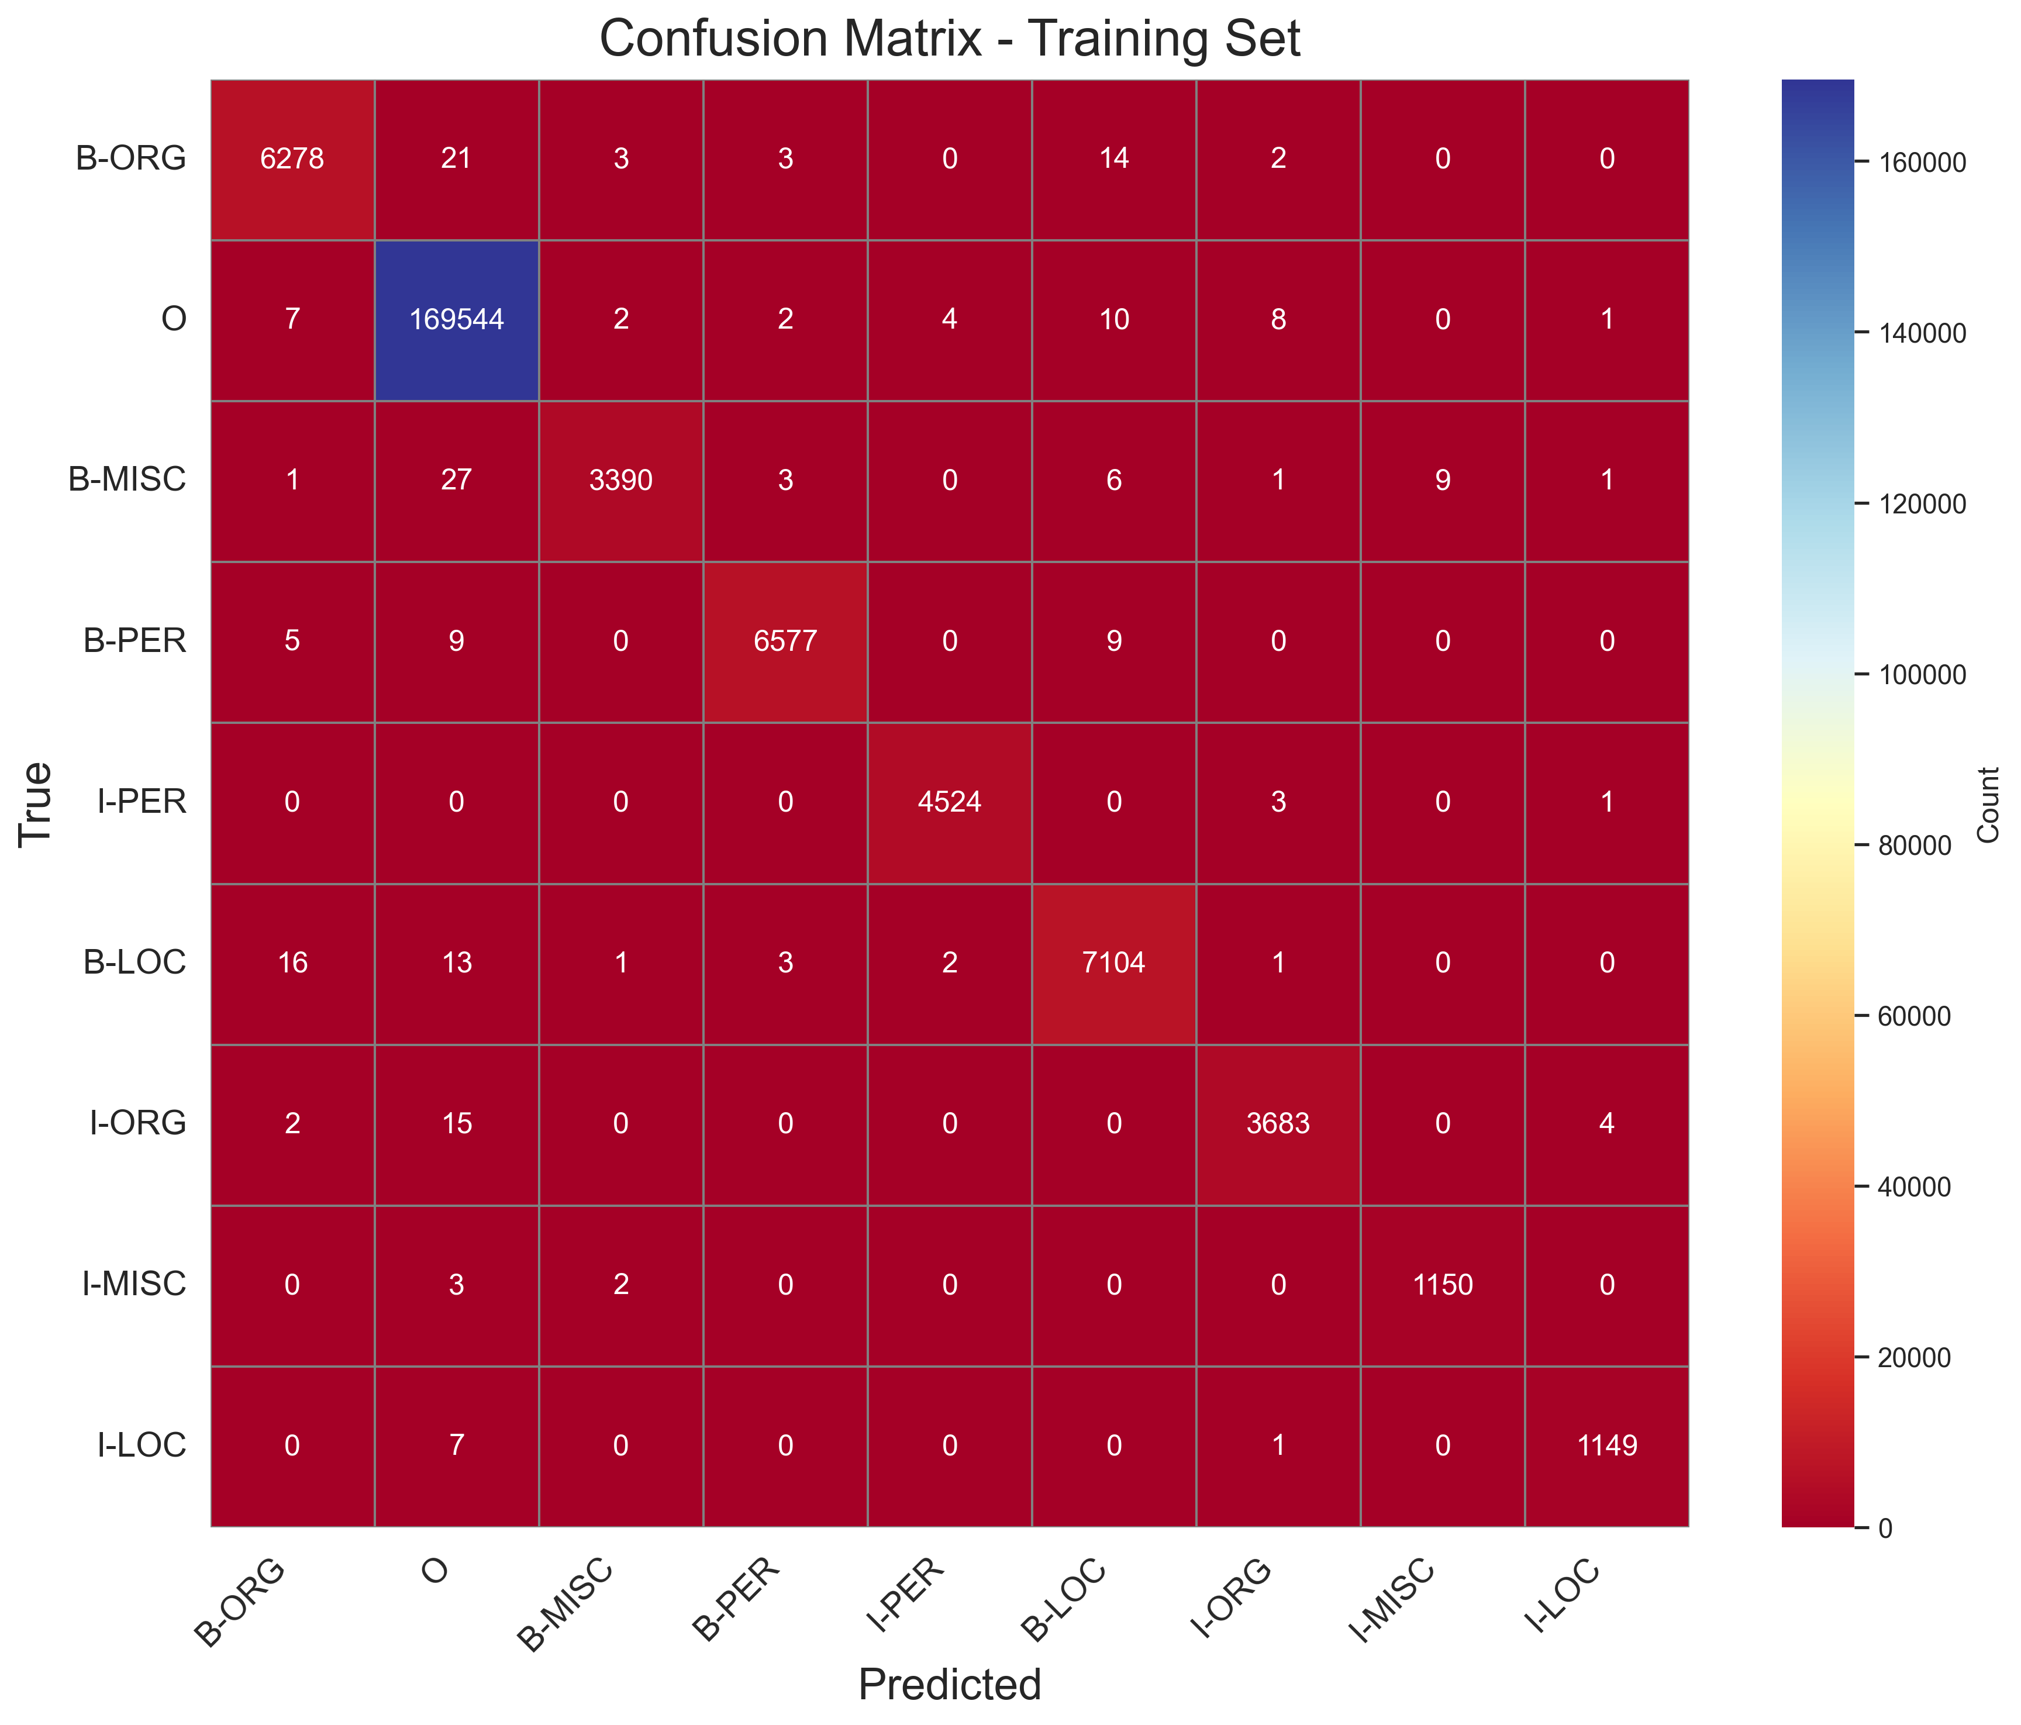
CRF Confusion Matrices
Each Matrix represents the true labels (rows) vs predicted labels (columns).
The diagonal elements indicate correct predictions, while off-diagonal elements represent misclassifications
E.G O predicted true as 169,544, 42,632 and 37,905 in training, Validation and test sets respectively;
But also misclassified as I-LOC: 7, 9 and 20 in training, validation and testing sets

Slide 17
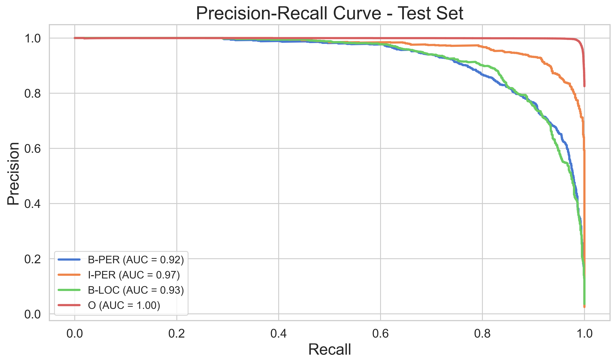
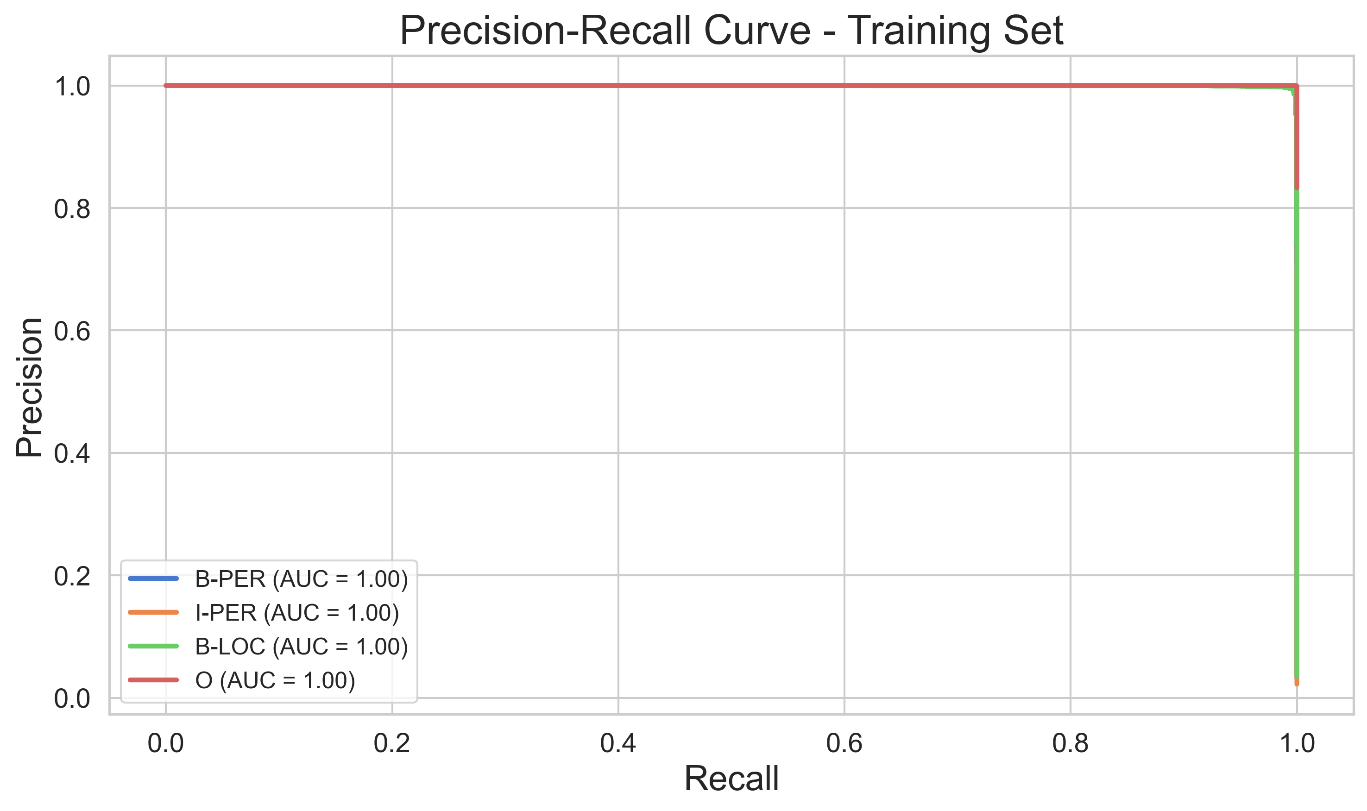
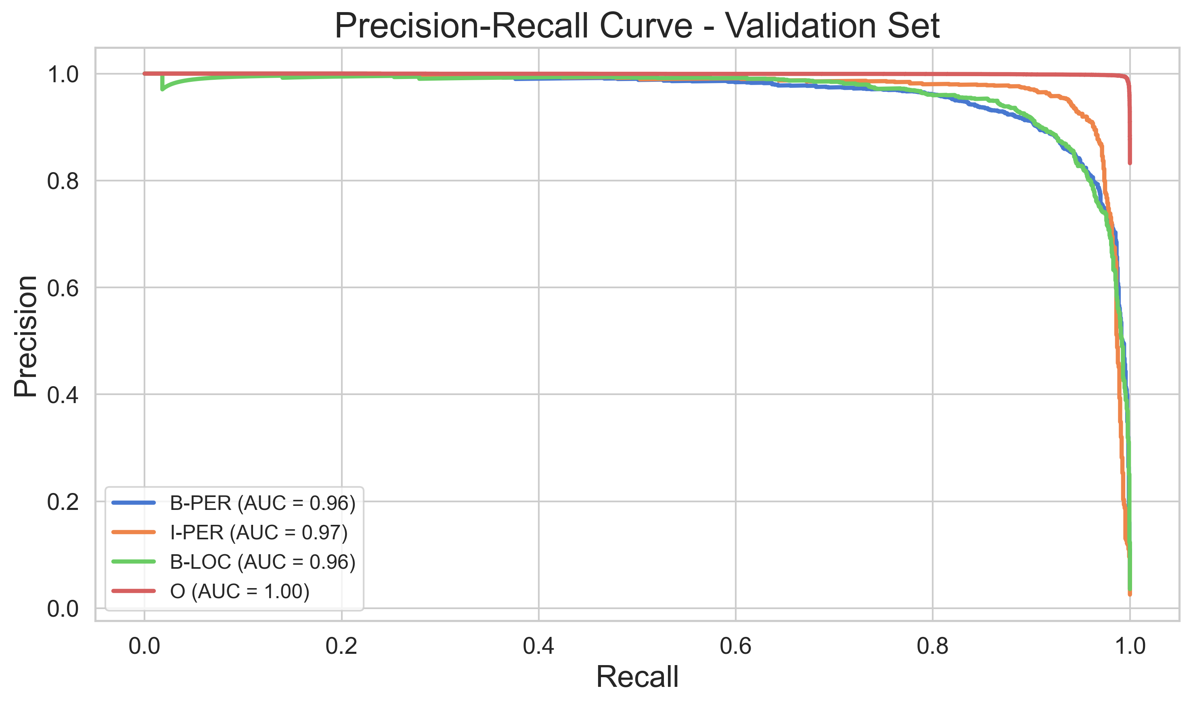
RF F1-Score comparison for Training vs Validation Vs Test sets & RF Precision vs Recall for the Training, Validation and Test sets
Random Forest – Precision vs Recall
High precision on all entity classes
Performance drops insignificantly

Slide 18
CRF vs Random Forest- Final take
Summary of model comparison
Metric | CRF (Test Set) | Random Forest (Test Set)
Accuracy | 95.6% | 59.5%
Micro F1-Score | 80.6% | 40.4%
Weighted F1-Score | 93.2% | 67.7%
Strengths | Context-aware, strong generalization | Simple, fast, interpretable
Weaknesses | Can overfit if not tune | Ignores word sequences/context
Best use case | Tasks needing sequence understanding | Quick baseline or feature-based tasks

Slide 19
Discussion & Conclusion
Comparative performance recap
Why did CRF outperform RF
CRF | RF
Captures sequence: it understands word relationships | Handles features well but lacks context awareness
Better precision, recall, and F1 across all entity | Good only on high-frequency classes (like ‘O’)

Slide 20
Limitations of the study
Only tested on English using the CoNLL-2003 Dataset
RF was used in its basic form (no embeddings or sequence modelling)
CRF may overfit slightly without regularization tuning
Results may vary across languages or domains (e.g., medical, legal)

Slide 21
Recommendation & future work
Improving NER performance further
For CRF: add embeddings (like word2vec or BERT), use regularization
For RF: consider hybrid models (e.g., CRF + RF or RF + LSTM)
Explore other datasets and low-resource languages
Experiment with domain adaption for specific fields

Slide 22
Final conclusion
Key Takeaways
CRF is more effective than RF for named entity recognition
Handles sequence data, maintains high generalization
RF has interpretability but lacks sequence handling
The study helps guide model selection in NER applications

Slide 23
Anthony Bush Castro, 20-CCS-281

